Slide 1
Spring Term Progress Report
CS463
Group: Stat Champs
Project: Machine Learn Your Way to March Madness Glory

Slide 2
Brief recap of project purpose and goals
Background: Machine learning is used by Biochemistry/Biophysics.
Purpose: Our client, Dr. Victor Hsu, is a professor in the Biochemistry and Biophysics department at OSU who recognized that his students should understand machine learning in order to prepare them for their careers.
No opportunity for them to learn it, hard to learn it from its application to BC/BP.
Goal: Produce an online module where BC/BP students could learn machine learning.
Idea: User chooses machine learning algorithm and college basketball statistics to train a model on, can observe how differences in statistics and algorithm choice influence a March Madness bracket that is generated.

Slide 3
Where Alex Is On the Project
All of Alex’s requirements fulfilled as of last term
Still could make generated brackets look nicer, but changes won’t be in the product presented at Expo

Slide 4
Problems Alex Encountered
JavaScript difficulties. Solution: tutorials, bootstrapping
Cross-compatibility among browsers (action item)
Group issue: Oregon State server does not support embedded Python, looked to AWS as solution

Slide 5
Example of a cool piece of code
<div class=”col−lg−4 text−center”> 2 <i class=”fa fa−envelope−o fa−3x sr−contact”></i> 3 <p><a href=”mailto : hoffera@oregonstate .edu”>Contact Alex Hoffer</a></p> 4 </div>
HTML code that utilizes CSS and JavaScript to show a “Mail” button that the user clicks on to send me an email if the user has a question about the project. A picture of this in action is on the next slide.

Slide 6
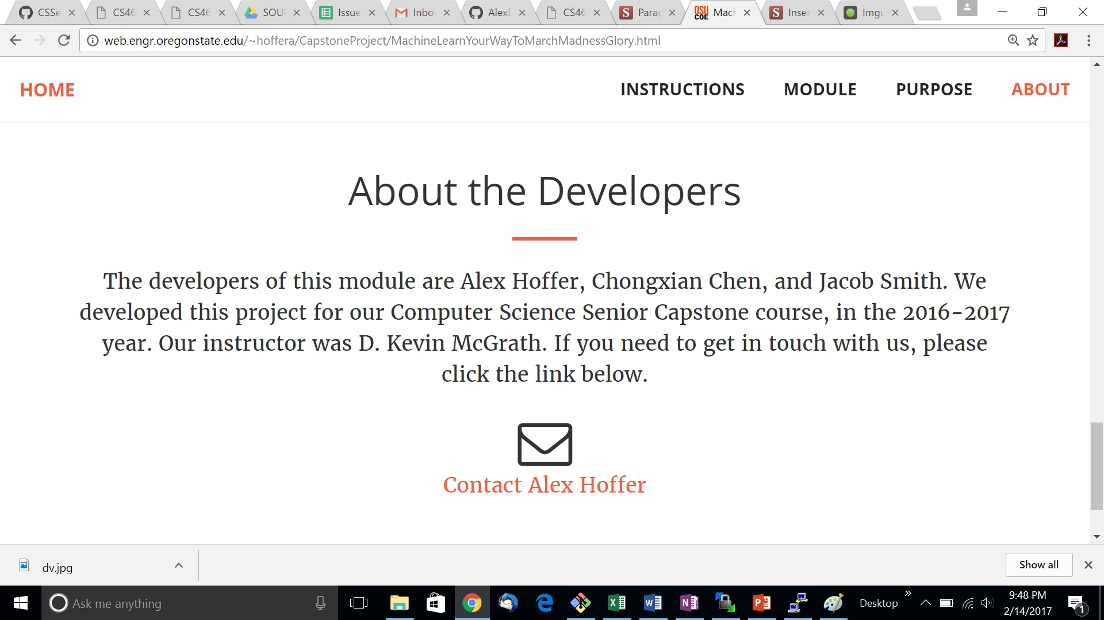
Sample screenshot: “About the Developers” page.

Slide 7
Walkthrough of code of Alex’s requirements

Slide 8
Where Jake Is On the Project
All of Jake’s requirements were fulfilled as of last term
Still could add more data from this years tournament to see how it affects the outcomes.

Slide 9
Problems Jake Encountered
Data set didn’t include this years data so I had to manually pull the data
Had difficulties with python scripts for scraping data as it would produce a lot of duplicates
Group issue: Free version of AWS is slow with large amounts of data so scripts take a long time to run.

Slide 10
Example of a cool piece of code
# Iterating through every boxscore url, fetching the data via creating Game objects
for url in links:
game_id = url.split("=")[-1]
if status_dict[game_id] == 'Postponed' or status_dict[game_id] == 'Cancelled':
print "No Final Score for %s" % url
continue
else:
# Making a small dataframe that contains tourney-specific information
tourney_col = ['Tournament', 'Round', 'Away_Seed', 'Home_Seed']
ncaa = False
data = np.array([np.repeat(np.nan,4)])
tourney_df = pd.DataFrame(data, columns=tourney_col)
This code iterates through ESPN’s boxscore’s and records the data. First it checks to make sure the game was played then it records a couple specific stats for the tourney.

Slide 11
Where Chongxian Is On the Project
All of Chongxian’s requirements were fulfilled as of last term
Still could add more algorithmns and potentially upgrade AWS.
Could try to make the algorithms more efficient.

Slide 12
Problems Chongxian Encountered
None of our team members have taken Machine Learning classes before, I have to explore about it. In the beginning we don't even know what language to use or what library to start with. Our TA Xinze Guan got us started with SciKit Learn library in Python.
We found that OSU server doesn't run Python script. Then I moved to Amazon Web Service (AWS). But the AWS free machine has too small memory so I spend a while figuring out how to install all the required Python environments for our project.
Visualizing our results also met difficulty on AWS since there is no monitor part on AWS server, it purely is a computing machine. Thus PIL in Python got some trouble. After troubleshooting I finally figure it out and our module is successfully ran on it.

Slide 13
Project demonstration and code walkthrough

Slide 14
Expo Pitch
Materials we will have
Background
Purpose
How it works
Results

