Slide 1
Winter Term Progress Report – Alex Hoffer
CS462
Group: Stat Champs
Project: Machine Learn Your Way to March Madness Glory

Slide 2
Alex’s Term overview as of Week 6
Fulfillment of responsibility #1
Fulfillment of responsibility #2
Revision of documents for OneNote hosting
Writing progress report
Writing these slides
Voice-over demonstration (this presentation)
Team captain responsibilities
Uploading documents to OneNote
Registering our team for Spring Expo

Slide 3
Responsibility #1: Description
In abstract:
Hosting of web page, development of basic Graphical User Interface (GUI) for project to help users navigate through page
This bolded sentence was how my first responsibility was described in our Technology Review document, drafted in Fall Term
Specifically:
Host website on my public_html branch of the ENGR server
Produce HTML: Title of page, Links to other parts of page at top of page using divs, lists, sections, etc. The sections of our page that I created include Home, Instructions, Module, Purpose, and About. The modification of such sections are found in my Responsibility #2. The basic structure of our web page.

Slide 4
Responsibility #1: Description (continued)
Produce CSS: Customize the html to look nice for users to improve usability of module. Without clean, readable interface, module may not make sense for Biochemistry/Biophysics students.
Produce JavaScript: Allow for changes to occur within browser without re-loading the page. To refer to the HTML portion- ability to click on a link in the home menu and have the page automatically scroll down to that section without requiring the page to refresh. This improves page usability by providing an intuitive way to navigate through the site and reduces the load on the server by requiring fewer page refreshes.

Slide 5
Responsibility #1: Technologies Used
HTML – used to communicate between server and user, divide page into sections such as Home, Instructions, Module, Purpose, and About to improve both usability (user will not be overwhelmed by a massive amount of information) and code readability/maintainability (easier to read and modify code when the entire web page is split into logical chunks that are properly commented).
CSS – used to make the page look nice. Without CSS, HTML looks quite ugly, which reduces usability of the GUI. Creation of tags in HTML allows for aesthetic modification of page components using separate CSS files that are loaded into the HTML file which generates the page.
JavaScript – used to make the page more interesting and appealing to interact with. For example, while HTML allowed for the division of the page into smaller components, JavaScript allowed for the navigation between such smaller components without reloading the page.

Slide 6
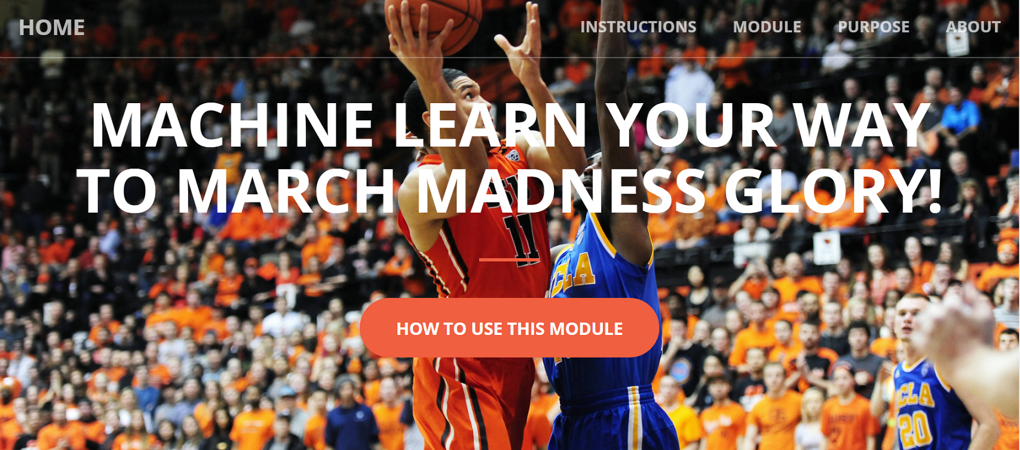
Responsibility #1: Screenshot of Main Page

Slide 7
Responsibility #1: Demonstration
Of course, a screenshot of the main page of our web site is just one part of Responsibility #1, and to see the JavaScript that Responsibility #1 encompasses, I will load up the page for a demonstration:
http://web.engr.oregonstate.edu/~hoffera/CapstoneProject/MachineLearnYourWayToMarchMadnessGlory.html

Slide 8
Responsibility #2: Description
In abstract:
Presentation of Instructions on how to use the module (before the module itself is presented), presentation of Module, Purpose, and About pages.
The bolded part of the previous bullet point is how my Responsibility #2 was described in our Technology Review from Fall Term.
Specifically:
Using the foundational GUI developed in Responsibility #1, develop the sub-components found on the main page, including the Instructions, Module, Purpose, and About components.
Use CSS and JavaScript to make each of these subcomponents look nice to enhance usability. For example, a button that navigates to other subcomponents that changes color when the mouse hovers over it.

Slide 9
Responsibility #2: Description (continued)
Write the content for each page. For Instructions, the subcomponent is there, but since the module itself hasn’t been developed fully yet (this is encompassed by Chongxian and Jake’s responsibilities), I don’t know what the instructions are. This will likely be the final thing added to our project. The Module subcomponent will consist simply of the Machine Learning module. The Purpose subcomponent includes a description of why the module was developed (i.e. Dr. Victor Hsu’s intentions in commissioning us to work on this project) and contains a button that leads to the “About the Developers” subcomponent. The “About the Developers” subcomponent includes our names, our class information, and a button with a picture of mail to indicate e-mail that links the user to my email in case they wish to contact us about the project.

Slide 10
Responsibility #2: Technologies Used
Essentially a repeat of Responsibility #1’s Technologies Used page. CSS and JavaScript were primarily used here, with JavaScript allowing for us to move from one subcomponent to the next with ease and CSS providing a nice design to the subcomponents.

Slide 11
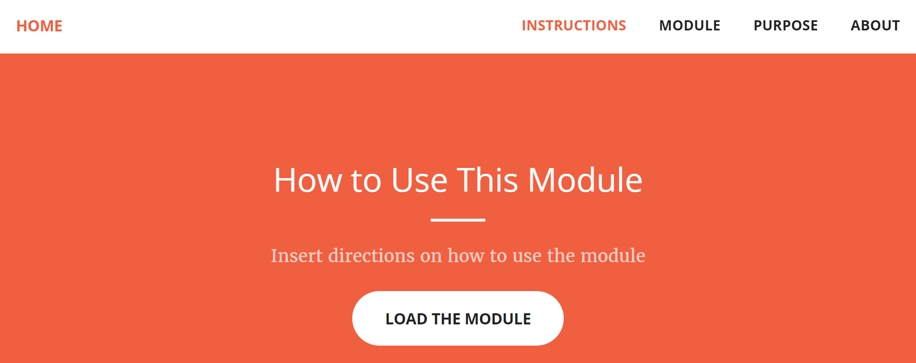
Responsibility #2: Screenshot, Instructions Page

Slide 12
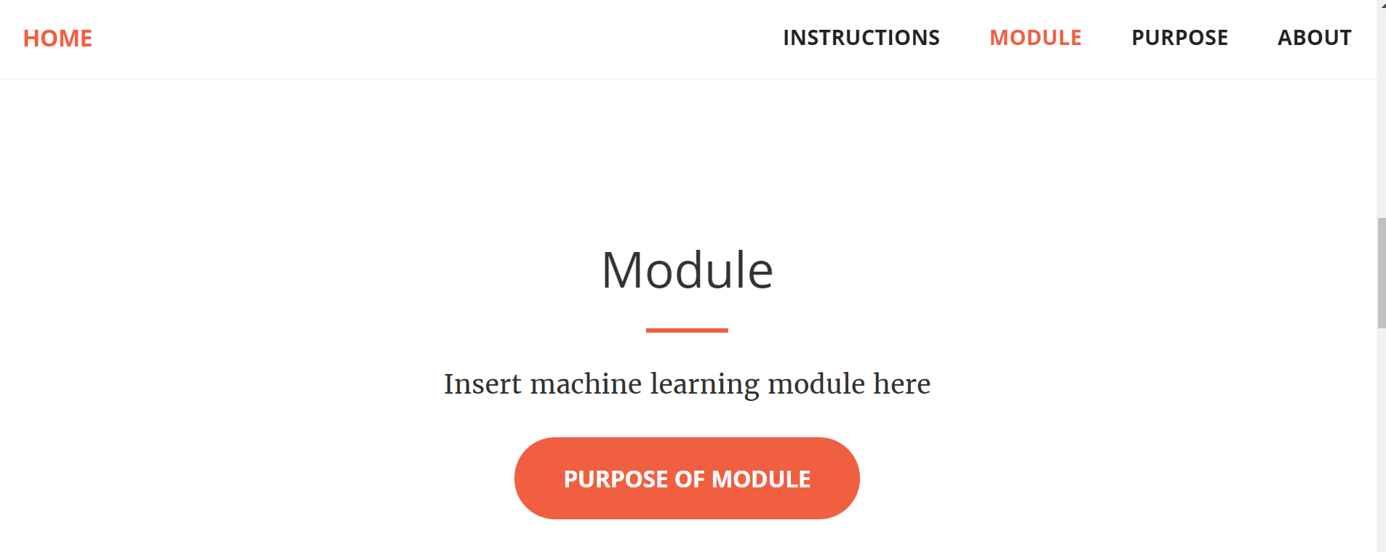
Responsibility #2: Screenshot, Module Page

Slide 13
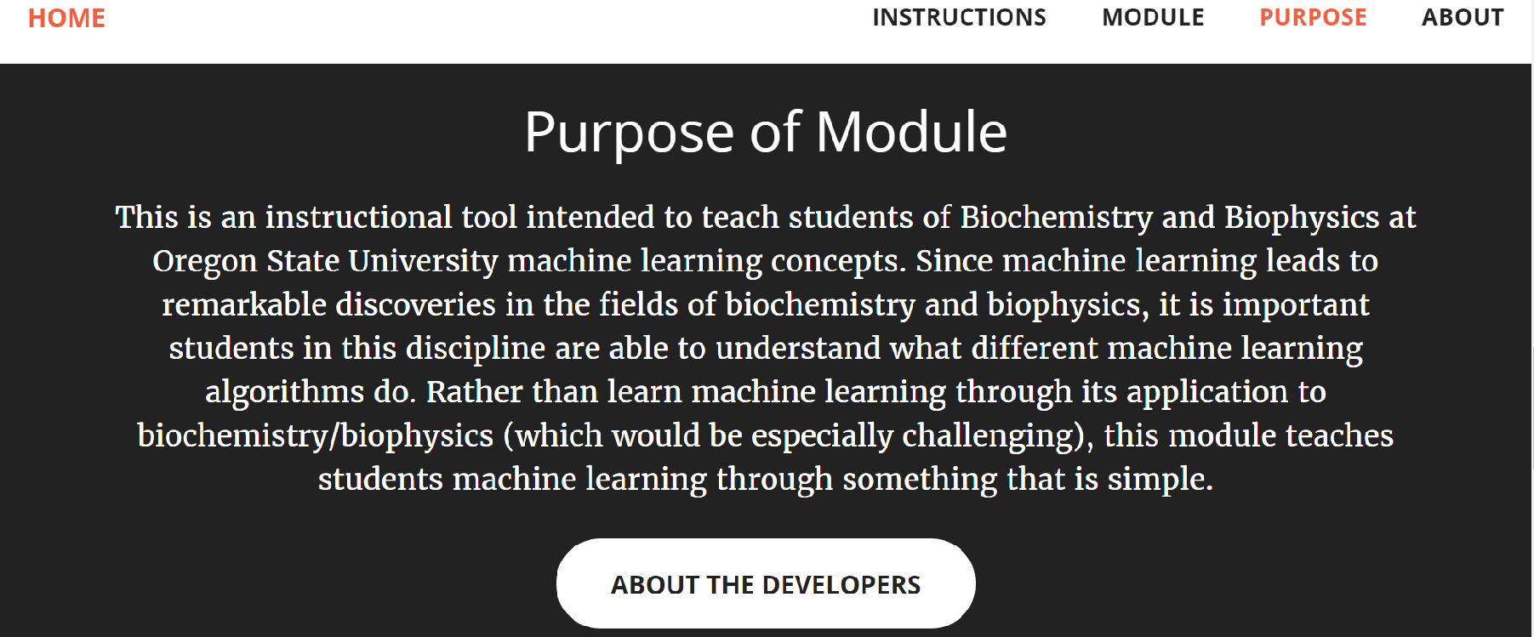
Responsibility #2: Screenshot, Purpose Page

Slide 14
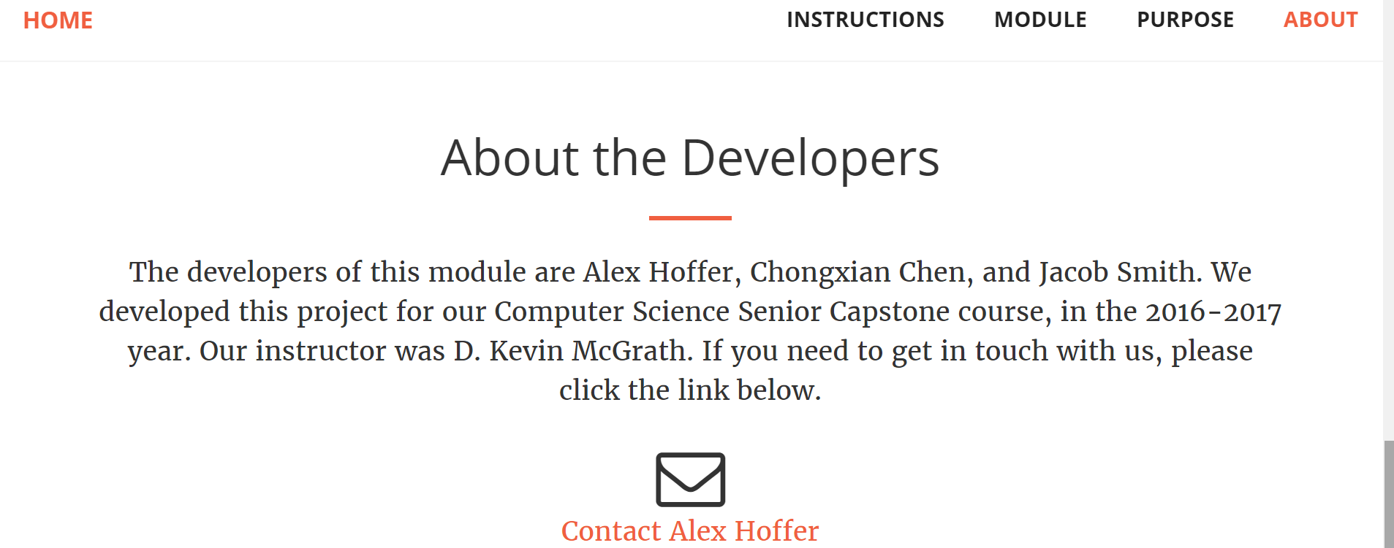
Responsibility #2: Screenshot, About Page

Slide 15
Responsibility #2: Demonstration
The screenshots of this Responsibility do it a lot of justice, but we can do a quick demonstration of what the subcomponents look like and how we get from one to the other using the buttons.
http://web.engr.oregonstate.edu/~hoffera/CapstoneProject/MachineLearnYourWayToMarchMadnessGlory.html

Slide 16
End of Winter Term and Abroad: What Alex needs to do to complete this project + course
Fulfill responsibility #3
Description of responsibility #3: Given a machine learned bracket of Chongxian’s creation, format it to look nice
Help develop poster
Present poster at Spring Expo

Slide 17
Jakes Overview
So far this term the responsibility I have been focusing on is collecting the data for machine learning training and testing.
I will be collecting stats until the basketball season is over which is the beginning of next term.
After the stats are done I will put all the data into a database and connect it to Alex’s webpage so we can display the data.
I will also be helping Alex implement the python module and bracket on the website because I have some experience with web design.

Slide 18
Responsibility #4
Getting the data:
For getting the data I actually didn’t use any of the statistics websites I mentioned in the tech review. I ended up finding the data on a website called Kaggle.com, it is a data science website with a wide variety of stats.
This website only had data leading up to this season so I had to manually pull most of the data for this season and any additional stat metrics I or George wanted to have.

Slide 19
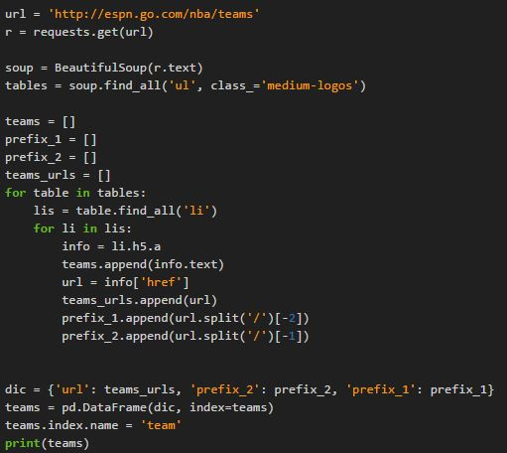
Responsibility #4
For getting this years data I started out writing a python script to grab the stats for me, here is a screen shot of part of it.
This part of the script just gets the teams and the url of where the data is. This is testing it on NBA data cause there are less teams.

Slide 20
Responsibility #5
Storing the data:
For this I am still planning on using phpmyadmin to store the data and attach it to the website.
I have not started adding the data to the database yet, all the data is just in excel or CSV files as of now. But it wont take long to add the data because its already in a compatible format for transfer.
The database is mainly for the website module so it will most likely be done before the beta release.

Slide 21
Chongxian’s Term overview as of Week 6
Fulfillment of responsibility #6
Fulfillment of responsibility #8
Keep Track of Weekly Progress
Writing progress report
Writing slides
Voice-over demonstration (this presentation)

Slide 22
Responsibility #6: Description
In abstract:
Explore SciKit-Learn library in python
Explore Machine Learning methods for our project
Predict result using data and generate output
Specifically:
Learn Supervised Learning method for our project
Separate data into training sets and testing sets
Write codes in Python to fit and predict results
Produce outputs with confidence of match results as a CSV file

Slide 23
Responsibility #6: Technologies Used
Python – I wrote the code in python primarily because Python is a popular and powerful language to use.
SciKit-Learn Libray – Scikit-learn library is a Python based machine learning library. It is open-sourced and easy to learn and use. The website provides rich documentations and examples. Besides SciKit-Learn has a large community supporting its development. There are also many machine learning projects I can learn from in GitHub that uses SciKit-Learn
Machine Learning – In order to understand machine learning better, I also study the Stanford Machine Learning online class by Professor Andrew Ng.

Slide 24
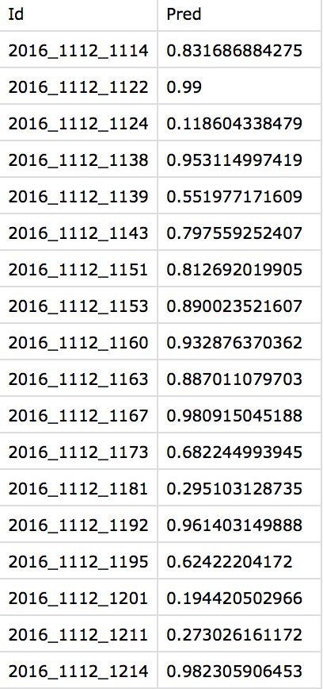
Responsibility #6: Screenshot of Output
The output file has two attributes. The first one has the season, team one ID, team two ID separated by an underscore. The second attribute indicate the chances the first team winning over the second team predict by our machine learning model.

