Slide 1
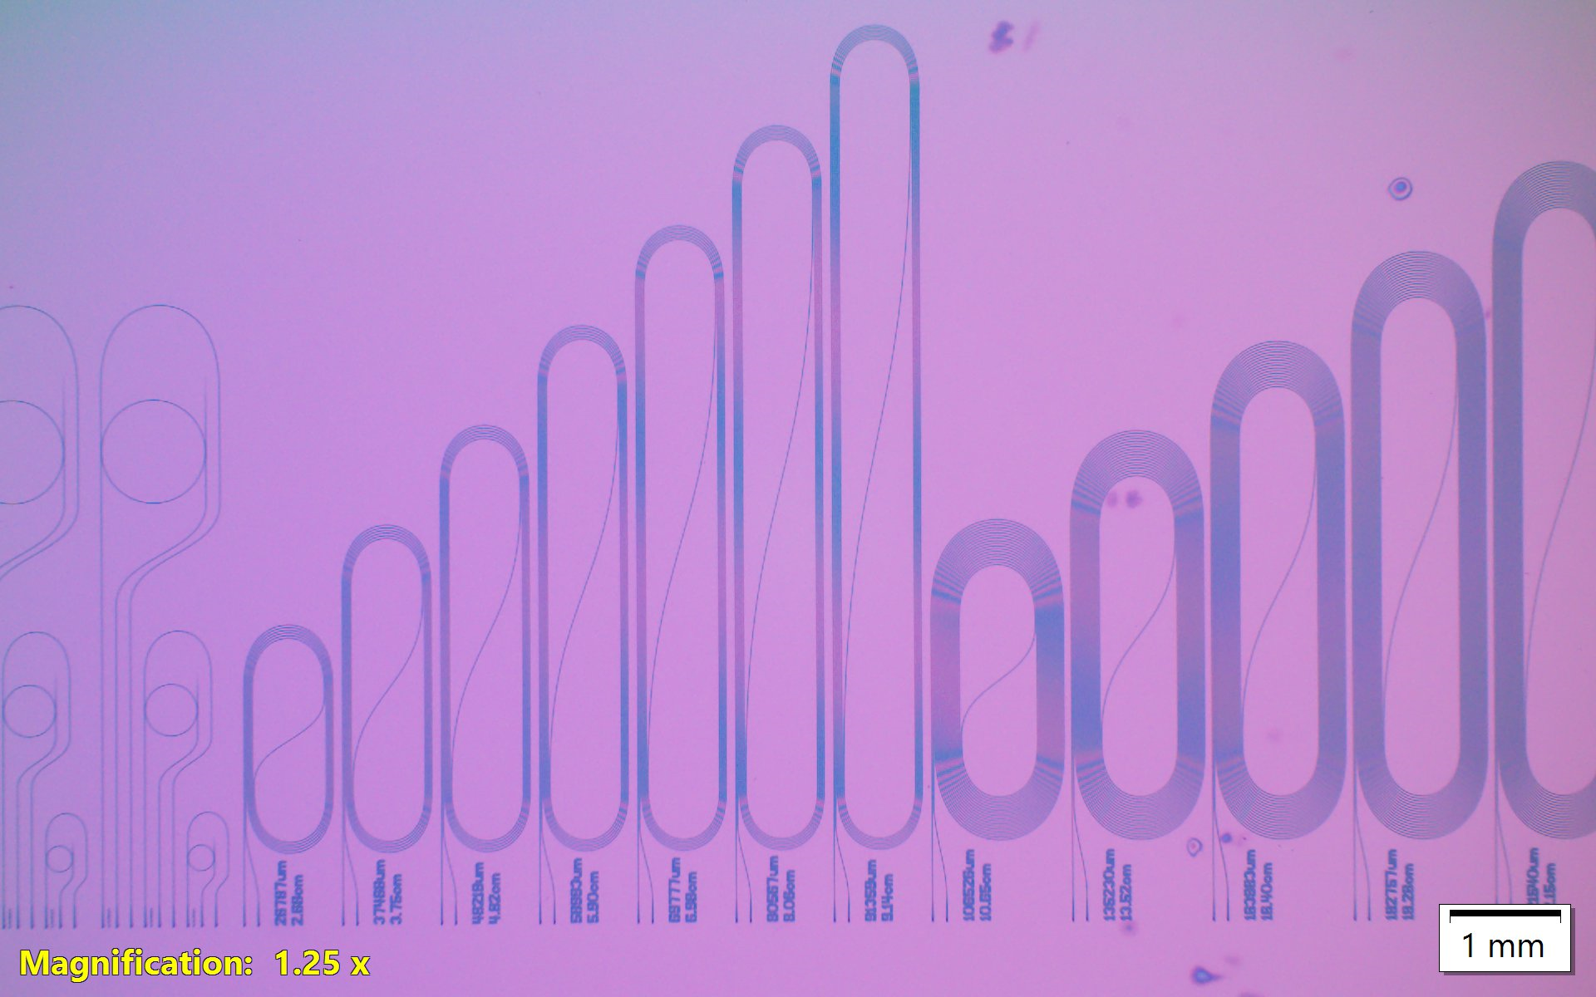
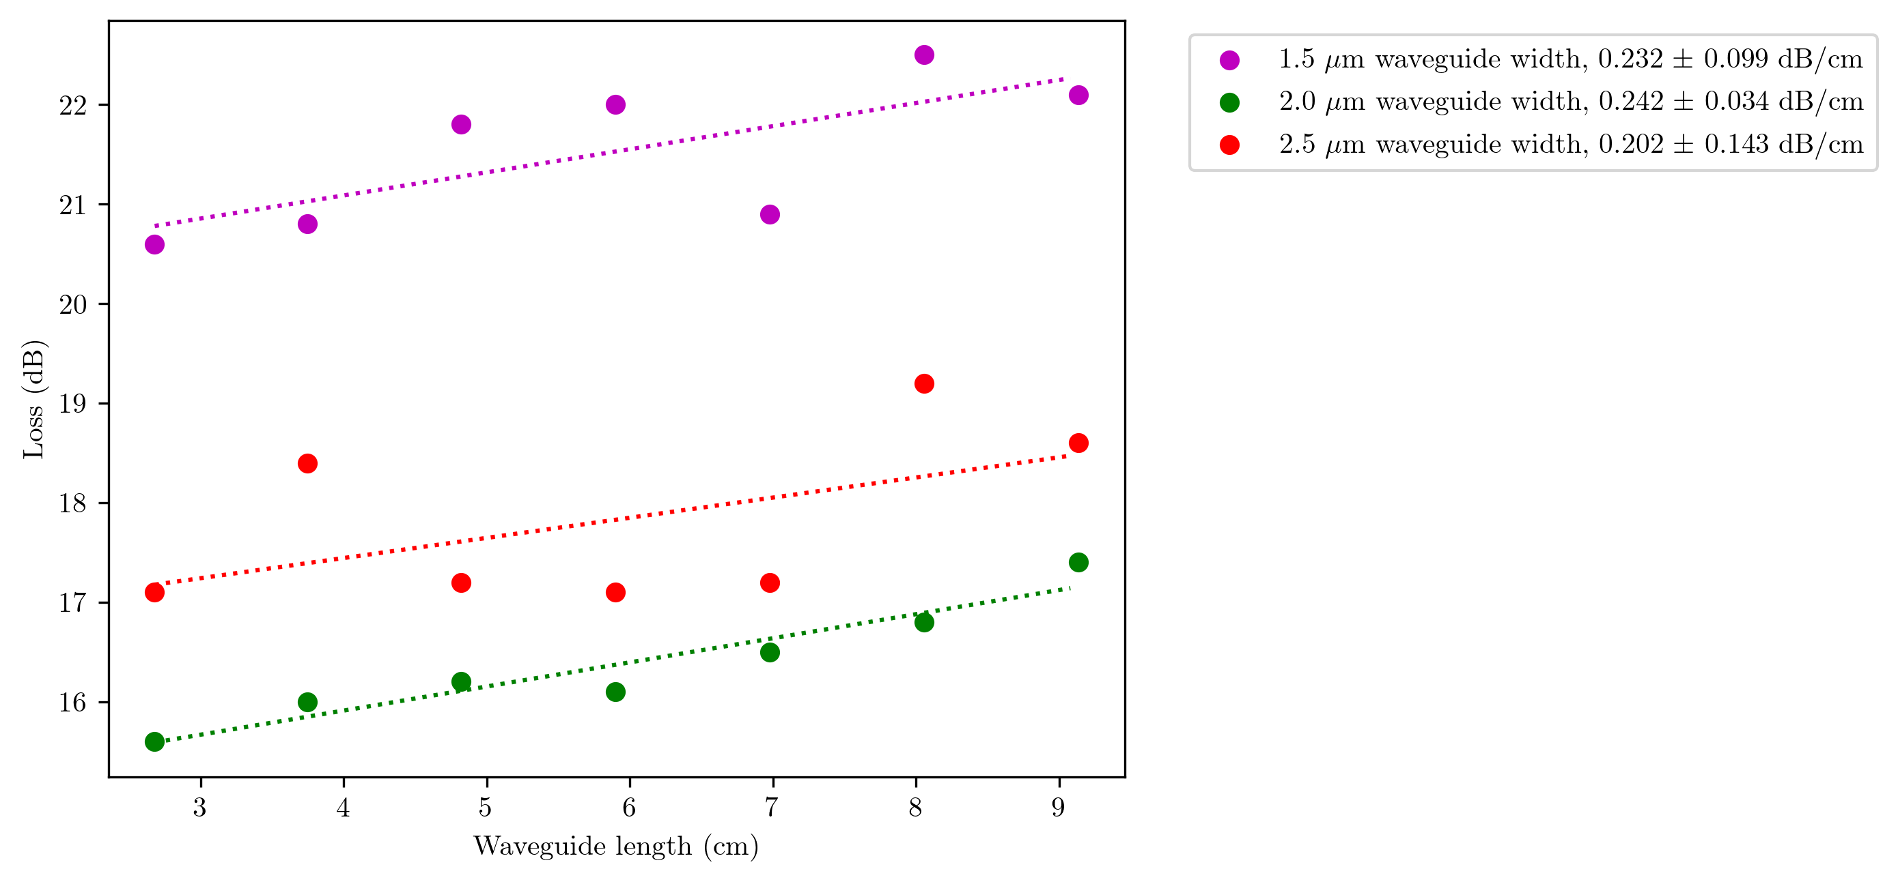
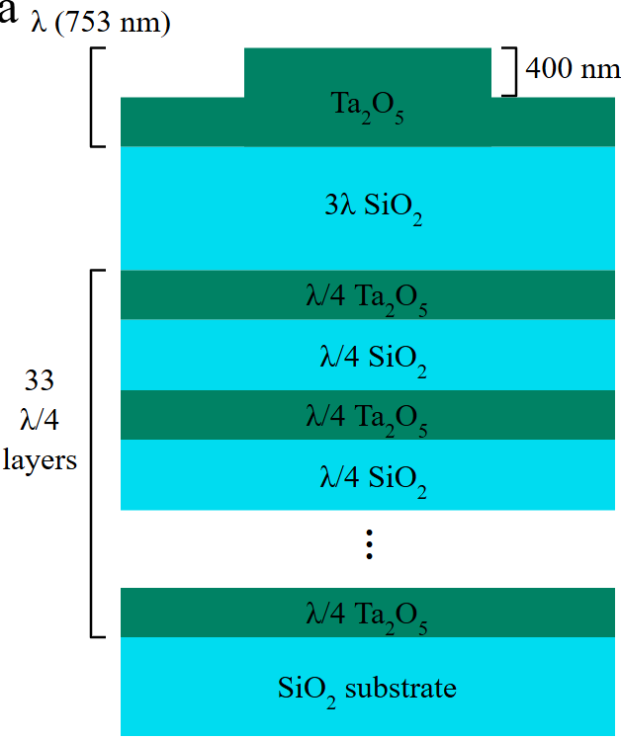
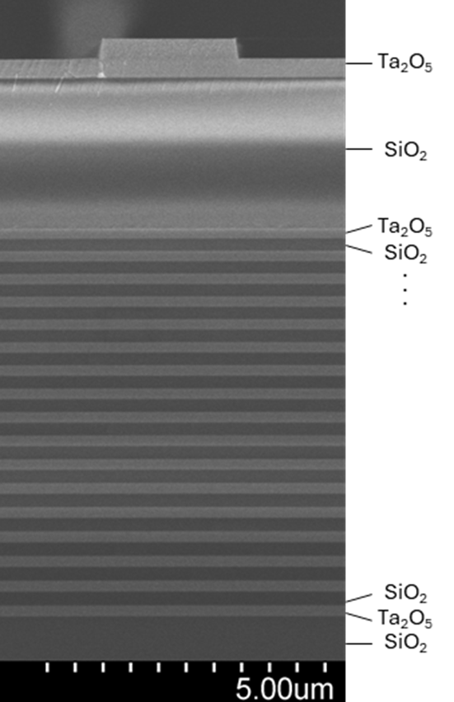
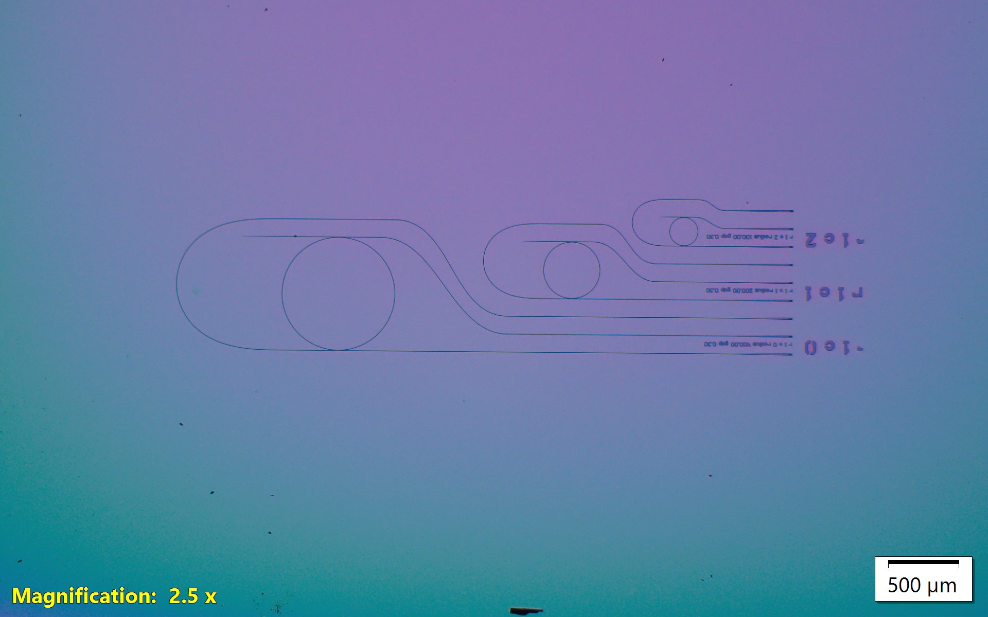
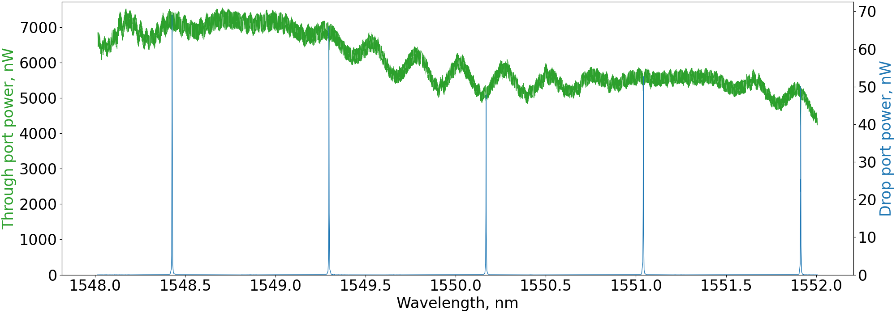
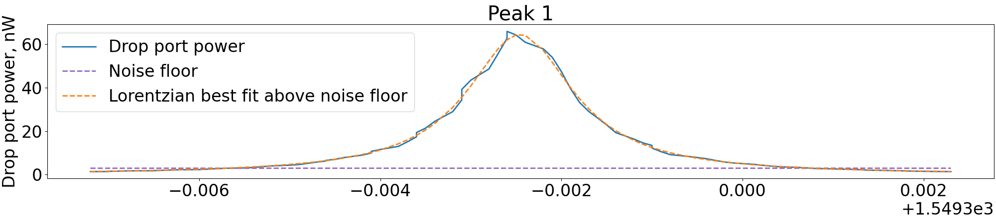
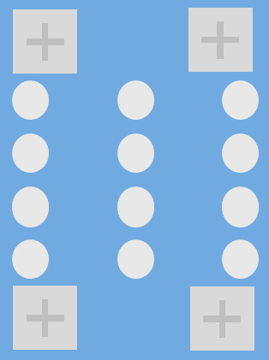
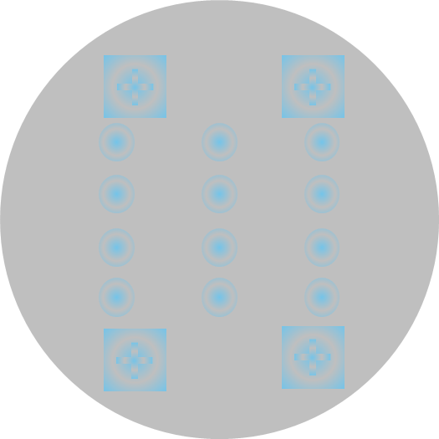
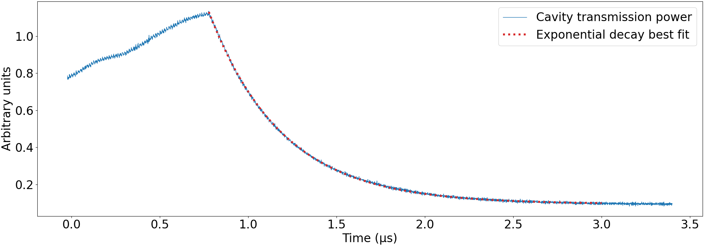


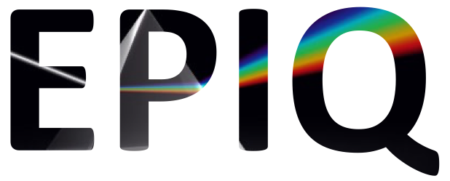
Integrated photonic waveguides on a >99.99% reflectivity dielectric mirror
Alex Fischer^{1,2}, Kate Musick¹, William Martinez¹, Robert Reyna¹, Travis Young¹, Tarik Cigeroglu³, Peter Rakich³, and Nils T. Otterstrom¹
¹Sandia National Laboratories, Albuquerque, NM
²University of New Mexico, Albuquerque, NM
³Yale University, New Haven, CT
Overview and goal
Want to integrate high-reflectivity microfabricated Fabry-Perot cavities with other integrated photonics for photon storage and other applications.
Switching light into cavities via interference of light weakly scattered out of cavity into waveguide requires ultra low loss waveguides to maintain cavity lifetime.
We fabricate dielectric mirrors with ¼ wavelength layers of alternating SiO₂ and Ta₂O₅.
Finesse 180,000 and reflectivity 0.999983.
We fabricate rib waveguides by etching 400 nm into one wavelength thick (753 nm) layer of Ta2O5.
Loss, measured with ring resonator linewidth, is as low as 0.35 dB/cm, but variable.
Waveguide loss measurements
Initial approach: measure transmission through spiral-wound “paperclip” waveguides.
Problem: grating coupler efficiency varies widely due to variations in etch depth, angle, etc.
Many samples and large chip area needed to get reliable loss measurement.
Better approach: ring resonator transmission spectrum. Finesse → propagation loss.
Best loss seen in ring resonator: 0.35 dB/cm.
Varies spatially across chip: need to control etch better.
Mirror and waveguide platform
Mirrors made in-house with ion beam sputtering.
Have made dielectric mirrors with up to 35 layers.
Vision: gratings to couple waveguides with cavities
Requires bonding flat layer with waveguides atop mirror, layer with curved mirror segments, and spacer.
Quantum applications (photon storage) in mind, but likely broadly applicable.
Mirror coating reflectivity measurements: ringdown
Coated off-the-shelf polished silica substrates.
Made cavities and measured cavity ringdown time and free spectral range.
Best reflectivity seen in 35 layer stack: 0.999983 reflectivity, or 180,000 finesse.
Above: decay time 417 ns for ~2 mm cavity.
Waveguide Layer
Flat substrate with mirror coating.
SiO₂ cladding and Ta₂O₅ waveguide layer.
Pattern/etch waveguides, couplers, etc.
Spacer Layer
Slots etched through substrate.
Mirror Layer
Greyscale lithography with reflow to make micro curved mirrors [1].
Coat with mirror layer.
[1] Naijun Jin, et. al., "Micro-fabricated mirrors with finesse exceeding one million," Optica 9, 965-970 (2022)
Purcell
Microfabricated curved mirror
-
Enhanced
Grating Coupler
Spacer
Next steps
Continue improving mirror and waveguide loss. Annealing?
Make cavities with mirrors on silicon wafers instead of optical substrates. Same reflectivity?
Worse surface roughness on silicon wafers?
Wafer bonding of flat mirrors with waveguides and wafer with curved micro-mirrors.
33-layer
mirror coating
Tantala
waveguide
SAND2026-21185C

