Slide 1
Project Work of Artificial Intelligence Giochi Matematici e Problem Solving
Alejandro Sánchez Marcos
José Pizzano Martín

Slide 2
Mathematical Games
What is a mathematical game?
A mathematical game is a mathematical problem presented as a game.
How do we solve a mathematical game?
Via software implementing Artificial Intelligence.

Slide 3
Competitions & Types of Problem
The classification made by the University of Bocconi is:
International ChampionShips.
Autumn Games.
Team Competitions.
Rosi Games.
Same main objective: facilities on the extraction and resolution on different games.

Slide 4
Data Extraction
Analyzed Competitions
2019 International Semifinals
2019 Autumn Games
2018 International Semifinals
Analysis divided on:
Text Analysis
Image Analysis

Slide 5
Study of the statements
60% of the Problems have an image.
Types of images:
Graph Images.
Numeric Data Images.
Matrix Images.
Geometric Images.
Main objective on all problems:
CSP with unique solution.
Count of all posible solutions
Find min/max value in a solution.
Equation problem with unique solution.
Logic problem.

Slide 6
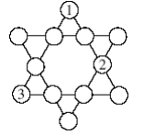
Graph Problems
Problems are presented with empty nodes and roads that connect them,
Riempite i cerchi vuoti di questa figura, in modo che ogni serie di quattro cerchi allineati sia tale
che i cerchi che la compongono contengano tutti e quattro i numeri da 1 a 4.

Slide 7
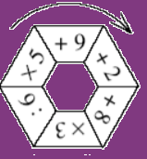
Numeric Data Problems
Problems are presented with numbers and symbols with an expanation of how to proceed with the data.
Mattia sceglie un numero intero compreso fra 1 e 9 (1 e 9 inclusi). Parte da una casella della ruota e applica al numero scelto l’operazione indicata in quella casella. Percorre poi la ruota nel senso della freccia e effettua successivamente le altre cinque operazioni. Per esempio, se sceglie 8 e la casella ‘+8’, effettua di seguito le operazioni seguenti: 8+8=16; 16x3=48; 48:6=8; 8x5=40; 40+9=49; 49+2=51. La divisione per 6 deve dare un numero intero perché il calcolo sia valido. Qual è il risultato massimo che Mattia può ottenere?

Slide 8
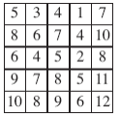
Matrix Problems
Problems are presented with a matrix (filled or not with numbers) and a procedure method.
Nello schema a fianco, scegliete un numero, poi barrate tutti i numeri che si trovano nella stessa
linea e nella stessa colonna. Poi continuate così, sapendo che un numero già scelto o barrato non
può essere scelto una seconda volta. Qual è al minimo il prodotto dei cinque numeri scelti?

Slide 9

Geometric Problems
Problems are presented with a figure or a geometric object which represents the data.
The statement has an explanation of how to proceed with the data.
Ciascuno di questi due oggetti è costituito da sei piccoli cubi di un centimetro di lato assemblati
insieme. Dopo averli eventualmente girati e/o spostati si incollino insieme questi due oggetti in
modo che la superficie del solido così ottenuto sia minima. Su quante facce si deve mettere la
colla? Si noti che due facce in contatto devono entrambe avere della colla, e che si deve mettere
della colla solo su facce che si devono incollare fra loro

Slide 10
Geometric images has a bigger difficulty to be treated in a generic way
because the analysis of the characteristics are very disparate.
Images have no secondary meaning that could alter the meaning of the problem or the
way to solve it

Slide 11
Study of the Statements
All statements are:
Brief.
Concise.
In Italian.
Data: presented clear and very explicit.
Resolution: Can be seen crearly (usually in bold).

Slide 12
Some problems can be raised in different ways, usually there is not only one form of looking at them.
Common features:
Only matters the solution, not process
There are no resources limitation
Calculus of the solutions is always manageable

Slide 13
How can be understanded the problems?
CSP (Constraint Satisfaction Problems)
Mathematical (based on equations) problems
Problems based on Geometric / Space understanding
Some others in a lower rate
This is an enormous field, where the problems need some of the following ‘Skills’:
Counting geometric figures in a picture
Drawing on a figure to get a result
Moving figures in the space
So on…

Slide 14
Backtracking Algorithm
function Backtracking-Search():
returns Recursive-Backtracking({ }, CSP)
function Recursive-Backtracking({ }, CSP):
if assigment is complete, return assigment
var <- Select-Unassigned-Value(variables, assigment, csp)
for each value in Order-Domain-Values(var, assigment, csp)
if value is consistent, then
add { var = value } to assigment
result <- Recursive-Backtracking(assigment, csp)
if result != failure then return result
remove { var = value } from assigment
return failure
1
2
3
4
7
5
6
7
8
9

Slide 15
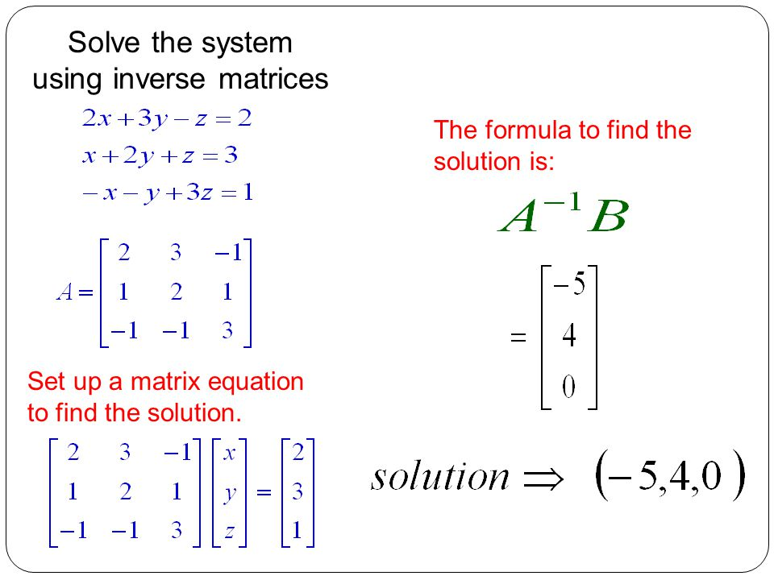
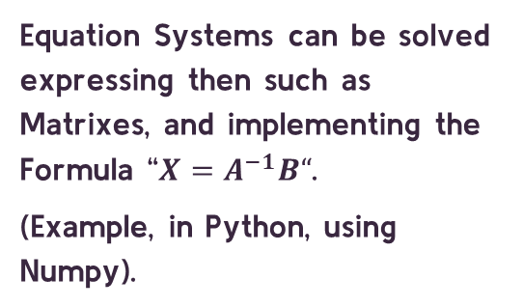
Equations / Equation Systems
Equations can be solve implementing already programmed libraries (Example: in Python, Sympy).
Equation Systems can be solved expressing then such as Matrixes, and implementing the Formula “$X=A^{−1}B“$.
(Example, in Python, using Numpy).

Slide 16
Uninformed search
Viable when the problems aren’t addapted to be represented in the other two ways.
(Example: Problems where it’s neccesary to follow some steps in order to find a solution)
Mattia sceglie un numero intero compreso fra 1 e 9 (1 e 9 inclusi). Parte da una casella della ruota e applica al numero scelto l’operazione indicata in quella casella. Percorre poi la ruota nel senso della freccia e effettua successivamente le altre cinque operazioni. Per esempio, se sceglie 8 e la casella ‘+8’, effettua di seguito le operazioni seguenti: 8+8=16; 16x3=48; 48:6=8; 8x5=40; 40+9=49; 49+2=51. La divisione per 6 deve dare un numero intero perché il calcolo sia valido. Qual è il risultato massimo che Mattia può ottenere?

Slide 17
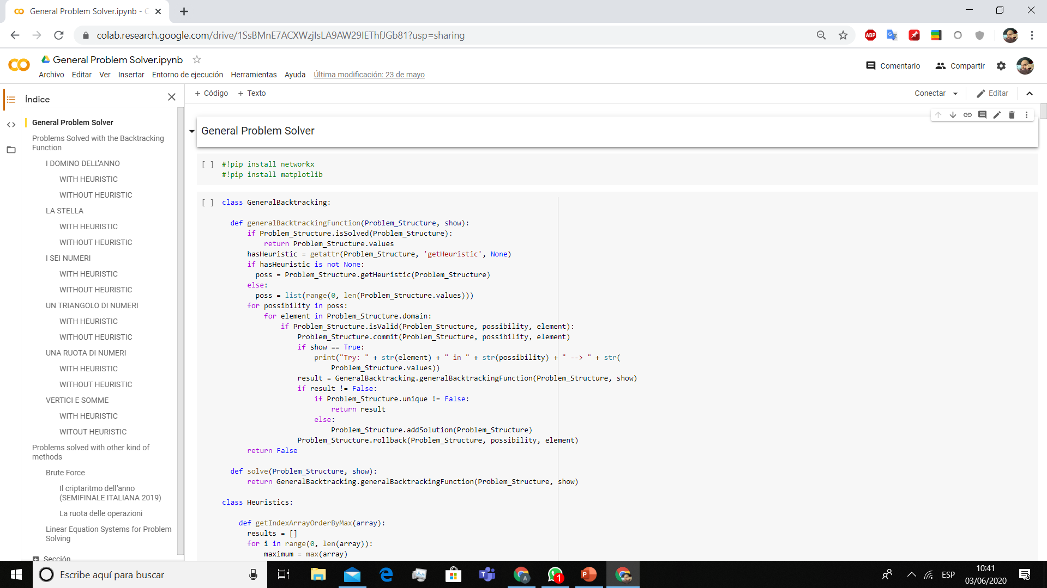
Our Demo
Here we implemented only the basic algorithms in order to demostrate how can each problem be solved.
Place your screenshot here

Slide 18
Heuristics tried in the Backtracking algorithm
Select Unassigned Values Sorting
Sort the elements that have to be explored first depending on the problem constraints.
Domino
First, gaps where we have two dominoes at both sides. Then, where we have at least one, and then where there are no dominoes at sides.
Stella / Triangolo
Nodes that are in lines with more complete nodes, will have fewer options.
Sei Numeri
The nodes whose sum of the adjacent sums is lower, will have a greater probability that this node contains a lower value.
Ruota dei Numeri /
Vertici e somma
suppose that the nodes that are part of triangles whose sums are lower, have a lower value.
Non rappresentano un miglioramento apprezzabile

Slide 19
Conclusions about the algorithms
In CSP – Search Problems, Heuristics are not a viable implementation option, they must be created specifically for each problem, and do not represent a real improvement.
The simpler the algorithm, and the fewer data structures you need, the easier it will be to implement in many problems

Slide 20
Possible architecture
We propose the following base architecture for a resolution Software project
First Layer:
Data and Features Extraction
Text and Image Extraction
Does it have an Image?
key words to Understand the Image?
Text Analysis
Image Processing
Get target, restrictions, data
Available Image Understanding methods
Manually input data

Slide 21
Second Layer:
Problem Understanding and Data modelling
Select best problem model
Third Layer:
Solver Algorithm
Apply the selected algorithm
CSP
(unique / all possible solutions)
Uninformated Search Algorithms
Propositional Logic Problem
Fail
Success
Equation / Equation System
Other (Geometric Problems…)
Fourth Layer:
Data Presentation
Model data based on the type of problem
Model data based on the type of problem

Slide 22
Thank you!

