Slide 1
Predicting drug sensitivity using (epi)genomic marks
Elysia Chou, Keefer Chern, Alexander Chang
May 1, 2019

Slide 2
Introduction
Cancer cell lines are widely used to study drug efficacy in vitro.
Aims:
Predictively model drug efficacy using elastic net regression with either
Epigenomic features (histone modifications) or
Genomic features (gene expression)

Slide 3
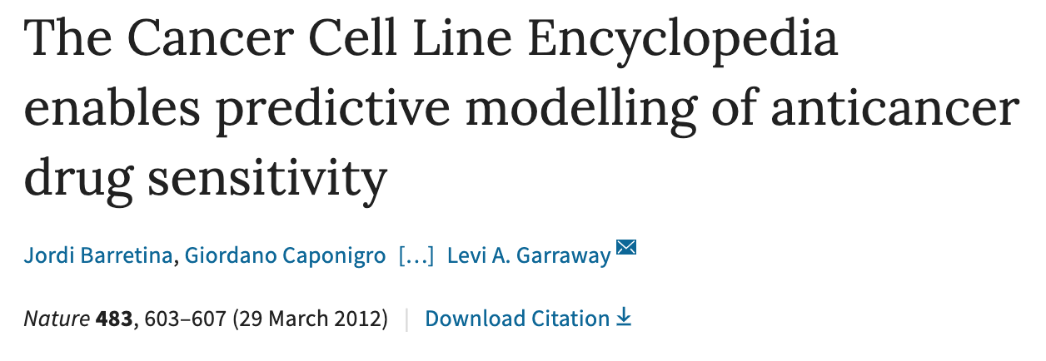
Motivation: compare to prior work
Paper’s approach: | Our approach:
Trained on all of the data Uses genomic data (not all public) | Train on 80% of the data Explore relationship between (epi-) genomic profiles and drug sensitivity

Slide 4

Data
Features
Global Chromatin Profiling
Gene Expression
Labels
Drug sensitivity for PD-0325901 (MEK inhibitor)
Notes:
The Cancer Cell Line Encyclopedia (CCLE) is a large-scale genomic dataset for 947 human cancer cell lines, together with pharmacologic profiling of 24 compounds across ~500 of these lines.

Slide 5
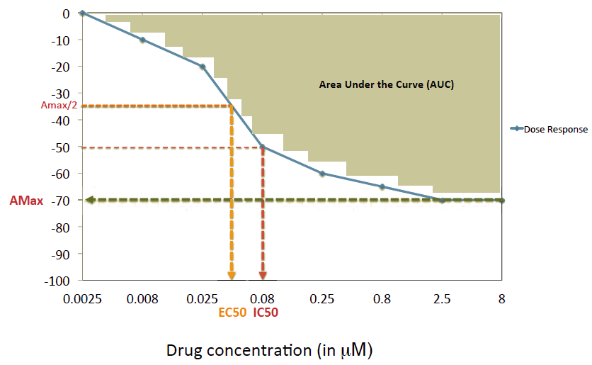
Labels: Drug Sensitivity Data (PD-0325901)
Drug Response for a cancer cell line
EC50
IC50
Amax
Activity Area/AUC
Relative growth inhibition (%)

Slide 6
Global Chromatin Profiling Analysis

Slide 7
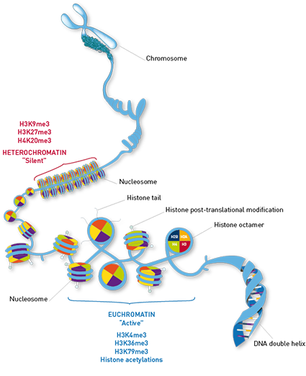
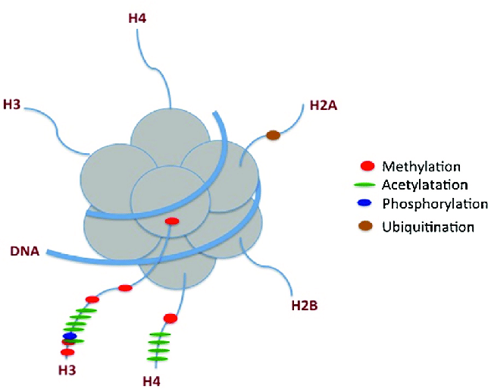
Post-translational histone modifications

Slide 8
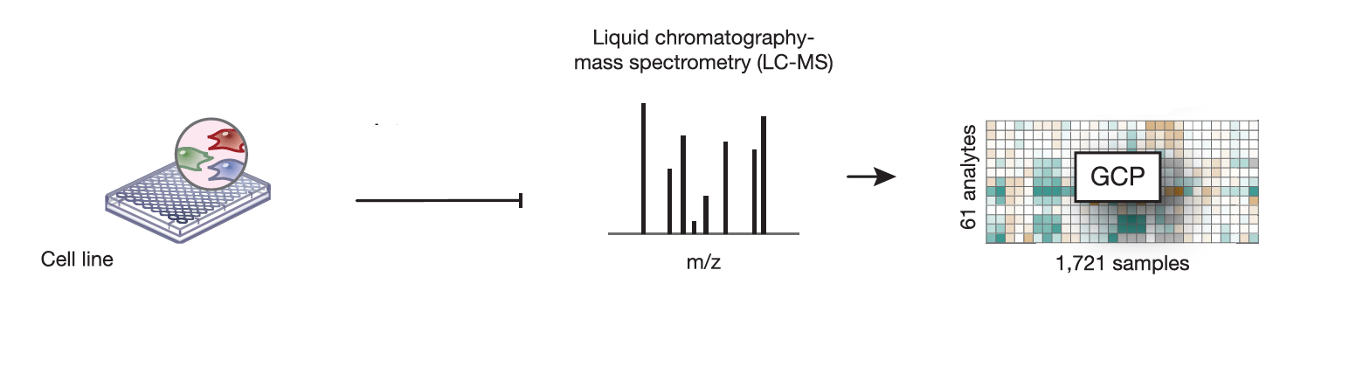
Global Chromatin Profiling (GCP) Data
42 histone modifications
GCP
458 samples
Notes:
Cancer cell lines have distinct molecular chromatin signatures

Slide 9
Resolve Missing Values
Column | Column name | # of NaNs
2 | H3K4me0 | 1
5 | H3K4ac1 | 40
20 | H3K18ac0K23ub1 | 162
34 | H3K27ac1K36me0 | 3
35 | H3K27ac1K36me1 | 15
36 | H3K27ac1K36me2 | 5
37 | H3K27ac1K36me3 | 1
40 | H3K56me1 | 162
42 | H3K79me1 | 1
43 | H3K79me2 | 2
If # NaNs ≤ 30: impute missing values with mean of the column
Columns removed if # NaNs > 30
Features remaining: 39
Labels remaining: 3
Notes:
NaNs: insufficient chromatographic resolution and isobaric interferences at the fragment ion level

Slide 10

Method: Elastic Net Regression
Linear regression with L1 and L2 regularization
Supposed to be better at dealing with situations with correlations between parameters
Loss function:
𝛂 = mixing parameter (lower → less L1)
𝛌 = regularization parameter (0 = no regularization)
Notes:
Alex - The first part is the standard MSE. The other term is the regularization term, which has both the L1 and L2 regularization parameter terms. The parameter $\lambda$ works the same as $\lambda$ from L1 or L2 regularization, which indicates how much to regularize. The $\alpha$ term is the mixing parameter, which indicates how much of the L1 or L2 regularization to perform.

Slide 11
Hyperparameter Tuning for Elastic Net Regression
80/20 train/test split
Determine optimal 𝛂 and 𝛌 for our model using 10-fold cross-validation on training set
MSE and R²

Slide 12

Workflow
𝛂, 𝛌
80%
Hyperparameter Tuning
Elastic Net Regression
Training Data
Features
10-fold cross-validation
MSE, R²
Metrics
458 x 39 matrix, standardized
20%
Test Data
Run Trained Model
Notes:
Alex - Alpha = 1 fully LASSO

Slide 13
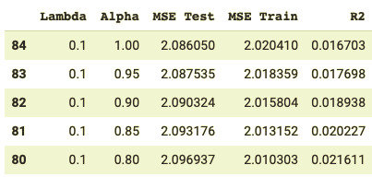
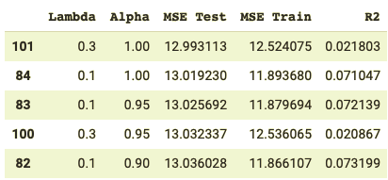
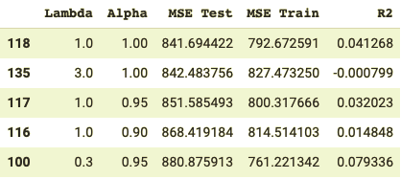
Results
From hyperparameter tuning
Activity Area
IC 50
A_max
Notes:
Alex - However, we got pretty bad results ...

Slide 14
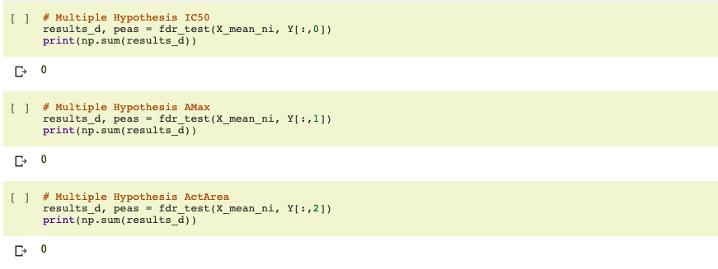
Linear regression on individual features showed no significant correlation
Multiple hypothesis correction to reduce false discovery rate using Benjamini-Hochberg
Notes:
Alex

Slide 15
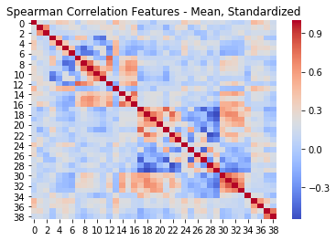
Heatmap shows little correlation between 39 features
Notes:
Keefer

Slide 16
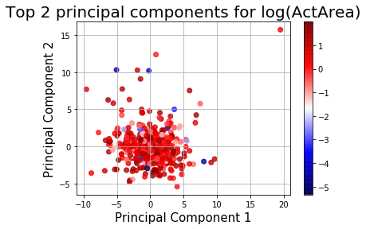
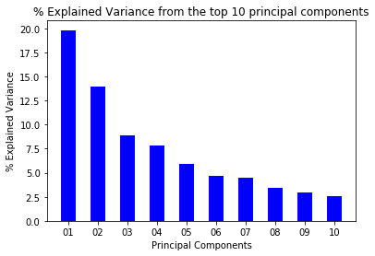
PCA shows no distinction between features and data
Absolute Pearson correlation between PCs and features was < 0.1
Notes:
Keefer

Slide 17
Reasoning our results
May still have correlation
We did not have enough features (39) for the patterns/relations to be captured
Since this is mass spectrometry downstream data, there could have been too many confounding factors that muffled out patterns for a signalling pathway.
There could be no correlation.
Notes:
Keefer

Slide 18
Gene Expression Analysis

Slide 19
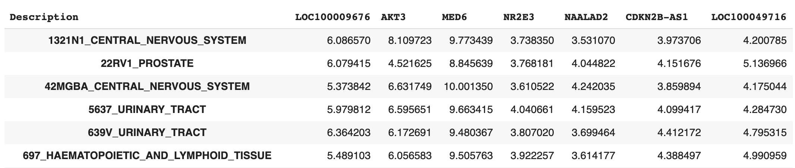
Resolve Missing Values
Missing values only present in EC50, so we decided not to use it as a label. (134 missing values)
No missing values in gene expression data
...
Notes:
NaNs: insufficient chromatographic resolution and isobaric interferences at the fragment ion level

Slide 20
Method: Elastic Net Regression
Linear regression with L1 and L2 regularization
Supposed to be better at dealing with situations with correlations between parameters
Loss function:
𝛂 = mixing parameter (lower → less L1)
𝛌 = regularization parameter (0 = no regularization)
Notes:
The first part is the standard MSE. The other term is the regularization term, which has both the L1 and L2 regularization parameter terms. The parameter $\lambda$ works the same as $\lambda$ from L1 or L2 regularization, which indicates how much to regularize. The $\alpha$ term is the mixing parameter, which indicates how much of the L1 or L2 regularization to perform.

Slide 21
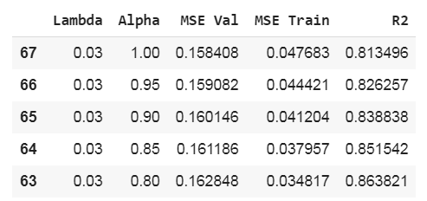
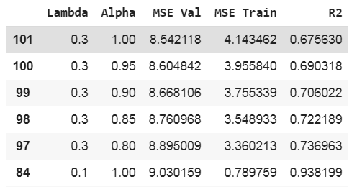
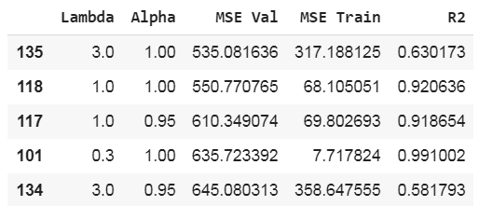
Results
From hyperparameter tuning
Activity Area
IC 50
A_max
Notes:
As we can see the values we obtained showed a correlation in the dataset and that the elastic net model can fit the data.
We chose the hyperparameters trying to make sure that they don’t overfit (MSE_Train value) and that there is correlation (R2 value).

Slide 22
Analysis of hyperparameter tuning
Paper
Did not state their hyperparameter
Stated they chose ones with smallest MSE
Activity Area
A_max
IC 50
Notes:
In the paper, they chose the hyperparameters by looking at the row with the smallest MSE on the test data.
They do not state the hyperparameters they used
For us, the row with the smallest MSE have an alpha of 1
We infer that the mutation data that we do not have, which they used, may affect hyperparameter tuning
Or else there is no reason to use elastic net.

Slide 23
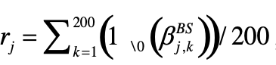
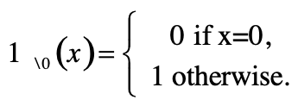
Bootstrapping for finding significant features
Generated 200 resampled datasets by sampling train data with replacement
Each consists of 250 samples, about (1-1/e) or 63% of the training data size
Solve elastic net for each bootstrap dataset
Used the optimal α and λ from the hyperparameter training
Generate a matrix of regression coefficients β
Each row, k, represents the solution for one bootstrap dataset
Each column, j, is the weight on that feature
Calculate percentage of bootstrap datasets inferred as significant for each feature:
Notes:
Alex -
Generated 200 resampled datasets by sampling train data with replacement
Each consists of 250 examples, about (1-1/e) or 63% of the training data size
Solve elastic net for each bootstrap dataset -
used the optimal α and λ from the hyperparameter training
Generate a matrix of regression coefficients
Each row represents the solution for one bootstrap dataset
Each column is the weight on that feature
Calculate percentage of bootstrap datasets inferred as significant:

Slide 24
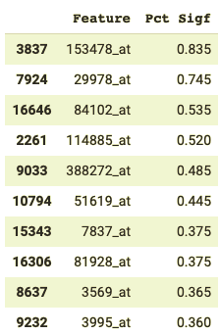
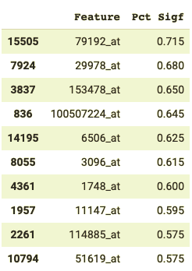
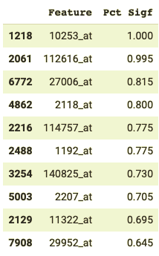
Top 10 genes that showed up frequently during the bootstrap
IC50
A_{max}
Act Area

Slide 25
Top 10 genes that showed up frequently during the bootstrap for Activity Area
Gene ID | Gene Name | Function | Frequency | Ave Weight
10253_at | SPRY2 | Regulator of MAPK output | 1 | 0.655
112616_at | CMTM7 | Tumor suppressor | 0.995 | 0.728
27006_at | FGF22 | Mitogenic and cell survival activities | 0.815 | 0.464
2118_at | ETV4 | RET Signaling | 0.8 | 0.723
114757_at | CYGB | Protective function during oxidative stress | 0.775 | 0.697
1192_at | CLIC1 | Chloride intracellular channel | 0.775 | 0.445
140825_at | NEURL2 | Regulation of myofibril organization | 0.73 | 0.482
2207_at | FCER1G | IgE receptor involved in allergic reactions | 0.705 | 0.649
11322_at | TMC6 | High rate of progression to squamous cell carcinoma | 0.695 | 0.492
29952_at | DPP7 | Inhibits suppression of apoptosis | 0.645 | 0.450

Slide 26
Weights have flipped signs when compared to the paper’s top features
 |  | Our model |  | Barretina et al.
Gene Name | Function | Frequency | Ave Weight | Frequency | Ave Weight
SPRY2 | Regulator of MAPK output | 1 | 0.655 | 0.980 | -0.328
NEURL2 | Regulation of myofibril organization | 0.73 | 0.482 | 0.845 | -0.120
CMTM7 | Tumor suppressor | 0.995 | 0.728 | N/A | -0.014
FCER1G | IgE receptor involved in allergic reactions | 0.705 | 0.649 | N/A | -0.008

Slide 27
Differences between our model and the paper
Log-transformed labels
SNP and CNV data not included in our model
Results from bootstrapping:
Train MSE: 0.039 – Test MSE: 1.63

Slide 28
Conclusions
No correlation was found between global chromatin profiling data has with MEK inhibitor sensitivity
Gene expression data can be used for prediction of MEK inhibitor’s activity area
Our top bootstrapped feature is the paper’s top bootstrapped feature for PD-0325901, but flipped in sign

Slide 29
Thank you! – Questions?

Slide 30
References
Gillet, J. P., Varma, S., & Gottesman, M. M. (2013). The clinical relevance of cancer cell lines. Journal of the National Cancer Institute, 105(7), 452-458.
Barretina, J., Caponigro, G., Stransky, N., Venkatesan, K., Margolin, A. A., Kim, S., ... \& Reddy, A. (2012). The Cancer Cell Line Encyclopedia enables predictive modelling of anticancer drug sensitivity. Nature, 483(7391), 603.
Litichevskiy, L., Peckner, R., Abelin, J. G., Asiedu, J. K., Creech, A. L., Davis, J. F., ... \& Jaffe, J. D. (2018). A library of phosphoproteomic and chromatin signatures for characterizing cellular responses to drug perturbations. Cell systems, 6(4), 424-443.
Jaffe, J. D., Wang, Y., Chan, H. M., Zhang, J., Huether, R., Kryukov, G. V., … \& Stegmeier, F. (2013). Global chromatin profiling reveals NSD2 mutations in pediatric acute lymphoblastic leukemia. Nature genetics, 45(11), 1386–1391. doi:10.1038/ng.2777
Rahman, R., \& Pal, R. (2016, February). Analyzing drug sensitivity prediction based on dose response curve characteristics. In 2016 IEEE-EMBS International Conference on Biomedical and Health Informatics (BHI) (pp. 140-143). IEEE.
Data retrieved from: https://portals.broadinstitute.org/ccle
https://www.diagenode.com/en/categories/histone-antibodies
https://www.researchgate.net/figure/Schematic-representation-of-histone-modifications-The-methylation-sites-are-represented_fig1_283086163

