Slide 1

Noted
A group bulletin board app.
Create a board, add some notes.
Share the board with a friend
and edit it together.

Slide 2
Outline
1) Features of the app
2) Structure of the app
3) Implementation Technologies
4) Demonstation

Slide 3
Features
Sign up / Login
Create a board
Search for boards
Subscribe to a board
Edit a board

Slide 4
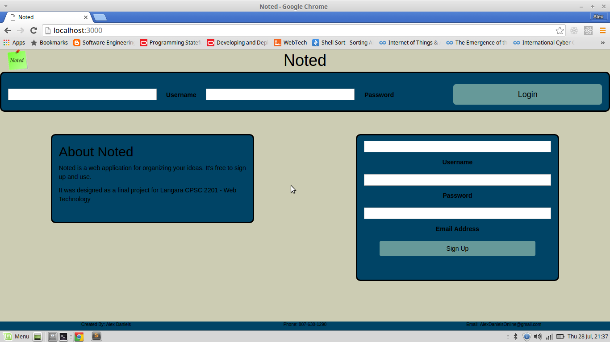
Signup / Login

Slide 5
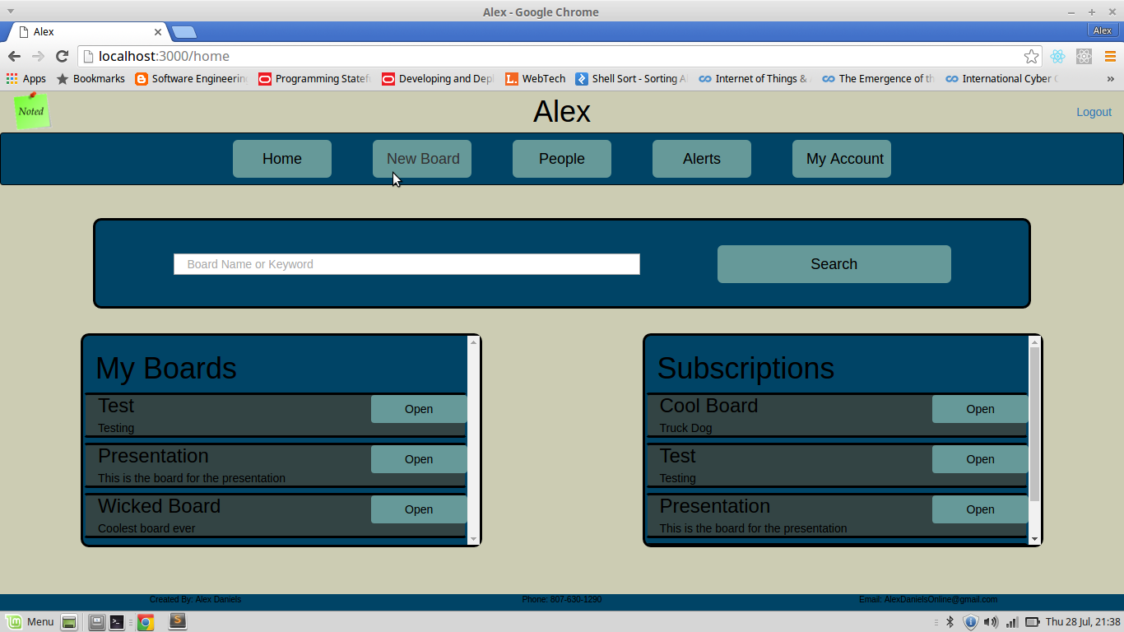
Home

Slide 6
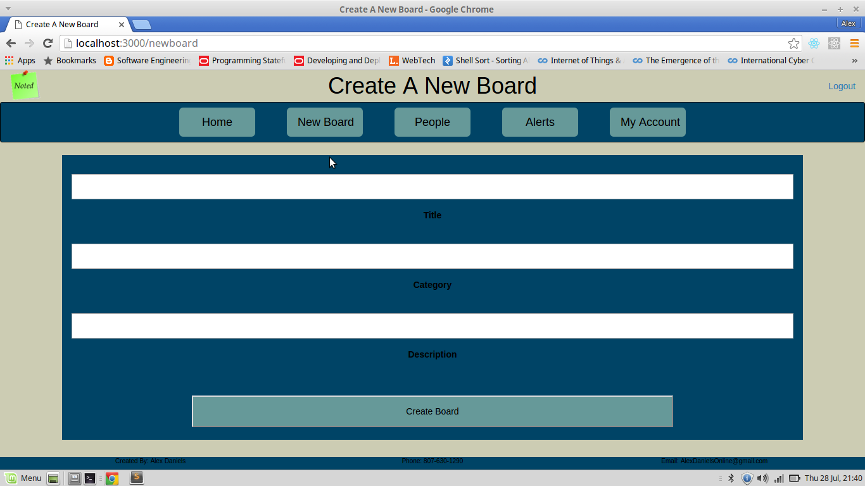
Create a Board

Slide 7
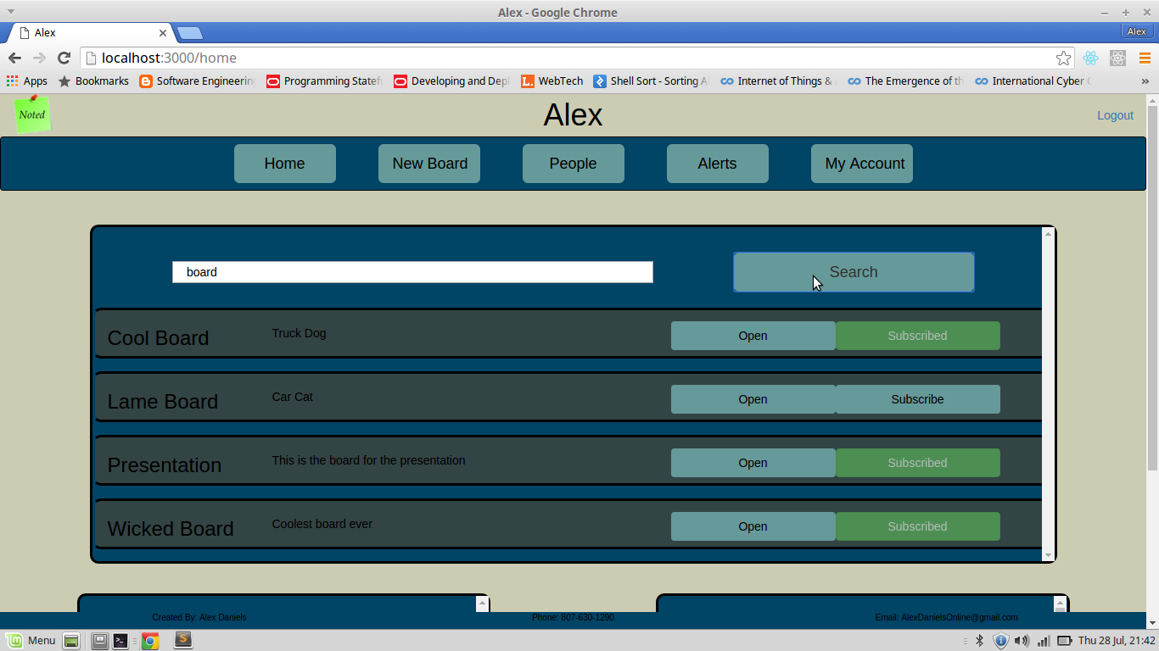
Search and Subscribe

Slide 8
Editor
Put picture here...

Slide 9
Structure
Models
Node Restful API
Express Routes
React Components
Jade Templates

Slide 10
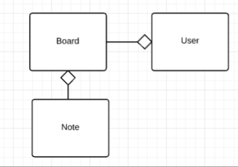
Models
Board
Note
User

Slide 11
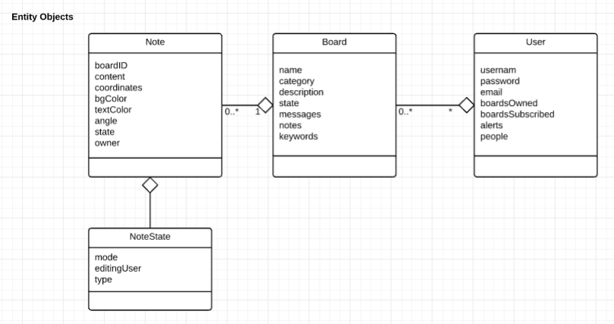
Object Designs

Slide 12
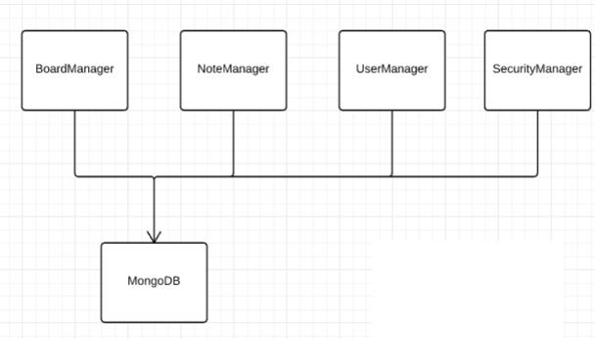
API
Acts as a wrapper for mongoDB
Allows for a more declarative programming style

Slide 13
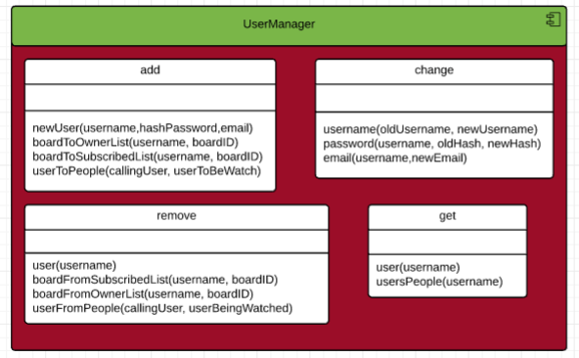
UserManager

Slide 14
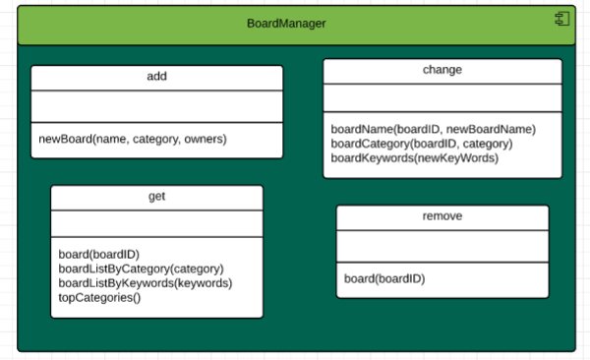
BoardManager

Slide 15
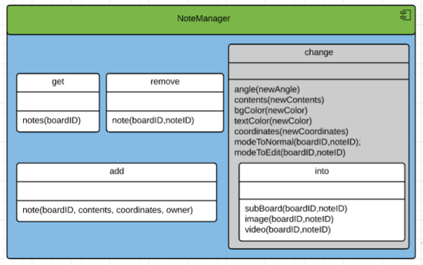
NoteManager

Slide 16
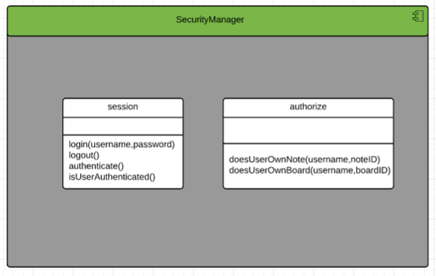
SecurityManager

Slide 17
Routes
/
/user
/board
/note
/security

Slide 18
Routes
The index or '/' route manages requests for pages
The other routes are a bridge between
the client and the API
Handles Security, Errors, and Context

Slide 19
React Components
Used for agregation in the MyBoards, MySubscriptions and Search components.
Used in every aspect of the board editor page
Used to quickly implement small components such as the 'Logout' button
Board Editor Component Needlessly
Complex and patchy due to poor design

Slide 20
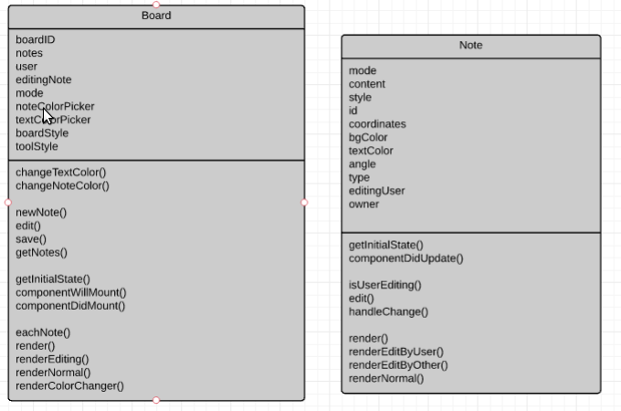
React Components

Slide 21
Jade
One jade layout for the whole website
Used partials for Header, Nav and Footer

Slide 22
Implementation
API
React
Bootstrap

Slide 23
API
Implemented as Node modules
Implemented using Javascript Prototypes

Slide 24
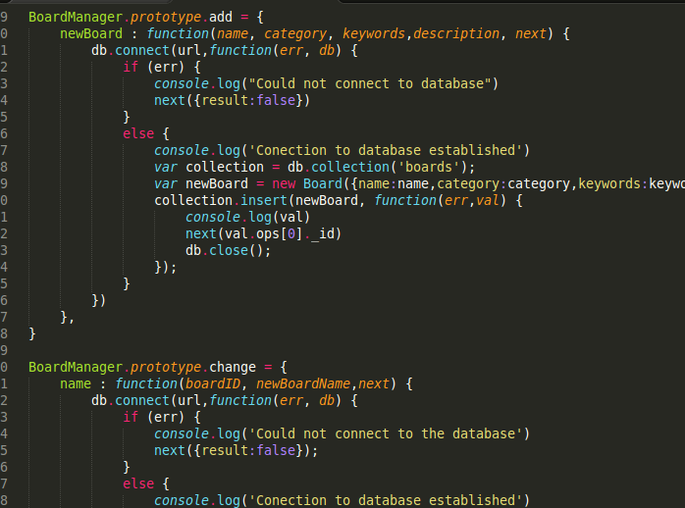
API

Slide 25
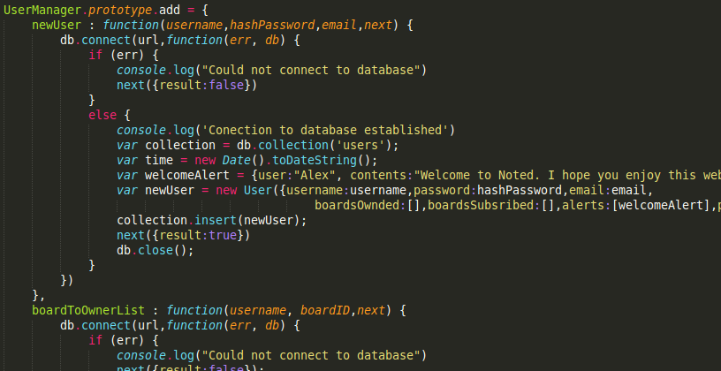
API

Slide 26
React
Agregation
Board Editor

Slide 27
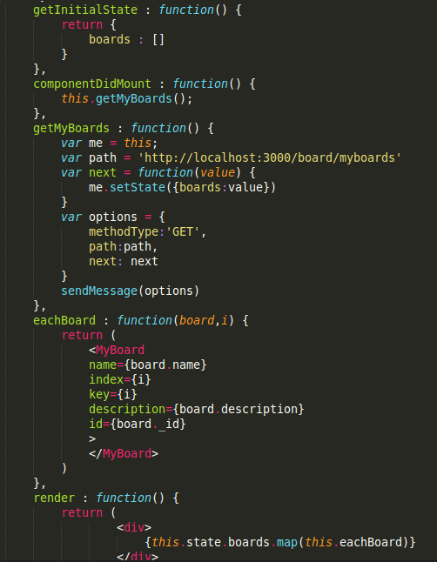
Agregation

Slide 28
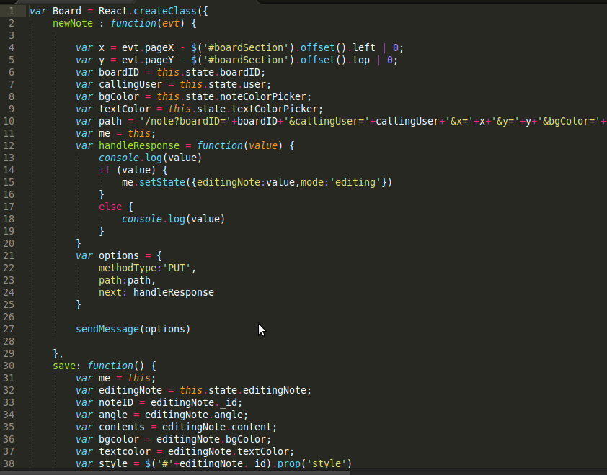
Editor

Slide 29
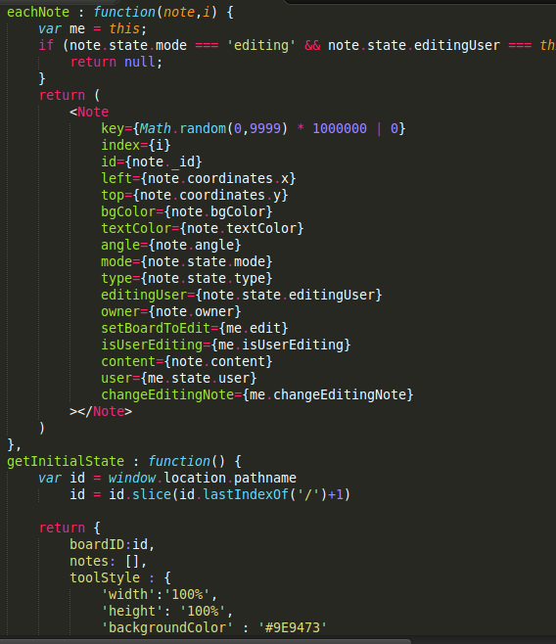
Editor

Slide 30
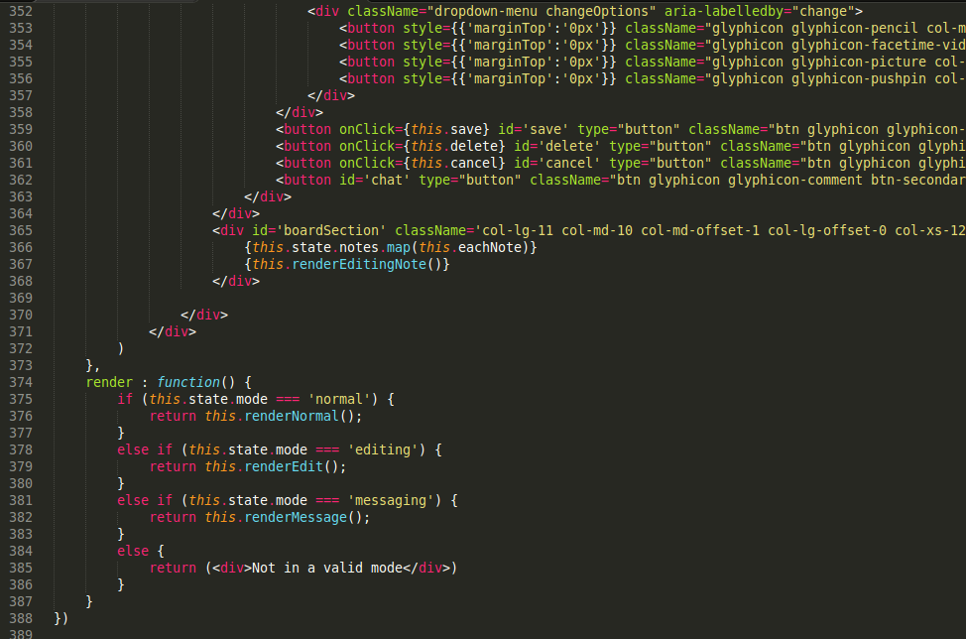
Editor

Slide 31
Bootstrap
Used for every aspect of the web site
Used box model for component spacing
Used for Responsive Design
Used for Input design

Slide 32
Demonstration

