Slide 1
Class 2 code
G.Carteny

Slide 2
Table of contents
R Numeric types
Arithmetic operators and transformations
Object type: Vector
Object type: Matrices
Object type: Arrays
Object type: Lists
Object type: Data Frames
Mean 1
Mean 2
Median 1
Median 2
Quantiles/IQR
Standard deviation/Variance
Standard error
Central limit theorem
The Mean (Arithmetic Average)
Properties of the Mean
The Median
hp

Slide 3
R Numeric types
# Real numbers ("double") x <- 9 z <- 13.2 # Integers y <- 4L # Characters start <- "R is so much" end <- "fun!" sentence <- paste(start, end, sep = " ") # Logicals & Boolean operators 2 + 5 == 6 # Does 2 + 5 equal 6? isFALSE(3 + 4 != 2 + 5) # Is it false that 3 + 4 is not equal to 2 + 5? 3 | 4 >= 2 + 1 # Is 3 OR 4 greater than/equal to 2 + 1? 3 & 7 %in% c(1:5) # Are 3 AND 7 included in an integer sequence from 1 to 5?

Slide 4
Arithmetic operators and transformations
x + y # addition x - y # subtraction x * y # multiplication x / y # division x ^ y # exponentiation log(x) # natural logarithm exp(x) # exponential sqrt(x) # square root a %*% b # vector/matrix multiplication t(a) # vector/matrix transposition solve(A) # matrix inversion

Slide 5
Object type: Vector
A vector is a serial listing of data elements of the same type (e.g. integer, double, logical, or character).
item <- c("flour", "sugar", "potatoes", "tomatoes", "bananas") price <- c(.99, 1.49, 1.99, 2.79, 1.89) pricey <- price > 1.5

Slide 6
Object type: Matrices
A matrix is a rectangular arrangement of data elements of the same type.
mat1 <- matrix(seq(-.35, .35, .1), nrow = 2, ncol = 4) mat1
[,1] [,2] [,3] [,4] [1,] -0.35 -0.15 0.05 0.25 [2,] -0.25 -0.05 0.15 0.35

Slide 7
Object type: Arrays
An array is a multidimensional arrangement of data elements of the same type.
You may think of an array as a generalization of a matrix to any number of dimensions:
all elements are of the same type
fixed dimensional structure
any vector or matrix can be stored as an array using as.array()

Slide 8
Object type: Lists
Lists allow you to store objects of various classes, various storage types, and various sizes. This can be very useful, e.g., for returning various outputs from a function.
my_list <- list() my_list$char_mat <- matrix(LETTERS, nrow = 2, ncol = 13) my_list$vectors <- list() my_list$vectors$num_vec1 <- c(1:2) my_list$vectors$num_vec2 <- runif(10, min = 0, max = 1)

Slide 9
Object type: Data Frames
Data frames are lists of variables of equal length, producing a rectangular structure. Unlike matrix columns, data frame columns can be of different storage types and classes.
groceries <- data.frame( item = c("flour", "sugar", "potatoes", "tomatoes", "bananas"), price = c(.99, 1.49, 1.99, 2.79, 1.89) ) groceries
item price 1 flour 0.99 2 sugar 1.49 3 potatoes 1.99 4 tomatoes 2.79 5 bananas 1.89

Slide 10
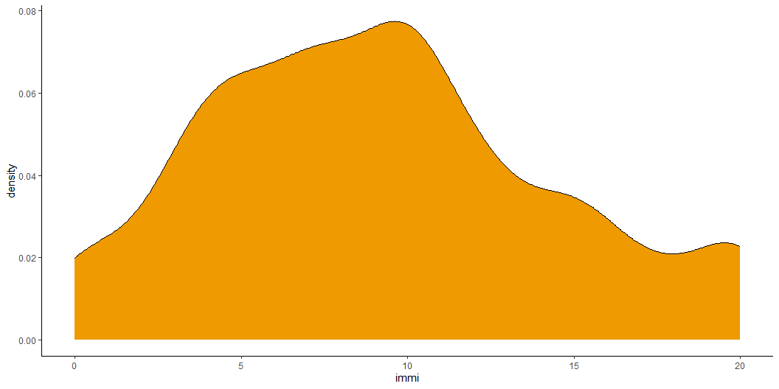
Mean 1
ess_reg %>% ggplot(aes(x=immi)) + geom_density(fill='orange2') + theme_classic()

Slide 11
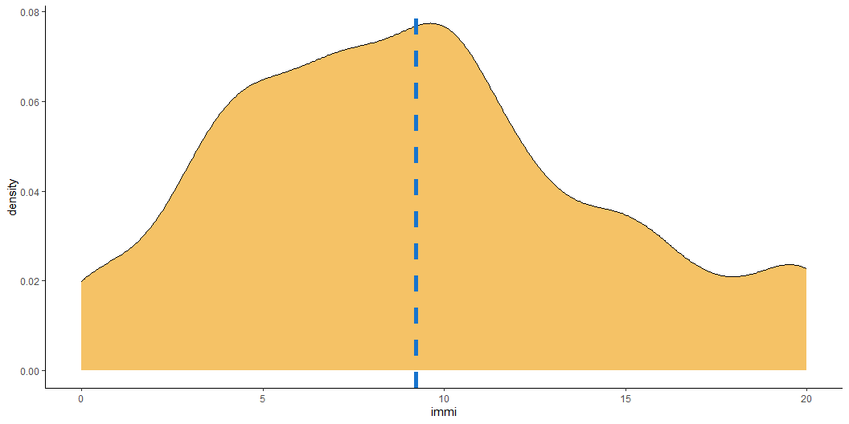
Mean 2
ess_reg %>% mutate( immi_mean = mean(immi, na.rm=T) ) %>% ggplot(aes(x=immi)) + geom_density(fill='orange2', alpha=.6) + geom_vline(aes(xintercept = immi_mean), linetype = 'dashed', colour = 'dodgerblue3', linewidth = 2) + theme_classic()

Slide 12

Median 1
ess_reg %>% mutate( immi_mean = mean(immi, na.rm=T), immi_med = median(immi, na.rm=T) ) %>% ggplot(aes(x=immi)) + geom_density(fill='orange2', alpha=.6) + geom_vline(aes(xintercept = immi_mean), linetype = 'dashed', colour = 'dodgerblue3', linewidth = 1) + geom_vline(aes(xintercept = immi_med), linetype = 'dashed', colour = 'green4', linewidth = 1) + theme_classic()

Slide 13
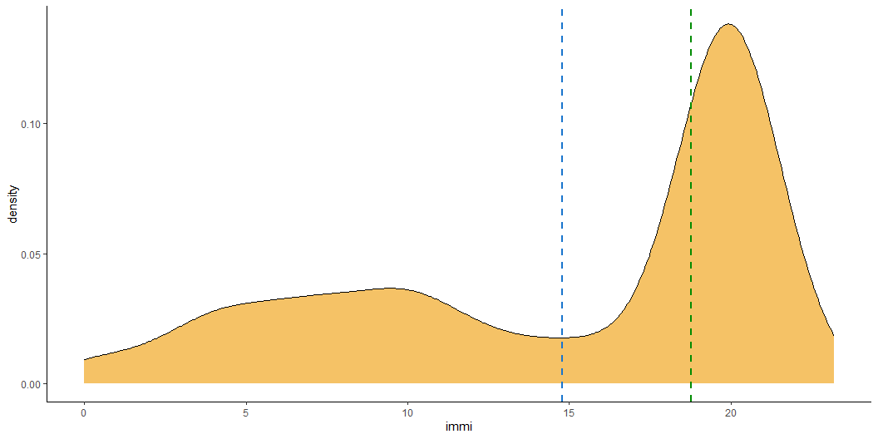
Median 2
set.seed(1234) ess_reg %>% dplyr::select(immi) %>% rbind(.,data.frame(immi = rnorm(1000, mean=20, sd=1))) %>% mutate( immi_mean = mean(immi, na.rm=T), immi_med = median(immi, na.rm=T) ) %>% ggplot(aes(x=immi)) + geom_density(fill='orange2', alpha=.6) + geom_vline(aes(xintercept = immi_mean), linetype = 'dashed', colour = 'dodgerblue3', linewidth = 1) + geom_vline(aes(xintercept = immi_med), linetype = 'dashed', colour = 'green4', linewidth = 1) + theme_classic()

Slide 14
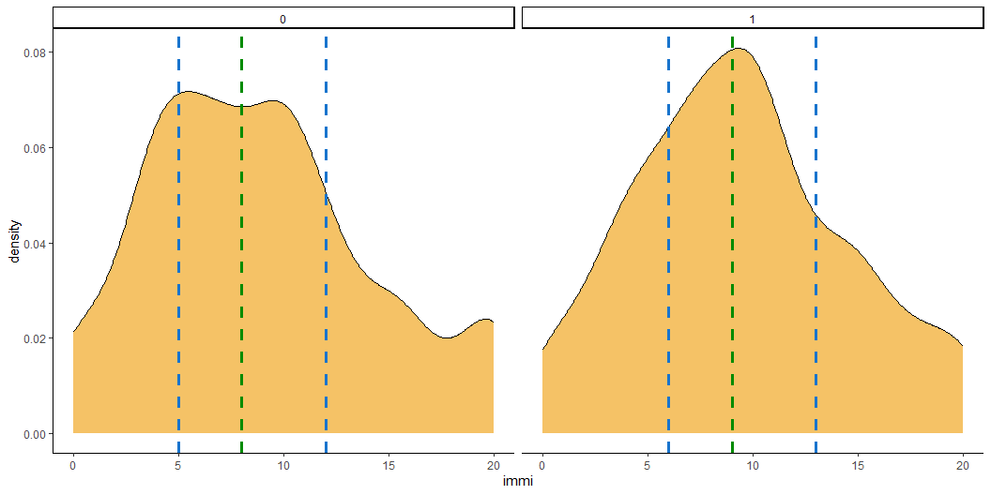
Quantiles/IQR
set.seed(1234) ess_reg %>% dplyr::select(sex,immi) %>% na.omit %>% # rbind(.,data.frame(immi = rnorm(1000, mean=20, sd=1))) %>% mutate( .by = sex, immi_q25 = quantile(immi, .25, na.rm=T), immi_q75 = quantile(immi, .75, na.rm=T), immi_med = median(immi, na.rm=T) ) %>% ggplot(aes(x=immi)) + geom_density(fill='orange2', alpha=.6) + geom_vline(aes(xintercept = immi_q25), linetype = 'dashed', colour = 'dodgerblue3', linewidth = 1.2) + geom_vline(aes(xintercept = immi_q75), linetype = 'dashed', colour = 'dodgerblue3', linewidth = 1.2) + geom_vline(aes(xintercept = immi_med), linetype = 'dashed', colour = 'green4', linewidth = 1.2) + facet_grid(~sex) + theme_classic()

Slide 15

Standard deviation/Variance
ess_reg %>% mutate( immi_mean = mean(immi, na.rm = TRUE), immi_sd = sd(immi, na.rm = TRUE) ) %>% ggplot(aes(x = immi)) + geom_density(fill = 'orange2', alpha = 0.6) + geom_vline(aes(xintercept = immi_mean), linetype = 'dashed', colour = 'dodgerblue3', linewidth = 1) + geom_vline(aes(xintercept = immi_mean + immi_sd), linetype = 'dashed', colour = 'red', linewidth = 1) + geom_vline(aes(xintercept = immi_mean - immi_sd), linetype = 'dashed', colour = 'red', linewidth = 1) + theme_classic()

Slide 16

Standard error
ess_reg %>% mutate( immi_mean = mean(immi, na.rm = TRUE), immi_se = sd(immi, na.rm = TRUE) / sqrt(sum(!is.na(immi))) ) %>% ggplot(aes(x = immi)) + geom_density(fill = 'orange2', alpha = 0.6) + geom_vline(aes(xintercept = immi_mean), linetype = 'dashed', colour = 'dodgerblue3', linewidth = 1) + geom_vline(aes(xintercept = immi_mean + immi_se), linetype = 'dashed', colour = 'purple', linewidth = 1) + geom_vline(aes(xintercept = immi_mean - immi_se), linetype = 'dashed', colour = 'purple', linewidth = 1) + theme_classic()

Slide 17
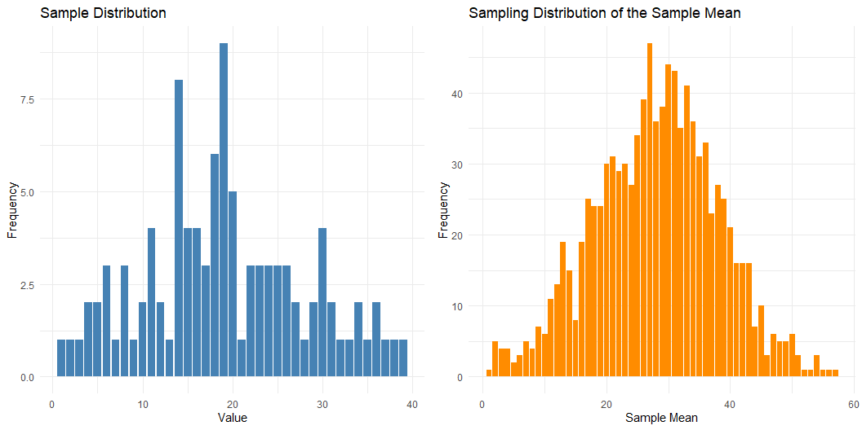
Central limit theorem
library(ggplot2) library(dplyr) set.seed(1234) # 1. Create population population <- rnorm(10000, mean = 50, sd = 10) # 2. Take one sample from the population sample_data <- sample(population, size = 100, replace = TRUE) # 3. Simulate sampling distribution of the sample mean sample_means <- replicate(1000, mean(sample(population, size = 100, replace = TRUE))) # 4. Create data frames for plotting df_sample <- as.data.frame(table(round(sample_data))) colnames(df_sample) <- c("value", "frequency") df_sampling_dist <- as.data.frame(table(round(sample_means, 1))) colnames(df_sampling_dist) <- c("sample_mean", "frequency") # 5. Plot: Sample distribution p1 <- ggplot(df_sample, aes(x = as.numeric(value), y = frequency)) + geom_bar(stat = "identity", fill = "steelblue") + labs(title = "Sample Distribution", x = "Value", y = "Frequency") + theme_minimal() # 6. Plot: Sampling distribution of the sample mean p2 <- ggplot(df_sampling_dist, aes(x = as.numeric(sample_mean), y = frequency)) + geom_bar(stat = "identity", fill = "darkorange") + labs(title = "Sampling Distribution of the Sample Mean", x = "Sample Mean", y = "Frequency") + theme_minimal() # 7. Show both plots side by side library(gridExtra) grid.arrange(p1, p2, nrow = 1)

Slide 18
The Mean (Arithmetic Average)
Calculated by summing all values and dividing by the number of observations
Formula:
$$\text{Mean}=\frac{∑x_{i}}{n}$$
Sensitive to every value in the dataset
Affected by extreme values (outliers)
Appropriate for symmetric distributions

Slide 19
Properties of the Mean
Uses all data points — efficient and mathematically tractable
Minimises squared deviations
Not robust to outliers
Sample mean is an unbiased estimator of the population mean

Slide 20
The Median
The middle value when data are ordered
If even number of observations: average of the two middle values
Not influenced by extreme values or skewed distributions
Best used when the data are ordinal or skewed

Slide 21
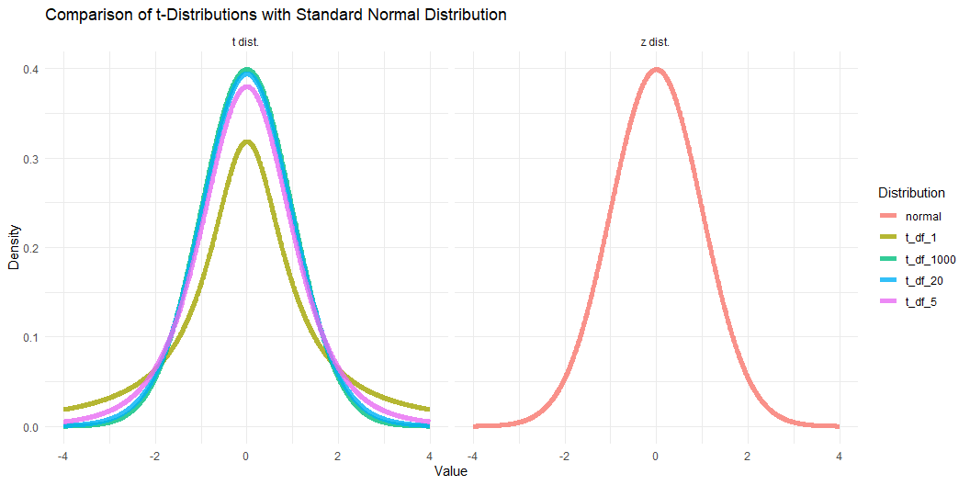
hp
library(tidyr) # Define the range of x values x_vals <- seq(-4, 4, length.out = 1000) # Create a data frame with densities for t-distributions and the normal distribution df_plot <- tibble( x = x_vals, t_df_1 = dt(x, df = 1), t_df_5 = dt(x, df = 5), t_df_20 = dt(x, df = 20), t_df_1000 = dt(x, df = 1000), normal = dnorm(x) ) %>% pivot_longer(cols = -x, names_to = "distribution", values_to = "density") %>% mutate(isnormal = as.factor(ifelse(distribution=='normal','z dist.' , 't dist.'))) # Plot the distributions ggplot(df_plot, aes(x = x, y = density, color = distribution)) + geom_line(size = 2, alpha=.8) + labs( title = "Comparison of t-Distributions with Standard Normal Distribution", x = "Value", y = "Density", color = "Distribution" ) + facet_grid(~isnormal) + theme_minimal()

Slide 22
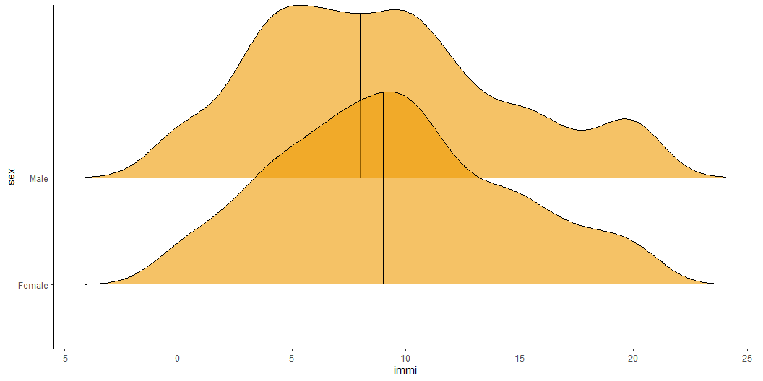
set.seed(1234) ess_reg %>% dplyr::select(sex,immi) %>% na.omit %>% # rbind(.,data.frame(immi = rnorm(1000, mean=20, sd=1))) %>% mutate( .by = sex, immi_q25 = quantile(immi, .25, na.rm=T), immi_q75 = quantile(immi, .75, na.rm=T), immi_med = median(immi, na.rm=T) ) %>% mutate(sex = ifelse(sex==0,'Male','Female')) %>% ggplot(aes(x=immi, y=sex)) + geom_density_ridges(fill='orange2', alpha=.6, quantile_lines= T, quantiles=c(.5)) + # facet_grid(~sex) + theme_classic()

