Slide 1

Quantitative Research in Political Science How to Apply the Classical Toolbox
Giuseppe Carteny
Postdoctoral Researcher
Department of European Social Research
University of Saarland
UdS SoSe2025 - Class 5 (12.05.2025)

Slide 2
Today‘s seminar
Review of the assignments
Generalised Linear Models
Quantities of Interest
R programming
Assignment

Slide 3
Review of the assignments

Slide 4
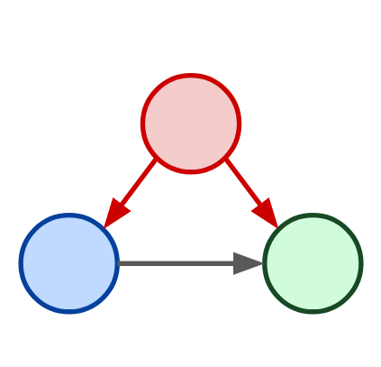
Assignment #1
Come up with some “expectations” about the relationship of interest
Start to thing whether your DV is affected also by other variables
Your model
N.B.: This is not necessarily the one you’ll develop in you term paper… so no worries, but come up with something plausible
Confounder
Independent Variable
Dependent Variable

Slide 5
Assignment #2
Keep on going with the code
I’ll ask you to upload it before Friday ☺

Slide 6
Generalised Linear Models

Slide 7
GLMs
Are a unified methodology for producing parameter estimates (Gill 2001, Gill and Torres 2019).
All generalized linear models have three characteristic parts:
Family which stipulates a random process that can plausibly generate an outcome (𝑦)
Linear component, namely a linear model, from which we derive a systematic component
Inverse link function, namely a function linking systematic component and the random process that generates the outcome (𝑦)
Partially readapted from: https://github.com/denis-cohen/statmodeling

Slide 8
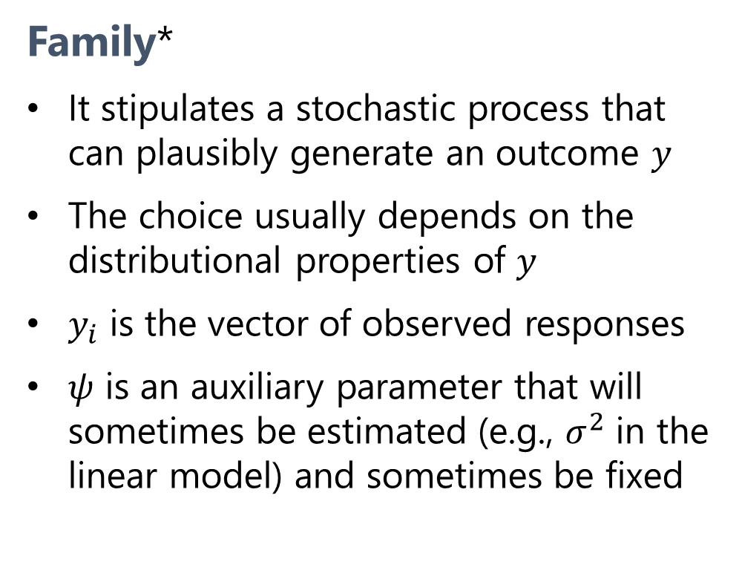
The three parts of every GLM
Family*
It stipulates a stochastic process that can plausibly generate an outcome 𝑦
The choice usually depends on the distributional properties of 𝑦
$y_{i}$ is the vector of observed responses
$ψ$ is an auxiliary parameter that will sometimes be estimated (e.g., $σ^{2}$ in the linear model) and sometimes be fixed
$$y_{i}∼\text{f}\left(θ_{i},ψ\right)$$
* Aliases: data-generating process, generative model, likelihood function

Slide 9
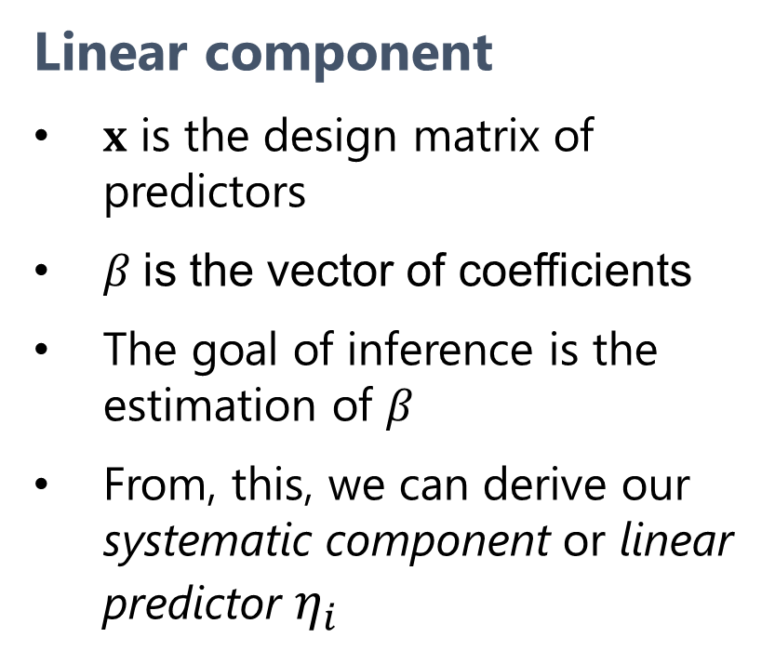

The three parts of every GLM
Linear component
$x$ is the design matrix of predictors
$β$is the vector of coefficients
The goal of inference is the estimation of $β$
From, this, we can derive our systematic component or linear predictor $η_{i}$
$$y_{i}∼\text{f}\left(θ_{i},ψ\right)$$
$$y_{i}^{∗}=x_{i}^{′}β+ε_{i}$$
$$η_{i}=x_{i}^{′}β$$

Slide 10


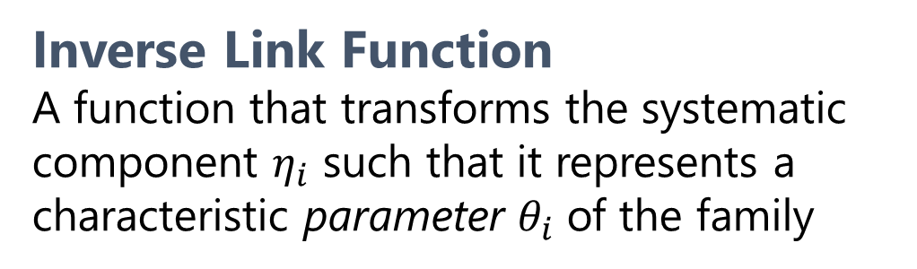
The three parts of every GLM
Inverse Link Function
A function that transforms the systematic component $η_{i}$ such that it represents a characteristic parameter $θ_{i}$ of the family
$$y_{i}∼\text{f}\left(θ_{i},ψ\right)$$
$$y_{i}^{∗}=x_{i}^{′}β+ε_{i}$$
$$η_{i}=x_{i}^{′}β$$
$$θ_{i}=g^{−1}\left(η_{i}\right)$$

Slide 11
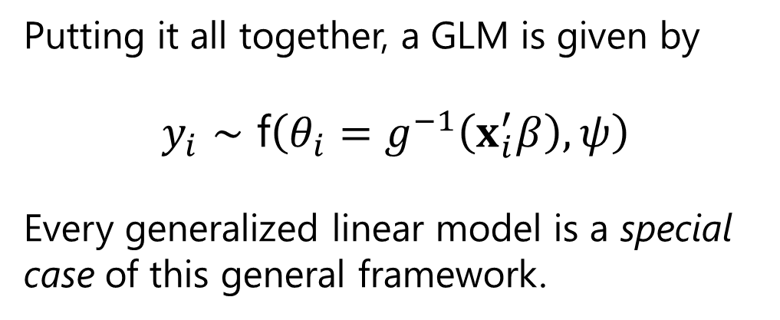
The three parts of every GLM
Putting it all together, a GLM is given by
$$y_{i}∼\text{f}\left(θ_{i}=g^{−1}\left(x_{i}^{′}β\right),ψ\right)$$
Every generalized linear model is a special case of this general framework.
$$y_{i}∼\text{f}\left(θ_{i},ψ\right)$$
$$y_{i}^{∗}=x_{i}^{′}β+ε_{i}$$
$$η_{i}=x_{i}^{′}β$$
$$θ_{i}=g^{−1}\left(η_{i}\right)$$

Slide 12




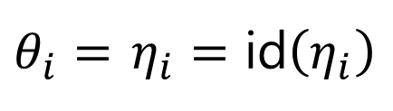
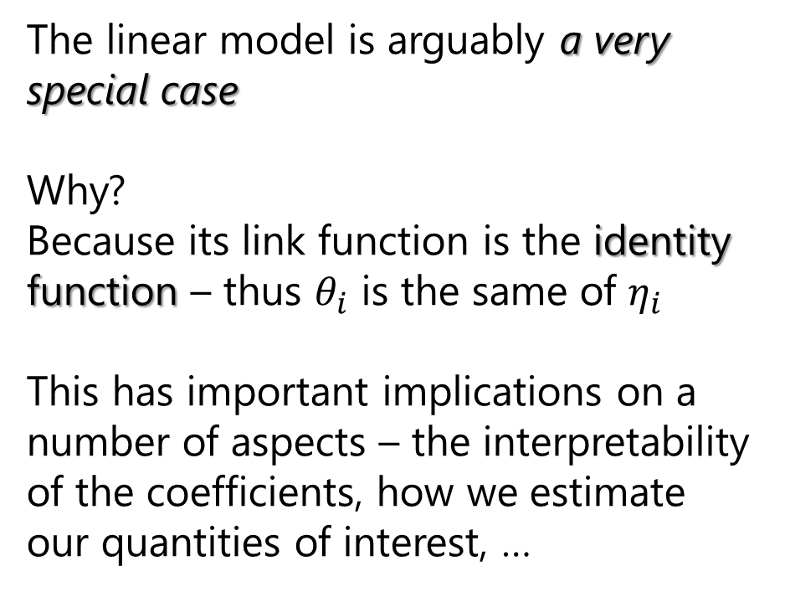


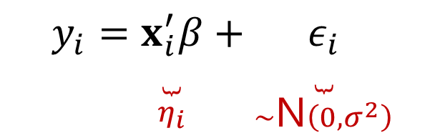
The Linear Model (LM)
The linear model is arguably a very special case
Why?
Because its link function is the identity function – thus $θ_{i}$ is the same of $η_{i}$
This has important implications on a number of aspects – the interpretability of the coefficients, how we estimate our quantities of interest, …
$$y_{i}∼\text{N}\left(η_{i},σ^{2}\right)$$
$$y_{i}∼\text{f}\left(θ_{i},ψ\right)$$
$$y_{i}=\underset{η_{i}}{\underset{⏟}{x_{i}^{′}β}}+\underset{∼\text{N}\left(0,σ^{2}\right)}{\underset{⏟}{ε_{i}}}$$
$$y_{i}^{∗}=x_{i}^{′}β+ε_{i}$$
$$η_{i}=\text{id}\left(η_{i}\right)$$
$$η_{i}=x_{i}^{′}β$$
$θ_{i}=$ $η_{i}=\text{id}\left(η_{i}\right)$
$$θ_{i}=g^{−1}\left(η_{i}\right)$$

Slide 13
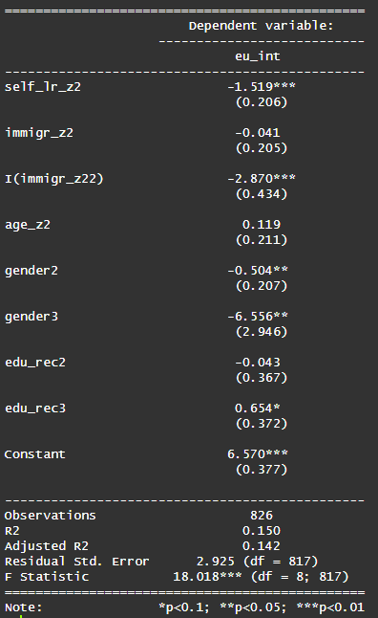

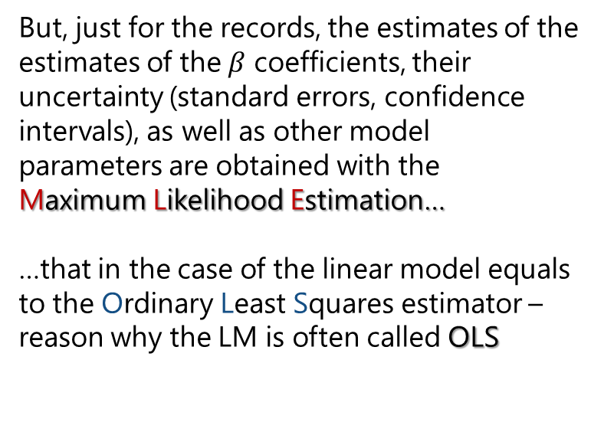

How do we get those estimates?
Now, we won’t dive into the machinery that brings you from this….
… to this
$$y_{i}∼\text{f}\left(θ_{i}=g^{−1}\left(x_{i}^{′}β\right),ψ\right)$$
But, just for the records, the estimates of the estimates of the $β$ coefficients, their uncertainty (standard errors, confidence intervals), as well as other model parameters are obtained with the Maximum Likelihood Estimation…
…that in the case of the linear model equals to the Ordinary Least Squares estimator – reason why the LM is often called OLS
Likelihood function of the linear model
$$L\left(β,σ^{2}\right)={\left(2πσ^{2}\right)}^{−n/2}exp\left(−\frac{1}{2σ^{2}}{\left(y−Xβ\right)}^{⊤}\left(y−Xβ\right)\right)$$
$${\left(X^{⊤}X\right)}^{−1}X^{⊤}y$$
Ordinary Least Square estimator

Slide 14
Do you know how to read this?
Questions:
What are those numbers?
And how you should interpret them?
Answers:
Those are regression coefficients
And those values are the expected change on the DV for one unit change in the predictor…
…when all the other predictors are at their 0, or baseline category

Slide 15
Quantities of Interest

Slide 16
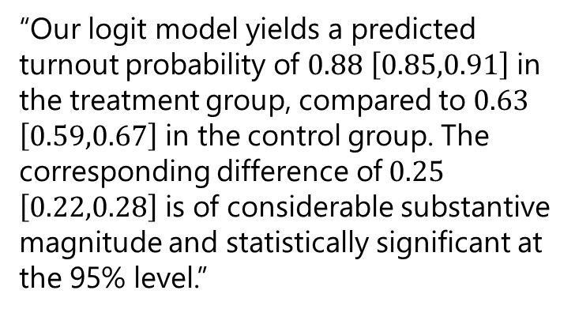
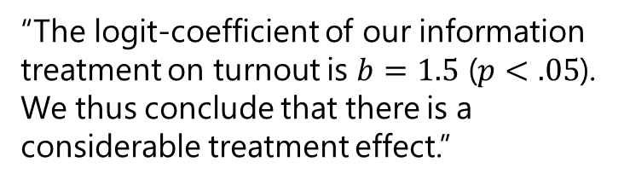
Why we need these QoI?
Your readers have a right to know!
It makes your research accessible to non-technical audiences.
Chances are: You will not truly understand your own findings without it.
“The logit-coefficient of our information treatment on turnout is $b=1.5$ ($p<.05$). We thus conclude that there is a considerable treatment effect.”
“Our logit model yields a predicted turnout probability of $0.88$ $\left[0.85,0.91\right]$ in the treatment group, compared to $0.63$ $\left[0.59,0.67\right]$ in the control group. The corresponding difference of $0.25$ $\left[0.22,0.28\right]$ is of considerable substantive magnitude and statistically significant at the 95% level.”

Slide 17
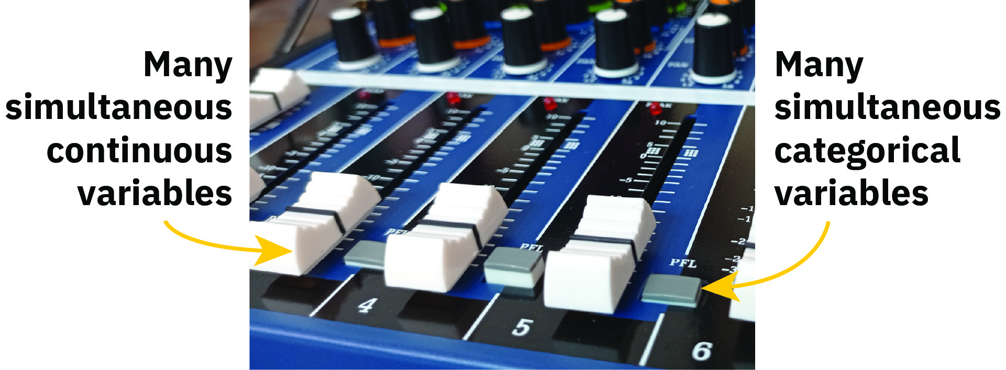
QoI and mixers…!?
https://www.andrewheiss.com/blog/2022/05/20/marginalia/images/mixer-board-annotated-80.jpg

Slide 18
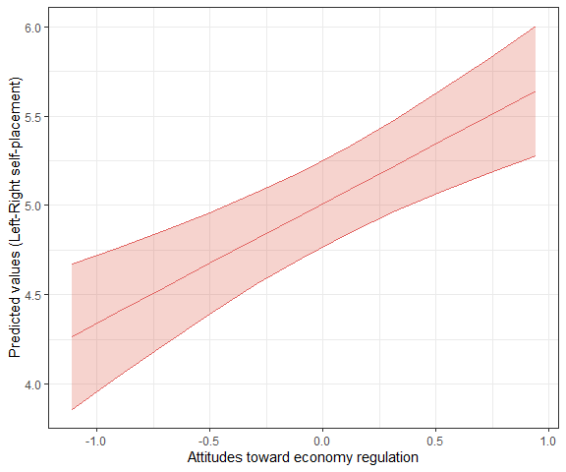
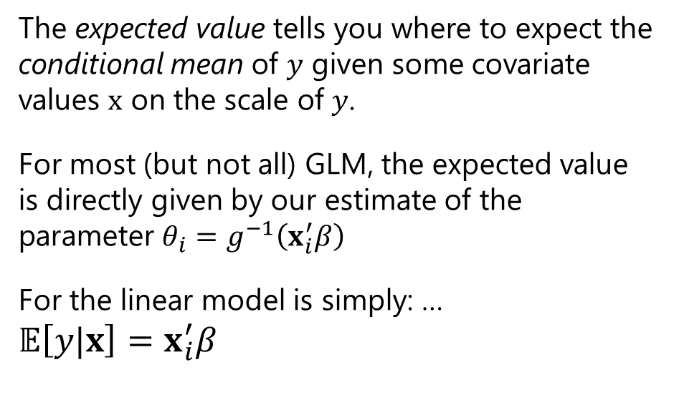
Expected/Predicted values
The expected value tells you where to expect the conditional mean of $y$ given some covariate values $x$ on the scale of $y$.
For most (but not all) GLM, the expected value is directly given by our estimate of the parameter $θ_{i}=g^{−1}\left(x_{i}^{′}β\right)$
For the linear model is simply: …
$𝔼\left[y|x\right]=x_{i}^{′}β$

Slide 19
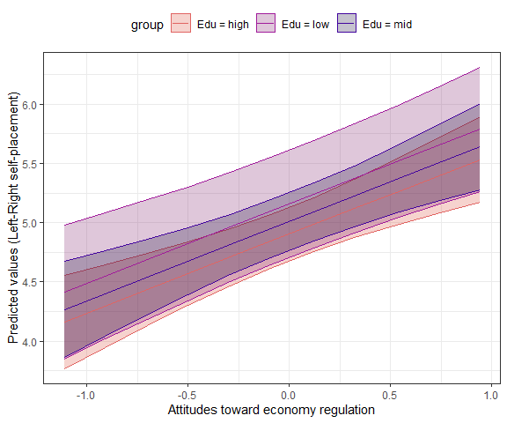
Expected/Predicted values
Similar to the logic of the coefficients, the value of other predictors affect the estimates of these expected/predicted values… but in the linear model only marginally!
In the linear values on the other covariates do not affect the slope of your curve - unless you have interactions between your main variable and other covariates
They affect the intercept of your estimates – namely whether the line/curve is lower/higher in the plot

Slide 20
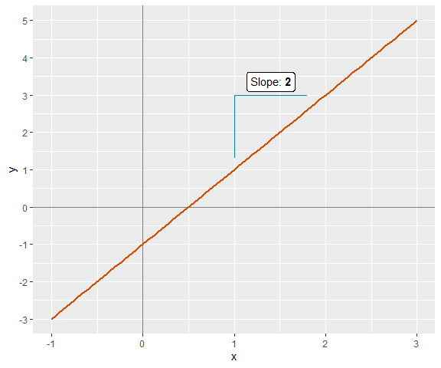
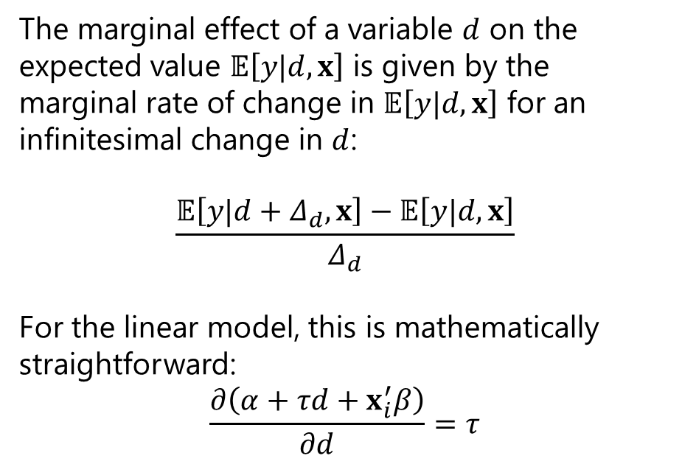
Marginal effect
Do you remember… the derivatives?
What is the derivative of a straight line?
The marginal effect of a variable $d$ on the expected value $𝔼\left[y|d,x\right]$ is given by the marginal rate of change in $𝔼\left[y|d,x\right]$ for an infinitesimal change in $d$:
$$\frac{𝔼\left[y|d+Δ_{d},x\right]−𝔼\left[y|d,x\right]}{Δ_{d}}$$
For the linear model, this is mathematically straightforward:
$$\frac{∂\left(α+τd+x_{i}^{′}β\right)}{∂d}=τ$$

Slide 21
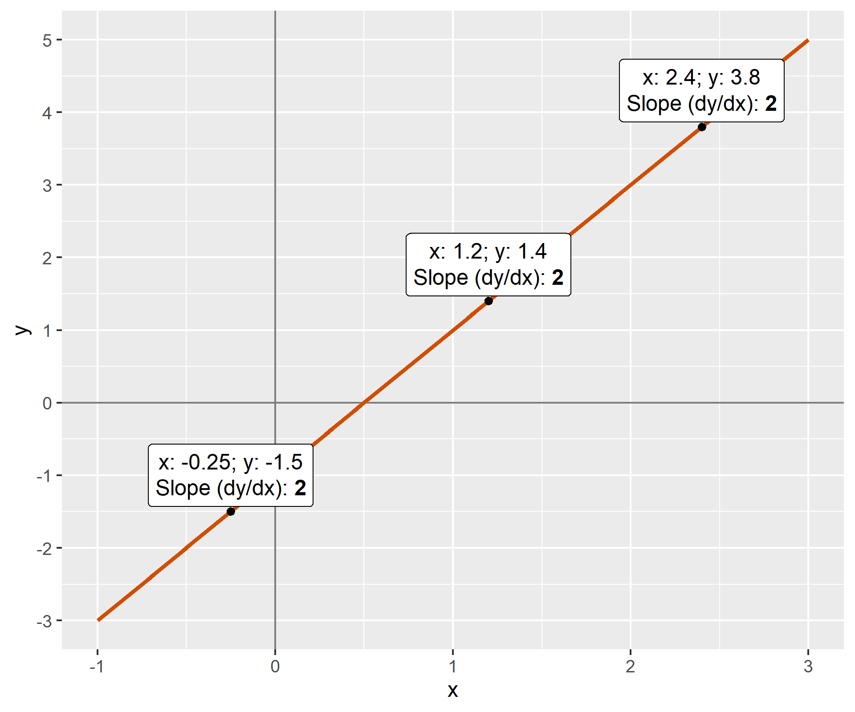
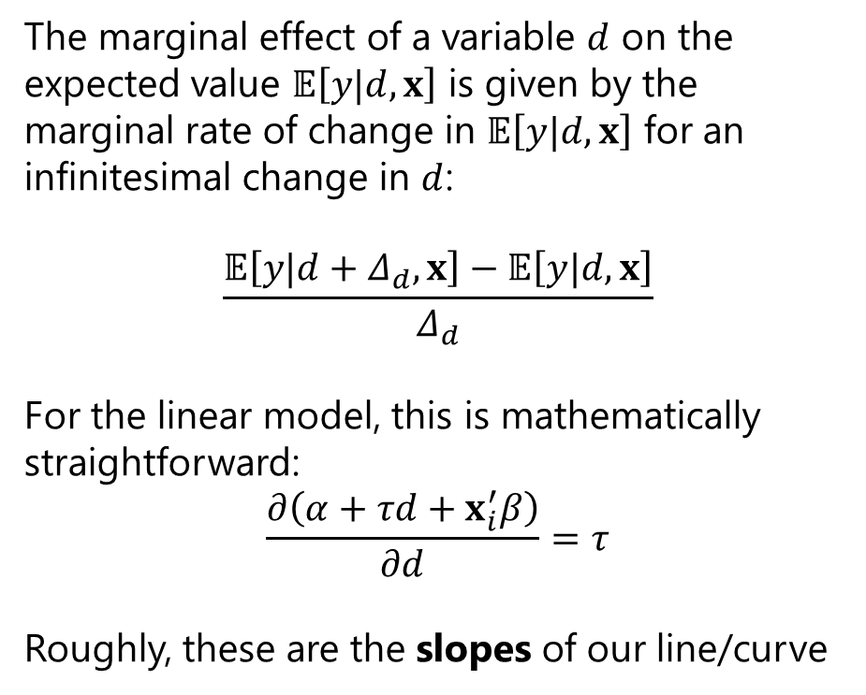
Marginal effect
Do you remember… the derivatives?
What is the derivative of a straight line?
The marginal effect of a variable $d$ on the expected value $𝔼\left[y|d,x\right]$ is given by the marginal rate of change in $𝔼\left[y|d,x\right]$ for an infinitesimal change in $d$:
$$\frac{𝔼\left[y|d+Δ_{d},x\right]−𝔼\left[y|d,x\right]}{Δ_{d}}$$
For the linear model, this is mathematically straightforward:
$$\frac{∂\left(α+τd+x_{i}^{′}β\right)}{∂d}=τ$$
Roughly, these are the slopes of our line/curve

Slide 22
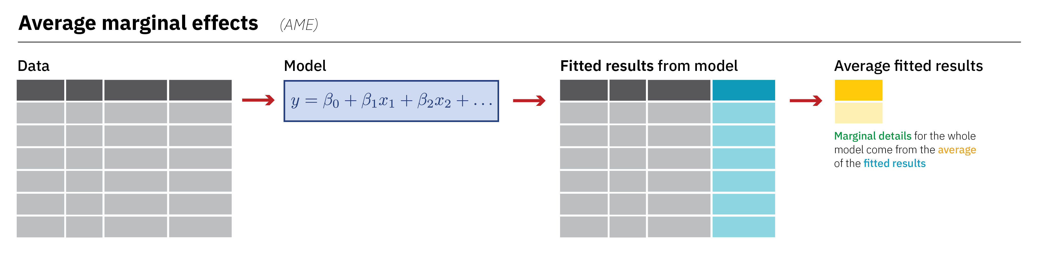
Average marginal effect
Marginal effects can be calculated in may different ways – check this post
In particular, there are different ways to aggregate the marginal effects that we get from estimating the slope for each observation
What we will deal with, mostly, are the so-called…
https://www.andrewheiss.com/blog/2022/05/20/marginalia/images/flow-ame@3x.png

Slide 23
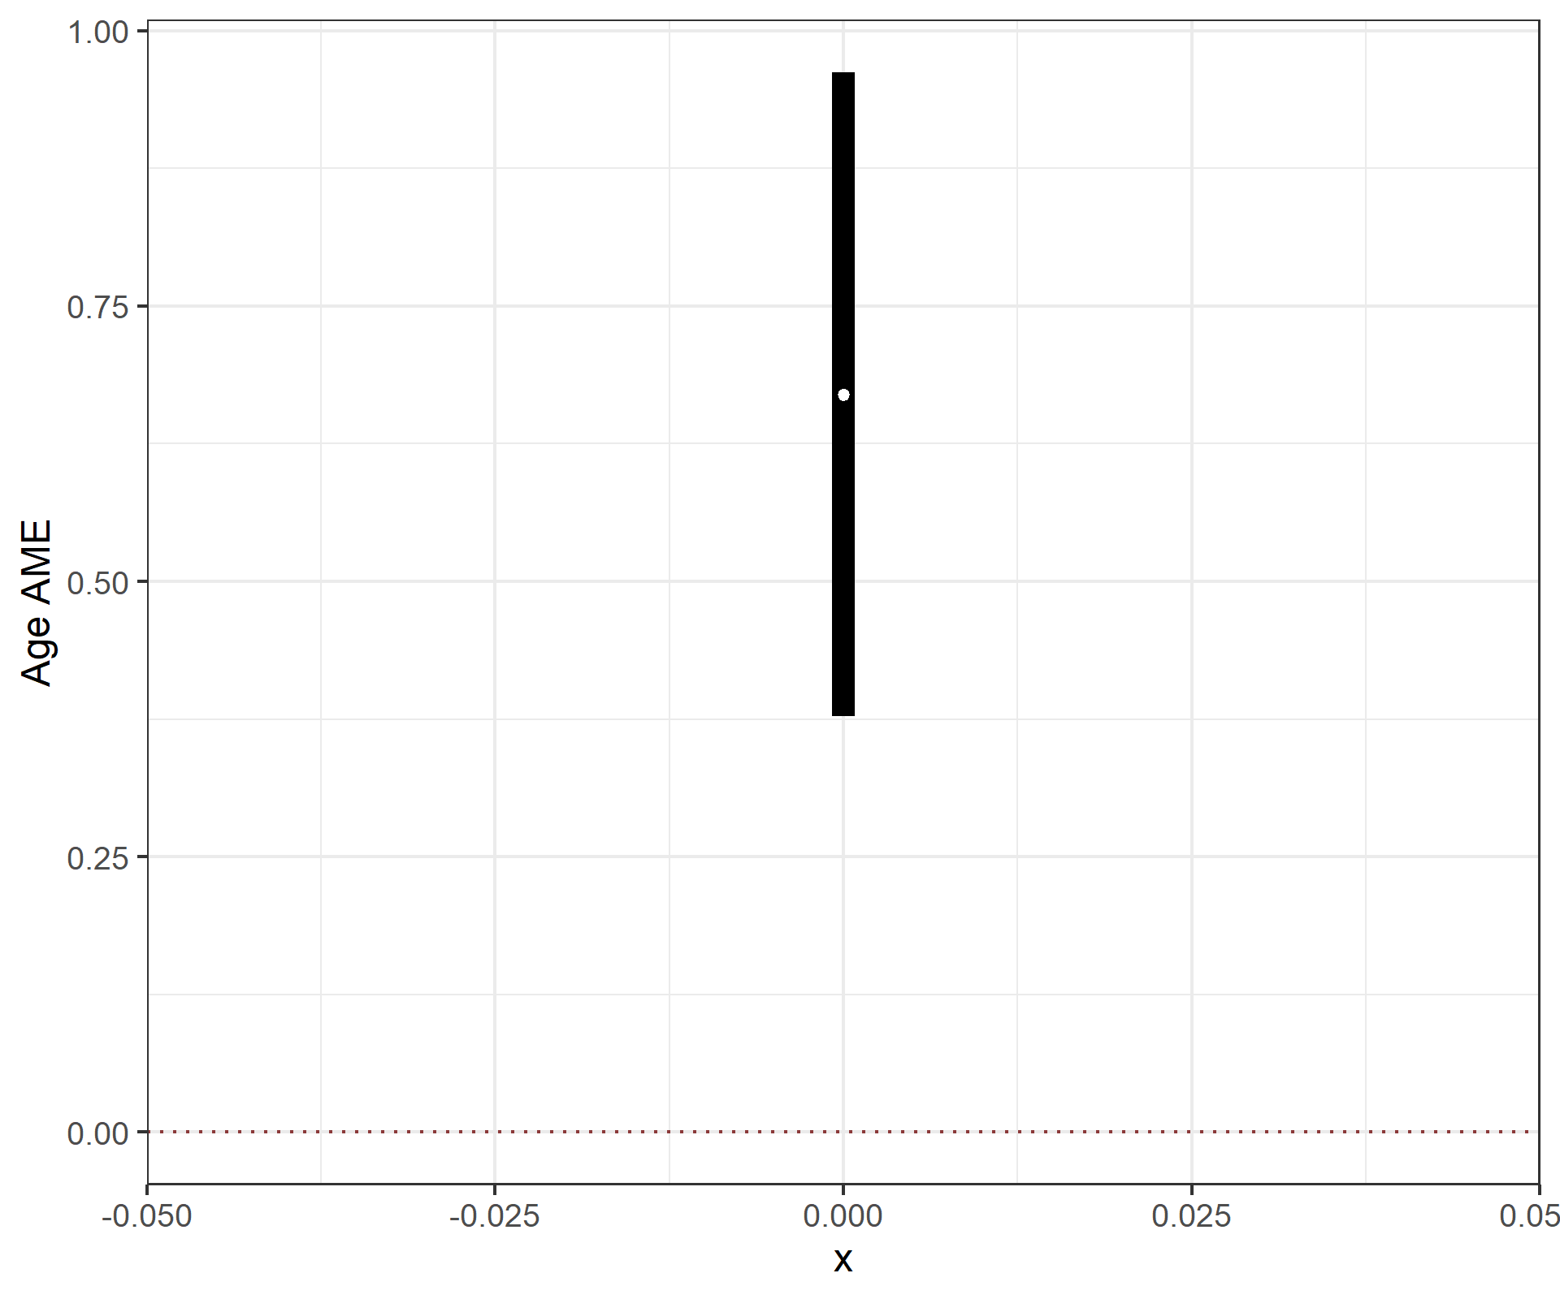
Average marginal effect
When talking about the expected/predicted values we said that in the LM the values of other covariates do not affect the slope of the line/curve
So… what should happen to the AME at different levels of other covariates?

Slide 24
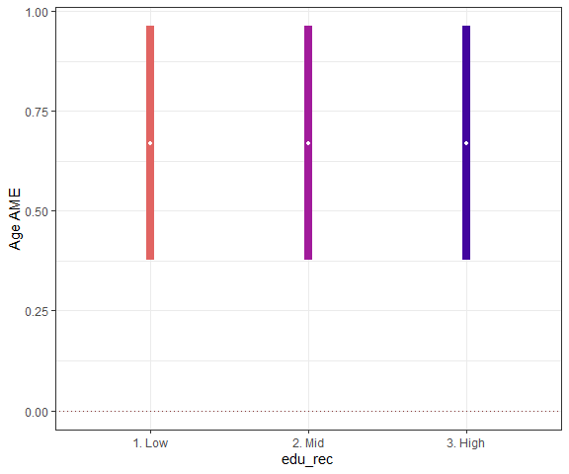
Average marginal effect
When talking about the expected/predicted values we said that in the LM the values of other covariates do not affect the slope of the line/curve
So… what should happen to the AME at different levels of other covariates?
It doesn’t change…

Slide 25
R programming

Slide 26
Checkpoint
This is also an hands-on session so...
Git & Github
(1) Sync your fork/orogin (2) pull your fork/origin
RStudio
Open the script ~/scripts/class5/class5_glm_ees.R

Slide 27
Assignments

Slide 28
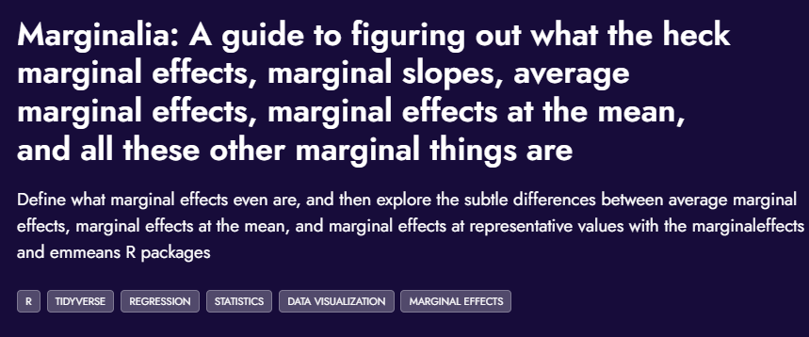
Assignment #1
Read
This post is an amazing source for understanding marginal effects
It will be SUPER useful for our next session, when we will deal with the logit regression
link

Slide 29
Assignment #2
Build your statistical model!
Calculate the quantities of interest
Check how they change if you change other covariates values
Your model
N.B.: This is not necessarily the one you’ll develop in you term paper… so no worries, but come up with something plausible
Confounder
Independent Variable
Dependent Variable

Slide 30
Thank you for your attention!

