Slide 1

Quantitative Research in Political Science How to Apply the Classical Toolbox
Giuseppe Carteny
Postdoctoral Researcher
Department of European Social Research
University of Saarland
UdS SoSe2025 - Class 6 (19.05.2025)

Slide 2
Today‘s seminar
Review of the assignments
GLMs: from LM to logit
Quantities of Interest: logit
R programming
Assignment

Slide 3
Review of the assignments

Slide 4
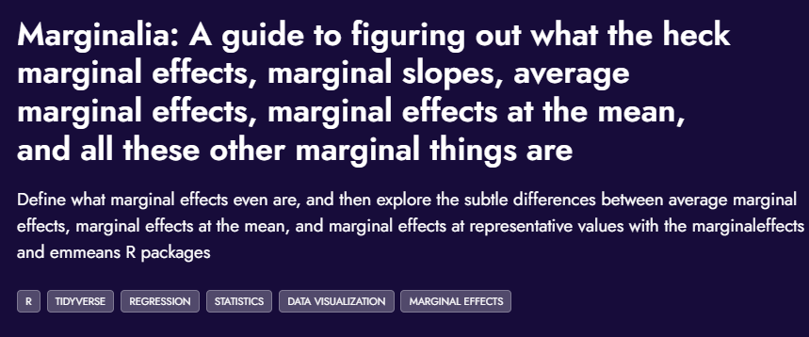
Assignment #1
Read
What’s the post talking about?
Why
link

Slide 5
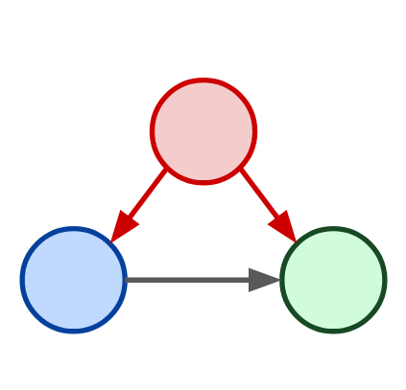
Assignment #2
Build your statistical model!
Calculate the quantities of interest
Check how they change if you change other covariates values
Your model
N.B.: This is not necessarily the one you’ll develop in you term paper… so no worries, but come up with something plausible
Confounder
Independent Variable
Dependent Variable

Slide 6
GLMs from LM to logit

Slide 7
GLMs
Are a unified methodology for producing parameter estimates (Gill 2001, Gill and Torres 2019).
All generalized linear models have three characteristic parts:
Family which stipulates a random process that can plausibly generate an outcome (𝑦)
Linear component, namely a linear model, from which we derive a systematic component
Inverse link function, namely a function linking systematic component and the random process that generates the outcome (𝑦)

Slide 8



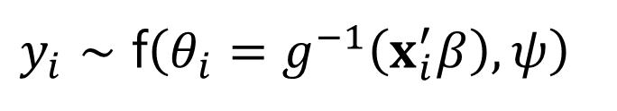

GLMs
Are a unified methodology for producing parameter estimates (Gill 2001, Gill and Torres 2019).
All generalized linear models have three characteristic parts:
Family which stipulates a random process that can plausibly generate an outcome (𝑦)
Linear component, namely a linear model, from which we derive a systematic component
Inverse link function, namely a function linking systematic component and the random process that generates the outcome (𝑦)
$$y_{i}∼\text{f}\left(θ_{i}=g^{−1}\left(x_{i}^{′}β\right),ψ\right)$$
$$y_{i}∼\text{f}\left(θ_{i},ψ\right)$$
$$y_{i}^{∗}=x_{i}^{′}β+ε_{i}$$
$$θ_{i}=g^{−1}\left(η_{i}\right)$$
$$η_{i}=x_{i}^{′}β$$

Slide 9





GLMs
Are a unified methodology for producing parameter estimates (Gill 2001, Gill and Torres 2019).
All generalized linear models have three characteristic parts:
Family which stipulates a random process that can plausibly generate an outcome (𝑦)
Linear component, namely a linear model, from which we derive a systematic component
Inverse link function, namely a function linking systematic component and the random process that generates the outcome (𝑦)
$$y_{i}∼\text{f}\left(θ_{i}=g^{−1}\left(x_{i}^{′}β\right),ψ\right)$$
$$y_{i}∼\text{f}\left(θ_{i},ψ\right)$$
$$y_{i}^{∗}=x_{i}^{′}β+ε_{i}$$
$$θ_{i}=g^{−1}\left(η_{i}\right)$$
$$η_{i}=x_{i}^{′}β$$
The linear model
$$y_{i}∼\text{N}\left(x_{i}^{′}β,σ^{2}\right)$$
$$y_{i}∼\text{N}\left(θ_{i},σ^{2}\right)$$
$$y_{i}^{∗}=x_{i}^{′}β+ε_{i}$$
$θ_{i}=$ $η_{i}=\text{id}\left(η_{i}\right)$
$$ε_{i} \text{\sim }\text{N}\left(0,σ^{2}\right)$$

Slide 10
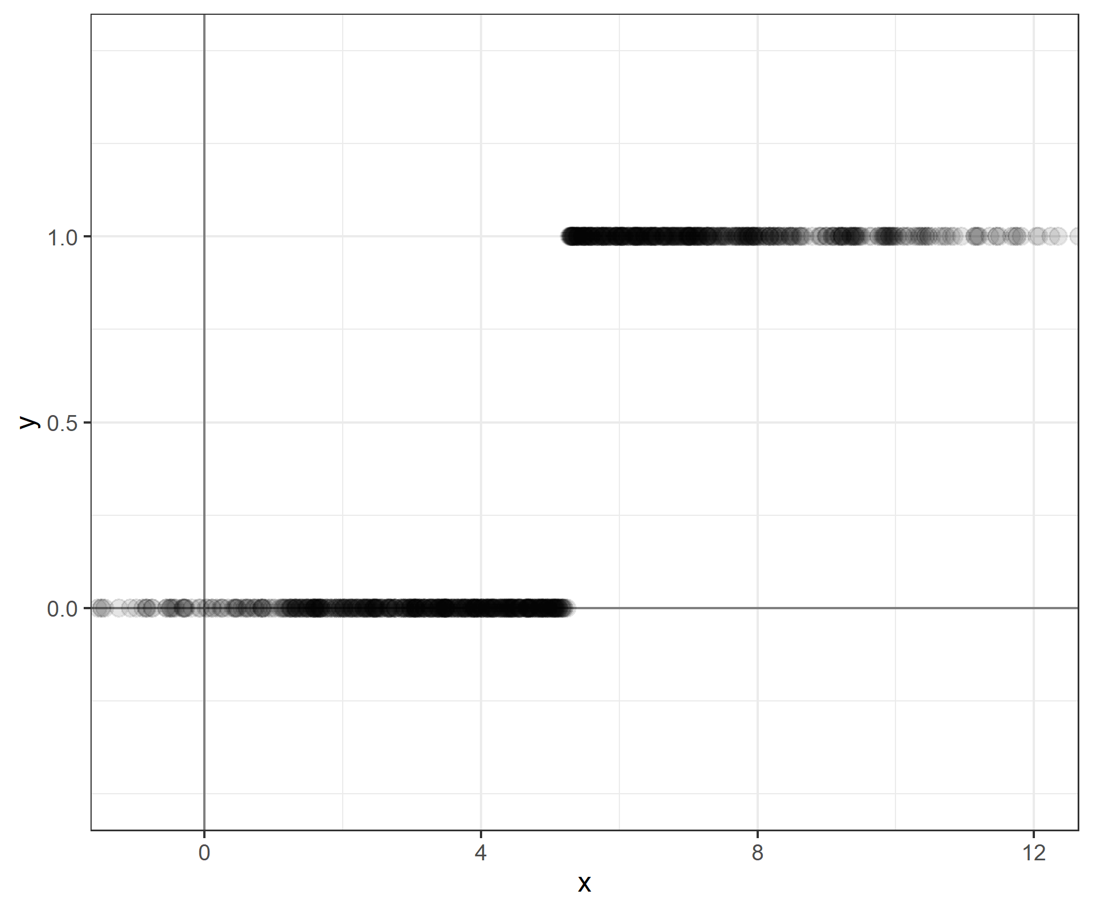
GLMs: from LM to logit
What happens when we try to use the linear model for binary outcomes?
Let’s say that you have a dependent variable that takes only 0 or 1 values, and a continuous variable that takes values between -1 and 13 approximately
You are trying to model Pr(y=1|x)

Slide 11
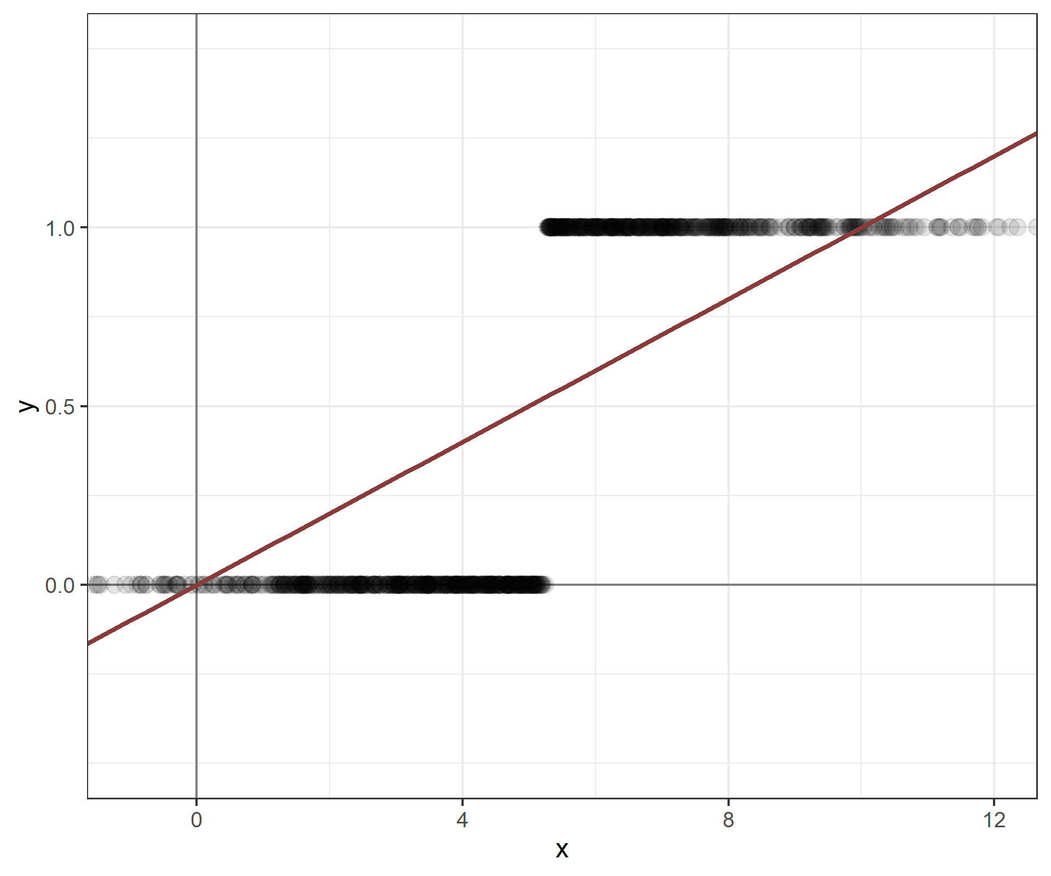
GLMs: from LM to logit
What happens when we try to use the linear model for binary outcomes?
Let’s say that you have a dependent variable that takes only 0 or 1 values, and a continuous variable that takes values between -1 and 13 approximately
You are trying to model Pr(y=1|x)
You apply the linear model, and what you estimating is the so-called linear probability model

Slide 12
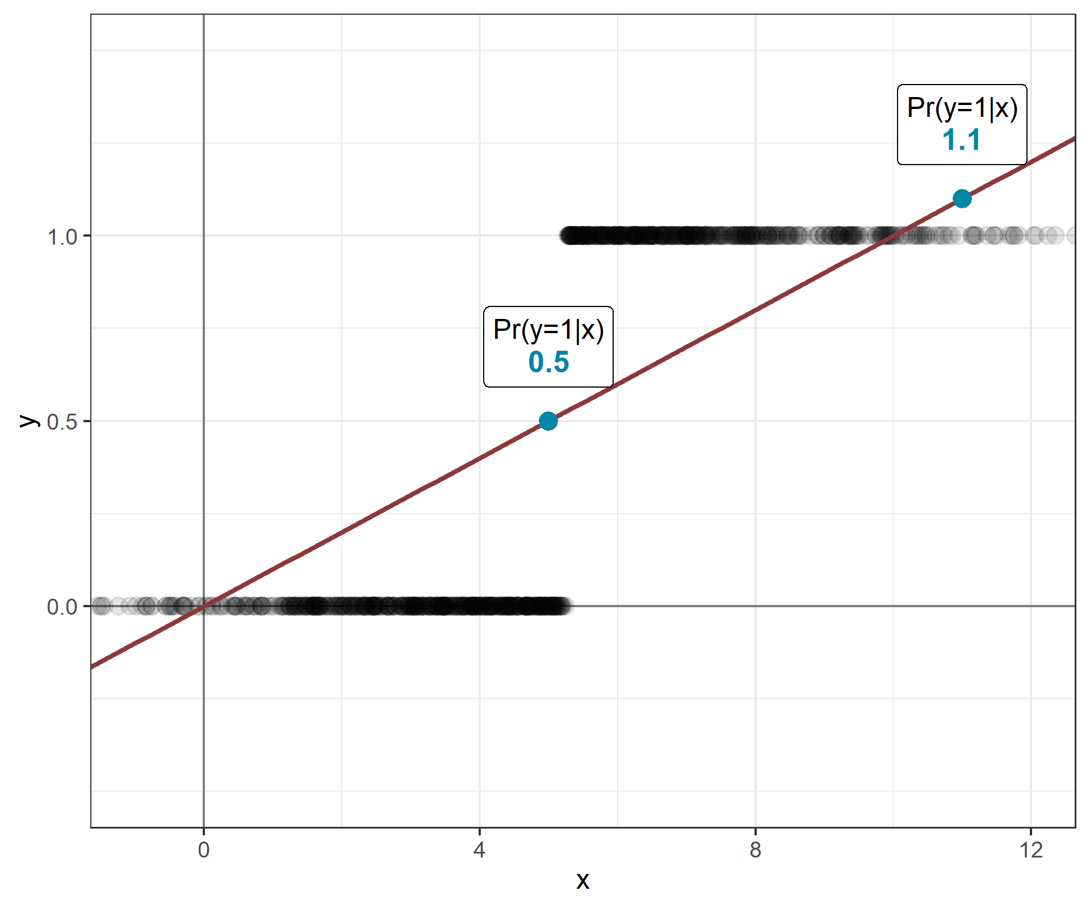
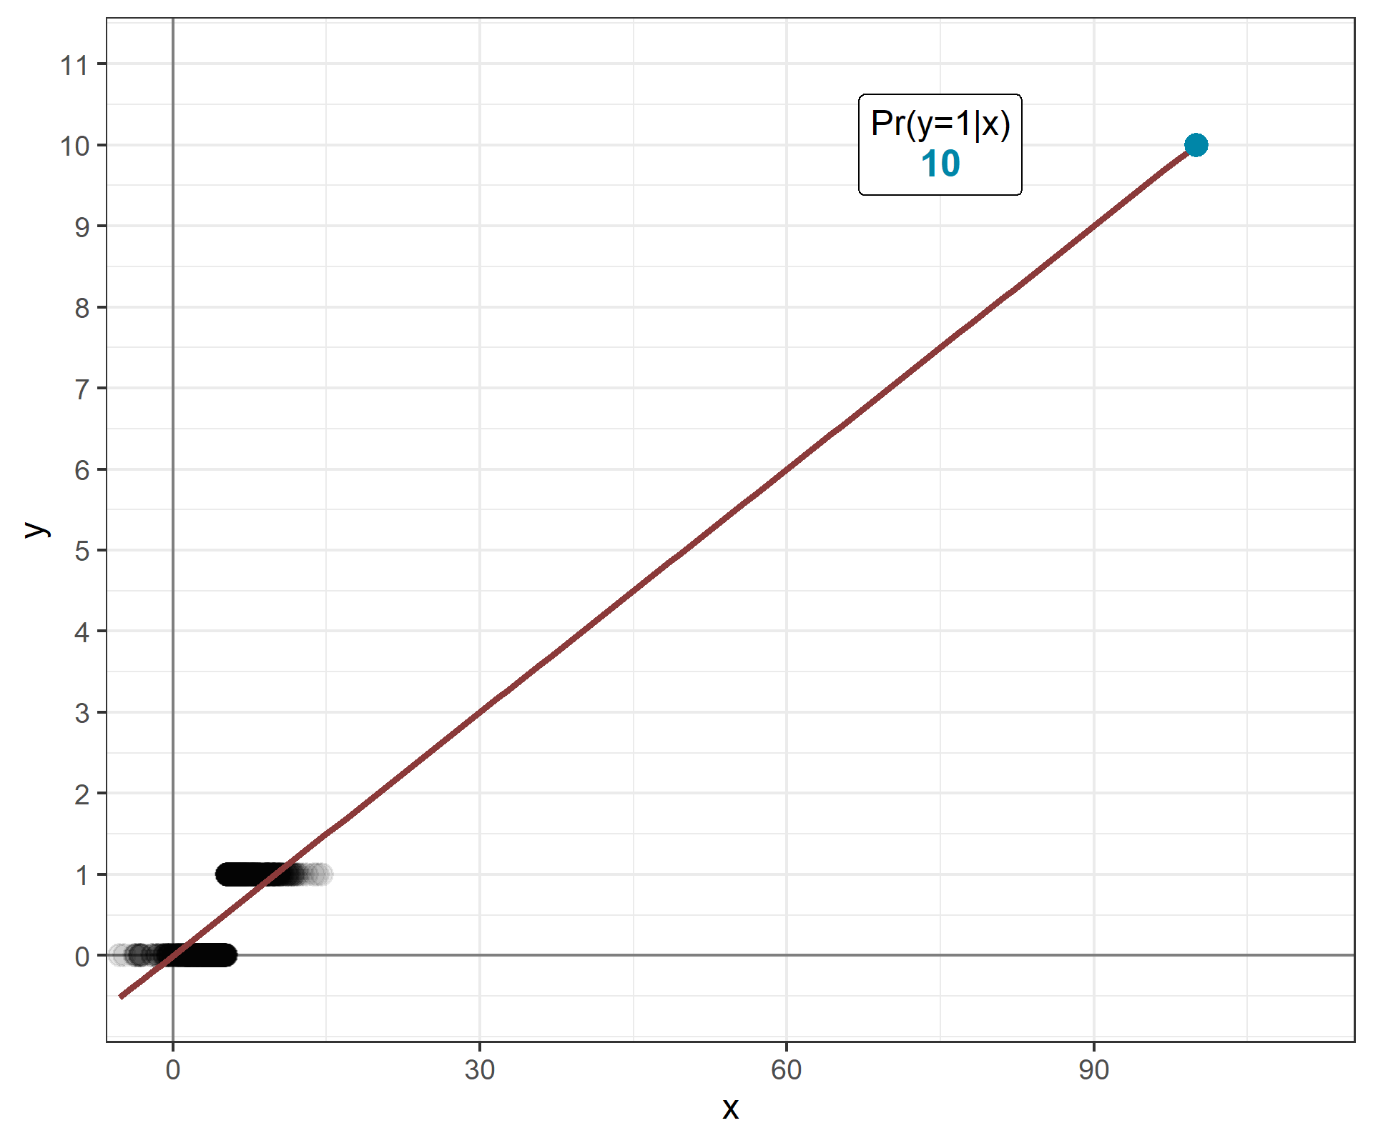

GLMs: from LM to logit
The linear probability model is a good model, retains some of the characteristics of the LM:
The estimates can be interpreted straightforwardly
You don’t have issues in estimating the QoIs – predicted values, AMEs,…
But it also has important issues:
It violates some of the LM assumptions (heteroscedasticity, normality,…)
But also creates nonsensical expected values!

Slide 13
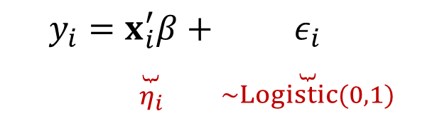






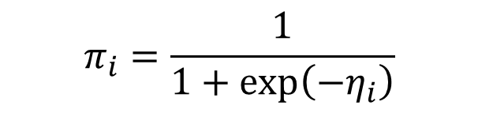

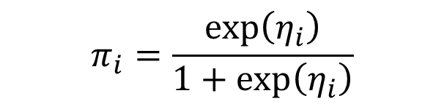
GLMs: from LM to logit
Therefore, there are a number of models for these kind of dependent variables
The most used one is the logistic regression based on the logistic function
$y_{i}$= $Pr\left(y=1∣x\right)$
$$y_{i}∼\text{Bernoulli}\left(π_{i}\right)$$
$$y_{i}∼\text{f}\left(θ_{i},ψ\right)$$
$$y_{i}=\underset{η_{i}}{\underset{⏟}{x_{i}^{′}β}}+\underset{∼Logistic(0,1)}{\underset{⏟}{ε_{i}}}$$
$$y_{i}^{∗}=x_{i}^{′}β+ε_{i}$$
$$π_{i}=\frac{exp\left(η_{i}\right)}{1+exp\left(η_{i}\right)}$$
$$η_{i}=x_{i}^{′}β$$
same
$$π_{i}=\frac{1}{1+exp\left(−η_{i}\right)}$$
$$θ_{i}=g^{−1}\left(η_{i}\right)$$
$$exp\left(⋅\right)=e^{\left(⋅\right)}$$

Slide 14

GLMs: from LM to logit
Therefore, there are a number of models for these kind of dependent variables
The most used one is the logistic regression based on the logistic function
Inverting the logistic function we get the logit transformation, that maps probabilities (0,1) to the real line (−∞, ∞).
$y_{i}$= $Pr\left(y=1∣x\right)$
$$y_{i}∼\text{Bernoulli}\left(π_{i}\right)$$
$$y_{i}∼\text{f}\left(θ_{i},ψ\right)$$
$$y_{i}=\underset{η_{i}}{\underset{⏟}{x_{i}^{′}β}}+\underset{∼Logistic(0,1)}{\underset{⏟}{ε_{i}}}$$
$$y_{i}^{∗}=x_{i}^{′}β+ε_{i}$$
$$π_{i}=\frac{exp\left(η_{i}\right)}{1+exp\left(η_{i}\right)}$$
$$η_{i}=x_{i}^{′}β$$
$$ln\left(\frac{π_{i}}{1−π_{i}}\right)=η_{i}$$
$$θ_{i}=g^{−1}\left(η_{i}\right)$$

Slide 15

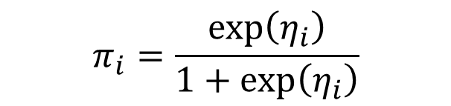
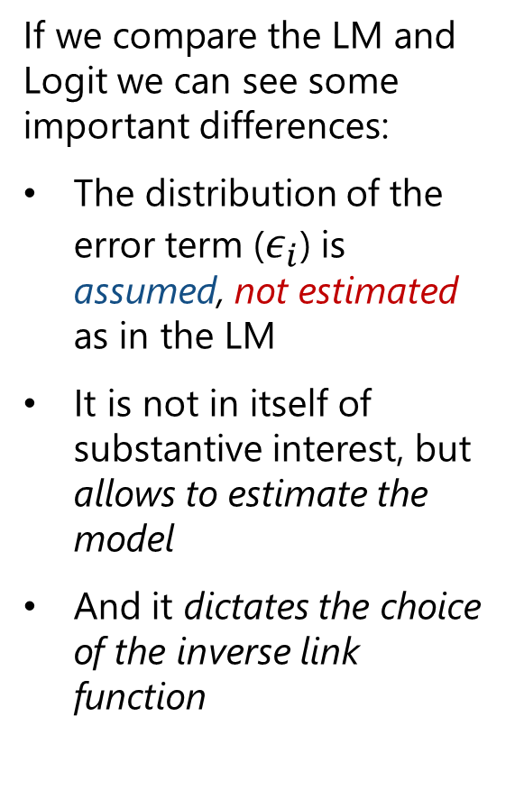





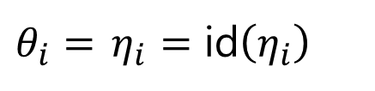

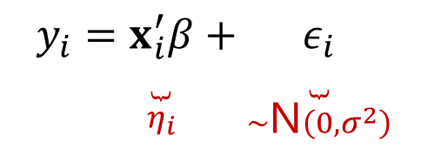
GLMs: from LM to logit
If we compare the LM and Logit we can see some important differences:
The distribution of the error term ($ε_{i}$) is assumed, not estimated as in the LM
It is not in itself of substantive interest, but allows to estimate the model
And it dictates the choice of the inverse link function
logit
LM
$$y_{i}∼\text{Bernoulli}\left(π_{i}\right)$$
$$y_{i}∼\text{N}\left(η_{i},σ^{2}\right)$$
$$y_{i}∼\text{f}\left(θ_{i},ψ\right)$$
$$y_{i}=\underset{η_{i}}{\underset{⏟}{x_{i}^{′}β}}+\underset{∼Logistic(0,1)}{\underset{⏟}{ε_{i}}}$$
$$y_{i}=\underset{η_{i}}{\underset{⏟}{x_{i}^{′}β}}+\underset{∼\text{N}\left(0,σ^{2}\right)}{\underset{⏟}{ε_{i}}}$$
$$y_{i}^{∗}=x_{i}^{′}β+ε_{i}$$
$$π_{i}=\frac{exp\left(η_{i}\right)}{1+exp\left(η_{i}\right)}$$
$$η_{i}=x_{i}^{′}β$$
$θ_{i}=$ $η_{i}=\text{id}\left(η_{i}\right)$
$$θ_{i}=g^{−1}\left(η_{i}\right)$$

Slide 16
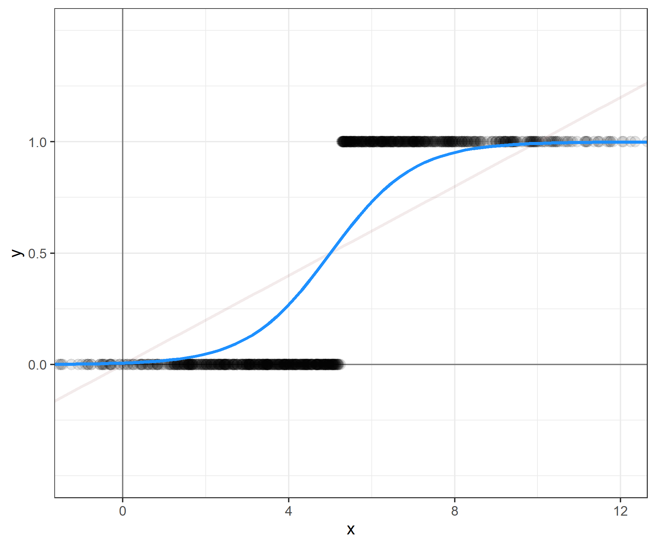
GLMs: from LM to logit
Returning to our previous example:

Slide 17
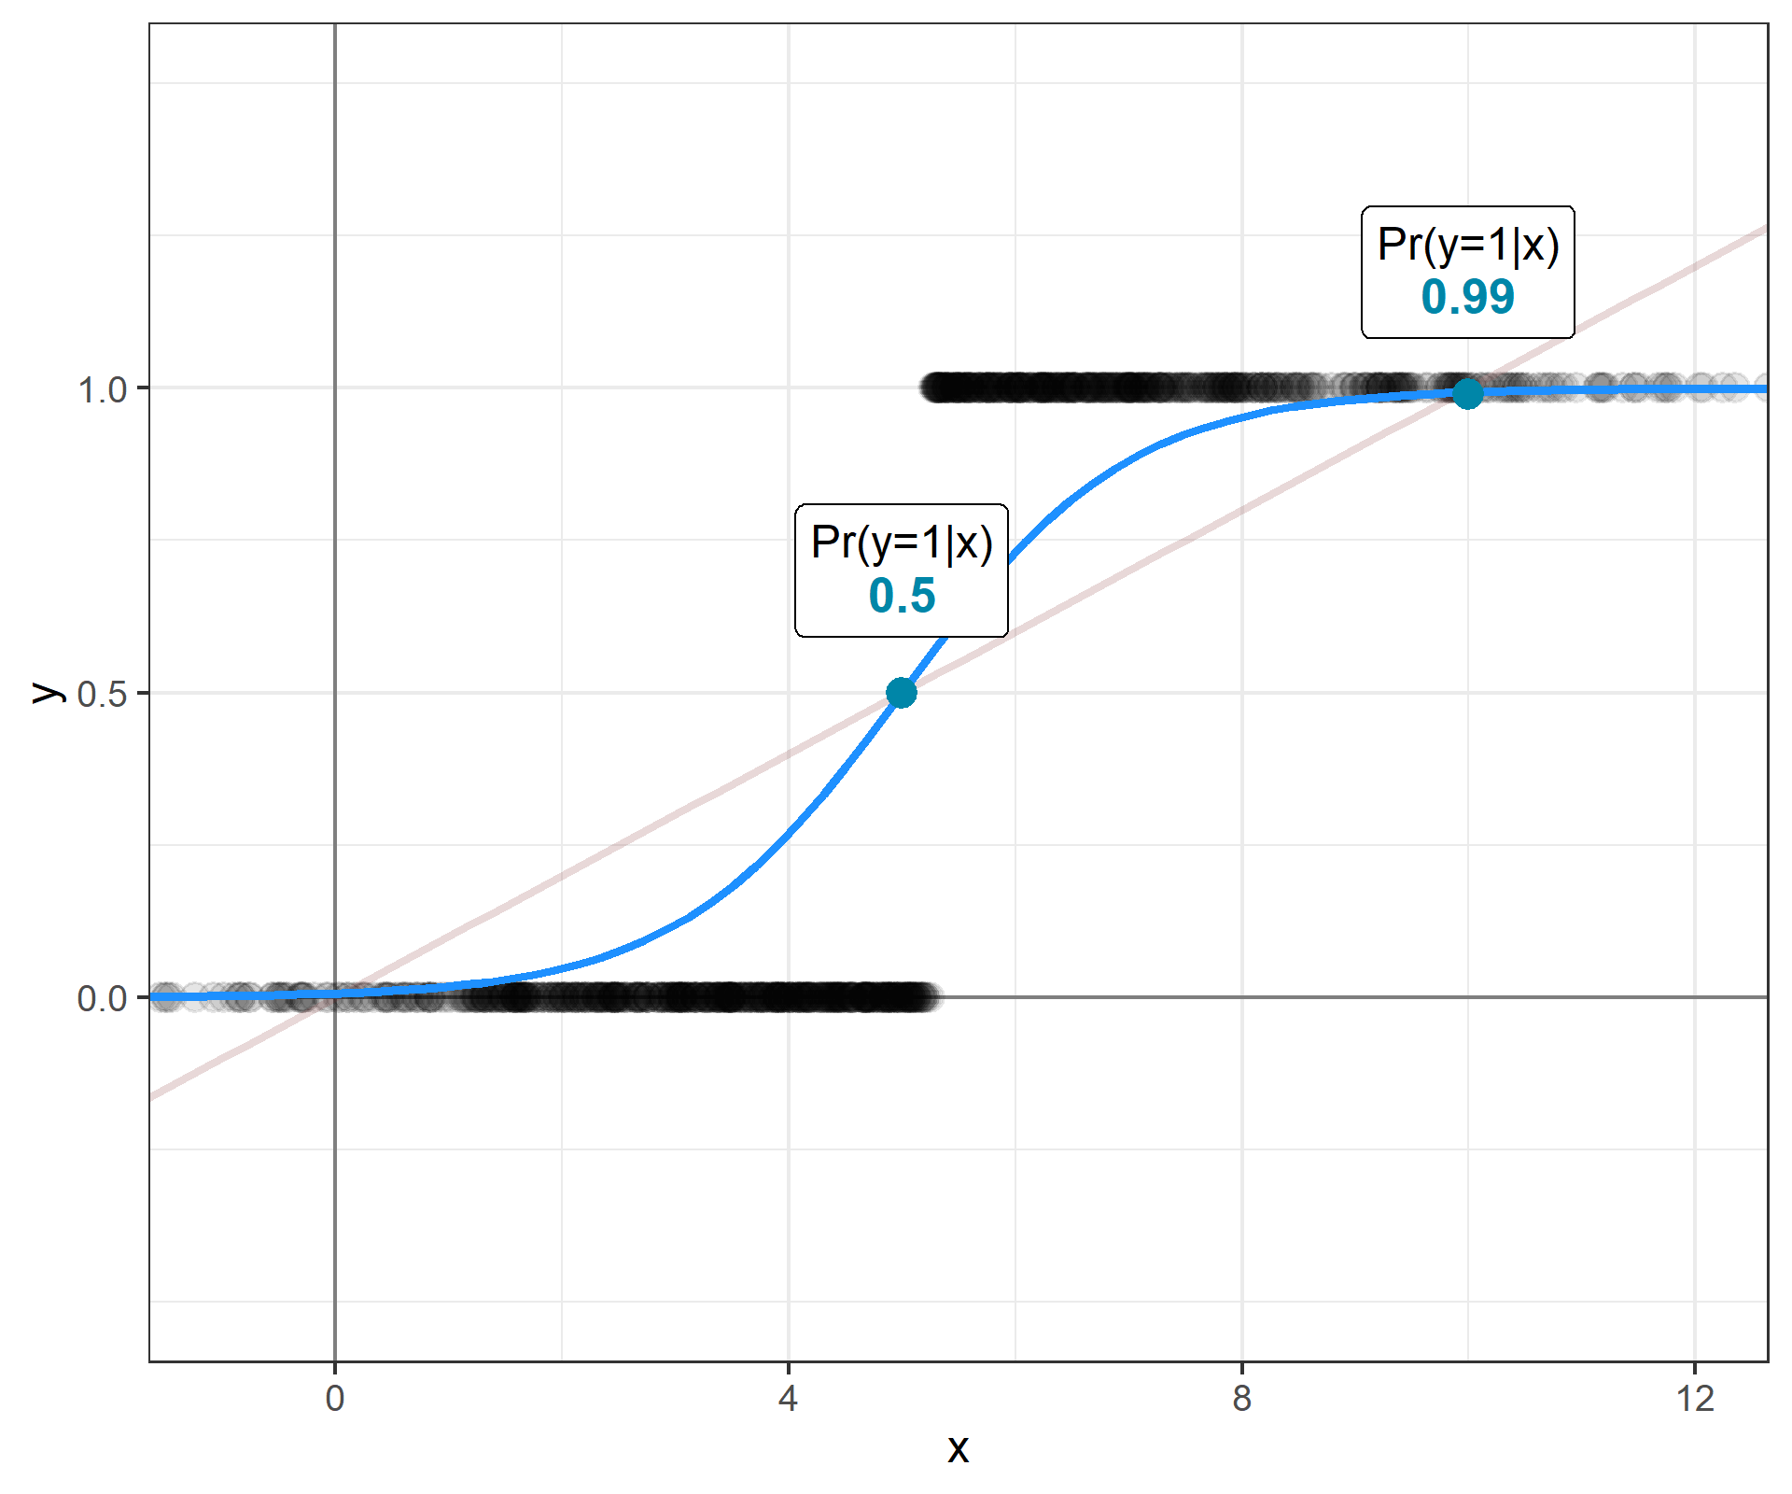
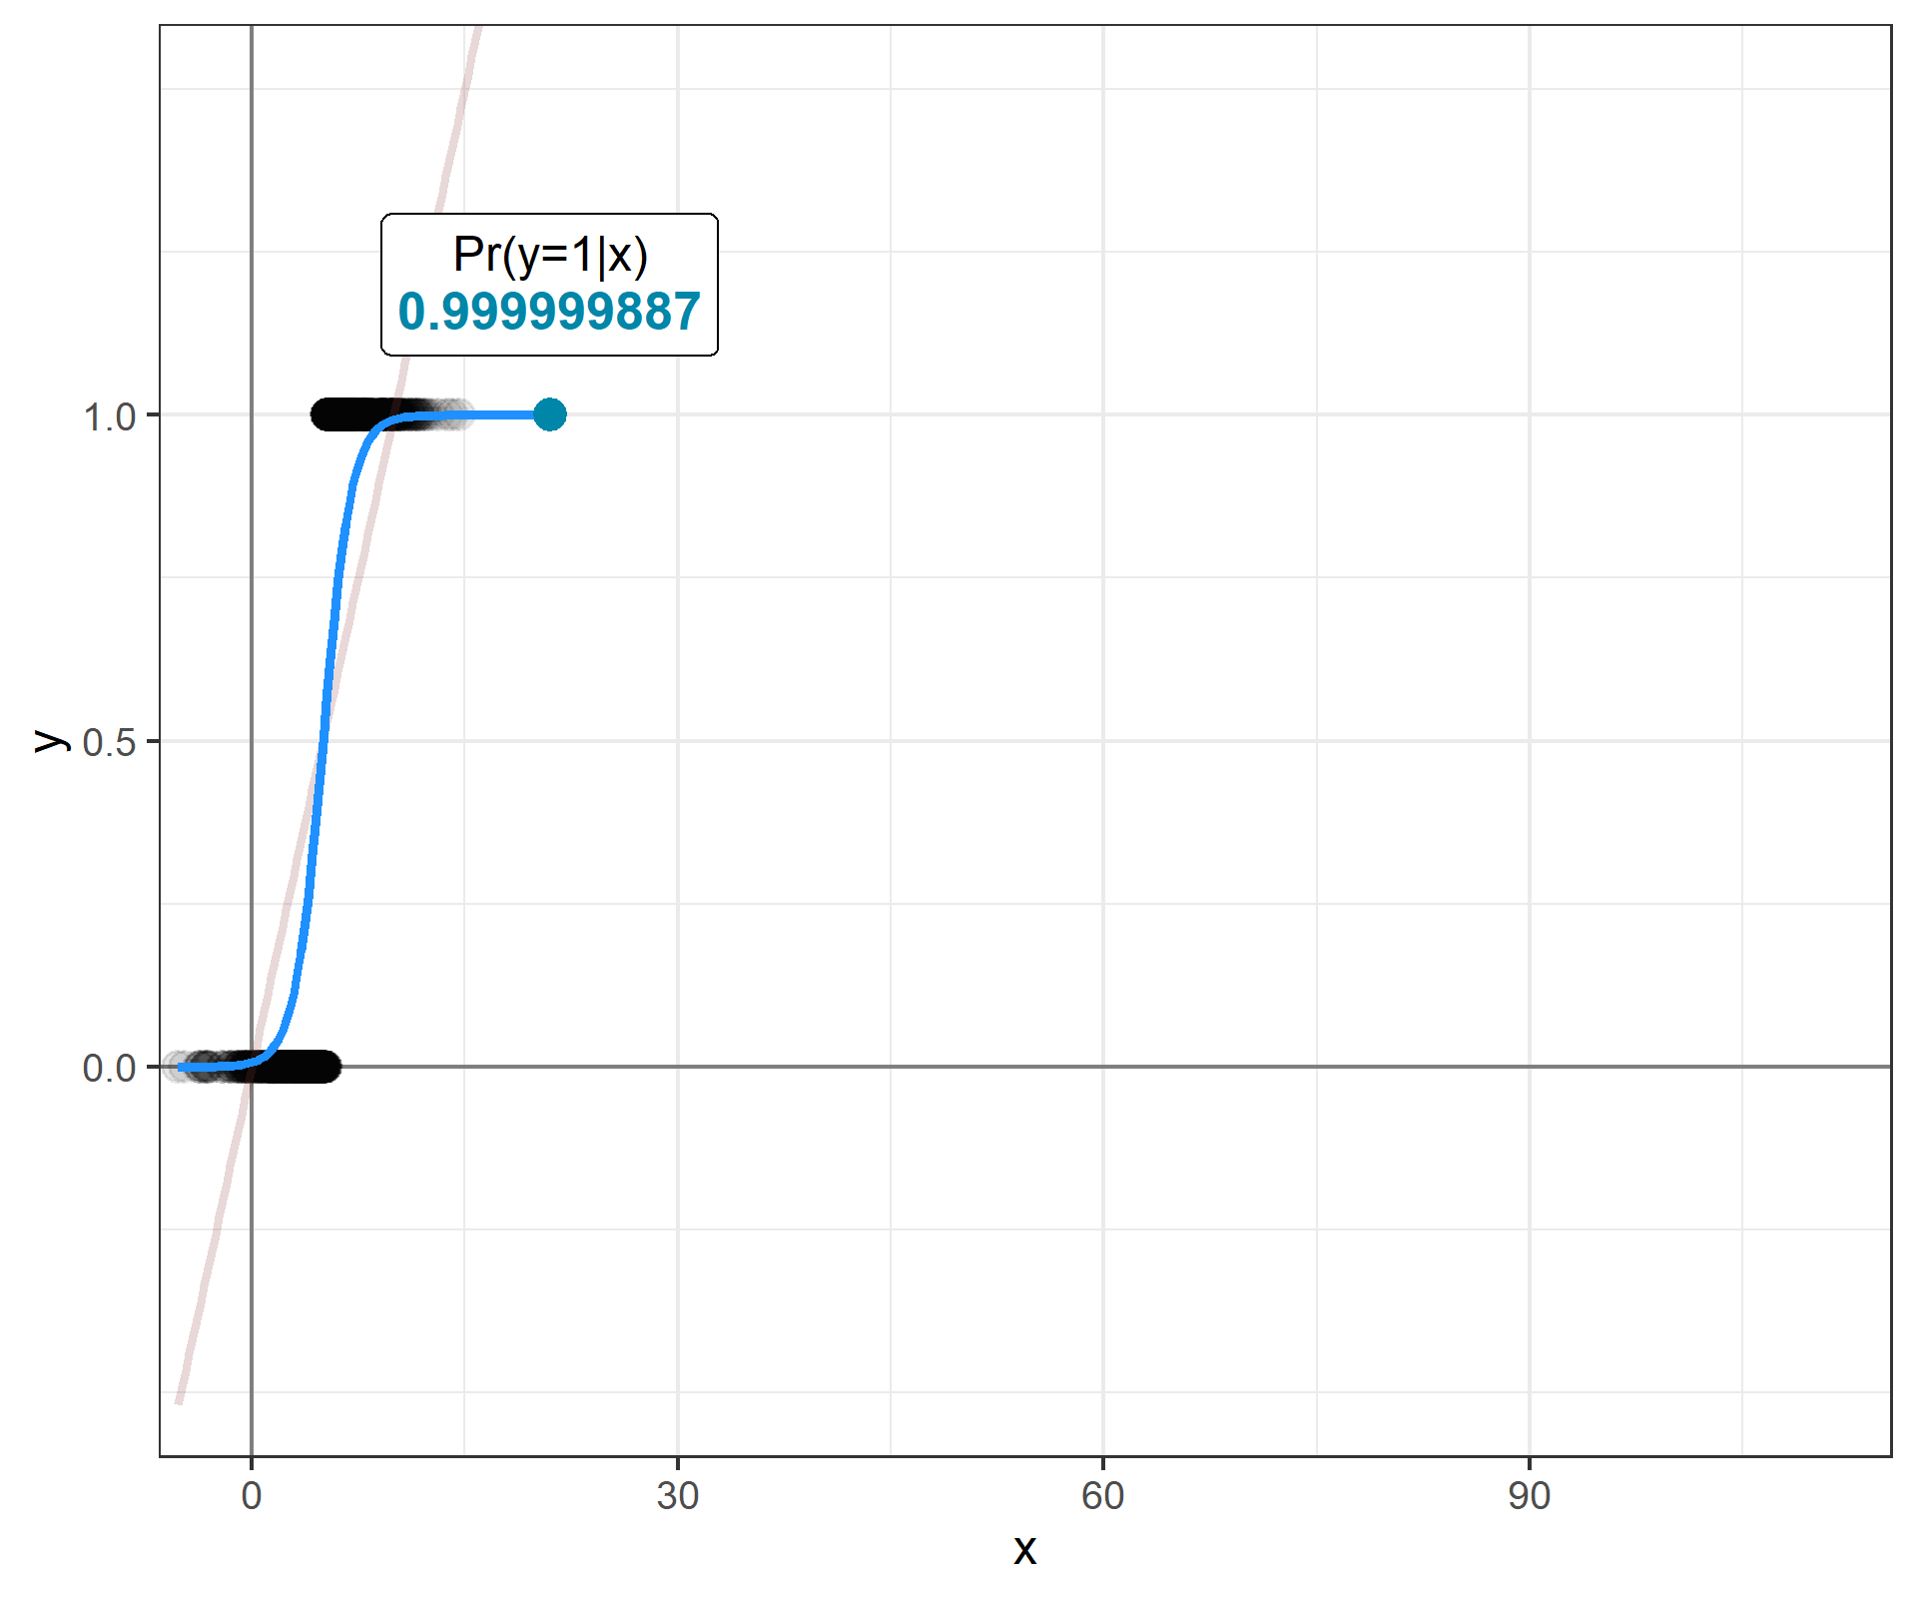
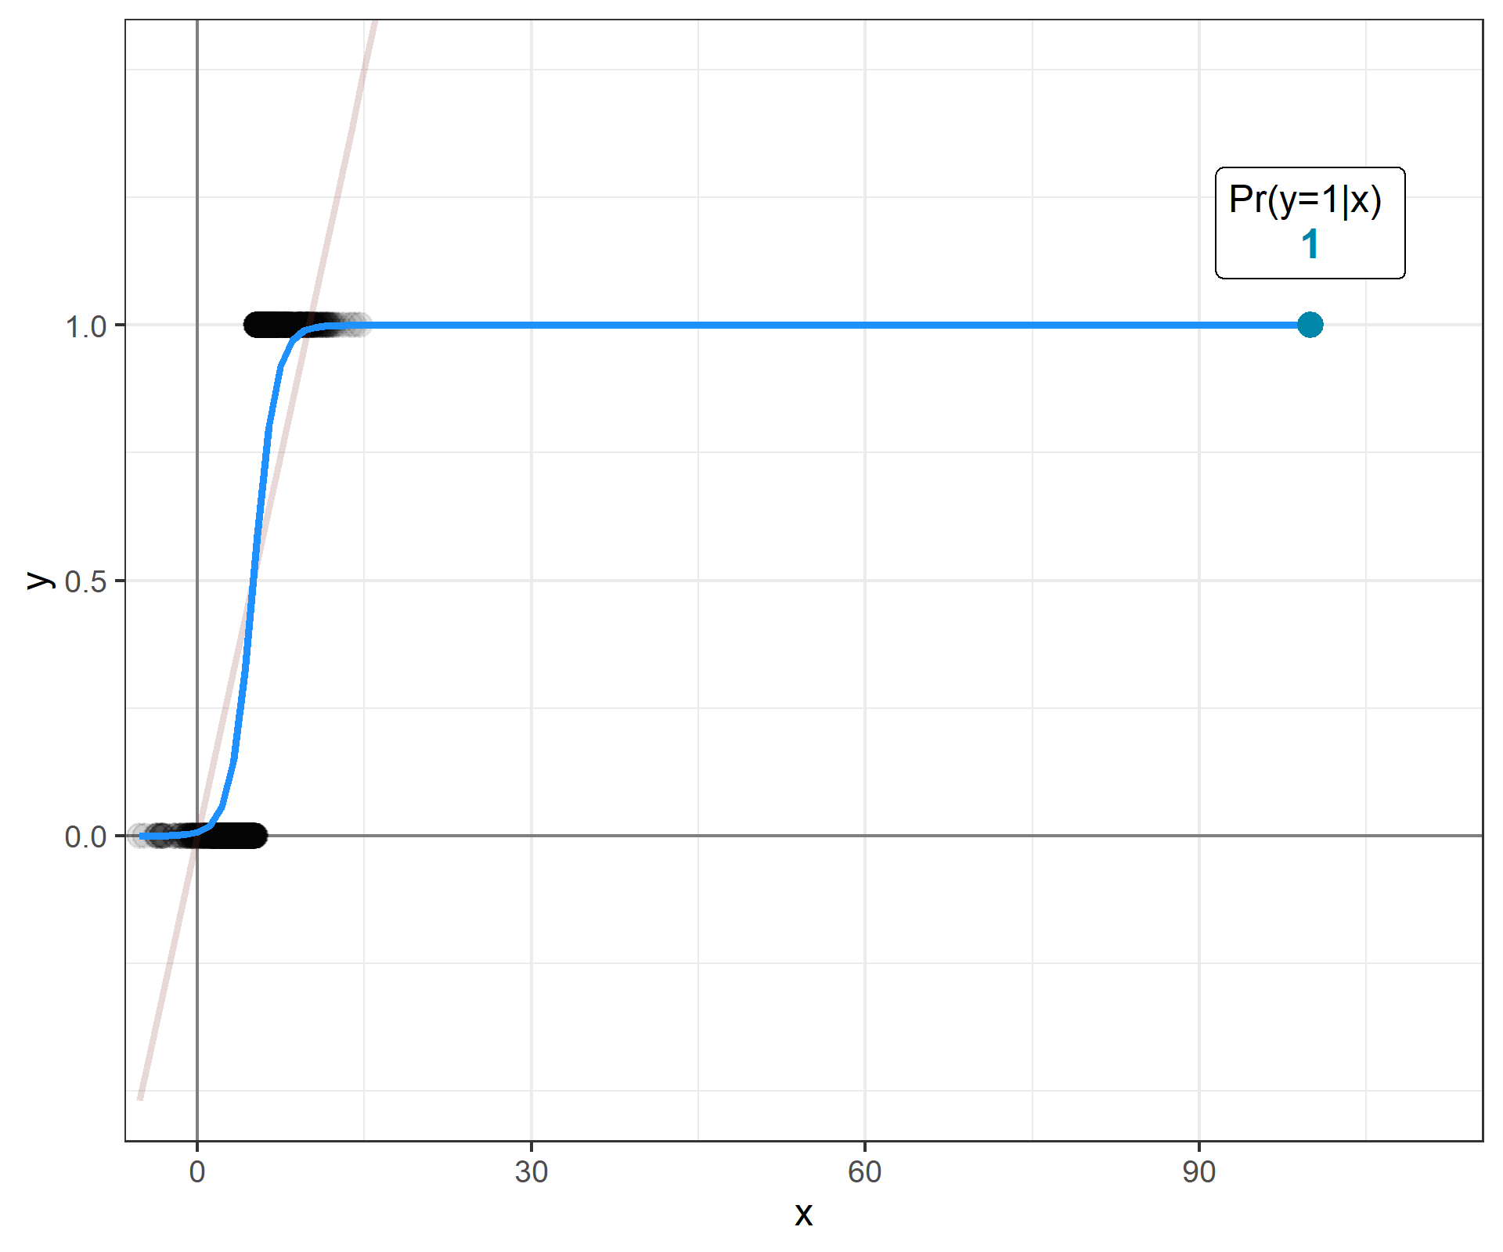
GLMs: from LM to logit
Returning to our previous example:
The logit model keeps the estimates of Pr(y=1|x) between [0,1]

Slide 18
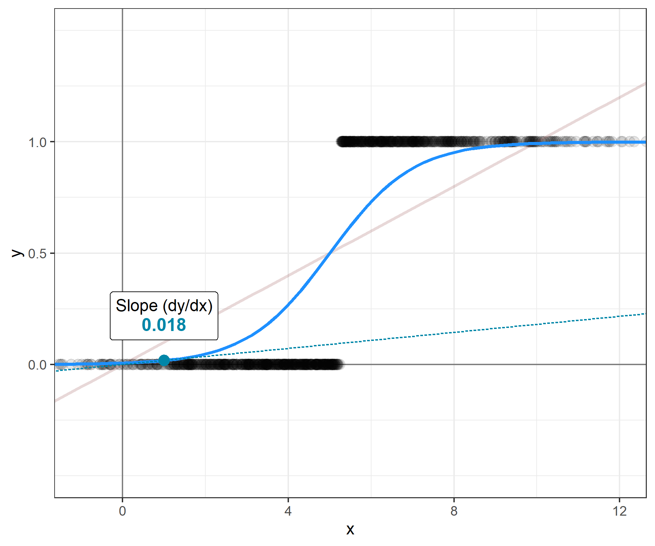
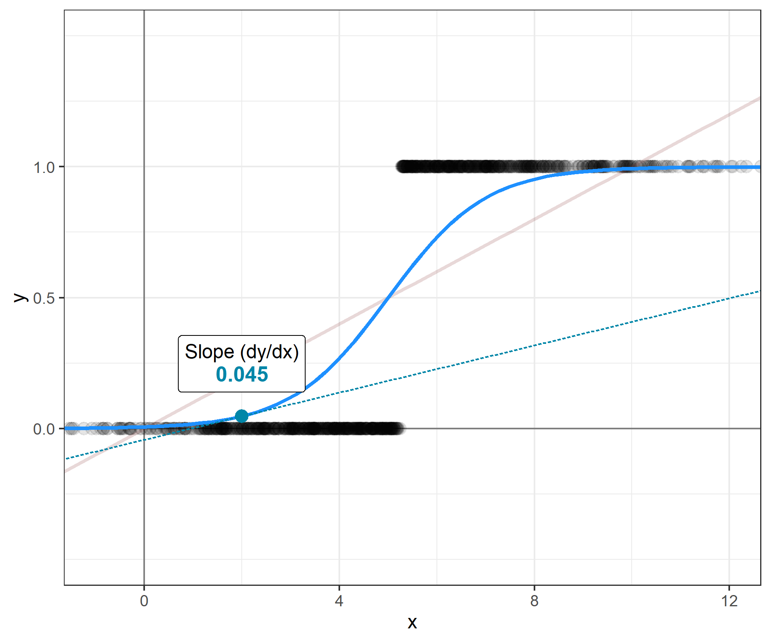
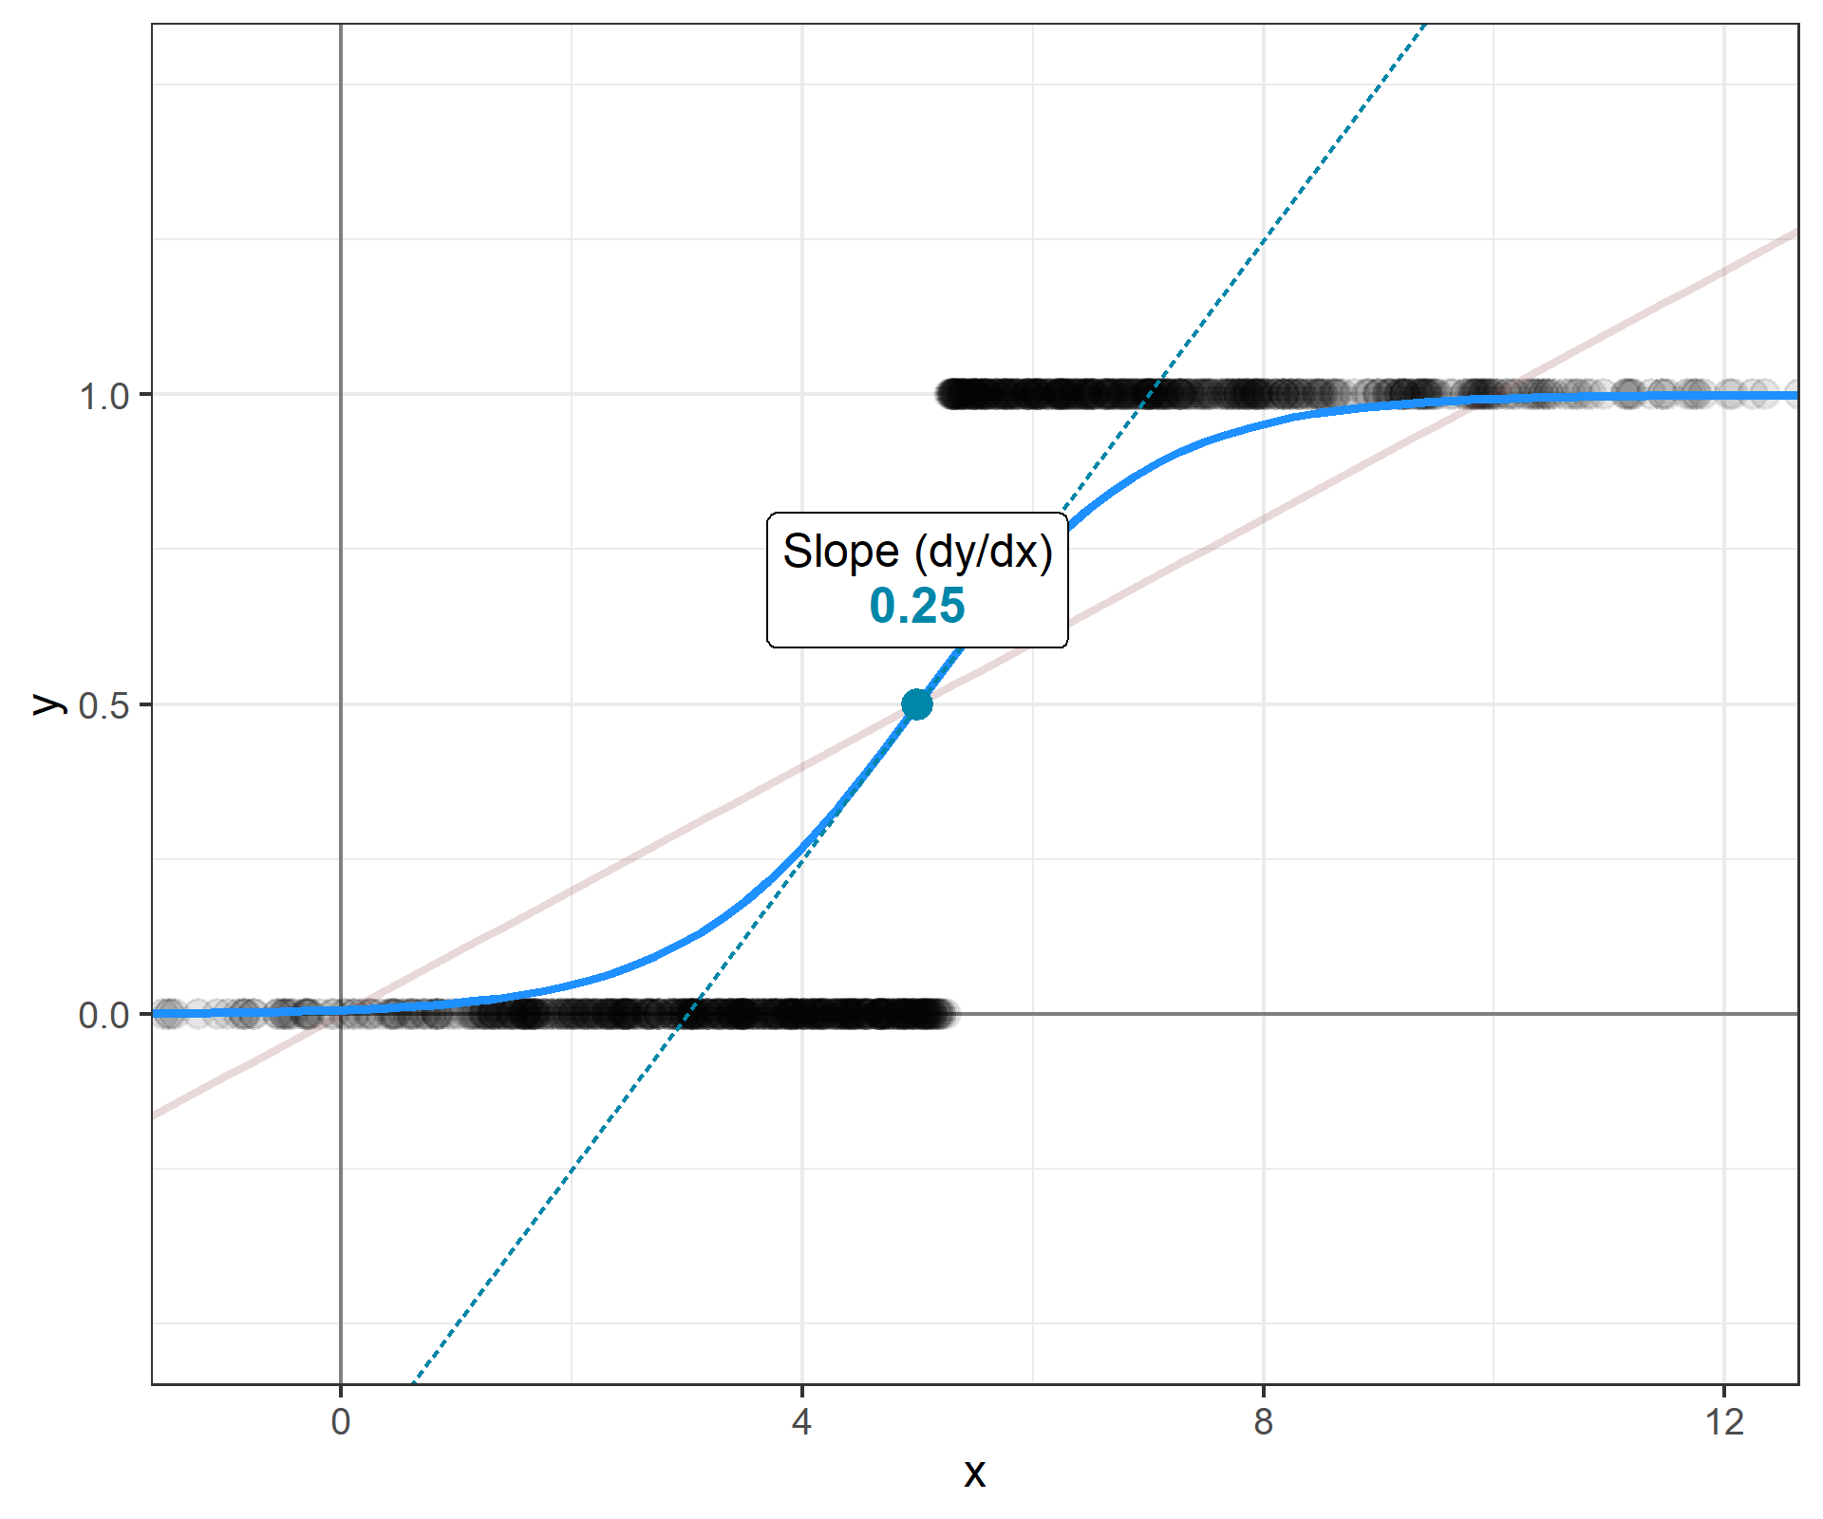
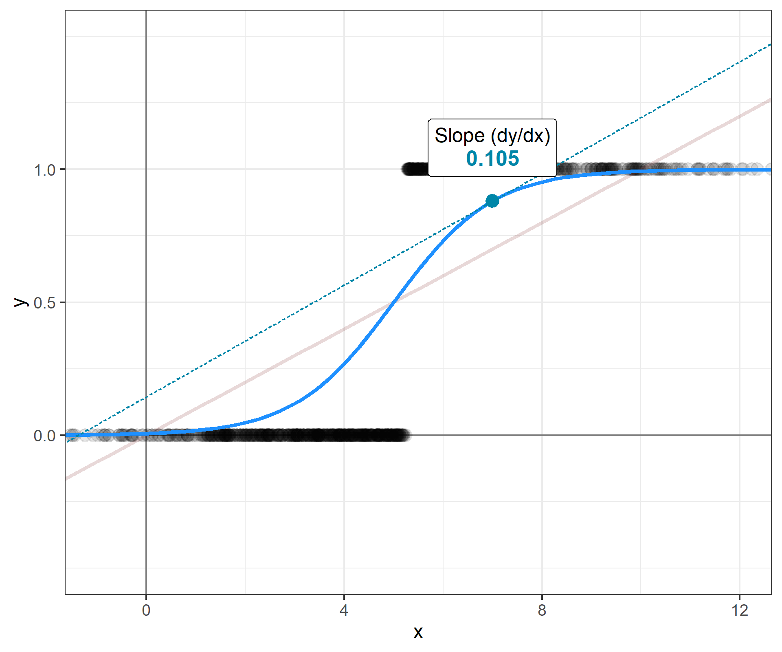
GLMs: from LM to logit
Returning to our previous example:
The logit model keeps the estimates of Pr(y=1|x) between [0,1]
But this has a “price to pay”…
Non-linearity of (many) estimates

Slide 19
Quantities of Interest

Slide 20
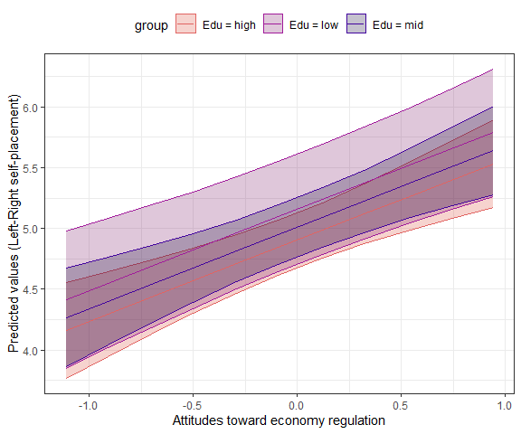
Expected/Predicted values
We saw that with the LM when you estimate the predicted values, the slopes of the curves are not affected by the values that other variables take

Slide 21
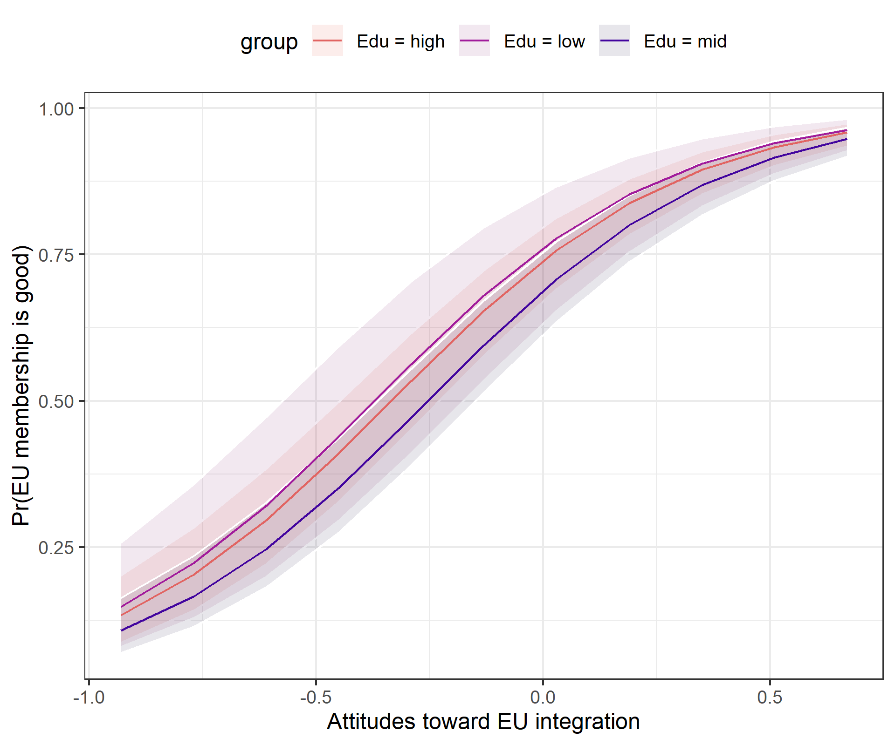
Expected/Predicted values
We saw that with the LM when you estimate the predicted values, the slopes of the curves are not affected by the values that other variables take – what is affected is only the intercept
Unfortunately, when we deal with logit regression this is not the case. The slopes are affected by the values of other variables

Slide 22
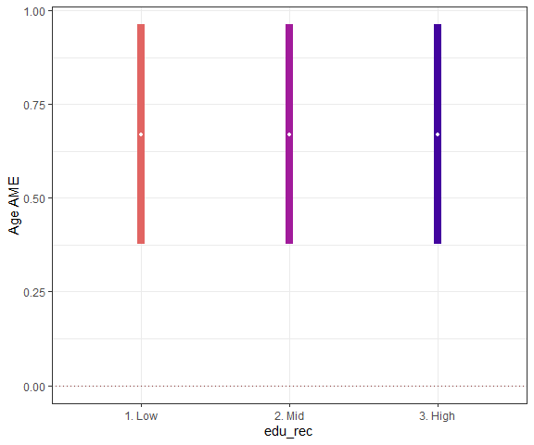
Average marginal effect
This is much clearer when considering the AMEs of the variable – that are, more or less, the estimates of the curve slope
Do you remember those for the LM?

Slide 23
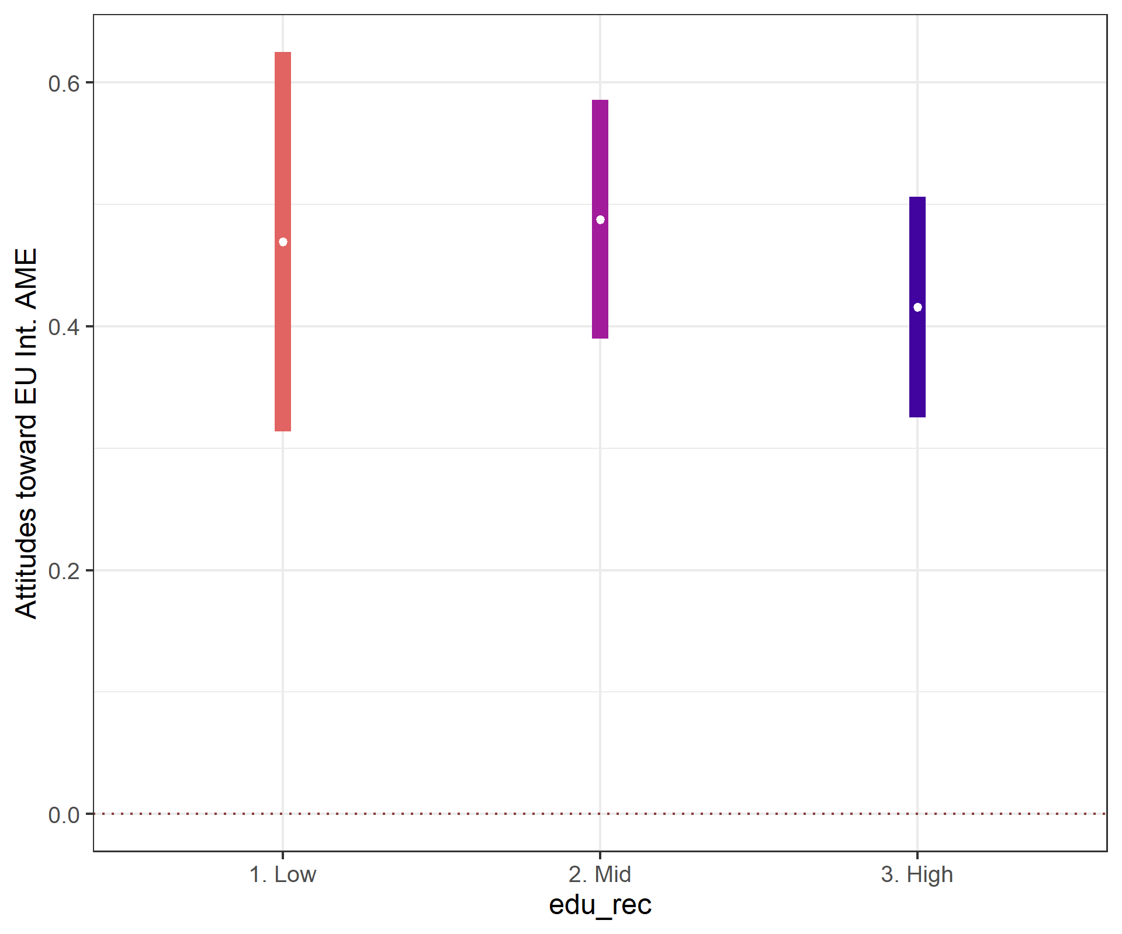
Average marginal effect
This is much clearer when considering the AMEs of the variable – that are, more or less, the estimates of the curve slope
Do you remember those for the LM?
Forget them ☺
In this case the estimates are not so different – the differences are not statistically significant at 95% c.i. – but in other cases they might be!

Slide 24
Average marginal effect
This is much clearer when considering the AMEs of the variable – that are, more or less, the estimates of the curve slope
Do you remember those for the LM?
Forget them ☺
In this case the estimates are not so different – the differences are not statistically significant at 95% c.i. – but in other cases they might be!
Solutions?
Not really…

Slide 25
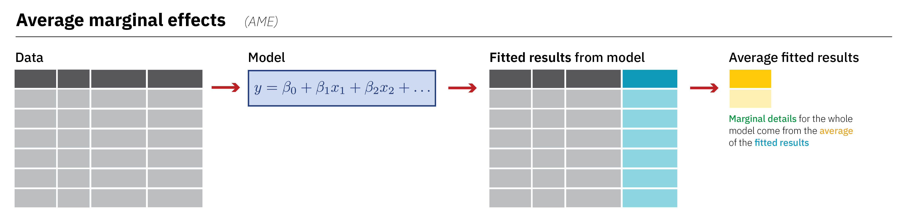
Average marginal effect
as seen in this post, the marginaleffects offers a consistent solution
Nonetheless, your AME (but also your coefficient values and statistical significance) will be still inevitably affected by the values of the other variables!
What we will deal with, mostly, are the so-called…
https://www.andrewheiss.com/blog/2022/05/20/marginalia/images/flow-ame@3x.png

Slide 26
R programming

Slide 27
Checkpoint
This is also an hands-on session so...
Git & Github
(1) Sync your fork/orogin (2) pull your fork/origin
RStudio
Open the script ~/scripts/class6/class6_glm_ees.R

Slide 28
Assignments

Slide 29
Assignment #1
Now it’s time to get some substantive conclusions from your quantities of interest!
Your model
N.B.: This is not necessarily the one you’ll develop in you term paper… so no worries, but come up with something plausible
Confounder
Independent Variable
Dependent Variable

Slide 30
Assignment #2
This time use a logit regression
You need to select a DV
It can be either a dichotomous variable or a categorical variable that you then transform in a dichotomous variable
Another model!
N.B.: This is not necessarily the one you’ll develop in you term paper… so no worries, but come up with something plausible
Confounder
Independent Variable
Dependent Variable

Slide 31
Thank you for your attention!

