Slide 1

Quantitative Research in Political Science How to Apply the Classical Toolbox
Giuseppe Carteny
Postdoctoral Researcher
Department of European Social Research
University of Saarland
UdS SoSe2025 - Class 3 (28.04.2025)

Slide 2
Today‘s seminar
Review of the assignments
Univariate statistics (categorical)
Hypothesis testing
R programming
Assignment

Slide 3
Assignment #1
IMPORTANT
We must remove one of the courses from the LSF platform
‘How to Analyse Digital Content for Political Science Research’ by Alexander (Veranstaltungsnummer 1566865)
Please de-register from that course on the LSF course as soon as possible
This course (Veranstaltungsnummer 156687) will then be changed

Slide 4
Review of the assignments

Slide 5
Assignment #1
Did you read?
Resources
Agresti & Finlay (2009) - Chapters 1, 2, 3

Slide 6
Assignment #2
Did you clone the repository?
Did it work? Issues?
Repo
https://github.com/giucarny/qrps_sose25/
Did you check the additional resources I suggested?
What’s the difference between forking and cloning…
Action | Where It Happens | Purpose | Typical Use Case
Fork | On GitHub | Create your own copy of a repository | Contributing to someone else's project
Clone | On your computer | Work on a repository locally | Developing with local tools and environment

Slide 7
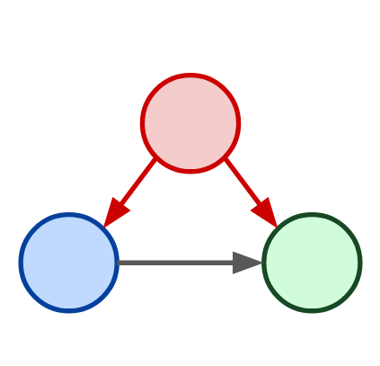
Assignment #3
How is it going with your model?
Did you select your variable from the questionnaire?
Soon you need to work with it….
Confounder
Independent Variable
Dependent Variable

Slide 8
Univariate statistics
(Categorical)

Slide 9
Different statistics
Central distribution statistics
Mean
Median
Mode
Correlation statistics
Covariance
Correlation
ChiSq
Dispersion statistics
Variance/Standard deviation
Standard error
Percentiles/Quantiles
Interquartile range
Notes:
Separation of concern so that different individual can take care of different parts of a project without worrying about other parts of the project.

Slide 10
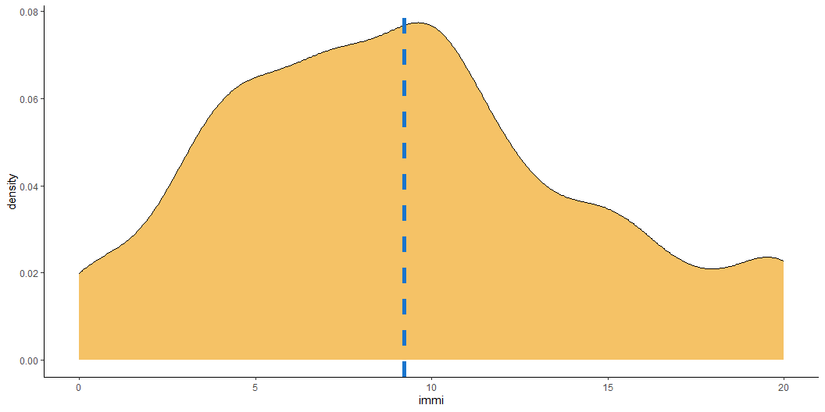
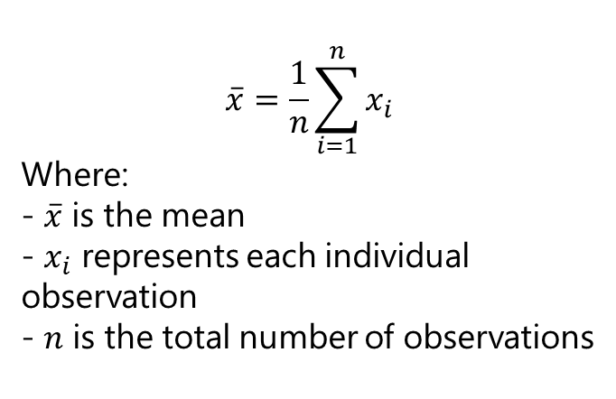
Central distribution Mean
Calculated by summing all values and dividing by the number of observations
Sensitive to every value in the dataset
Affected by extreme values (outliers)
Mostly appropriate for symmetric distributions
$$\overset{‾}{x}=\frac{1}{n}\sum_{i=1}^{n}{x_{i}}$$
Where: - $\overset{‾}{x}$ is the mean - $x_{i}$ represents each individual observation - $n$ is the total number of observations
Notes:
Separation of concern so that different individual can take care of different parts of a project without worrying about other parts of the project.

Slide 11
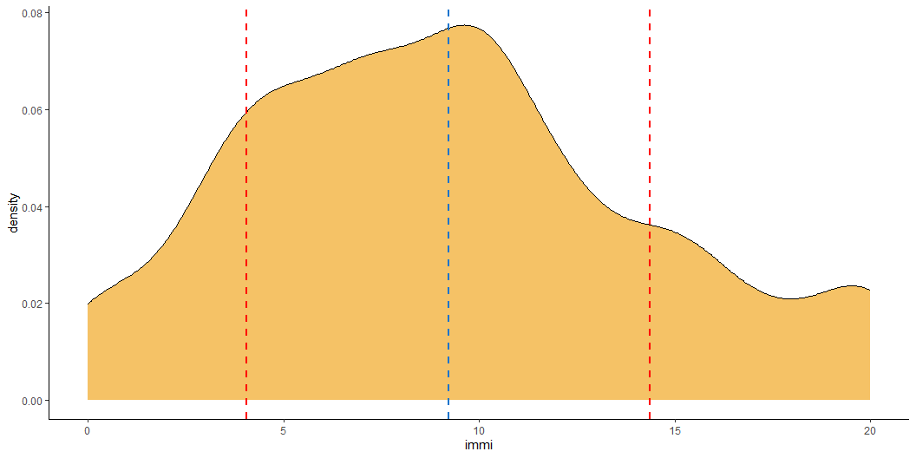


Dispersion Variance/Standard Deviation
Variance
$$s^{2}=\frac{1}{n−1}\sum_{i=1}^{n}{{\left(x_{i}−\overset{‾}{x}\right)}^{2}}$$
Measures the average squared deviation from the mean
Captures how data values spread out from the centre
Units are in squared scale of the original variable
Sensitive to outliers
$$s=\sqrt{\frac{1}{n−1}\sum_{i=1}^{n}{{\left(x_{i}−\overset{‾}{x}\right)}^{2}}}$$
Standard deviation
Square root of the variance
Expresses dispersion in original units
Captures how data values spread out from the centre
Units are in original units
Most commonly used measure of spread
Like variance, sensitive to extreme values
Notes:
Separation of concern so that different individual can take care of different parts of a project without worrying about other parts of the project.

Slide 12


Dispersion Standard Error
$$SE_{\overset{‾}{x}}=\frac{s}{\sqrt{n}}$$
Measures the precision of the sample mean as an estimate of the population mean
- Is the standard deviation of the sample mean distribution!
Decreases with larger sample size
Used in confidence intervals and tests for means
Notes:
Separation of concern so that different individual can take care of different parts of a project without worrying about other parts of the project.

Slide 13
Different statistics
Central distribution statistics
Mean
Median
Mode
Correlation statistics
Covariance
Correlation
ChiSq
Dispersion statistics
Variance/Standard deviation
Standard error
Percentiles/Quantiles
Interquartile range
Notes:
Separation of concern so that different individual can take care of different parts of a project without worrying about other parts of the project.

Slide 14

Quantiles & friends (IQR)
Quantiles are cut points that divide the range of a probability distribution into continuous intervals with equal probabilities. They can partition data into any number of equal-sized, adjacent subgroups.
Common quantiles include:
Quartiles: Divide data into four equal parts.
Deciles: Divide data into ten equal parts.
Percentiles: Divide data into 100 equal parts.
Thus, percentiles are a specific type of quantile. For instance, the 25th percentile (P25) is equivalent to the first quartile (Q1), and the 50th percentile (P50) corresponds to the median.
Notes:
Separation of concern so that different individual can take care of different parts of a project without worrying about other parts of the project.

Slide 15
Hypothesis testing

Slide 16
Testing for differences
Sometimes we want to know whether two estimates are systematically different
How can we do that?
We will look only at the case of continuous differences
this will return useful in the multivariate analysis framework when we will be talking about coefficients and parameters
But there are, of course, a plethora of tests, which are specific to the nature of the random variable analysed
Notes:
Separation of concern so that different individual can take care of different parts of a project without worrying about other parts of the project.

Slide 17
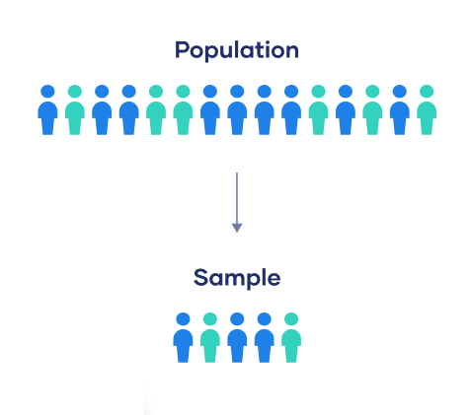
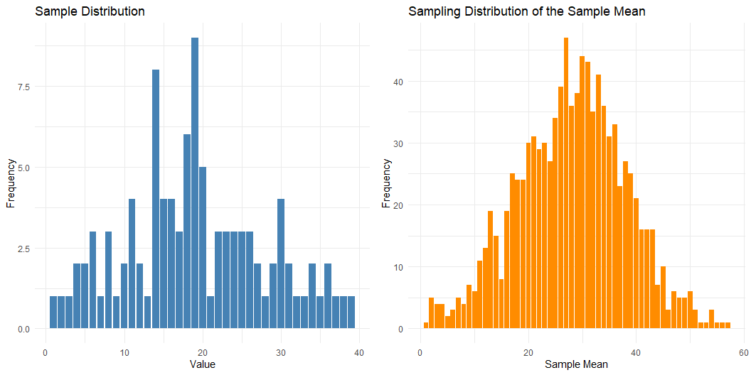
Hypothesis testing
The role of the standar error
The standard error tells us how much the sample mean is expected to vary from the true population mean.
Smaller standard errors mean more precise estimates.
If we know that the distribution of the estimate is - for instance, normal - then we use the standard error to estimate the confidence interval
Most used: 95% CI
Mean+(1.96*se)
Do you remember the central limit therem?
CLICK HERE!
Notes:
Separation of concern so that different individual can take care of different parts of a project without worrying about other parts of the project.

Slide 18
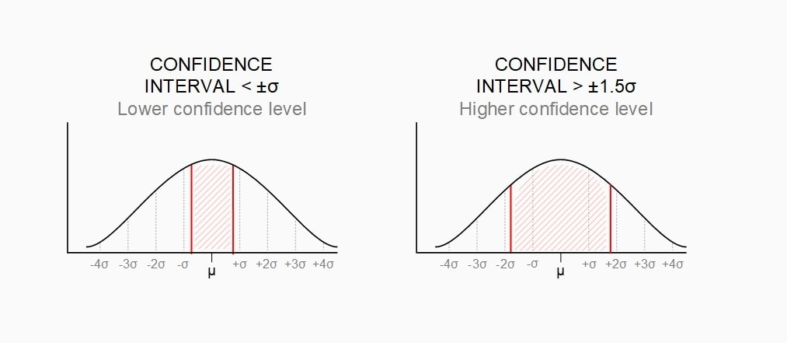
Hypothesis testing
The role of the standar error
The standard error tells us how much the sample mean is expected to vary from the true population mean.
Smaller standard errors mean more precise estimates.
If we know that the distribution of the estimate is - for instance, normal - then we use the standard error to estimate the confidence interval
Most used: 95% CI
Mean+(1.96*se)
Notes:
Separation of concern so that different individual can take care of different parts of a project without worrying about other parts of the project.

Slide 19
Hypothesis testing
What are (statistical) hypotheses?
Key Terms
Null Hypothesis (H₀): There is no difference, no effect, or no relationship.
Alternative Hypothesis (H₁): There is a difference, an effect, or a relationship.
Statistical Significance
If the data are very unlikely under the null hypothesis, we say the result is statistically significant.
It means the observed effect is probably not just due to random chance.
Notes:
Separation of concern so that different individual can take care of different parts of a project without worrying about other parts of the project.

Slide 20
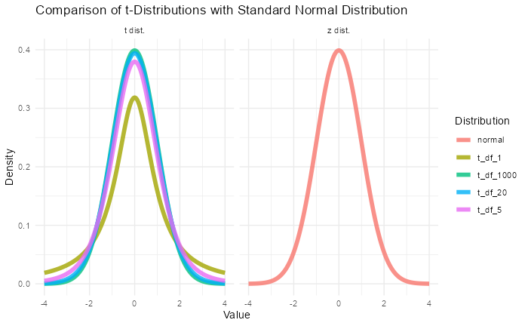
Z-test and t-test
There are, also here, tons of statistical tests.
But the most common, and useful for our purposes are the z-test and the t-test
We assume that the estimate we are considering is distributed in a certain way
z-test: Used when the sample size is large or the population standard deviation is known.
t-test: Used when the sample size is small and the population standard deviation is unknown (which is common in practice).
Test Statistic
In both cases, we calculate a test statistic (z or t value). It measures how far the sample result is from what we expect under the null hypothesis.
Notes:
Separation of concern so that different individual can take care of different parts of a project without worrying about other parts of the project.

Slide 21
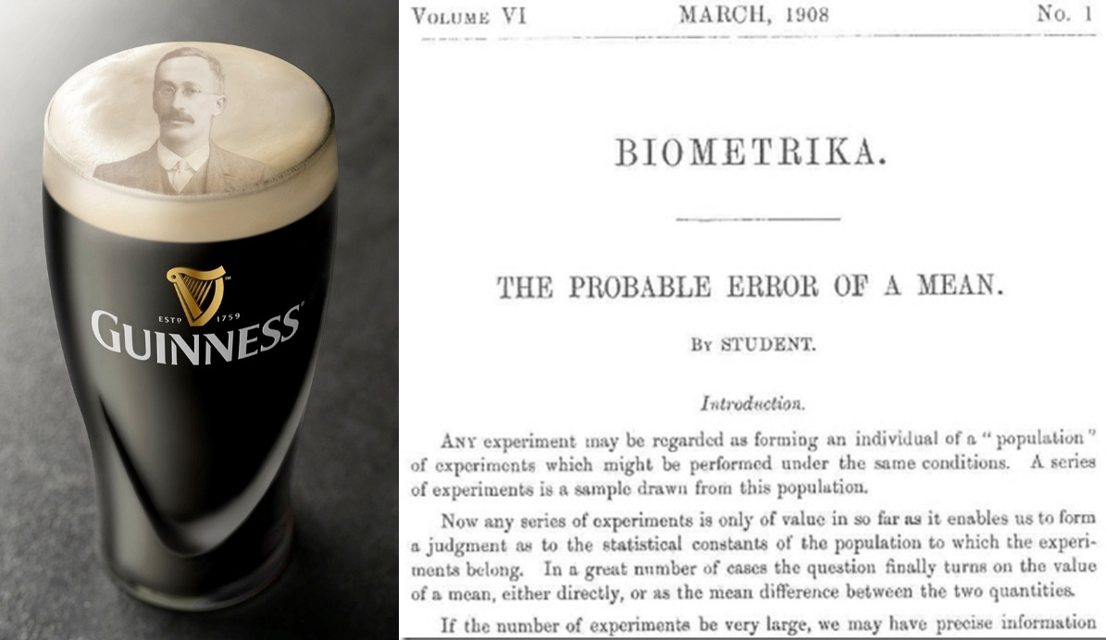
Hold by beer…
William Sealy Gosset (1876–1937), an English chemist and statistician, employed at the Guinness Brewery in Dublin, Ireland.​
Gosset faced challenges in quality control, particularly in assessing the chemical properties of barley with small sample sizes.
Existing statistical methods were inadequate for such small samples. So he developed a new statistical method to estimate the mean and variability from small samples, leading to the formulation of the t-distribution and the t-test.
In 1908, Gosset published his findings in the journal Biometrika under the pseudonym "Student" due to Guinness's policy against employees publishing under their real names
The method became known as Student's t-test, widely used for hypothesis testing when dealing with small sample sizes.
Notes:
Separation of concern so that different individual can take care of different parts of a project without worrying about other parts of the project.

Slide 22
P-value and decision rule
P-values
The p-value tells us the probability of observing a result as extreme as (or more extreme than) what we found, if the null hypothesis is true.
A small p-value (typically less than 0.05) means strong evidence against the null hypothesis.
Decision Rule
If p-value < 0.05: Reject the null hypothesis (the result is statistically significant).
If p-value > 0.05: Do not reject the null hypothesis (no strong evidence against it).
Notes:
Separation of concern so that different individual can take care of different parts of a project without worrying about other parts of the project.

Slide 23
We cannot confirm an Hp
Why We Cannot "Confirm" the Null Hypothesis
In hypothesis testing, we are looking for evidence against the null hypothesis, not for it.
If we reject the null hypothesis (because the p-value is small), we have evidence that something is happening.
But if we do not reject the null hypothesis (because the p-value is large), it does not mean the null is true — it only means we do not have enough evidence to prove it false.
Notes:
Separation of concern so that different individual can take care of different parts of a project without worrying about other parts of the project.

Slide 24
R programming

Slide 25
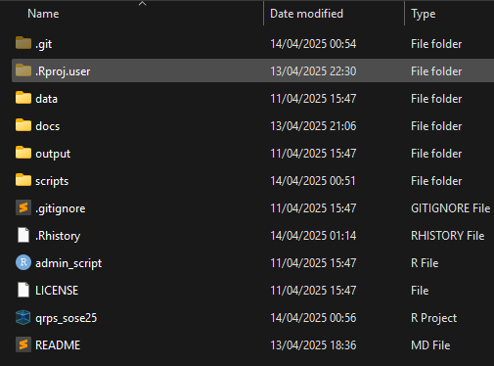
Basic management
A few rules that can make your life easier:
Create an R project
Create a simple, rational folder structure
Keep different file types in different folder
Create sub-folders
Keep it tidy
In naming there are no wrong answers,…
but use all lower case or upper case ( helps you in never forgetting the cases )
but use underscore in between
but make the name as general as possible
! You can create it with R!
Notes:
Separation of concern so that different individual can take care of different parts of a project without worrying about other parts of the project.

Slide 26
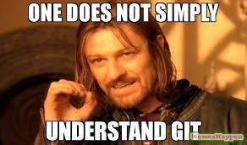




Basic management
There is an additional software that can make your life easier
Git: version control system that tracks versions of files
Pros
Very useful backup of your code
Cons
You cannot backup files >~ 20mb
The basic version needs to be programmed using the OS console – e.g., cmd in Windows
But there’s GitHub
A (proprietary) developer platform that allows users to create, store, manage, and share their code.
painful
Notes:
Separation of concern so that different individual can take care of different parts of a project without worrying about other parts of the project.

Slide 27
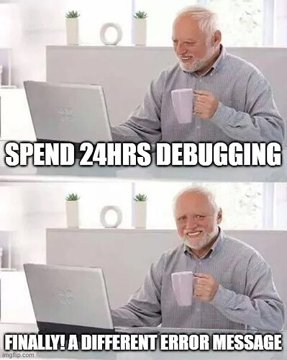
Basic coding
If you want an understandable, efficient code…
DIY: Do it by yourself
KIS: Keep it simple
Be clear about inputs and ouputs
Break down problems, split tasks
Aggregate tasks in the output
DRY: Don’t repeat yourself
Do not perform the same calculation/operation twice
Instead define an object/a function
Write comments
Use Rstudio tabs
Debugging will become much much easier…
Notes:
Separation of concern so that different individual can take care of different parts of a project without worrying about other parts of the project.

Slide 28
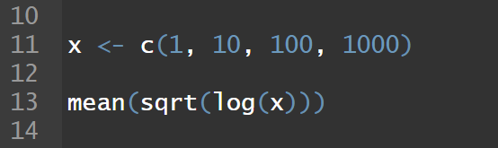
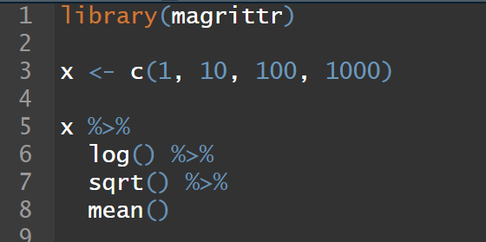
R base and the tidyverse
R has a native syntax which allows you to do amazing things
Nonetheless, it can be pretty dense, unreadable, convoluted
Because of this, a superhero called Wickam (and a bunch of other ones) came up with the idea to create a complementary syntax that allows you to do the same things that you would do in base R, and a set of packages
The tidyverse an opinionated collection of R packages designed for data science. All packages share an underlying design philosophy, grammar, and data structures.
Notes:
Separation of concern so that different individual can take care of different parts of a project without worrying about other parts of the project.

Slide 29

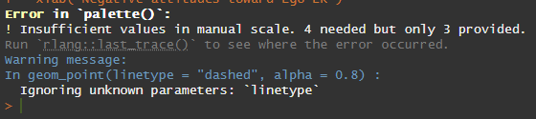
R packages
Packages are extensions to the R statistical programming language.
They allow you to do things without reinventing every time the wheel
But over-reliance on packages can be dangerous
They can be updated
They can be deleted
Your code might not be reproducible in the future
Notes:
Separation of concern so that different individual can take care of different parts of a project without worrying about other parts of the project.

Slide 30
R packages
Now, we need to introduce some packages that will make your life much easier and are mostly part of the tidyverse
here
haven (allows to upload different dataset formats)
dplyr
magrittr (the pipe operator)
ggplot (for visualizations)
Notes:
Separation of concern so that different individual can take care of different parts of a project without worrying about other parts of the project.

Slide 31
Hands-on practice

Slide 32
Checkpoint
Git & Github
Did you clone the repository? Issues?

Slide 33
Formatting your script
There are very few clear rules about it
My (current) workflow (that you don’t have to follow, until you remain rational in your choices) is the following
Admin/Setup – install and load packages, and options of the session, and environment cleaning
Tab with the functions used in the session
Tab for data loading
Tab for data wrangling
Tab for the analysis
Tab for visualizations/tables
Tab for exporting the output datasets
Notes:
Separation of concern so that different individual can take care of different parts of a project without worrying about other parts of the project.

Slide 34
Hands-on session
Fetch your repository with the new version of the repository online
Open the a new script and save it in the scripts folder
Let’s start working with it!
Notes:
Separation of concern so that different individual can take care of different parts of a project without worrying about other parts of the project.

Slide 35
Hands-on session
Admin/Setup – install and load packages, and options of the session, and environment cleaning
Load the data using here
Select the variable of interest
Check the distribution
Hints
We are working with one wave of a cross-sectional survey, this means that the rows represent an individual interviewed at one single point in time. Therefore the values in the columns (variables) are the replies of the respondent to the survey questions
People can also do not reply, because they don’t know the answer or other reasons
Usually these values are what we call “missing values”, and normally are dropped from the analyses
Notes:
Separation of concern so that different individual can take care of different parts of a project without worrying about other parts of the project.

Slide 36
Assignment

Slide 37
Assignment
Tbd
Probably some coding depending on how it went today
Notes:
Separation of concern so that different individual can take care of different parts of a project without worrying about other parts of the project.

Slide 38
Thank you for your attention!

