Slide 1

Quantitative Research in Political Science How to Apply the Classical Toolbox
Giuseppe Carteny
Postdoctoral Researcher
Department of European Social Research
University of Saarland
UdS SoSe2025 - Class 2 (2025.04.14)

Slide 2

Who am I?
Dr. Giuseppe Carteny
Postdoctoral researcher (Wissenschaftlicher Mitarbeiter) at the chair of Prof. Dr. Daniela Braun since 2023
Postdoctoral researcher at the Mannheim Centre for European Social Research (MZES) from 2021 to 2023
PhD in Political Studies at the University of Milan, and Msc and Bsc in political science at the LUISS University of Rome
I research gender-related issues - and how far-right is twisting these - for the UNTWIST project…
…but also party competition, political attitudes and behaviour in Europe and East Asia using public opinion surveys, experts’ data, party manifestos,…

Slide 3
Today‘s seminar
Review #1 (quick)
R and programming notions
Review #2 (quick)
Univariate statistics’ notions
Hands-on practice
Assignment

Slide 4
Review

Slide 5
Assignment #1
Did you practice?
How it was?
Practice
A platform to practice without installation: https://adp-cvk.quarto.pub/r-for-social-science-data-analysis/
Some basic statistics with R: https://statsandr.com/blog/descriptive-statistics-in-r/

Slide 6
Assignment #2
Did you read?
Resources
See the references!
Bueno de Mesquita & Fowlers (2021) - Chapters 2, 3, and 5
King (1998) – Chapter 1
(I’ll share them via Teams later today)

Slide 7
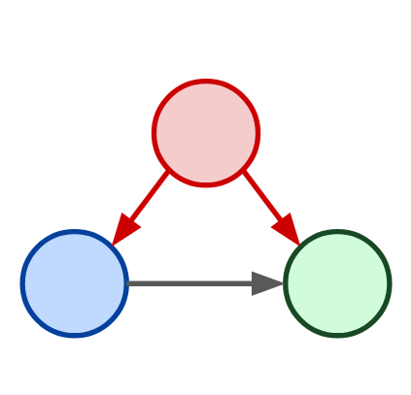
Assignment #3
How is it going with your model?
Confounder
Independent Variable
Dependent Variable

Slide 8
R and programming notions

Slide 9
Checkpoint
Installation
Are R and Rstudio installed on your computer/laptop?

Slide 10
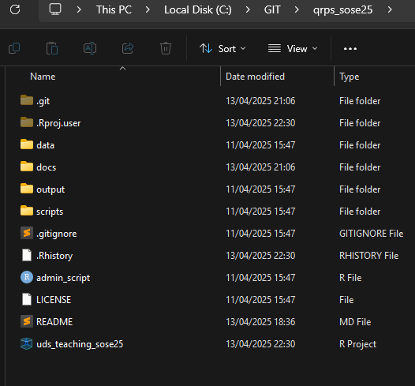
Basic management
A few rules that can make your life easier:
Create an R project
Create a simple, rational folder structure
Keep different file types in different folder
Create sub-folders
Keep it tidy
In naming there are no wrong answers,…
but use all lower case or upper case ( helps you in never forgetting the cases )
but use underscore in between
but make the name as general as possible
! You can create it with R!
Notes:
Separation of concern so that different individual can take care of different parts of a project without worrying about other parts of the project.

Slide 11


Basic management
There is an additional software that can make your life easier
Git: version control system that tracks versions of files
Pros
Very useful backup of your code
Cons
The basic version needs to be programmed using the OS console – e.g., cmd in Windows
You cannot backup files >~ 20mb
But there’s GitHub
a (proprietary) developer platform that allows developers to create, store, manage, and share their code.
Even if it’s a bit painful
! You can create it with R!
Notes:
Separation of concern so that different individual can take care of different parts of a project without worrying about other parts of the project.

Slide 12
Hands-on practice

Slide 13
Basic management: Git
Download Git:
Go to https://git-scm.com and download the latest version for your operating system (Windows, macOS, or Linux).
Install Git:
Run the downloaded installer.
Use default settings
Verify Installation:
Open a terminal (or Git Bash on Windows) and type:
Notes:
Separation of concern so that different individual can take care of different parts of a project without worrying about other parts of the project.

Slide 14
Basic management: Git
Create a GitHub account - https://github.com.
Install Git
Run the downloaded installer.
Use default settings
Verify Installation
Open a terminal and type:
(Pro: generate an ssh for security reasons)
Notes:
Separation of concern so that different individual can take care of different parts of a project without worrying about other parts of the project.

Slide 15
Basic management: Git
Download GitHub Desktop:
Visit the official GitHub Desktop download page and download the installer for your operating system (Windows or macOS).​
Install the Application
Open GitHub Desktop
Sign In to GitHub
Notes:
Separation of concern so that different individual can take care of different parts of a project without worrying about other parts of the project.

Slide 16
Basic programming
A few rules that can make your life easier:
Create an R project
Create a simple, rational folder structure – e.g. keep different file types in different folder [pic]
Keep it tidy
In naming there are no wrong answers,…
but use all lower case or upper case ( helps you in never forgetting the cases )
but use underscore in between
but make the name as general as possible
! You can create it with R!
Notes:
Separation of concern so that different individual can take care of different parts of a project without worrying about other parts of the project.

Slide 17
Basic rules of coding
DIY: Do It by Yourself
For visualizations: R Graphics Cookbook
To create analytical models

Slide 18
Useful links
You can explore a bit :
For visualizations: R Graphics Cookbook
To create analytical models

Slide 19
Assignment #3
Start building your Model!
Confounder
Independent Variable
Dependent Variable

Slide 20
Thank you for your attention!

Slide 21
References
Bueno de Mesquita, E., & Fowler, A. (2021). Thinking clearly with data: A guide to quantitative reasoning and analysis. Princeton University Press.
King, G. (1998). Unifying Political Methodology: The Likelihood Theory of Statistical Inference. University of Michigan Press.

