Slide 1

Quantitative Research in Political Science GitHub workflow
Giuseppe Carteny
Postdoctoral Researcher
Department of European Social Research
University of Saarland
UdS SoSe2025

Slide 2
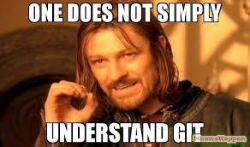

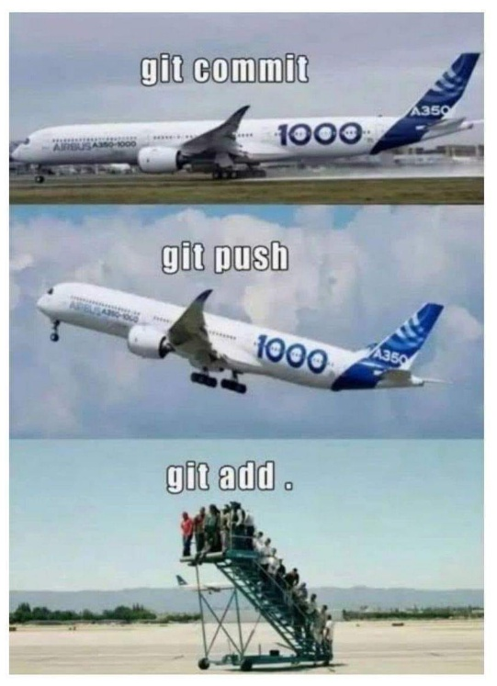

As said before…
There is an additional software that can make your life easier
Git: version control system that tracks versions of files
Pros
Very useful backup of your code
Cons
You cannot backup files >~ 20mb
The basic version needs to be programmed using the OS console – e.g., cmd in Windows
But there’s GitHub
A (proprietary) developer platform that allows users to create, store, manage, and share their code.
painful

Slide 3
Setup
Download GitHub Desktop:
Visit the official GitHub Desktop download page and download the installer for your operating system (Windows or macOS).​
Install the Desktop Application
Open GitHub Desktop and sign in
Fork the seminar repositor on the GitHub website: https://github.com/giucarny/qrps_sose25/
Clone your fork on your local machine

Slide 4
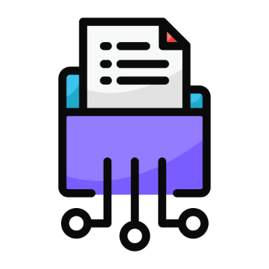
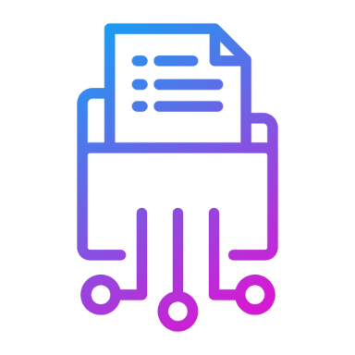
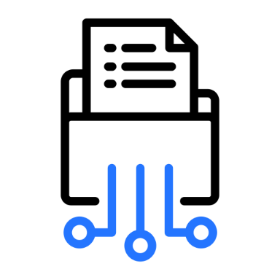
Setup
Forking
Creates an online copy of the upstream - the fork/origin
Upstream
The online repository of the maintainer(s) – i.e., Alex & I
Fork/Origin
Your online copy of the upstream
Cloning
Creates an offline copy of the fork/origin
Your local repo
offline copy of the fork/origin, on your machine

Slide 5
Workflow #0
Upstream
Fork/Origin
We change something in the folder - .e.g. new slides/code
- and then create a commit Commits are records of changes to one or more files in a repository
Our local repos
offline copy of the upstream, on our machines
Your local repo

Slide 6
Workflow #1
Upstream
Fork/Origin
Push
We update the upstream with the commit
Our local repos
offline copy of the upstream, on our machines
Your local repo

Slide 7
Workflow #2
You sync your fork
On the GitHub website (see the next slides)
Upstream
Fork/Origin
Our local repos
Your local repo

Slide 8
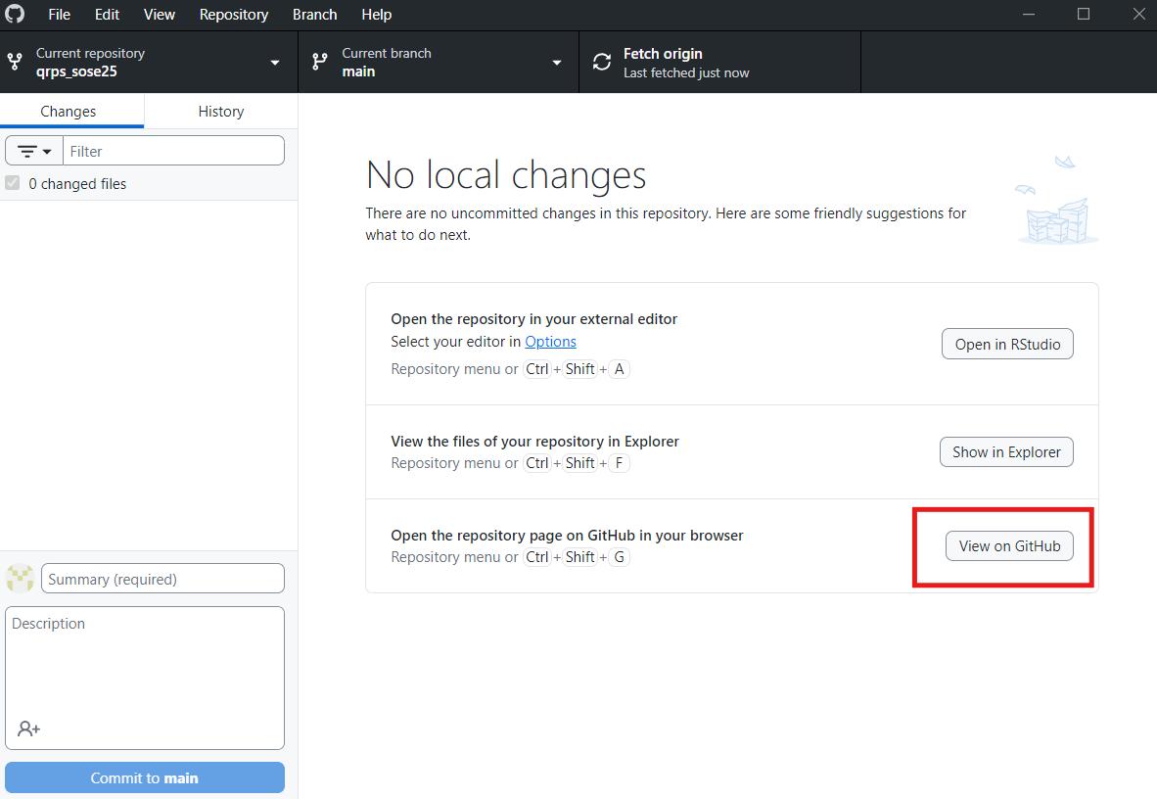
Workflow #2

Slide 9
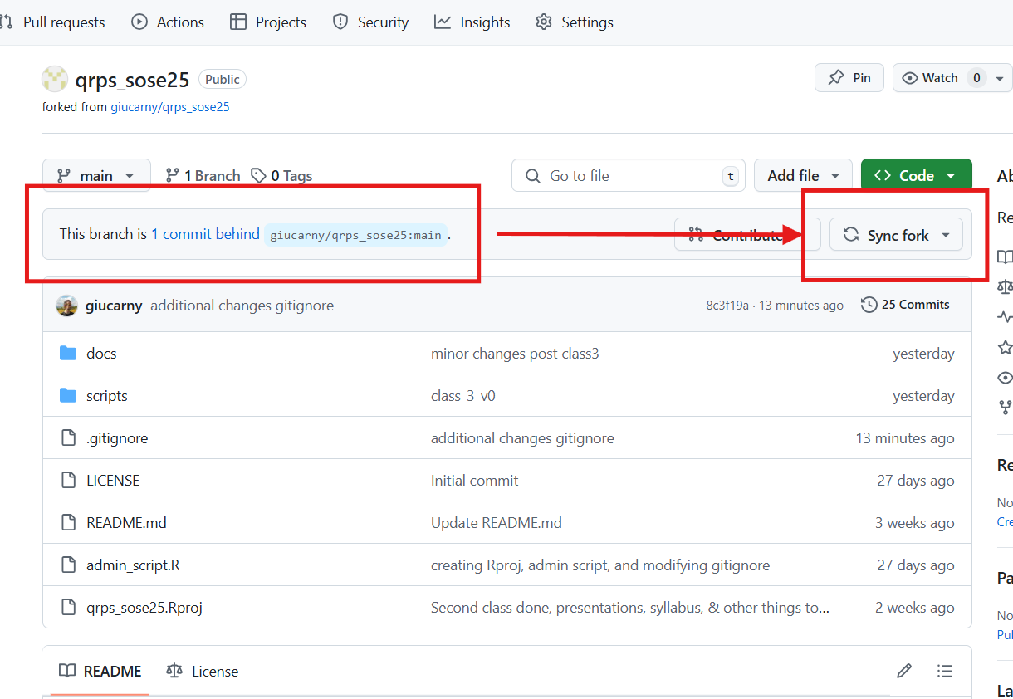
Workflow #2
This indicates that your fork is one commit behind

Slide 10
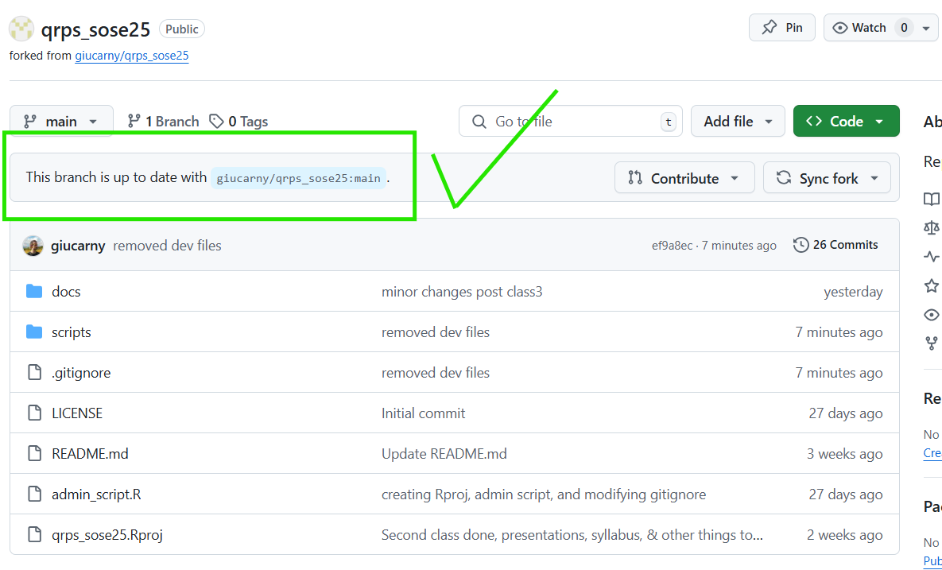
Workflow #2
Now your fork is synced

Slide 11
Workflow #3
Upstream
Fork/Origin
Pull
You update your local repository with the updates in the fork/origin
Our local repos
Your local repo

Slide 12
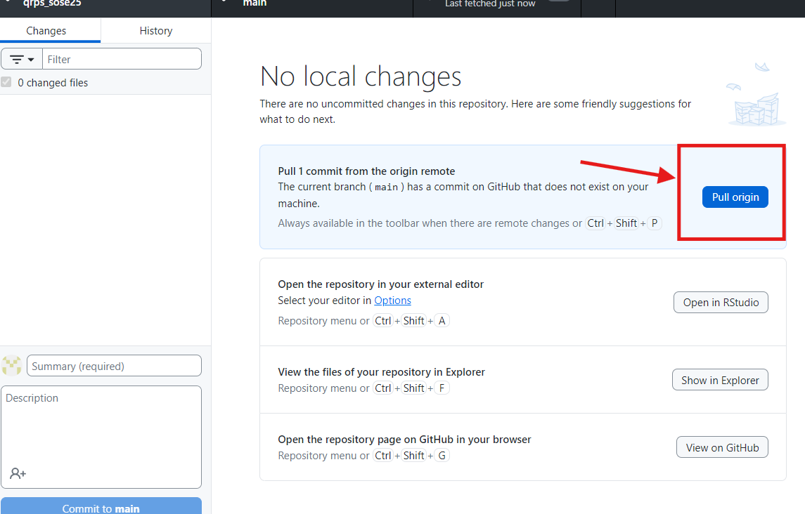
Workflow #3

Slide 13
Workflow #4
Upstream
Fork/Origin
Our local repos
Every time you change your local repository, Git will record these changes.
But to “save” these changes you need to create a commit
Your local repo

Slide 14
Workflow #4
Upstream
Fork/Origin
Then you can push your changes to your remote repo (origin)
Our local repos
Your local repo

Slide 15
Workflow #5
Then you can also push your changes from your fork/origin
to the upstream
This is called a
Pull request*
Upstream
Fork/Origin
* You will submit your term paper – and your code – using this procedure
But we will talk better about it later on…
Our local repos
Your local repo

Slide 16
Warning!
The workflow that we will be using is mostly the one from #1 to #3
Fork/Origin
Feel free to change the files in your fork/origin, , but… if you modify the files you pulled from our repository (for instance, the slides, or the scripts) this will create errors and inconsistencies
This is because git pulls a file, notice that the two files are different, and it will force you to make a choice – in the best case scenario
Therefore, if you want to modify the slides or the code we provide via the upstream, please create a copy and modify the copy, don’t work on the original files
Your local repo

