Slide 1

Quantitative Research in Political Science How to Apply the Classical Toolbox
Giuseppe Carteny
Postdoctoral Researcher
Department of European Social Research
University of Saarland
UdS SoSe2025 - Class 3 (28.04.2025)

Slide 2
Today‘s seminar
Review of the assignments
Univariate statistics (categorical)
Hypothesis testing
R programming
Assignment

Slide 3
Before we start…
IMPORTANT
We must remove one of the courses from the LSF platform
‘How to Analyse Digital Content for Political Science Research’ by Alexander (Veranstaltungsnummer 1566865)
Please de-register from that course on the LSF course as soon as possible
This course (Veranstaltungsnummer 156687) will then be modified

Slide 4
Review of the assignments

Slide 5
Assignment #1
Did you read?
Resources
Agresti & Finlay (2009) - Chapters 1, 2, 3

Slide 6
Assignment #2
Did you fork and clone the repository?
Did it work? Issues?
Repo
https://github.com/giucarny/qrps_sose25/
Did you check the additional resources I suggested?
What’s the difference between forking and cloning…
Action | Where It Happens | Purpose | Typical Use Case
Fork | On GitHub | Create your own copy of a repository | Contributing to someone else's project
Clone | On your computer | Work on a repository locally | Developing with local tools and environment

Slide 7
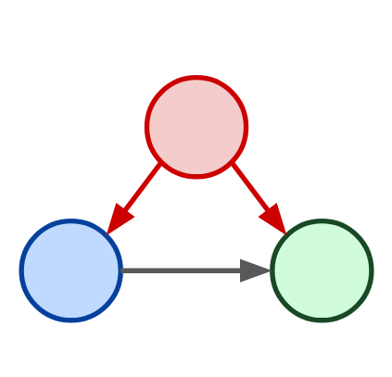
Assignment #3
How is it going with your model?
Did you select your variable from the questionnaire?
Soon you need to work with it….
Confounder
Independent Variable
Dependent Variable

Slide 8
Univariate statistics
(Categorical)

Slide 9
Different statistics
Central distribution statistics
Mean
Median
Mode
Correlation statistics
Covariance
Correlation
ChiSq
Dispersion statistics
Variance/Standard deviation
Standard error
Percentiles/Quantiles
Interquartile range

Slide 10
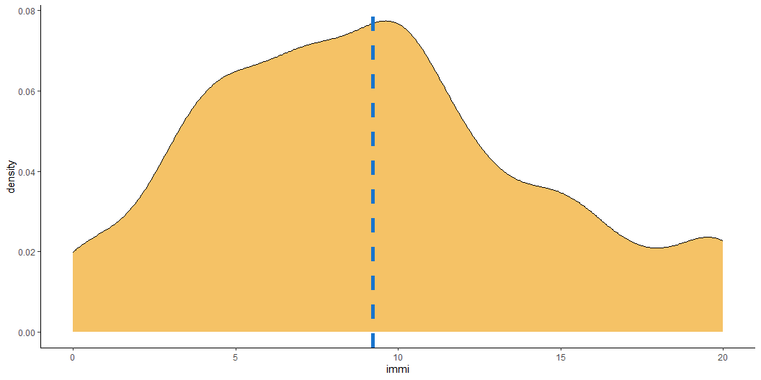
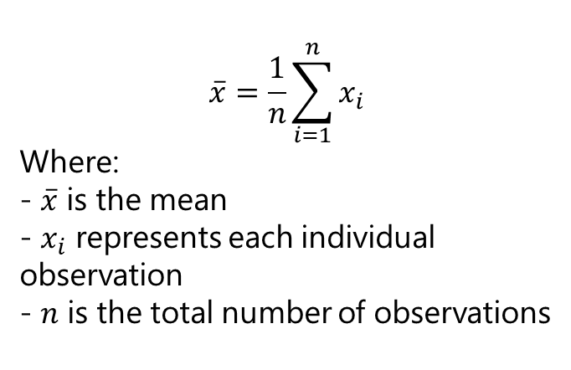
Central distribution Mean
Calculated by summing all values and dividing by the number of observations
Sensitive to every value in the dataset
Affected by extreme values (outliers)
Mostly appropriate for symmetric distributions
$$\overset{‾}{x}=\frac{1}{n}\sum_{i=1}^{n}{x_{i}}$$
Where: - $\overset{‾}{x}$ is the mean - $x_{i}$ represents each individual observation - $n$ is the total number of observations

Slide 11
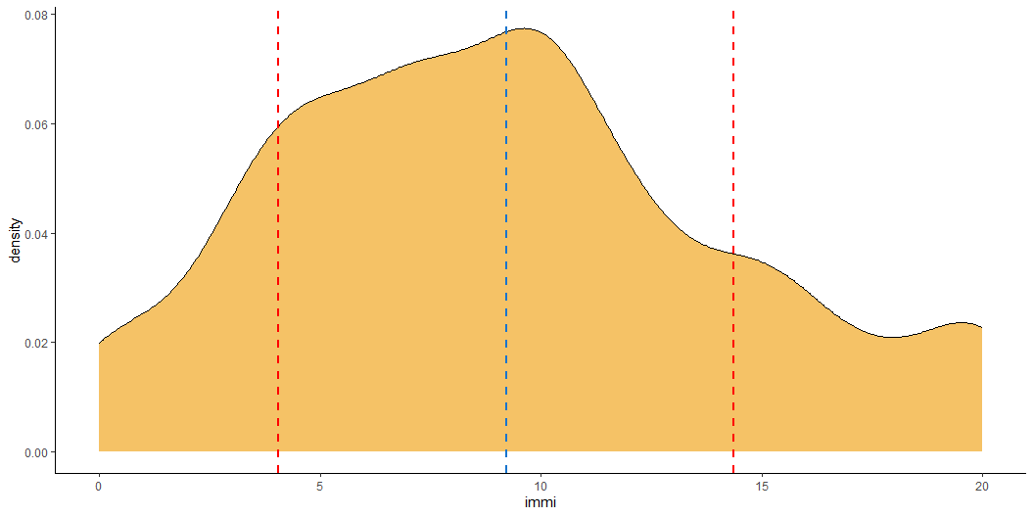


Dispersion Variance/Standard Deviation
Variance
$$s^{2}=\frac{1}{n−1}\sum_{i=1}^{n}{{\left(x_{i}−\overset{‾}{x}\right)}^{2}}$$
Measures the average squared deviation from the mean
Captures how data values spread out from the centre
Units are in squared scale of the original variable
Sensitive to outliers
$$s=\sqrt{\frac{1}{n−1}\sum_{i=1}^{n}{{\left(x_{i}−\overset{‾}{x}\right)}^{2}}}$$
Standard deviation
Square root of the variance
Expresses dispersion in original units
Captures how data values spread out from the centre
Units are in original units
Most commonly used measure of spread
Like variance, sensitive to extreme values

Slide 12


Dispersion Standard Error
$$SE_{\overset{‾}{x}}=\frac{s}{\sqrt{n}}$$
Measures the precision of the sample mean as an estimate of the population mean
- Is the standard deviation of the sample mean distribution!
Decreases with larger sample size
Used in confidence intervals and tests for means – see below in the presentation

Slide 13
Different statistics
Central distribution statistics
Mean
Median
Mode
Correlation statistics
Covariance
Correlation
ChiSq
Dispersion statistics
Variance/Standard deviation
Standard error
Percentiles/Quantiles
Interquartile range

Slide 14

Quantiles & friends (IQR)
Quantiles are cut points that divide the range of a distribution into continuous intervals with equal probabilities. They can partition data into any number of equal-sized, adjacent subgroups.
Common quantiles include:
Quartiles: Divide data into four equal parts.
Deciles: Divide data into ten equal parts.
Percentiles: Divide data into 100 equal parts.
Thus, percentiles are a specific type of quantile. For instance, the 25th percentile (P25) is equivalent to the first quartile (Q1), and the 50th percentile (P50) corresponds to the median.
The interquartile range (IQR) is a common measure of dispersion when dealing with categorical and continuous variables

Slide 15
To sum up…
Some measures are more useful for continuous variables – or in any case treated as such. This is the case of the mean, the variance, and the standard deviation.
Other variables tend to be more useful when dealing with categorical variables, like the median and the IQR
Nonetheless, remember that all these measures convey different information!

Slide 16
Hypothesis testing

Slide 17

Testing for differences
Sometimes we want to know whether two estimates are systematically different
How can we do that?
We do that using what is commonly called hypothesis testing
N.B.: We will look only at the case of continuous differences
this will return useful in the multivariate analysis framework when we will be talking about coefficients and parameters
But there are, of course, a plethora of tests, which are specific to the nature of the random variable analysed

Slide 18










Hypothesis testing
To understand hypothesis testing, let’s return to our (now, well-known) population-sample relationship…
We want to know how a variable (e.g., age) is distributed in the population. Let’s assume we don’t know the variable is distributed in the population. So…
We take a (random) sample of individuals
We calculate the mean and variance/standard deviation of the variable (age) in the sample
Population
Variable: Age
Population size: 30mln
Mean of age: ?
Variance/SD of age: ?
$$x$$
$$N$$
$$μ$$
$$σ$$
Sample
Variable: Age
Sample size: 1000
Mean of age: 45
Variance/SD of age: 20
$$x$$
$$n$$
$$\overset{‾}{x}$$
$$s$$

Slide 19
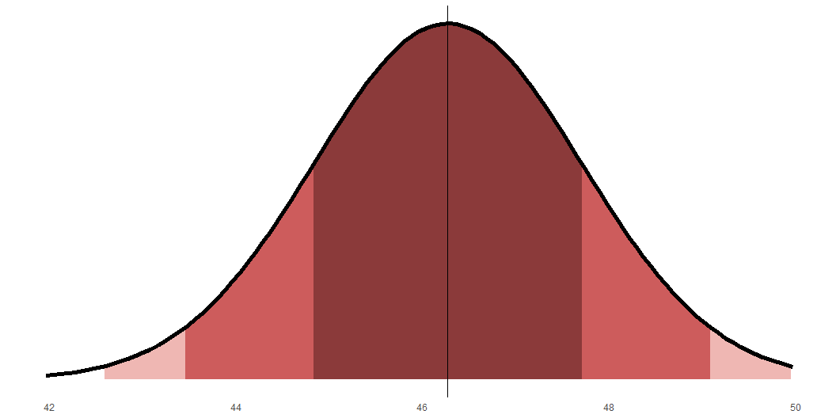
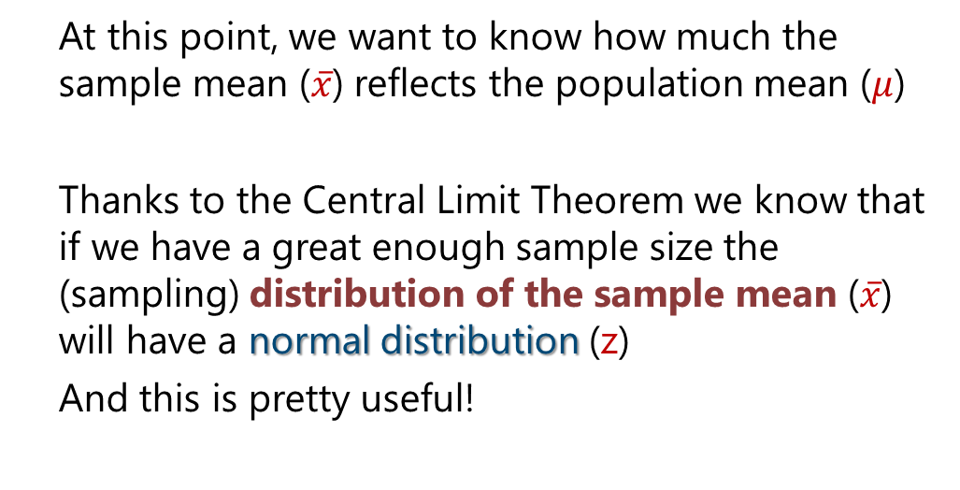
Hypothesis testing
At this point, we want to know how much the sample mean ($\overset{‾}{x}$) reflects the population mean ($μ$)
Thanks to the Central Limit Theorem we know that if we have a great enough sample size the (sampling) distribution of the sample mean ($\overset{‾}{x}$) will have a normal distribution (z)
And this is pretty useful!
Population
Variable: Age
Population size: 30mln
Mean of age: ?
Variance/SD of age: ?
$$x$$
$$N$$
$$μ$$
$$σ$$
Sample
Variable: Age
Sample size: 100
Mean of age: 45
Variance/SD of age: 15
$$x$$
$$n$$
$$\overset{‾}{x}$$
$$s$$

Slide 20
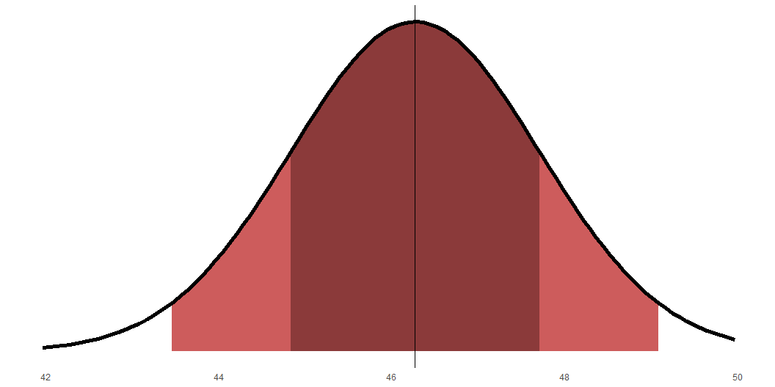
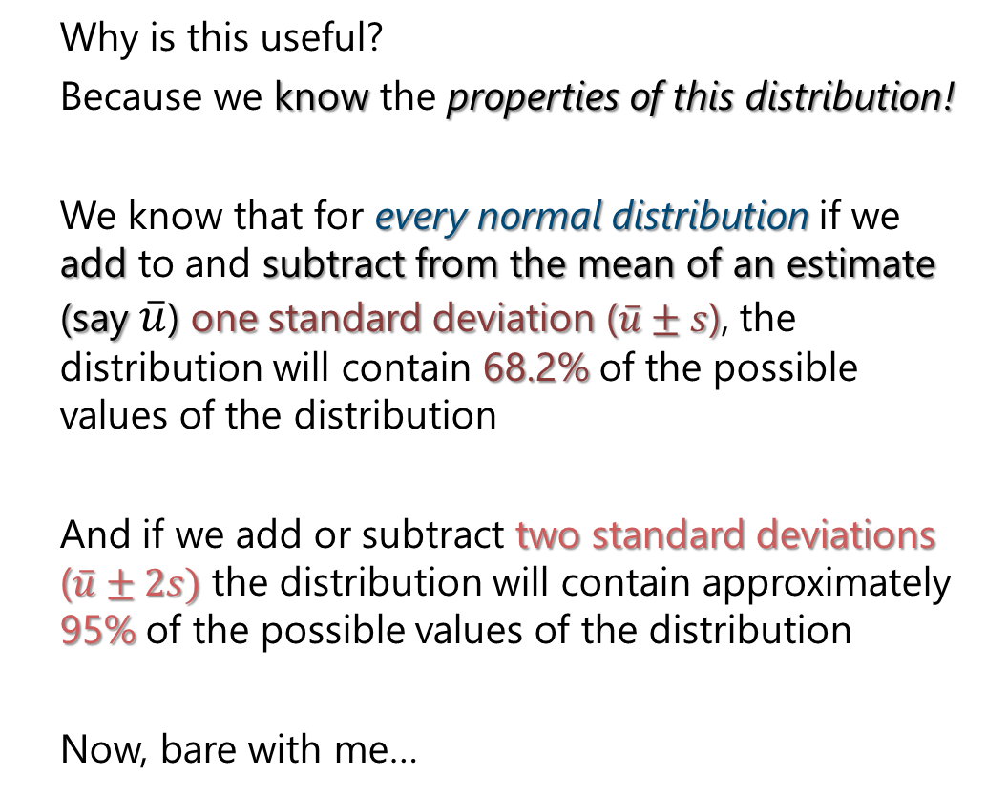



Hypothesis testing
Why is this useful?
Because we know the properties of this distribution!
We know that for every normal distribution if we add to and subtract from the mean of an estimate (say $\overset{‾}{u}$) one standard deviation ($\overset{‾}{u}±s$), the distribution will contain 68.2% of the possible values of the distribution
And if we add or subtract two standard deviations ($\overset{‾}{u}±2s)$ the distribution will contain approximately 95% of the possible values of the distribution
Now, bare with me…
$$\overset{‾}{u}$$
$$\overset{‾}{u}±2s$$
$$\overset{‾}{u}±s$$

Slide 21
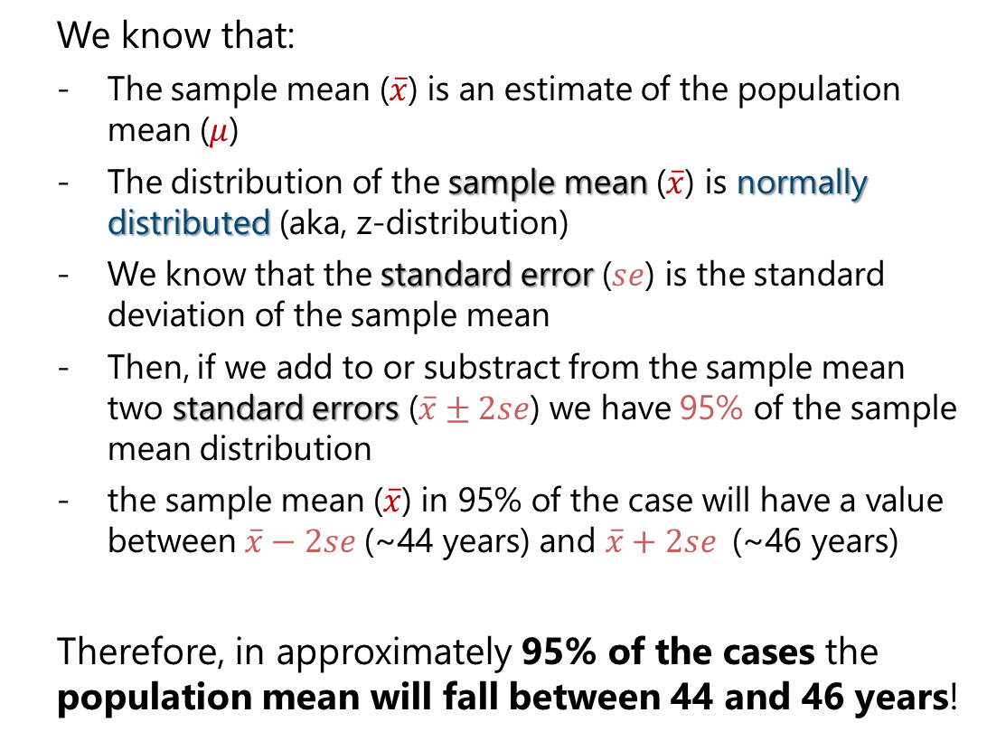



Hypothesis testing
We know that:
The sample mean ($\overset{‾}{x}$) is an estimate of the population mean ($μ$)
The distribution of the sample mean ($\overset{‾}{x}$) is normally distributed (aka, z-distribution)
We know that the standard error ($se$) is the standard deviation of the sample mean
Then, if we add to or substract from the sample mean two standard errors ($\overset{‾}{x}±2se$) we have 95% of the sample mean distribution
the sample mean ($\overset{‾}{x}$) in 95% of the case will have a value between $\overset{‾}{x}−2se$(~44 years) and $\overset{‾}{x}+2se$(~46 years)
Therefore, in approximately 95% of the cases the population mean will fall between 44 and 46 years!
$$\overset{‾}{x}$$
$$\overset{‾}{x}±2se$$
$$\overset{‾}{x}±se$$
Sample
Variable: Age
Sample size: 100
Mean of age: 45
Variance/SD of age: 15

Slide 22
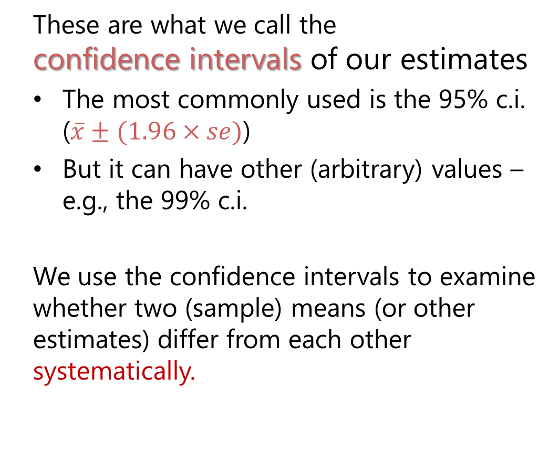



Hypothesis testing
These are what we call the confidence intervals of our estimates
The most commonly used is the 95% c.i. ($\overset{‾}{x}±(1.96×se)$)
But it can have other (arbitrary) values – e.g., the 99% c.i.
We use the confidence intervals to examine whether two (sample) means (or other estimates) differ from each other systematically.
$$\overset{‾}{x}$$
99% c.i.
$$\overset{‾}{x}±2.58se$$
95% c.i.
$$\overset{‾}{x}±1.96se$$
68% c.i.
$$\overset{‾}{x}±se$$

Slide 23
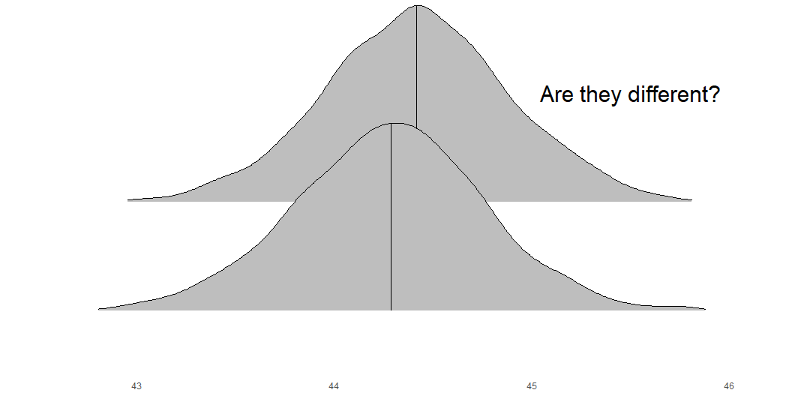
Hypothesis testing
What are (statistical) hypotheses?
A statistical hypothesis test is a method of statistical inference used to decide whether the data provide sufficient evidence to reject a particular hypothesis.
There are many tests, but the most common setup is the following:
Null Hypothesis (H₀): There is no difference, no effect, or no relationship.
Alternative Hypothesis (H₁): There is a difference, an effect, or a relationship.

Slide 24
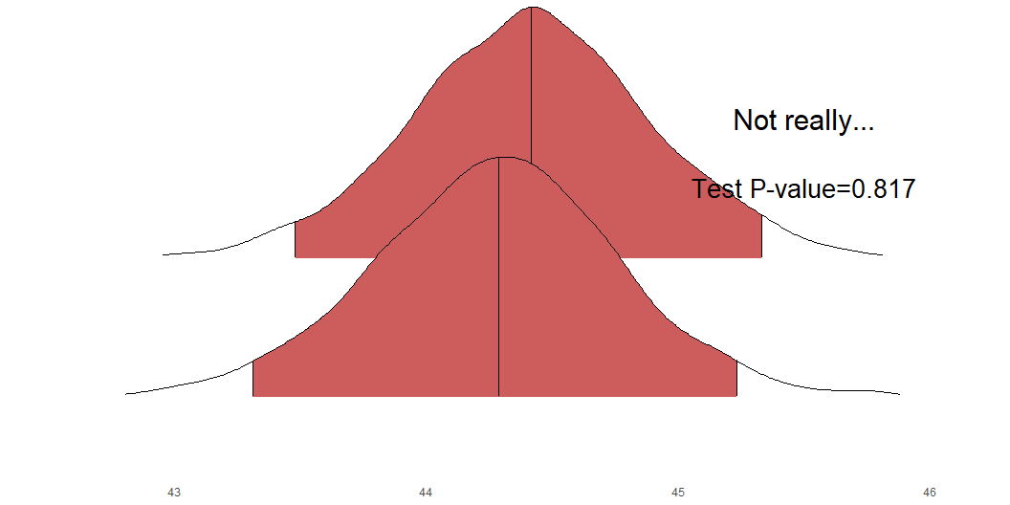
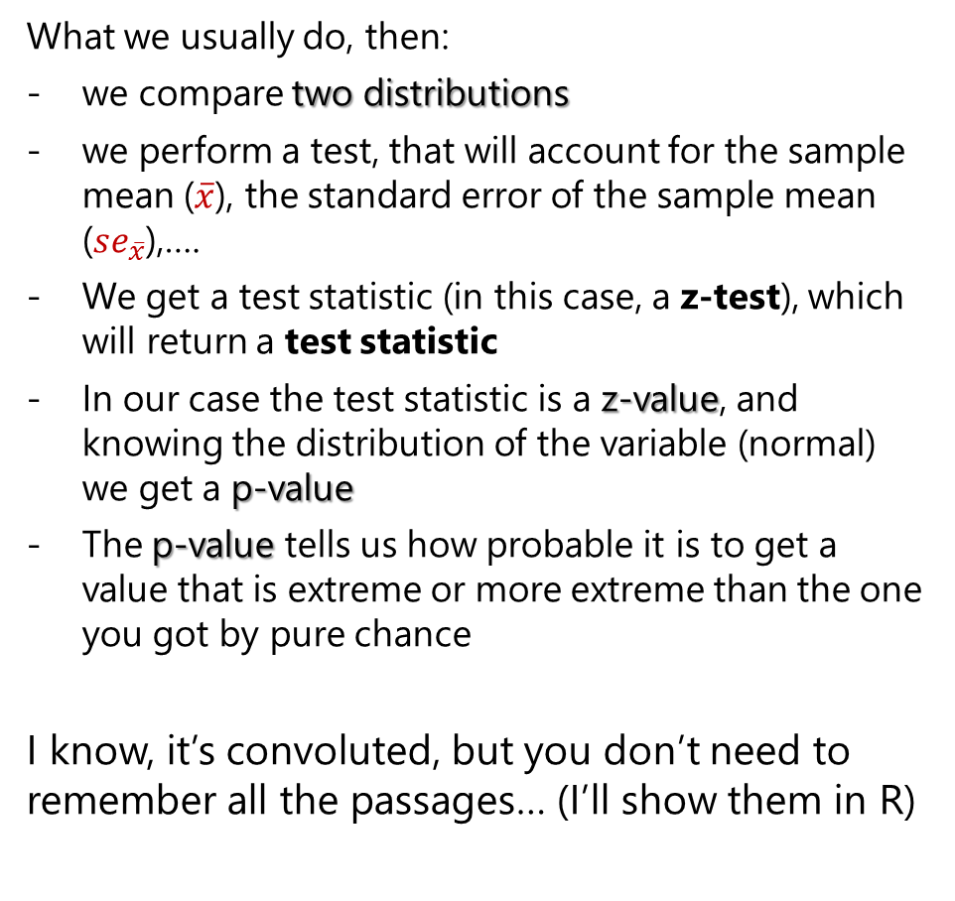
Hypothesis testing
What we usually do, then:
we compare two distributions
we perform a test, that will account for the sample mean ($\overset{‾}{x}$), the standard error of the sample mean (${se}_{\overset{‾}{x}}$),….
We get a test statistic (in this case, a z-test), which will return a test statistic
In our case the test statistic is a z-value, and knowing the distribution of the variable (normal) we get a p-value
The p-value tells us how probable it is to get a value that is extreme or more extreme than the one you got by pure chance
I know, it’s convoluted, but you don’t need to remember all the passages… (I’ll show them in R)
95% c.i.s
In short, the test tells us whether the data provide sufficient evidence to reject the null hypothesis at a certain confidence interval

Slide 25
Hypothesis testing
Statistical Significance
If the data are very unlikely under the null hypothesis, we say the result is statistically significant at a certain confidence interval/p-value
C.I. and p-value are somewhat complementary. For instance:
A p-value < 0.05 indicates that we can be confident that at least in 95% (1 – 0.05) of the cases the difference between the two means is not by random chance. This is usually considered a statistically significant difference
The p-value on the right (0.817) tells us that only in less than 19.83% (1 – 0.817) of the cases the observed difference would not be due to random chance — and this would not be considered a statistically significant difference
95% c.i.s

Slide 26
Z-test and t-test
Population
Variable: Age
Population size: 30mln
Mean of age: ?
Variance/SD of age: ?
Another thing: For normal distributions, the most common test is the z-test.
Nonetheless, the test relies on a strong assumption: namely that we know the standard deviation of the population
But often we don’t know it (as in our example)!
So… what to do?
We must assume that the mean distribution follows another distribution that is not the z (normal) distribution but the t (student) distribution!
OH NO… But there’s a good news!
$$x$$
$$N$$
$$μ$$
$$σ$$
Sample
Variable: Age
Sample size: 100
Mean of age: 45
Variance/SD of age: 15
$$x$$
$$n$$
$$\overset{‾}{x}$$
$$s$$

Slide 27
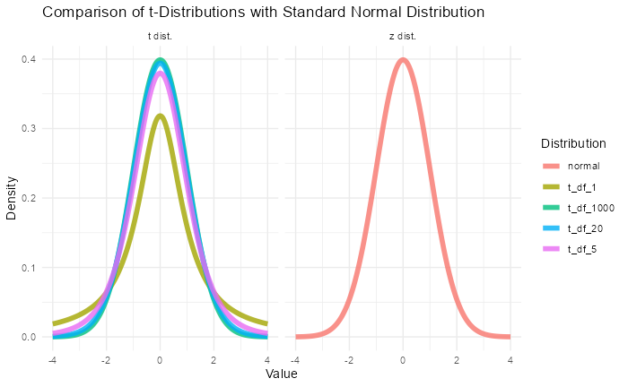
Z-test and t-test
When the sample size is sufficiently large, even if we don’t know the standard deviation of the population, the t distribution approximates the z distribution!
Thus, in a situation with a large sample size (say, 1000 observations), even if we don’t know the standard deviation of the population, we keep using a t-distribution (and t-test)… but if we use the z-distribution it wouldn’t change much.
We would have problems when we have very small sample sizes (say, n<30)

Slide 28
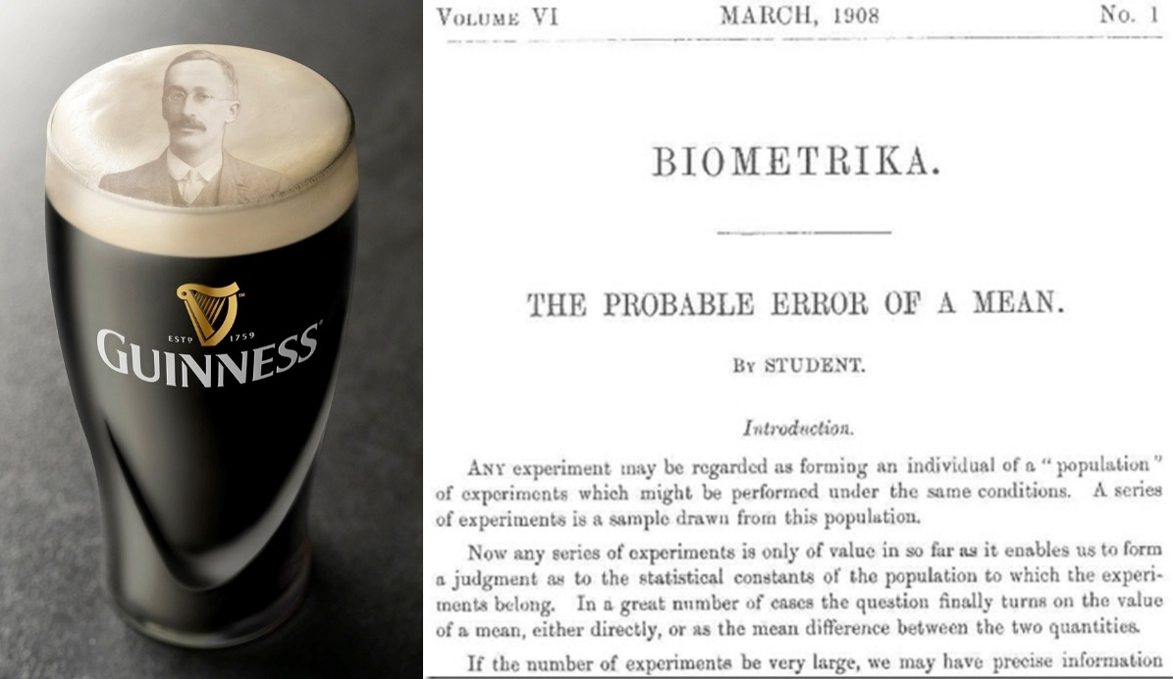
Hold by beer…
The t-test has an interesting story...
William Sealy Gosset (1876–1937), an English chemist and statistician, employed at the Guinness Brewery in Dublin, Ireland.​
Gosset faced challenges in quality control, particularly in assessing the chemical properties of barley with small sample sizes.
Existing statistical methods were inadequate for such small samples. So he developed a new statistical method to estimate the mean and variability from small samples, leading to the formulation of the t-distribution and the t-test.
In 1908, Gosset published his findings in the journal Biometrika under the pseudonym "Student" due to Guinness's policy against employees publishing under their real names
The method became known as Student's t-test, widely used for hypothesis testing when dealing with small sample sizes.

Slide 29
We cannot confirm an Hp
Final point: we cannot “confirm" the Null Hypothesis
In hypothesis testing, we are looking for evidence against the null hypothesis, not for it.
If we reject the null hypothesis (because the p-value is small), we have evidence that something is happening.
But if we do not reject the null hypothesis (because the p-value is large), it does not mean the null hypothesis is true — it only means we do not have enough evidence to prove it false.
We can return on this, but for now I leave it here…
95% c.i.s

Slide 30
R programming

Slide 31
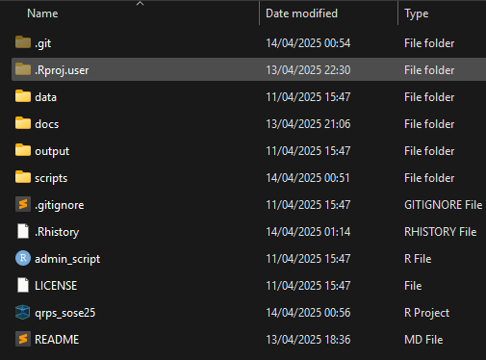
As said before…
A few rules that can make your life easier:
Create an R project
Create a simple, rational folder structure
Keep different file types in different folder
Create sub-folders
Keep it tidy
In naming there are no wrong answers,…
but use all lower case or upper case ( helps you in never forgetting the cases )
but use underscore in between
but make the name as general as possible
! You can create it with R!

Slide 32





As said before…
There is an additional software that can make your life easier
Git: version control system that tracks versions of files
Pros
Very useful backup of your code
Cons
You cannot backup files >~ 20mb
The basic version needs to be programmed using the OS console – e.g., cmd in Windows
But there’s GitHub
A (proprietary) developer platform that allows users to create, store, manage, and share their code.
painful

Slide 33

As said before…
If you want an understandable, efficient code…
DIY: Do it by yourself
KIS: Keep it simple
Be clear about inputs and ouputs
Break down problems, split tasks
Aggregate tasks in the output
DRY: Don’t repeat yourself
Do not perform the same calculation/operation twice
Instead define an object/a function
Write comments
Use Rstudio tabs
Debugging will become much much easier…

Slide 34
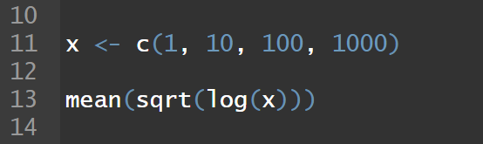
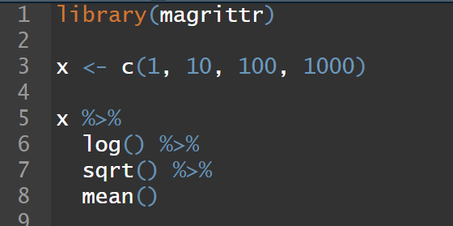
R base and the tidyverse
R has a native syntax which allows you to do amazing things. Nonetheless, it can be pretty dense, unreadable, convoluted
Because of this Wickham et al (2019) came up with the idea to create a complementary syntax and set of packages that allows you to do the same things that you would do in base R, but differently… and in a tidier, more readable, and more user friendly way.
The tidyverse Opinionated collection of R packages designed for data science. All packages share an underlying design philosophy, grammar, and data structures.

Slide 35

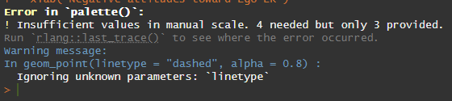
R packages
Packages are extensions to the R statistical programming language.
They allow you to do things without reinventing every time the wheel
But over-reliance on packages can be dangerous
They can be updated
They can be deleted
Your code might become be reproducible in the future

Slide 36






R packages
Now, we need to introduce some packages that will make your life much easier and are mostly part of the tidyverse.
Click on the icons!
haven
To load multiple types of datasets
dplyr a grammar of data manipulation
magrittr
famous for the pipe operator seen before
tidyr The goal is to help you create tidy data.
here extremely useful for avoiding to hard code every time the path to your files!
ggplot2 is a system for declaratively creating graphics, based on The Grammar of Graphics.

Slide 37
R packages
We will go through the packages during our hands-on sessions… but the tidyr package description gives you some indications that, in my opinion, are always useful:
The goal of tidyr is to help you create tidy data.
Tidy data is data where:
Each variable is a column
Each observation is a row
Each value is a cell
city | year | gdpchange
South Park | 2001 | -0.5451864
Springfield | 2001 | 1.4891976
South Park | 2002 | 1.4370989
Springfield | 2002 | 1.4935178
South Park | 2003 | 2.4436615
Springfield | 2003 | 1.5612424
South Park | 2004 | -0.9620170
Springfield | 2004 | -0.0697980
South Park | 2005 | 1.6643350
Springfield | 2005 | 1.0570046
Tidy dataset
Not tidy dataset
city | 2001 | 2002 | 2003 | 2004 | 2005
South Park | -0.5451864 | 1.437099 | 2.443662 | -0.962017 | 1.664335
Springfield | 1.4891976 | 1.493518 | 1.561242 | -0.069798 | 1.057005

Slide 38
Hands-on practice

Slide 39
Checkpoint
Git & Github
Did you fork and clone the repository? Issues?
Check the new hand-out in the class 3 folder!!

Slide 40
Formatting your script
There are very few clear rules about it
My (current) workflow (that you don’t have to follow, until you remain rational in your choices) is the following
Admin/Setup – install and load packages, and options of the session, and environment cleaning
Tab with the functions used in the session
Tab for data loading
Tab for data wrangling
Tab for the analysis
Tab for visualizations/tables
Tab for exporting the output datasets

Slide 41
Hands-on session
Admin/Setup – install and load packages, and options of the session, and environment cleaning
Load the data using here
Select the variable of interest
Check the distribution
Hints
We are working with one wave of a cross-sectional survey, this means that the rows represent an individual interviewed at one single point in time. Therefore the values in the columns (variables) are the replies of the respondent to the survey questions
People can also do not reply, because they don’t know the answer or other reasons
Usually these values are what we call “missing values”, and normally are dropped from the analyses

Slide 42
Assignments

Slide 43
Assignment #1
Come up with a research question about a variable that is “a matter of degree”
Select a dependent variable based on the 2019 European Election Study voter study questionnaire
Select another variable in order to test differences among groups
Your model
N.B.: This is not necessarily the one you’ll develop in you term paper… so no worries, but come up with something plausible
Confounder
Independent Variable
Dependent Variable

Slide 44
Assignment #2
Read these slides (again) – and those for the GitHub Workflow

Slide 45
Assignment #3
Read about test, p-values, etc.
Resources
See the references!
Agresti & Finlay (2009) - Chapters 4,5,6,7

Slide 46
Thank you for your attention!

