Slide 1
Welcome to HPC
Alexander Botzki
24 August 2025

Slide 2
Organisation and access

Slide 3
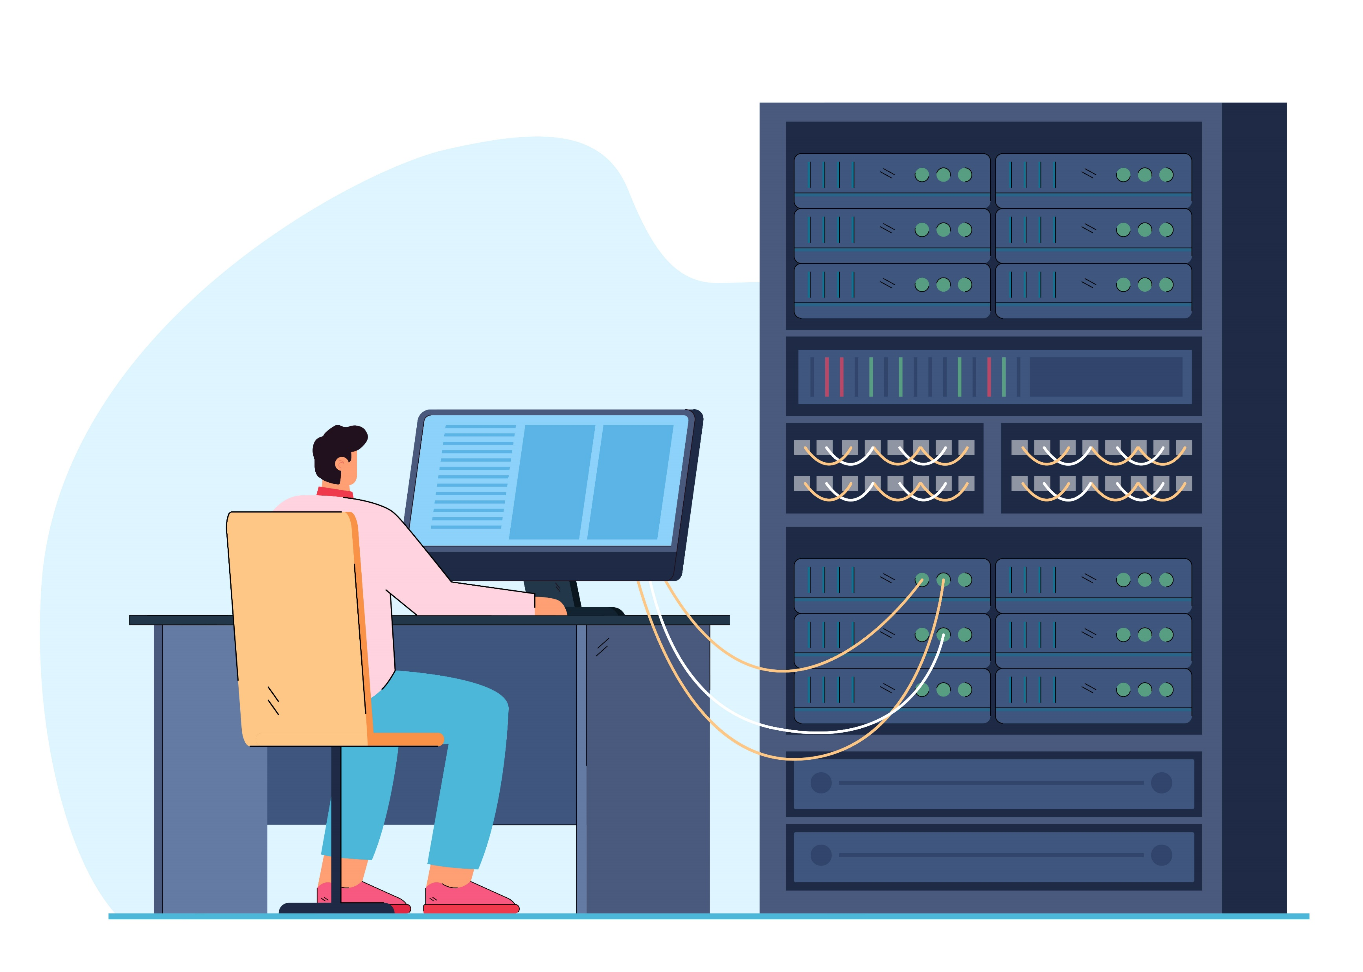
To cover in this course
1. When and what part of HPC to use for a specific task
2. Where to find additional resources for reproducible analysis/training
by @pch.vector on freepik
Notes:
Man using HPC image: https://www.freepik.com/free-vector/man-engineer-working-computer-server-rack-switchboard-guy-switching-panel-cabinet-with-plugged-ethernet-optical-cables-telecommunications-engineering-concept-flat-illustration_20827816.htm

Slide 4

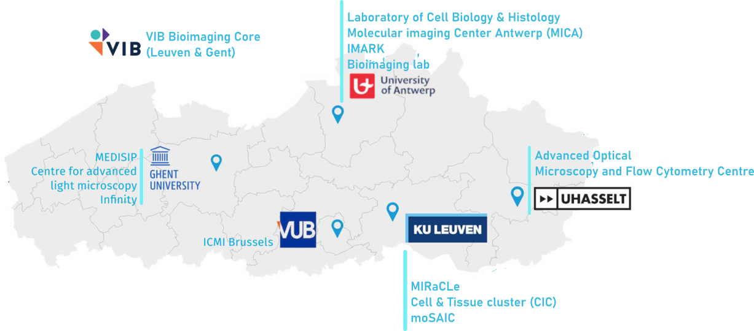
Flemish supercomputer centre (VSC)
Partnership between 5 Flemish universities (https://www.vscentrum.be/)
Tier-2
accessible through university
Tier-1
Accessible through projects
Different services:
Consultancy
Research collaboration
Trainings
Notes:
Flemish supercomputer : 5 Flemish university=> Tier 2 (provincial level) and Tier1 (regional level + mention projects), service

Slide 5



High performance computing
Tier-0
European
Tier-1
Regional/national
Tier-2
University
Tier-3
Desktop
Notes:
Explain the different level, start from the bottom, hive = Tier 2.5, Tier2, from Tier1: access through projects (mention academic don’t pay, industry do)

Slide 6
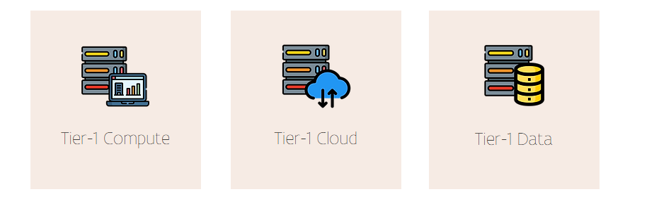

VSC components
Notes:
Today, we use 2 components: - analysis and data for storing, mention we will investigate tier-1 cloud future project

Slide 7

Questions
Where do you save the data?
Where do you the analysis ?
Where do you start when you log in?
Where to create the environment?
$VSC_HOME​ (low storage) $VSC_DATA​ (middle storage) $VSC_SCRATCH​ (large storage) $VSC_SCRATCH_PROJECTS_BASE​
(large storage)
Notes:
Activity: vsc home: logging, analysis: scratch_projects_base, vsc_data: code , data: backup if not to big in data

Slide 8
Structure cluster VSC
 | Tier-2 UGent | Tier-2 KULeuven | Tier-2 UA | Tier-1
$VSC_HOME | 3GB | 3 GB | 3GB (20000)
$VSC_DATA | 25GB | 75 GB | 25GB (100 000) | = Tier-2 from institute
$VSC_SCRATCH | 25 GB | 500 GB | 50GB | 3 GB (files 1048576)
$VSC_SCRATCH_PROJECTS_BASE |  |  |  | 10 TB (files 1048576) **
Check quota | quota | myquota | quota | my_dodrio_quota
Backed-up
Not
backed up
** With a good justification more can be requested
Notes:
Adapt color code, add backup and what it should contain

Slide 9


Creating a job: what you need
Queue for different types of jobs:
Memory
Presence | type of GPUs (NVIDIA, AMD)
Test queue (i.e. debug_queue)
Reservation:
To fast queueing
Used in projects
Used in training
Our flag for reservation
VIBtraining
Notes:
Queue systems : resources with different queue, depending on #people and resources asked more or less queue

Slide 10
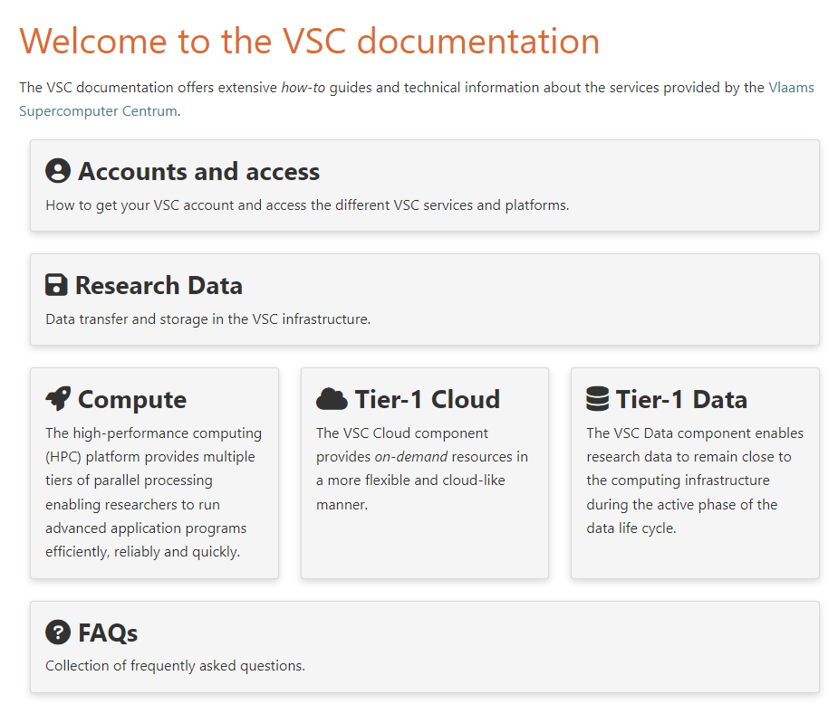
Documentation
Documentation VSC : link
What is the infrastucture
How to run jobs
Software info
How to request something
Activity:
Let’s navigate together!
Notes:
# navigate with them
Compute=> where to save data
Software
How to build software

Slide 11
Infrastructure

Slide 12

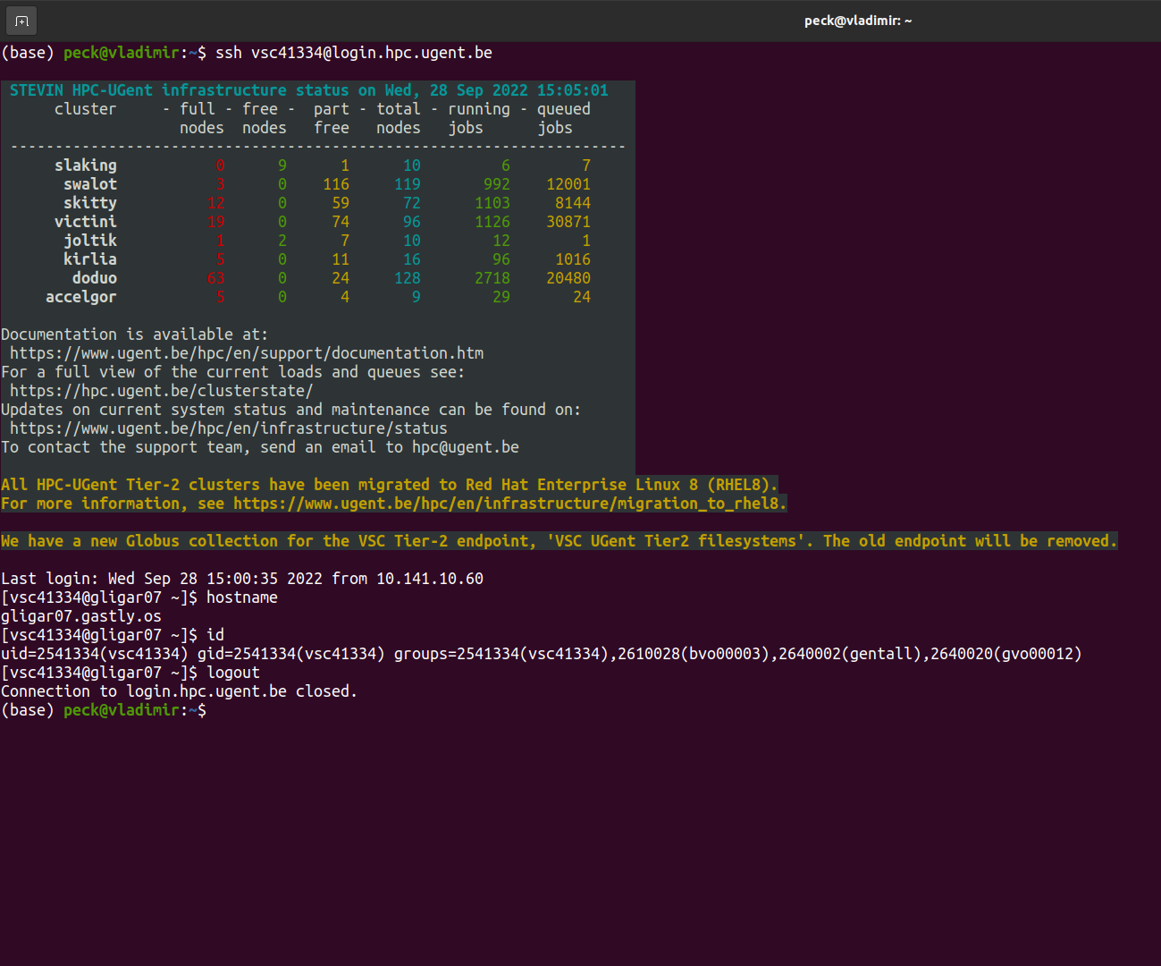
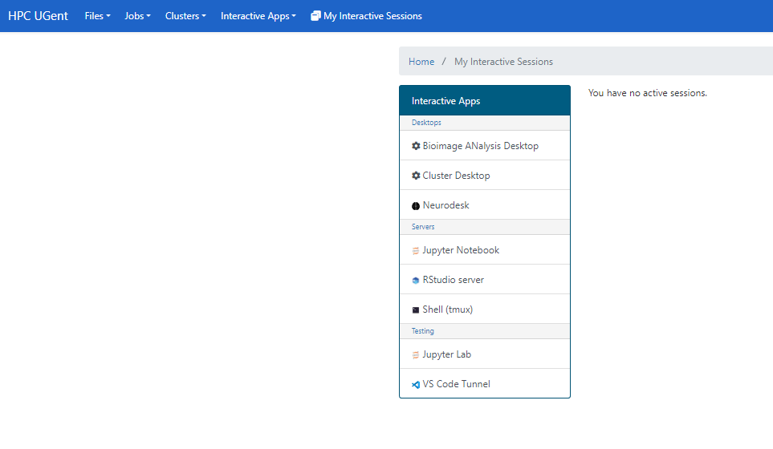
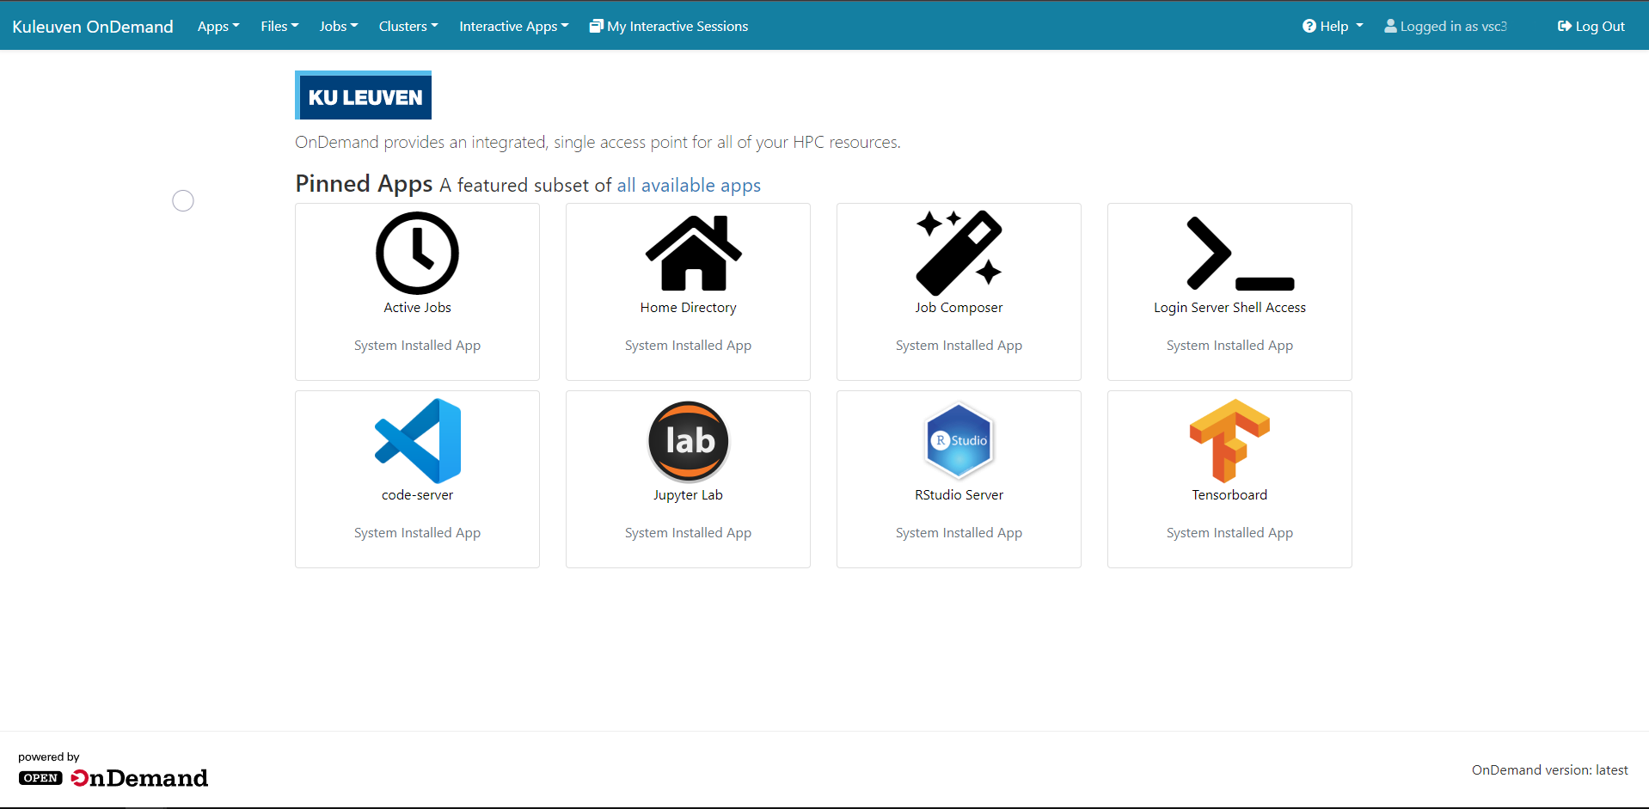
HPC before and now
Notes:
Slide after asking what do you know about HPC.
Question: when is the first HPC built?
Make the terminal bigger and put a picture of open on demand

Slide 13
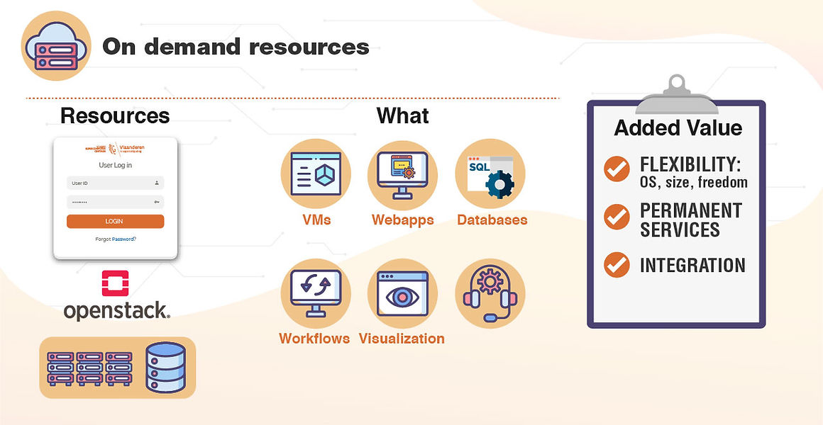
Open OnDemand framework
https://tier1.hpc.ugent.be/

Slide 14
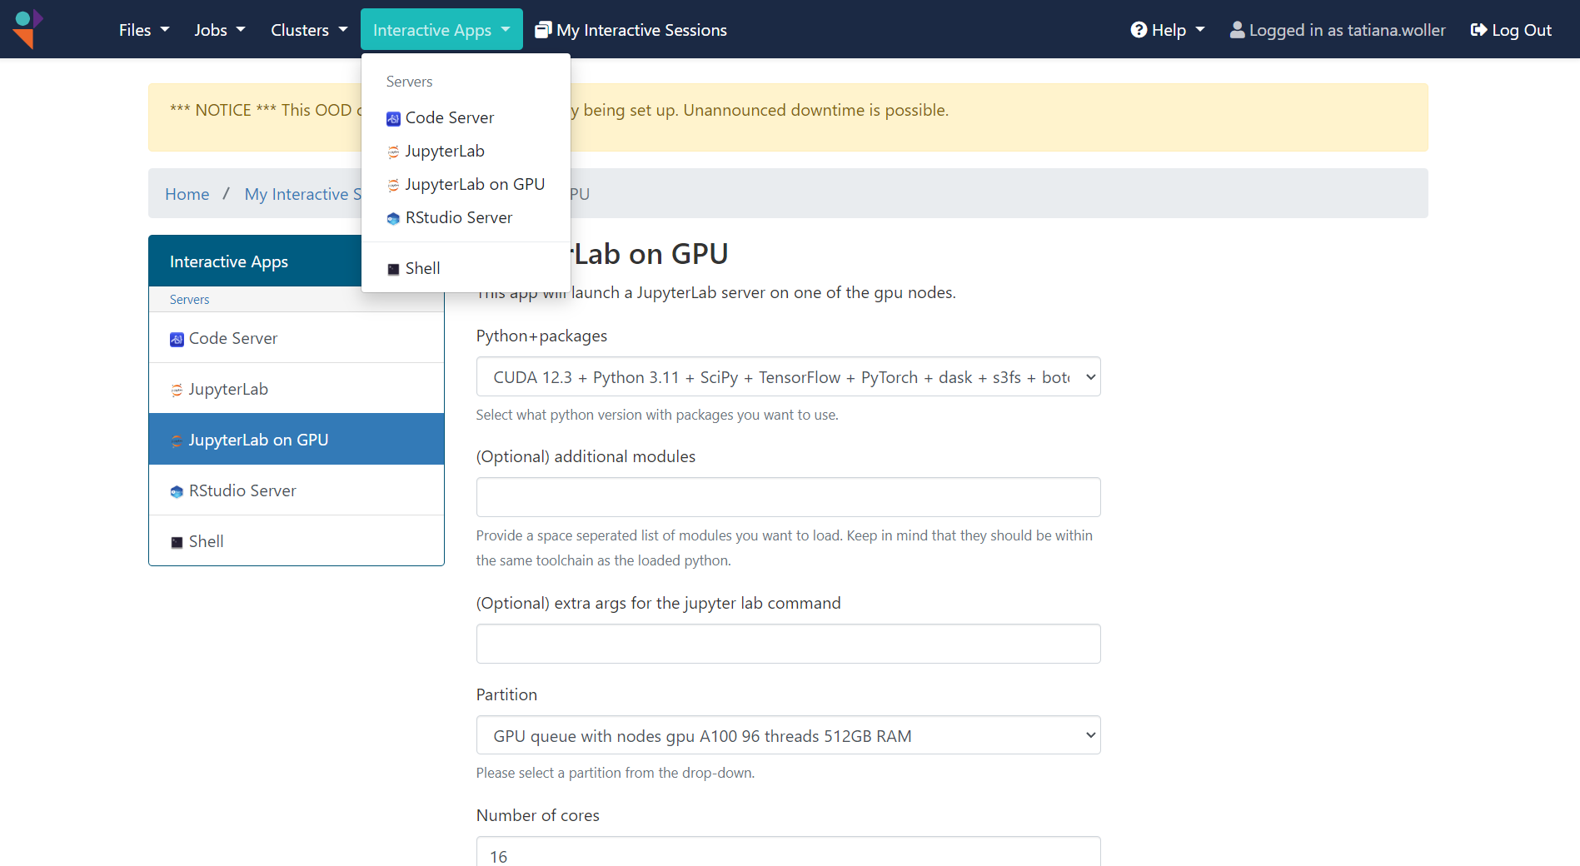
VIB compute
https://connect.vib.be/facilities/data-core

Slide 15














Different HPC flavours
Tier-2 UGent Tier-2 KUL
VIB compute Tier-1

Slide 16

Open OnDemand framework what to use
Image analysis on a remote desktop
Run a jupyter notebook with 2D visualization
Run automatic processes on a lot of files without visualization

Slide 17
HPC before and now
Notes:
Slide after asking what do you know about HPC.
Question: when is the first HPC built?
Make the terminal bigger and put a picture of open on demand

Slide 18
Open OnDemand framework
https://tier1.hpc.ugent.be/

Slide 19
VIB compute
https://connect.vib.be/facilities/data-core

Slide 20
Different HPC flavours
Tier-2 UGent Tier-2 KUL
VIB compute Tier-1

Slide 21
Open OnDemand framework what to use
Image analysis on a remote desktop
Run a jupyter notebook with 2D visualization
Run automatic processes on a lot of files without visualization

Slide 22
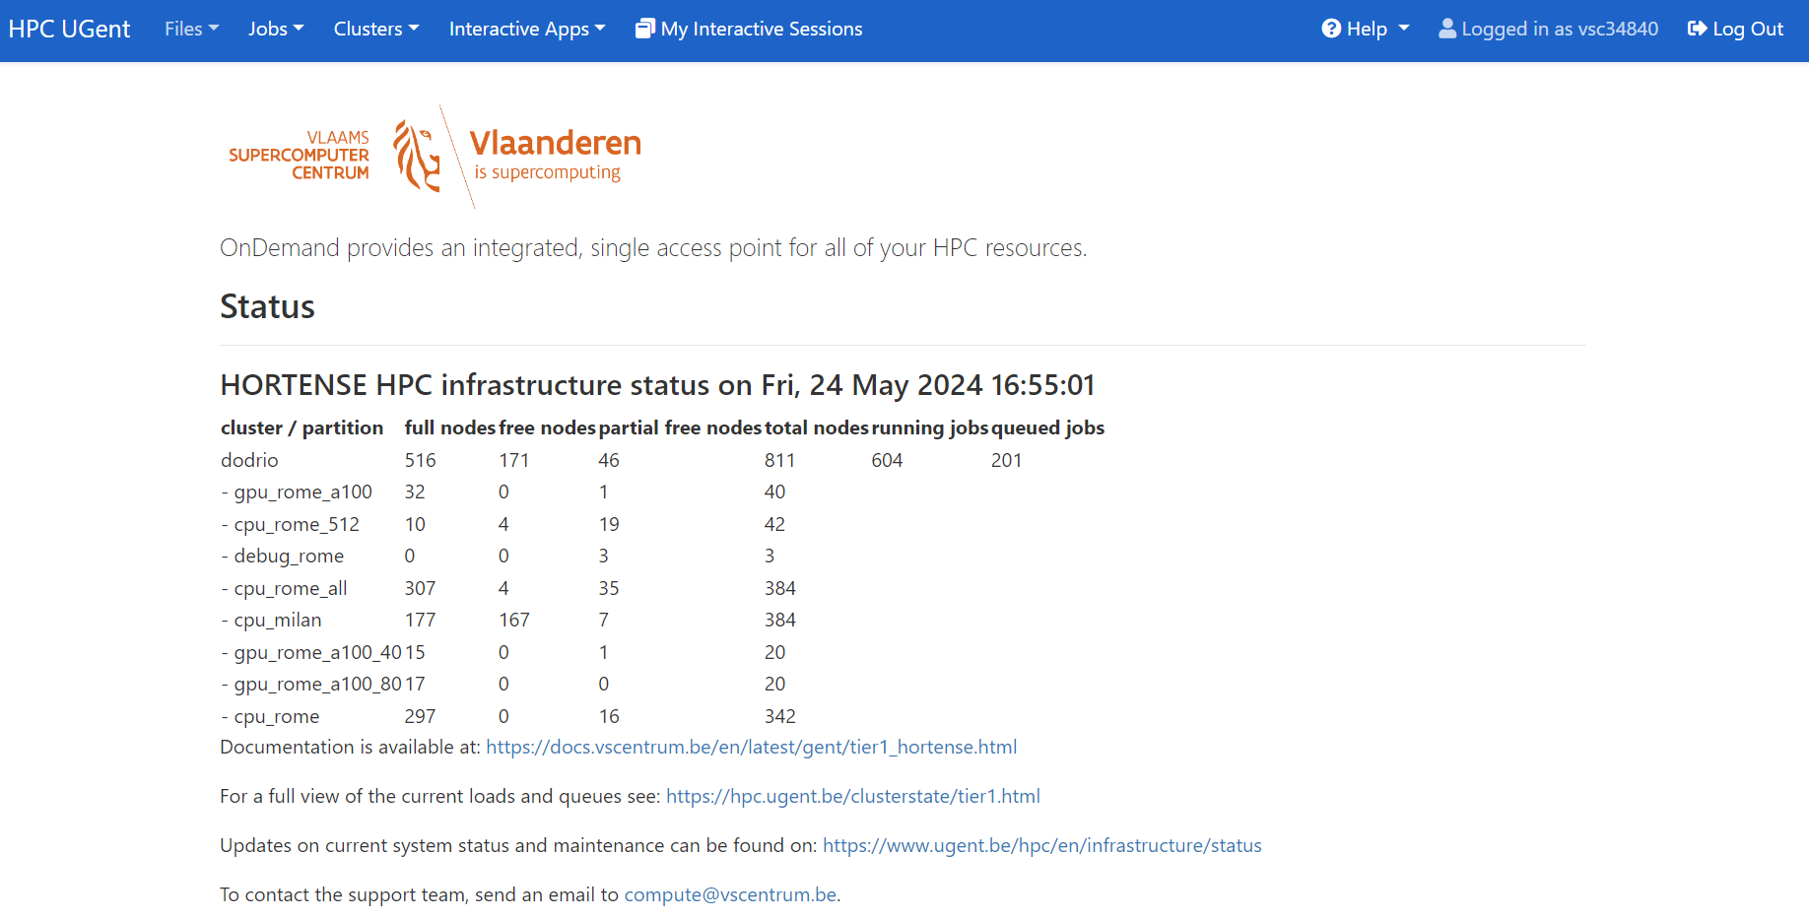
How to log in to Open On Demand
https://tier1.hpc.ugent.be/
Authentication through application (KUL, Microsoft)
Notes:
Go to url and do the authentification

Slide 23
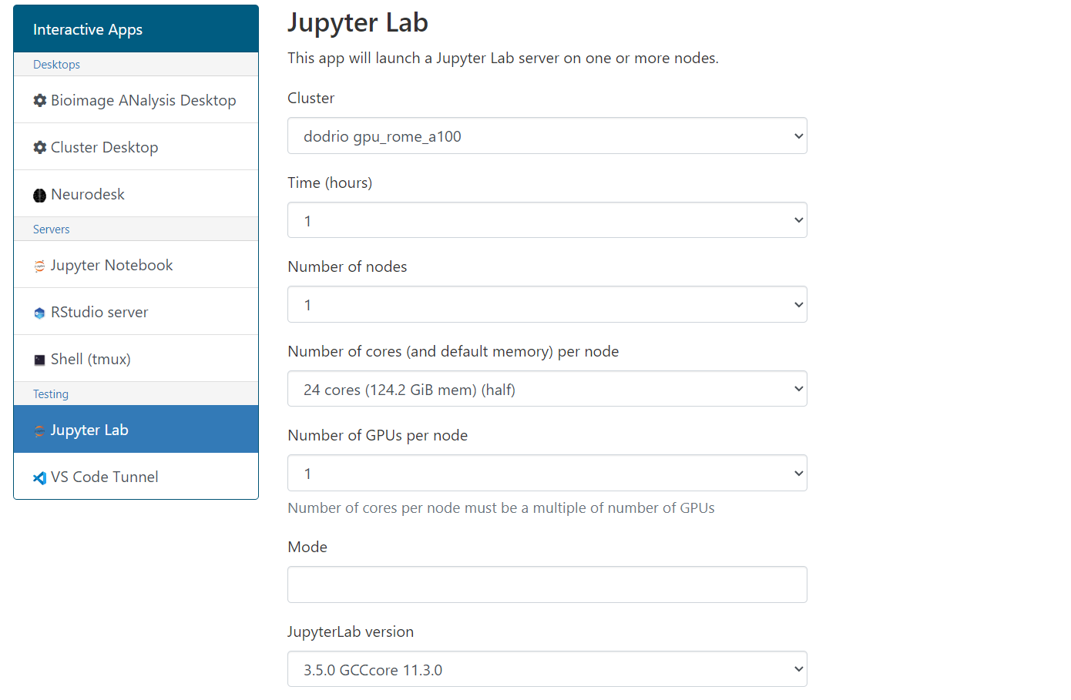
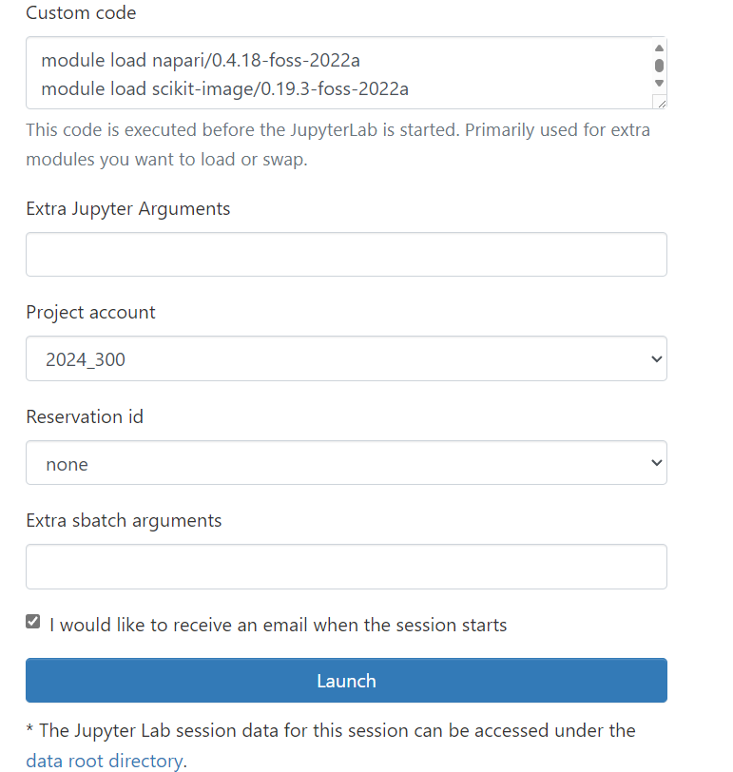
Jupyterlab
VIBtraining

Slide 24
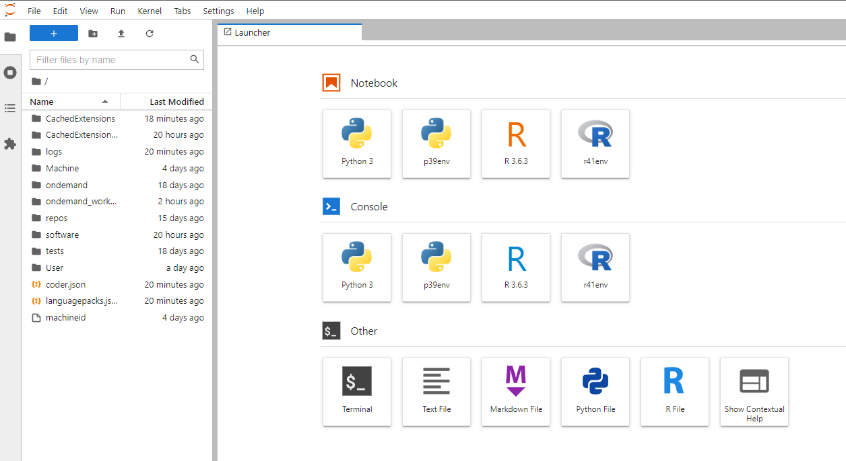
Jupyterlab

Slide 25
Which part of the VSC should I use for the following processes ?
A file conversion of a large lightsheet (100 GB) dataset to a standard format (OME-TIFFs)?
Fiji script to do the skeletonization of a brain sample ?
Denoising of an EM dataset using a notebook ?

Slide 26
Data transfer

Slide 27
How to log in to Open On Demand
https://tier1.hpc.ugent.be/
Authentication through application (KUL, Microsoft)
https://tier1.hpc.ugent.be/
Notes:
Go to url and do the authentification

Slide 28
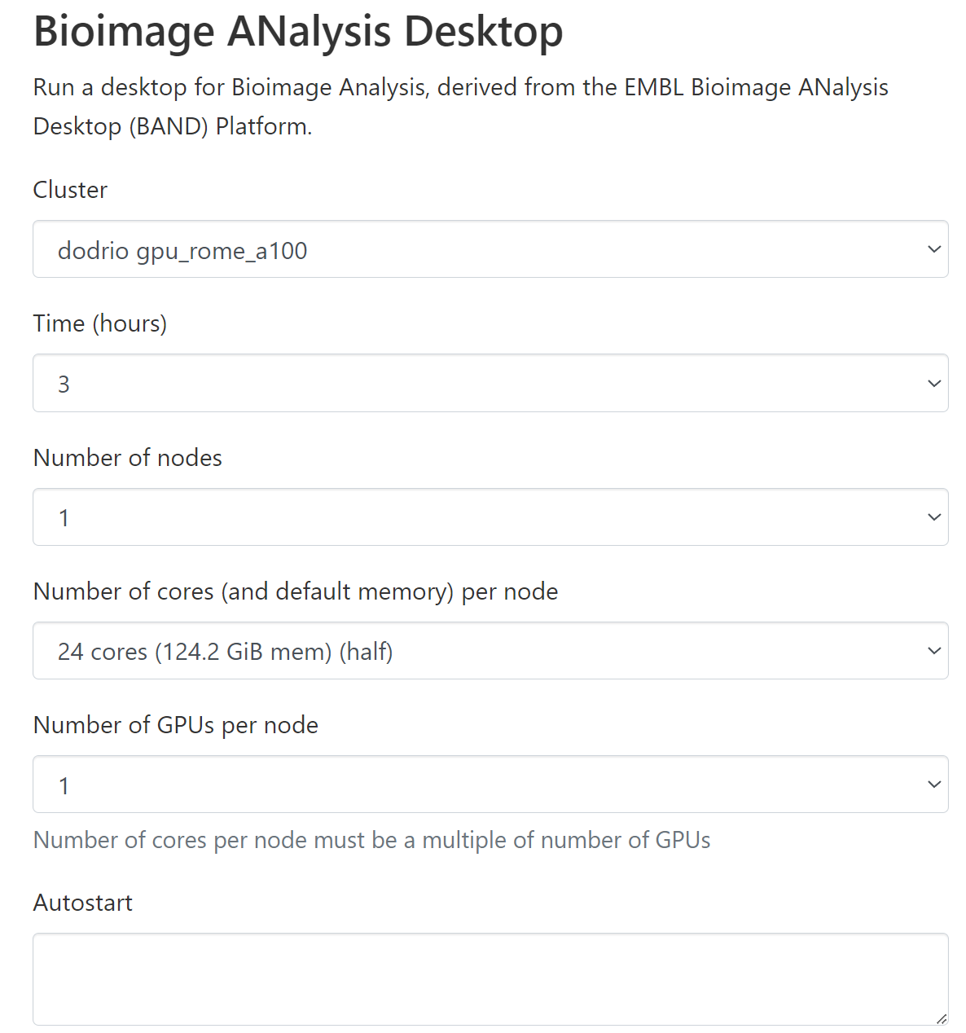
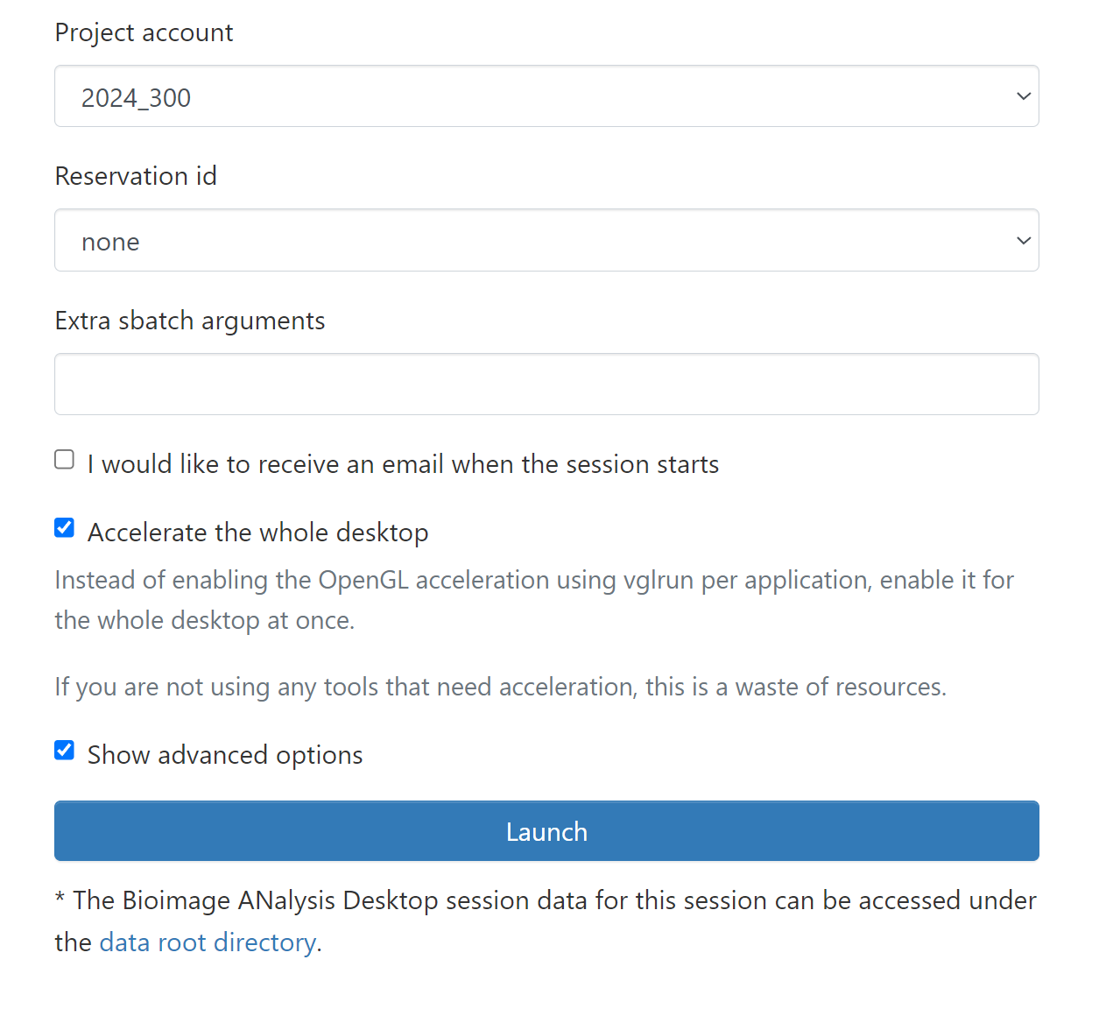
How to start Jupyterlab on the VSC
2024_301
gpu_rome_a100_80
vib_ml_summer_school_monday

Slide 29




A lot of software is installed on VSC
How to find software:
$ module av
$ module spider <software_name>
How to (un)load a software:
$ module load <software_name>
$ module unload <software_name>
$ module purge
Check which module is loaded:
$ module list
How to swap a module:
$ module swap …

Slide 30
Some useful command
Where are you: $pwd
To go to a map: $cd
To list the content of a map: $ls
To make/remove a map: $mkdir / rmdir
Check memory quota: my_dodrio_quota

Slide 31

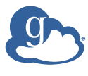





Globus enables a unified Access across disparate systems
Regional resources
Globus
HPC environment
Personal systems
Public cloud storage
Archive,
Repository
Microsoft Azure
Instrument
Notes:
To do add: globus explanation, mention bioimage archive and empiar

Slide 32

Data transfer
Possibilities
PC to Scratch
Scratch to Data
Automatic backup
To Data
Overnight
Computer can be off

Slide 33
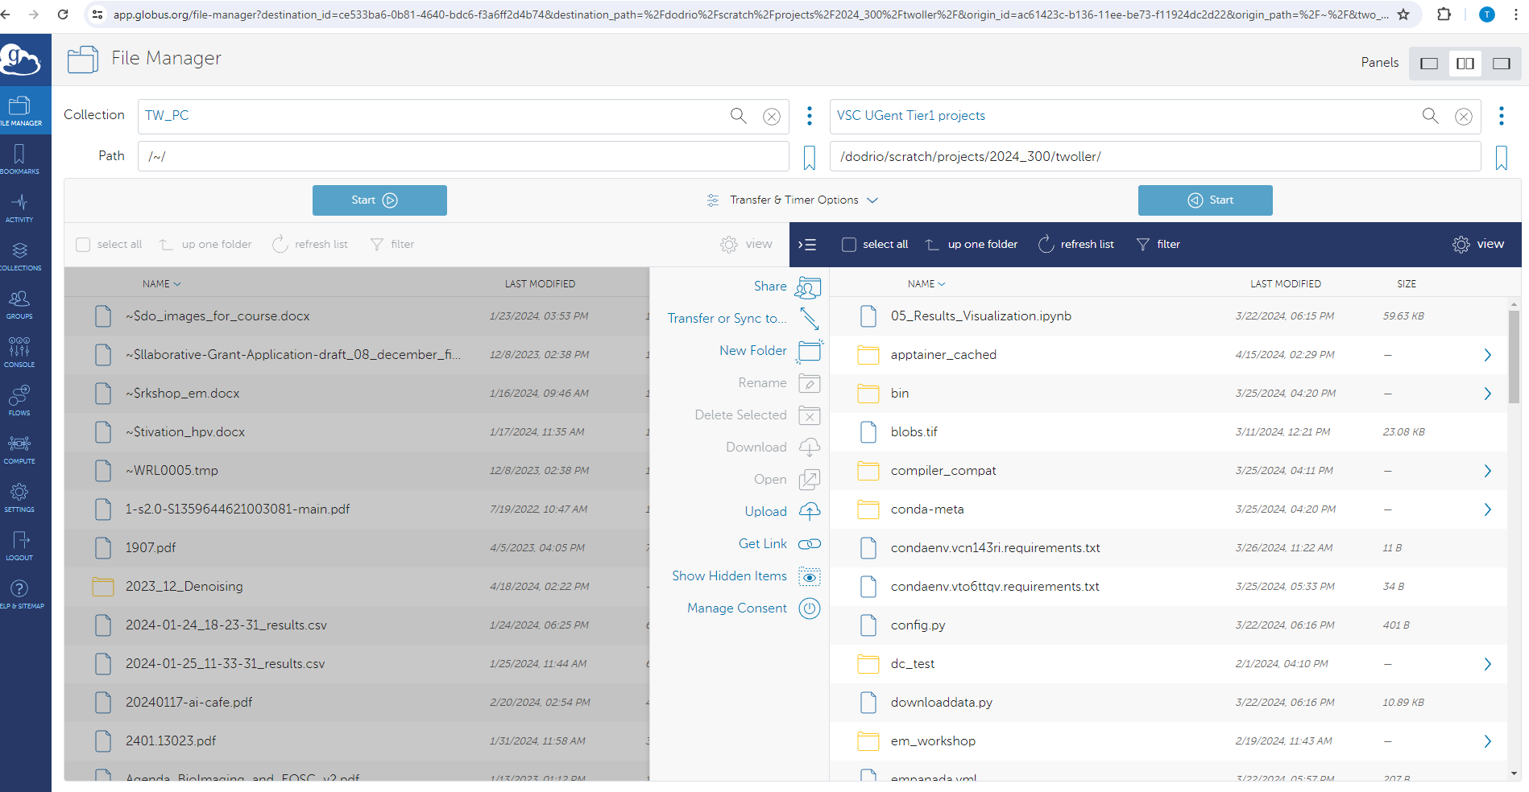
From your PC to $VSC_SCRATCH_PROJECT_BASE
Your_PC_name
2024_301
name
https://www.globus.org/globus-connect-personal

Slide 34
Exercise: how to use Globus
Installation: Globus personal: https://docs.globus.org/globus-connect-personal/install/
Select your Operating system
Browse to a folder and transfer an example file from your PC to $VSC_SCRATCH_PROJECTS/2024_301/<hackathon topic>/username

Slide 35
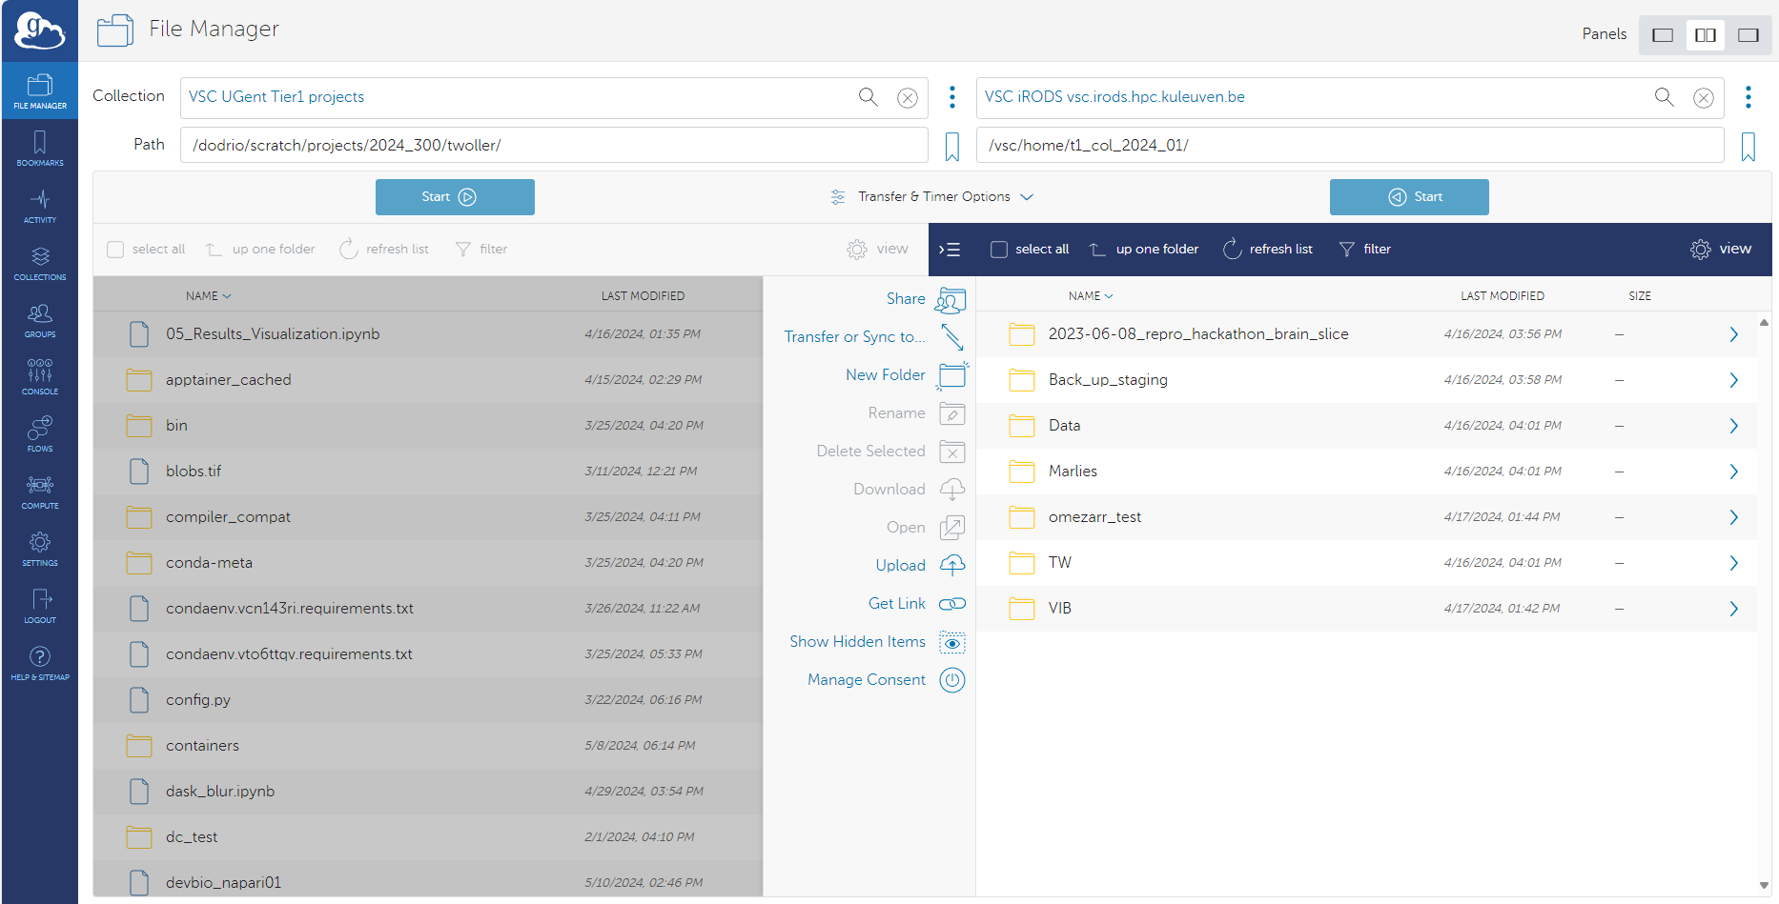

From $VSC_SCRATCH_PROJECT_BASE to backed-up data
Your_PC_name
name
https://www.globus.org/globus-connect-personal
Notes:
If time: do an exercise (add people to the collection)
Otherwise demo

Slide 36
Alexander Botzki

