Slide 1
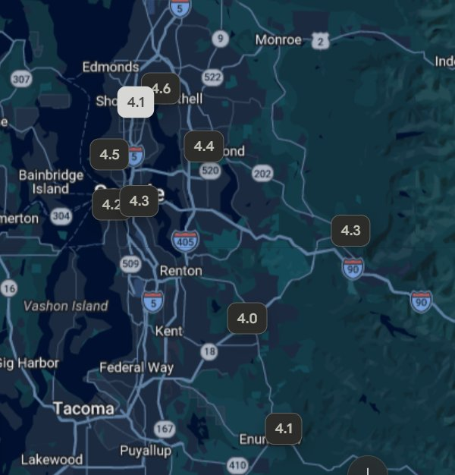
King County, WA — Historic Areas with Golf Courses
Interactive course map paired with nearby historic ZIP codes — pin numbers are Google ratings.
SEATTLE (IN-CITY)
Interbay Golf Center
98107 · Ballard
4.5
Jackson Park Golf
98125 · Maple Leaf
4.1
Bill Wright (Jefferson Park)
98108/98118/98144 · Columbia City · Beacon Hill
4.3
West Seattle Golf
98116/98126 · Admiral · Alki
4.2
EASTSIDE
Inglewood Golf Club
98028 · Kenmore (nr Bothell 98011)
4.6
Bellevue Golf Course
98005 · Bellevue
4.4
OUTLYING HISTORIC TOWNS
Mount Si Golf Course
98065 · Snoqualmie
4.3
Lake Wilderness Golf
Maple Valley 98038 (nr Black Diamond 98010)
4.0
Enumclaw Golf Course
98022 · Enumclaw
4.1
Screenshot: Google Maps · pin = average golfer rating

