Slide 1
Non-linear self-interference cancellation on base of mixed Newton method
Graduate student Degtyarev Alexander Andreevich Supervisor: DSc, Dvorkovich Alexander Viktorovich Scientific consultant: PhD, Bakhurin Sergey Alexeyevich
MIPT
Department of Multimedia Technologies and Telecommunications
2023-11-23

Slide 2
Introduction
Adaptive compensation of self-interference
Conclusions and further work
Contents
Introduction
In-band full-duplex systems data
Self-interference cancellation issue
Adaptive compensation of self-interference
Non-linear interference model
Mixed Newton method
Experimental setup
Simulation results
Conclusions and further work

Slide 3
Introduction
Adaptive compensation of self-interference
Conclusions and further work
Topic relevance
Requirements:
Effective resources arrangement among users
Networks with high reliability, low latency, and high data rates
In-band full-duplex technology (IBFD) provides:
Efficient exploitation of the spectrum, by frequency bandwidth sharing between transmitter and receiver
IBFD systems suffer from undesired self-interference at the receivers path

Slide 4
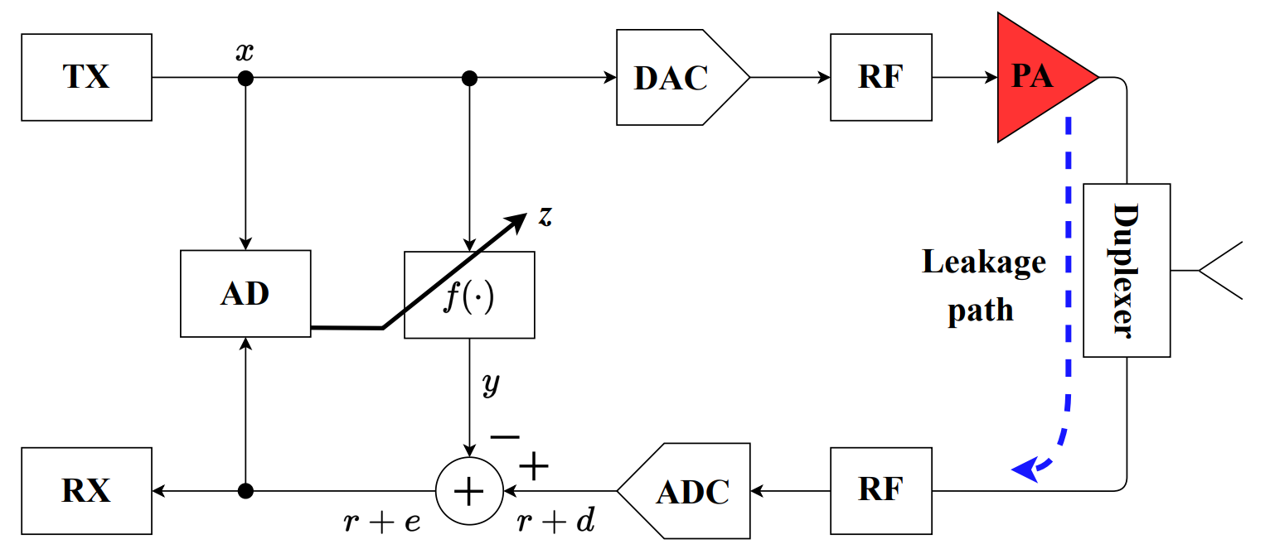
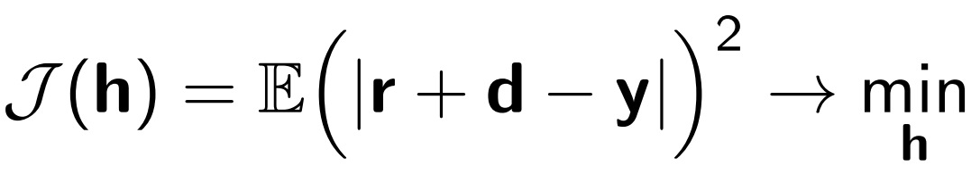
Introduction Adaptive compensation of self-interference
Self-interference cancellation (SIC) issue
Conclusions and further work
Figure: Full-duplex transceiver simplified scheme
RF-chipset integral implementation and isolation issues → TX leakage to RX
TX signal x is distorted in non-linear components (PA, Duplexer) and TX-RX leakage path
SIC is an interference identification task:
Degtyarev A., draw.io

Slide 5
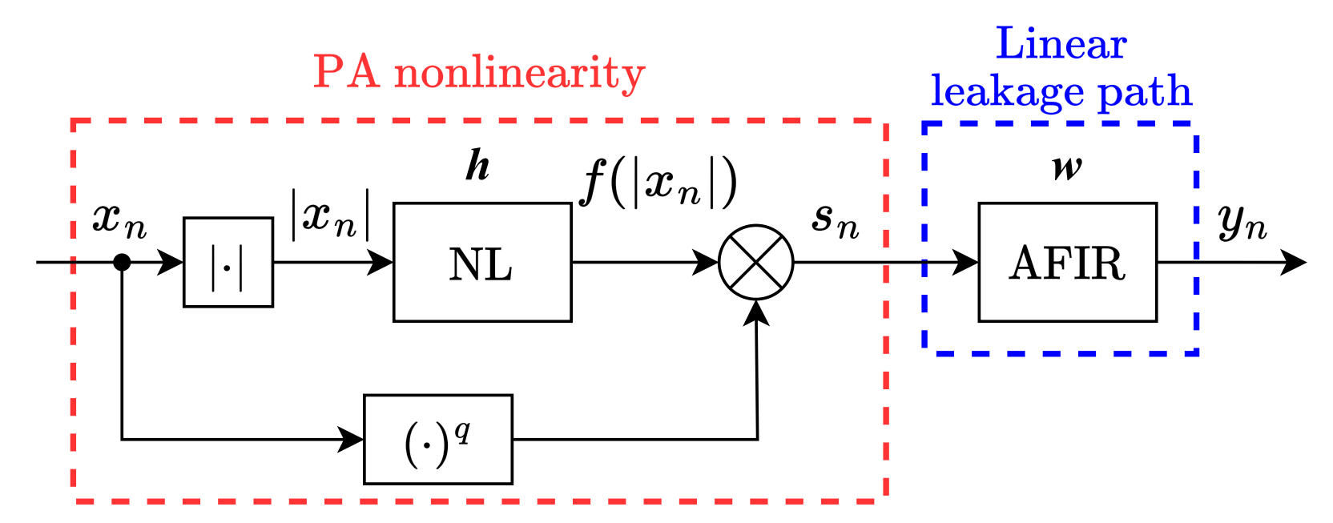
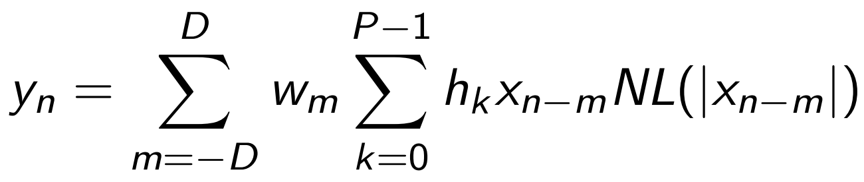
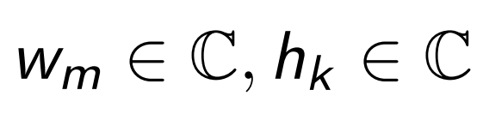
Introduction Adaptive compensation of self-interference
Non-linear interference model
Conclusions and further work
Degtyarev A., draw.io
Figure: Hammerstein model
Behavioral Hammerstein model describes interference creation physical process → low-complexity
Hammerstein model output sample:
– FIR and NL adaptive parameters.
5 / 11

Slide 6
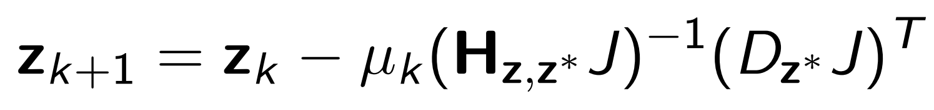
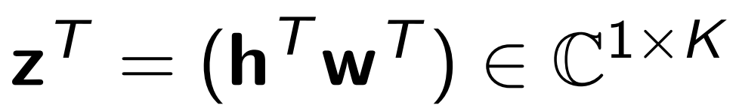
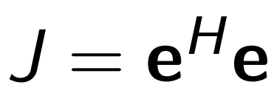
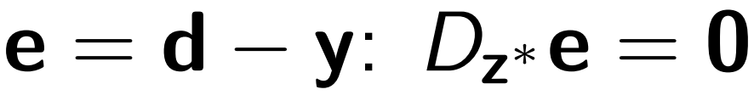
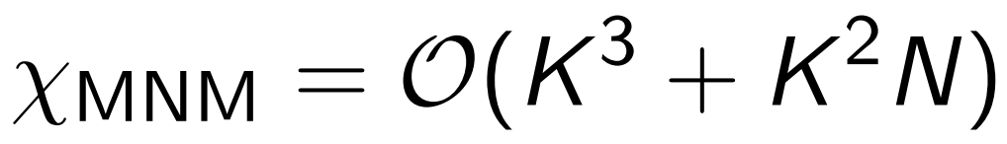
Introduction Adaptive compensation of self-interference
Introduction to mixed Newton method
Conclusions and further work
Mixed Newton method (MNM) – second order method:
– parameter vector, – MSE.
For holomorphic error , mixed hessian and gradient are expressed through jacobian:
For holomorphic error e method repulses from saddle points.
Computational complexity defined by hessian calculation and inversion:

Slide 7
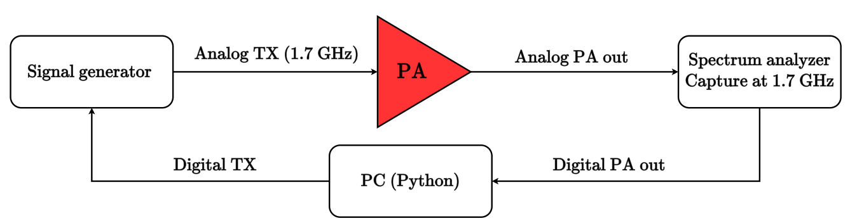
Introduction Adaptive compensation of self-interference
Experimental setup
Conclusions and further work
Degtyarev A., draw.io
Figure: Testbench {Degtyarev A., draw.io}
TX – QAM-modulated OFDM signal, 60 MHz bandwidth, 480 MHz sample rate
Average PA output power 20 dBm
Leakage path is simulated by digital FIR
Hammerstein model: NL – polynomial order 8, FIR – 45 taps

Slide 8
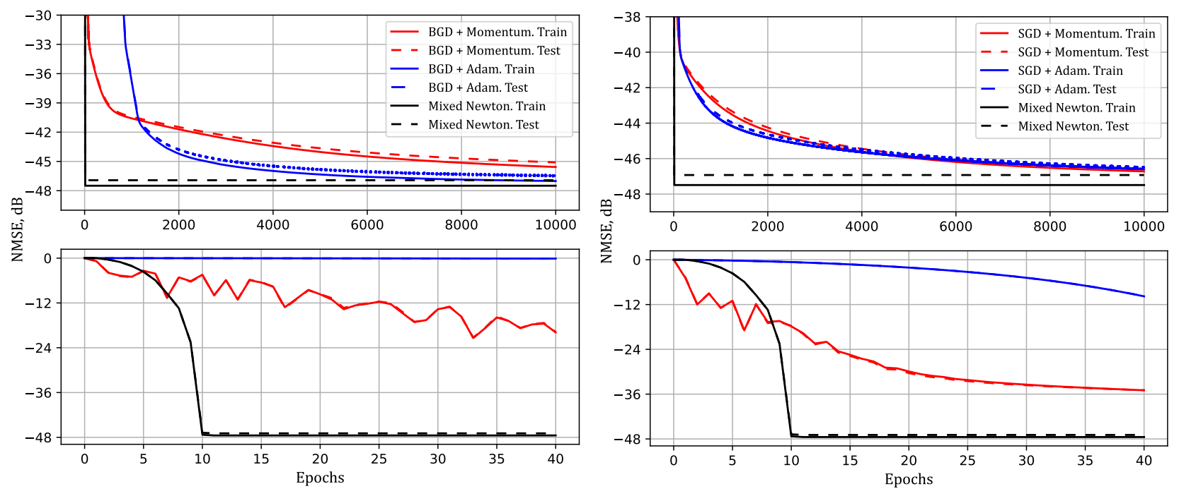
Introduction
Adaptive compensation of self-interference
Conclusions and further work
Learning curves
Degtyarev A., Python
(a) BGD with Momentum, BGD with (b) SGD with Momentum, SGD with
Adam and MNM learning curves on train and test data sets
Adam and MNM learning curves on train and test data sets
Mixed Newton achieves final performance in ∼30 epochs, comparing to gradient-based methods (∼10000 epochs)

Slide 9
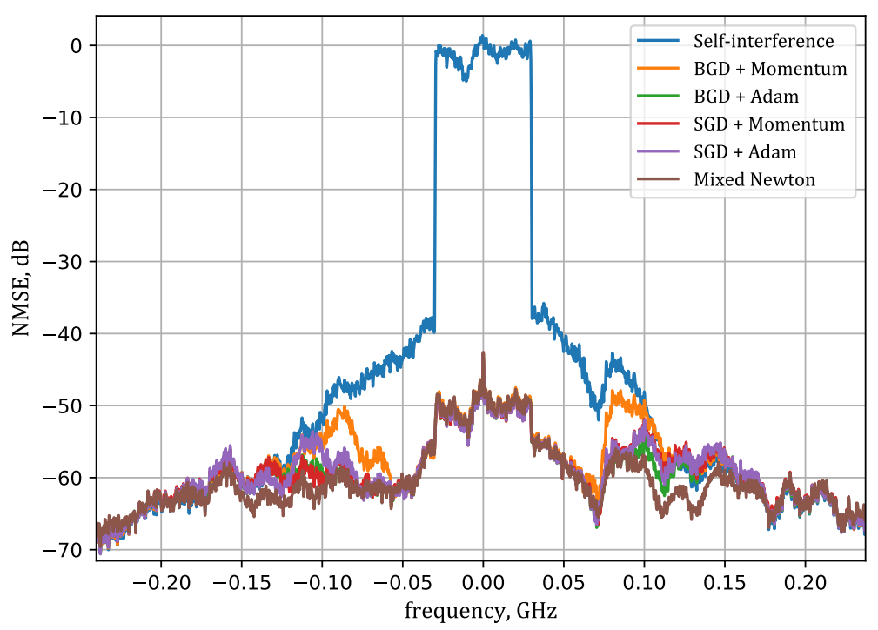
Introduction Adaptive compensation of self-interference
Algorithm performance
Conclusions and further work
Degtyarev A., Python
Figure: Power spectral densities of initial and suppressed interference. Signal power distribution along the frequency {Degtyarev A., Python}
9 / 11

Slide 10
Introduction Adaptive compensation of self-interference
Convergence speed comparison
Conclusions and further work
Table: Performance and convergence speed comparison
Algorithm | BGD Moment. | BGD Adam | SGD Moment. | SGD Adam | MNM
Epoch number | 10000 | 10000 | 10000 | 10000 | 30
Time per epoch, 10⁻² s | 3.8 | 4.0 | 3.7 | 4.1 | 21
Total elapsed tims, s | 380 | 403 | 386 | 412 | 6.2
NMSE, dB | -45.1 | -46.7 | -46.6 | -46.5 | -46.9
MNM step is ∼5 times longer comparing to gradient methods
Total convergence time decreased significantly
10 / 11

Slide 11
Introduction Adaptive compensation of self-interference
Conclusions and further work
Conclusions and further work
Total training time is decreased to 6 s comparing to 380 s for gradient-based methods to achieve ∼46.5 dB suppression
Mixed Newton requires high memory and computation resources due to hessian calculation and inversion
Mixed Newton can be modified by inverse hessian (or diagonal) estimation to reduce required resources
Application of modified version to complex-valued NN structures
11 / 11

