Slide 1

11 debugging tricks in Magento

Slide 2
Kovalenko Serhii
Engineer

Slide 3
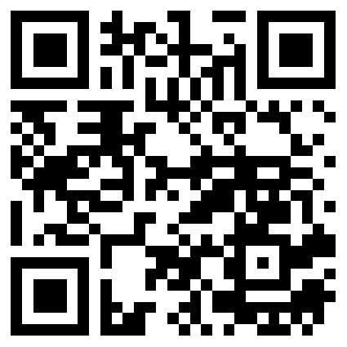
GitHub
https://github.com/sereban/mageconf2017

Slide 4

Layout

Slide 5

Layout
Root
Header
Content
Side Bar
…................
Footer

Slide 6
Where is my custom
block?
<block class="Magento\Framework\View\CustomBlock" name=”custom.block.name” template=”Magento_CustomModule::custom.phtml"/>

Slide 7
Layout Tree
Install
Apply {github}/layout/MageConfLayout.patch
bin/magento setup:upgrade --keep-generated
{url}?render_layout_tree=1
{url}?render_layout_tree=1&expand=1
Enable

Slide 8
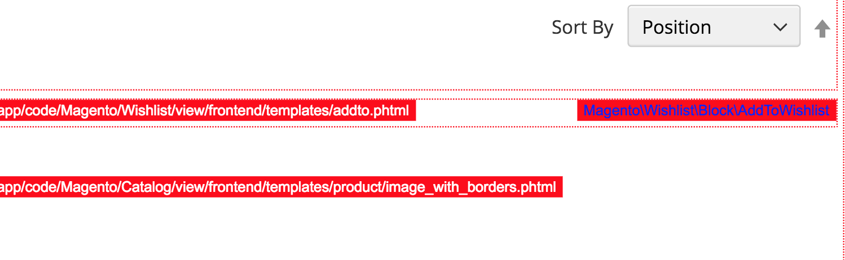
Alternative
Magento Admin
-> Stores Configuration
-> Advanced
-> Developer
-> Debug
-> Enable templates on StoreFront

Slide 9
Look at the code …
Magento\Framework\View\Layout\GeneratorPool
Magento\Framework\Data\Structure

Slide 10
Ui Component

Slide 11



In order to debug Ui components – you need to think as Ui components
How to debug Ui components?

Slide 12



Ui Technology stack

Slide 13

Debugging tools
Knockout
context debugger
UiRegistry
var registry = require('uiRegistry')

Slide 14
Look at the code…
Magento_Ui/js/grid/columns/column
Magento_Ui/js/grid/provider
Magento\Framework\View\Element\UiComponentFactory
Magento\Ui\Config\Data

Slide 15
Frontend Logger

Slide 16
Frontend logger for Dummies

Slide 17
Enable Frontend Logger
consoleLogger.setDisplayLevel(5);

Slide 18
XhProf theory and brief practice

Slide 19
XHProf+ XHGui

Slide 20
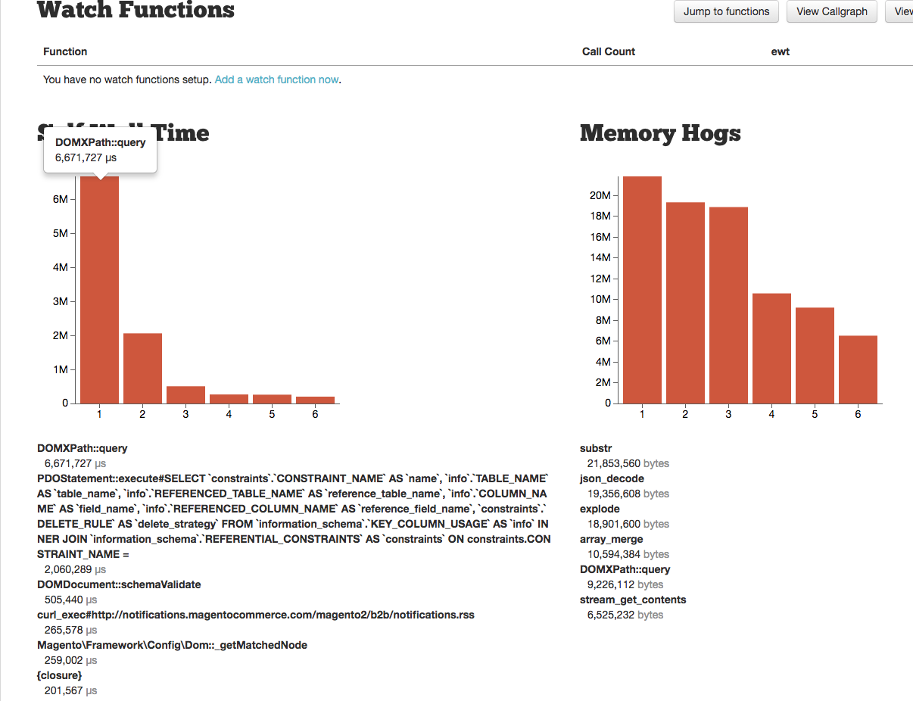

Slide 21
Magento Collection

Slide 22

Collections
Flat
EAV

Slide 23
$SQL = $collection
->getSelect()
->__toString();

Slide 24
Category Page
Magento\Catalog\Block\Product\ListProduct

Slide 25
Checkout

Slide 26

How to place order in one click
Product Cart Address Payment
Shipping method

Slide 27




Slide 28
Quick Order placement example
Installation
Apply patch from {github}/checkout/MageConfCheckout.patch
Command: bin/magento setup:upgrade –keep-generated
Create any product on backend

Slide 29
Transaction rollback
$connection->beginTransaction(); //...Code
//… All persisted into database data
//…Will be reverted
$connection->rollback();

Slide 30
Session hack
public function setData($key, $value = null) { //Avoid session storage modification }

Slide 31


Prevent loading or redirects

Slide 32


Debugging checkout success page

Slide 33
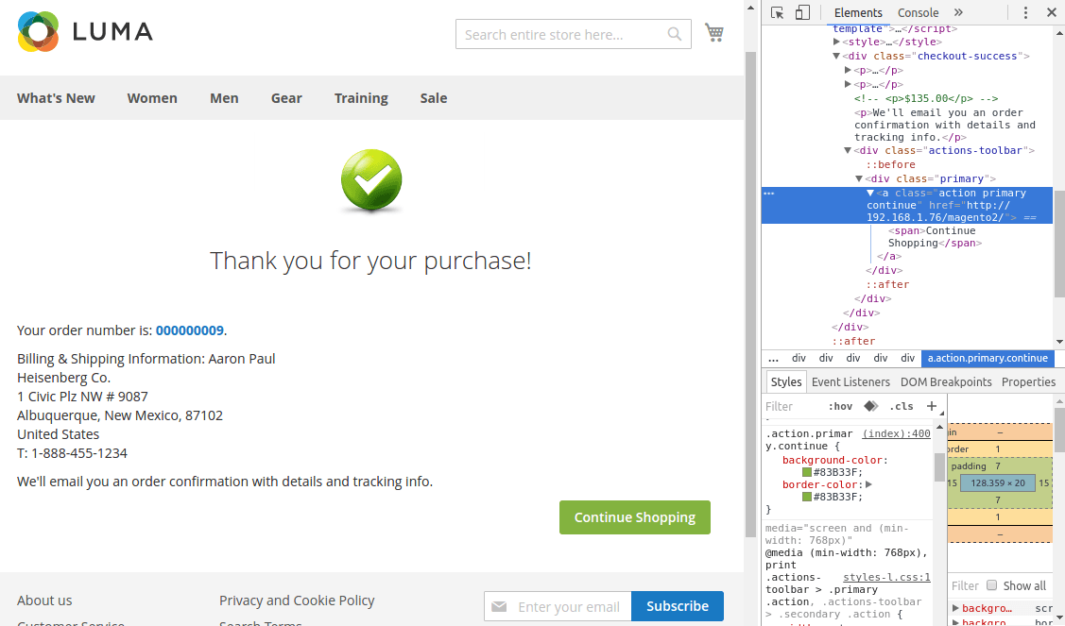

Slide 34
Look at the code…
Magento\Checkout\Controller\Onepage\Success
Magento\Checkout\Model\Session

Slide 35
Magento Setup

Slide 36
Setup Flow
2.0
2.1
2.5
…
PHP script
PHP script
PHP script
PHP script

Slide 37
Installation
Apply {github}/setup/MageConfSetup.patch
Command: bin/magento setup:upgrade –keep-generated
Change anything in MageConfSetup/InstallSchema.php
Do bin/magento setup:upgrade –keep-generated again
Repeat - Profit!

Slide 38
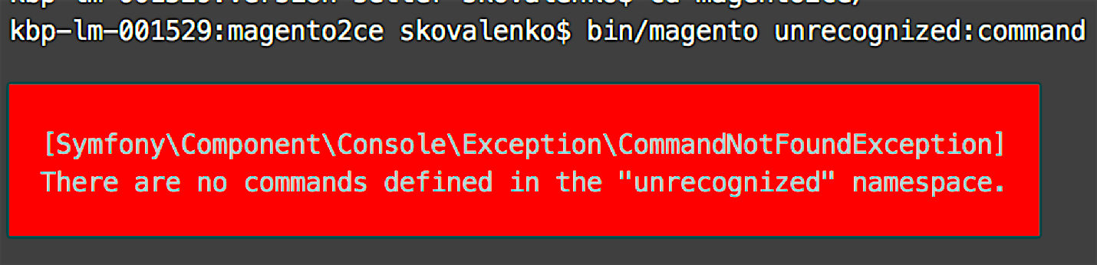
CLI not recognize my command

Slide 39
Installation
Apply patch {github}/cli/cli_bug.patch
Command: bin/magento setup:upgrade
Do any other CLI command
Observe error shown above

Slide 40
XML

Slide 41

How to become XML guru?
Override troubleshooting
Validation errors
Area specific scenarios

Slide 42
Magento
Routing

Slide 43
404 Page debug tricks
Base
CMS
Url Rewrite
Default

Slide 44
Let`s look at the code …
Magento\Framework\App\FrontController

Slide 45

Q & A

