Slide 1
Software Engineering
Introduction to Apache Hadoop Map Reduce
Lamprakis Panagiotis – 03113118

Slide 2
What is Apache Hadoop
Apache Hadoop is a framework designed for the processing of big data sets distributed over large sets of machines with commodity hardware.
The basic ideas have been taken from the Google File System (GFS or GoogleFS)

Slide 3
What does Apache Hadoop encompass.
Hadoop Common: Utilities that are used by the other modules.
Hadoop Distributed File System (HDFS): A distributed file system similar to the one developed by Google under the name GFS.
Hadoop YARN: This module provides the job scheduling resources used by the MapReduce framework.
Hadoop MapReduce: A framework designed to process huge amount of data

Slide 4
HDFS Architecture (1)
Assumptions of HDFS
Hardware Failure is seen more as a norm than as an exception. Instead of relying on expensive fault-tolerant hardware systems, commodity hardware is chosen. This not only reduces the investment for the whole cluster setup but also enables the easy replacement of failed hardware.
As Hadoop is designed for batch processing of large data sets, requirements that stem from the more user-centered POSIX standard are relaxed. Hence low-latency access to random parts of a file is less desirable than streaming files with high throughput.

Slide 5
HDFS Architecture (2)
Assumptions of HDFS
The applications using Hadoop process large data sets that reside in large files. Hence Hadoop is tuned to handle big files instead of a lot of small files.
Most big data applications write the data once and read it often (log files, HTML pages, user-provided images, etc.). Therefore Hadoop makes the assumption that a file is once created and then never updated. This simplifies the coherency model and enables high throughput.

Slide 6
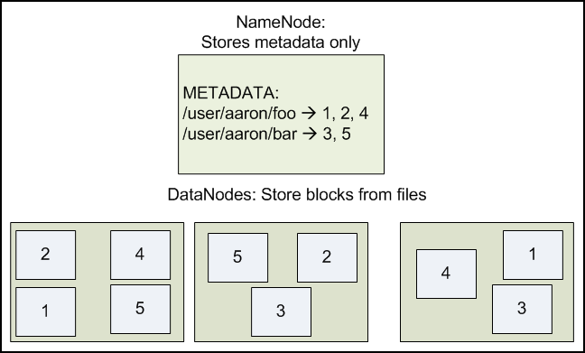
NameNode and DataNodes
One image is equal to a thousand words ...

Slide 7
HDFS: Robust against failures (1)
DataNode failure: Each DataNode sends from time to time a heartbeat message to the NameNode. If the NameNode does not receive any heartbeat for a specific amount of time from a DataNode, the node is seen to be dead and no further operations are scheduled for it. A dead DataNode decreases the replication factor of the data blocks it stored. To prevent data loss, the NameNode can start new replication processes to increase the replication factor for these blocks.
Network partitions: If the cluster breaks up into two or more partitions, the NameNode loses the connection to a set of DataNodes. These DataNodes are seen as dead and no further I/O operations are scheduled for them.

Slide 8
HDFS: Robust against failures (2)
NameNode failure: As the NameNode is a single point of failure, it is critical that its data (EditLog and FsImage) can be restored. Therefore one can configure to store more than one copy of the EditLog and FsImage file. Although this decreases the speed with which the NameNode can process operations, it ensures at the same time that multiple copies of the critical filesexist.

Slide 9


Hadoop MapReduce
Jeffrey Dean
Sanjay Ghewamat

Slide 10
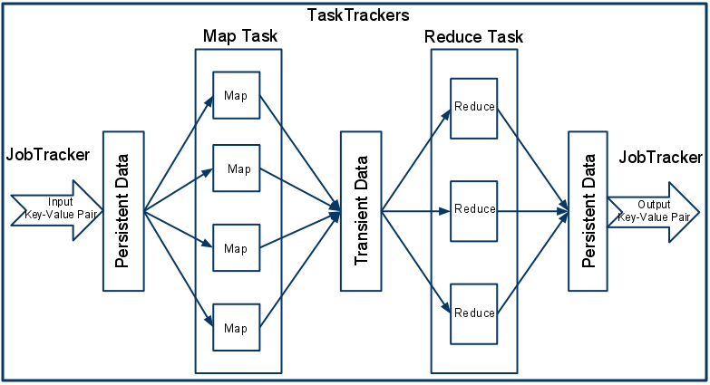
MapReduce Architecture

Slide 11
YARN
YARN (Yet Another Resource Negotiator) has been introduced to Hadoop with version 2.0 and solves a few issues with the resources scheduling of MapReduce in version 1.0.

Slide 12
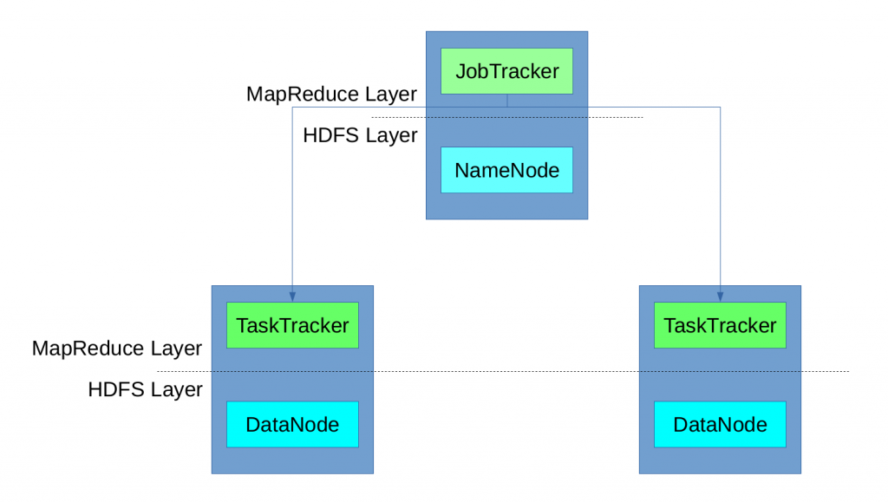
Before YARN

Slide 13
Cheat Sheet
A MapReduce job is split by the framework into tasks (Map tasks, Reducer tasks)
and each task is run on of the DataNode machines on the cluster. For the execution of tasks,
each DataNode machine provided a predefined number of slots (map slots, reducers slots).
The JobTracker was responsible for the reservation of execution slots for the different tasks
of a job and monitored their execution. If the execution failed, it reserved another slot and
re-started the task. It also cleand up temoprary resources and make the reserved slot
available to other tasks. Ηaving only one instance of the JobTracker limits scalability
(for very large clusters with thousands of nodes).
The concept of predefined map and reduce slots also caused resource problems
in case all map slots are used while reduce slots are still available and vice versa.

Slide 14
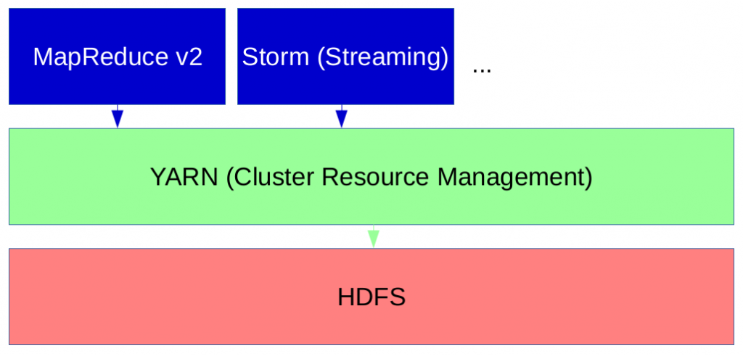
With YARN

Slide 15
Cheat Sheet
Hence Hadoop 2.0 introduced YARN as resource manager, which no longer uses
slots to manage resources. Instead nodes have "resources" (like memory and CPU cores)
which can be allocated by applications on a per request basis. This way MapReduce jobs
can run together with non-MapReduce jobs in the same cluster.
The heart of YARN is the Resource Manager (RM) which runs on the master node
and acts as a global resource scheduler. It also arbitrates resources between competing
applications. In contrast to the Resource Manager, the Node Managers (NM) run on slave
nodes and communicate with the RM. The NodeManager is responsible for creating
containers in which the applications run, monitors their CPU and memory usage and reports
them to the RM.

Slide 16
Let’s see a hands-on example on Hadoop MapReduce…

