Slide 1

LLMs meet Knowledge Graphs Exploring RDF graphs using Neuro-Symbolic AI
Alex Donkers
TU/e Built Environment Coding Café
29-10-2025

Slide 2

Alex who?
BSc Architecture
MSc Construction Management & Engineering
PhD Semantic Web Technologies & Digital Twins
Postdoc FireBIM & AM2PM
Learning CS one bug at a time😅

Slide 3
Why
Providing digitization of the built environment that …
... helps us to understand buildings better
… helps buildings to understand buildings better
… helps buildings to understand us better
… helps us to understand ourselves better?

Slide 4
Information in the Built Environment is messy.

Slide 5
It is crazy to ask architects and engineers to understand all this, let alone combine it with other information.

Slide 6
We take the position of an architect that wants to explore fire safety regulations using natural language.

Slide 7
Today
Knowledge graphs (RDF)
Ontologies (OWL)
Graphs meet LLMs
GraphRAG reasoning
https://github.com/AlexDonkers/ISBECodingCafe/

Slide 8
Module 1 Knowledge graphs
subject
predicate
object
Tabellenboek
Rule 6.27.3
has

Slide 9
Module 1 Knowledge graphs
NEN 6064
inspired
Tabellenboek
Rule 6.27.3
has
written by
Noordhoff

Slide 10
Module 1 Knowledge graphs
https://www.noordhoff.nl#Rule_6-27-3
https://www.example.org#has
https://www.noordhoff.nl#Tabellenboek
https://www.example.org#writtenBy
https://www.noordhoff.nl#Noordhoff

Slide 11
Module 1 Knowledge graphs
https://www.example.org#hasText
https://www.noordhoff.nl#Rule_6-27-3
“Tweezijdige wapening van kolommen voor C25 – B500”
https://www.example.org#has
https://www.noordhoff.nl#Tabellenboek
https://www.example.org#writtenBy
https://www.noordhoff.nl#Noordhoff

Slide 12
Module 1 Knowledge graphs
fro:hasText
nh:Rule_6-27-3
“Tweezijdige wapening van kolommen voor C25 – B500”
fro:has
nh:Tabellenboek
fro:writtenBy
nh:Noordhoff
https://www.noordhoff.nl#Tabellenboek > nh:Tabellenboek

Slide 13
Module 1 Knowledge graphs
@prefix nh: <https://www.noordhoff.nl#>
@prefix fro: <https://www.firebim.org/ontologies/fro#>
nh:Tabellenboek
fro:has nh:Rule_6-27-3 ;
fro:writtenBy nh:Noordhoff .
nh:Rule_6-27-3
fro:hasText “Tweezijdige wapening van kolommen voor C25 – B500” .

Slide 14
Module 1 Knowledge graphs
@prefix nh: <https://www.noordhoff.nl#>
@prefix fro: <https://www.firebim.org/ontologies/fro#>
nh:Tabellenboek
fro:has nh:Rule_6-27-3 ;
fro:writtenBy nh:Noordhoff .
nh:Rule_6-27-3
fro:hasText “Tweezijdige wapening van kolommen voor C25 – B500” .
SPARQL
SELECT ?text
WHERE {
?rule fro:hasText ?text .
}
>>>
“Tweezijdige wapening van kolommen voor C25 – B500”

Slide 15
Module 2 Ontologies
fro:Clause
fro:hasClause
fro:Document
Ontology
= Abstract representation of concepts
fro:hasAuthority
fro:Authority
is a
nh:Rule_6-27-3
fro:hasClause
nh:Tabellenboek
Data
= Real-world phenomena or ‘things’
fro:hasAuthority
nh:Noordhoff

Slide 16
Module 2 Ontologies
@prefix fbr-nl: <http://www.firebim.org/regulations/nl#>
@prefix fro: <https://www.firebim.org/ontologies/fro#>
@prefix fbo: <https://www.firebim.org/ontologies/fbo#>
fbr-nl:Clause_3.46
rdf:type fro:Clause ;
fro:hasText "De volgens NEN 6075 bepaalde weerstand tegen rookdoorgang van een subbrandcompartiment naar een besloten ruimte in het brandcompartiment is ten minste 20 minuten."@nl .
fro:isAbout fbo:FireCompartment

Slide 17
Module 2 Ontologies
fro:RegulatoryDocument
fro:Authority
fro:hasAuthority /
fro:isAuthorityOf
fro:Standard
fro:issues /
fro:isIssuedBy
fro:Jurisdiction
fro:TechnicalGuideline
fro:Document
fro:hasJurisdiction /
fro:isJurisdictionOf
fro:hasSubdivision /
fro:isSubdivisionOf
fro:hasSubdivision /
fro:isSubdivisionOf
fro:hasAnnex / fro:isAnnexOf
fro:DocumentSubdivision
fro:hasStatement / fro:isStatementOf
rdfs:label
^^xsd:String
fro:hasTitle / fro:isTitleOf
fro:Annex
fro:Statement
fro:hasSubclause / fro:isSubclauseOf
fro:hasID
^^xsd:String
fro:hasChapter / fro:isChapterOf
fro:Title
fro:Item
fro:hasAppendix / fro:isAppendixOf
fro:hasVersion
^^xsd:String
fro:hasSubchapter / fro:isSubchapterOf
fro:Chapter
fro:Appendix
fro:hasTable / fro:isTableOf
fro:hasText
^^xsd:String
fro:hasSection / fro:isSectionOf
fro:Subchapter
fro:Table
fro:hasFigure / fro:isFigureOf
fro:hasOfficialPublication
fro:Reference
fro:hasParagraph / fro:isParagraphOf
fro:Section
fro:Figure
fro:hasEquation / fro:isEquationOf
fro:hasIssueDate
^^xsd:Datetime
fro:hasArticle / fro:isArticleOf
fro:Paragraph
fro:Equation
fro:hasPublicationDate
^^xsd:Datetime
fro:Article
fro:hasValidDate
^^xsd:Datetime
fro:hasAnnex ⊑ fro:hasSubdivision
fro:hasTitle ⊑ fro:hasSubdivision
fro:hasChapter ⊑ fro:hasSubdivision
fro:hasSubchapter ⊑ fro:hasSubdivision
fro:hasSection ⊑ fro:hasSubdivision
fro:hasParagraph ⊑ fro:hasSubdivision
fro:hasArticle ⊑ fro:hasSubdivision
fro:hasStatement ⊑ fro:hasSubdivision
fro:hasSubclause ⊑ fro:hasSubdivision
fro:hasAppendix ⊑ fro:hasSubdivision fro:hasTable ⊑ fro:hasSubdivision
fro:hasFigure ⊑ fro:hasSubdivision
fro:hasEquation ⊑ fro:hasSubdivision
fro:isAnnexOf ⊑ fro:isSubdivisionOf
fro:isTitleOf ⊑ fro:isSubdivisionOf
fro:isChapterOf ⊑ fro:isSubdivisionOf
fro:isSubchapterOf ⊑ fro:isSubdivisionOf
fro:isSectionOf ⊑ fro:isSubdivisionOf
fro:isParagraphOf ⊑ fro:isSubdivisionOf
fro:isArticleOf ⊑ fro:isSubdivisionOf
fro:isStatementOf ⊑ fro:isSubdivisionOf
fro:isSubclauseOf ⊑ fro:isSubdivisionOf
fro:isAppendixOf ⊑ fro:isSubdivisionOf fro:isTableOf ⊑ fro:isSubdivisionOf
fro:isFigureOf ⊑ fro:isSubdivisionOf
fro:isEquationOf ⊑ fro:isSubdivisionOf
fro:references / fro:isReferencedBy
fro:isAbout & fro:isApplicableTo
fro:Reference
fro:Topic
fro:replaces /
fro:isReplacedBy
fro:Document ∪ fro:DocumentSubdivision

Slide 18
Module 3 Graphs meet LLMs
Until now, we discussed symbolic AI.
When introducing LLMs, we’ll touch the neural part of AI.
Symbolic is great, because it is white-box reasoning.
But, creating such symbolic representations is time-consuming.

Slide 19
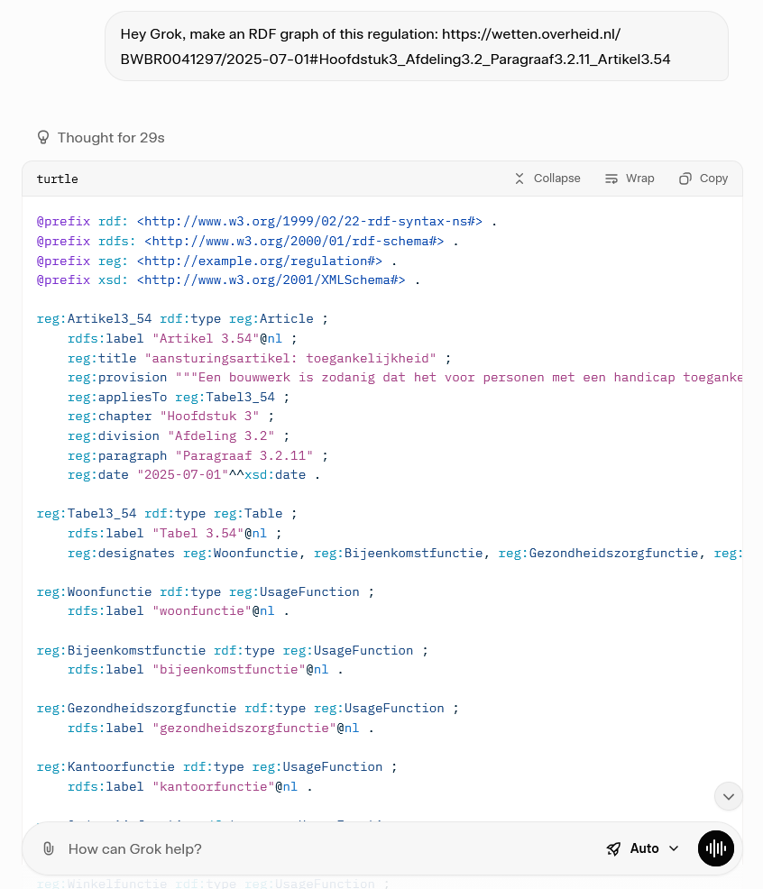
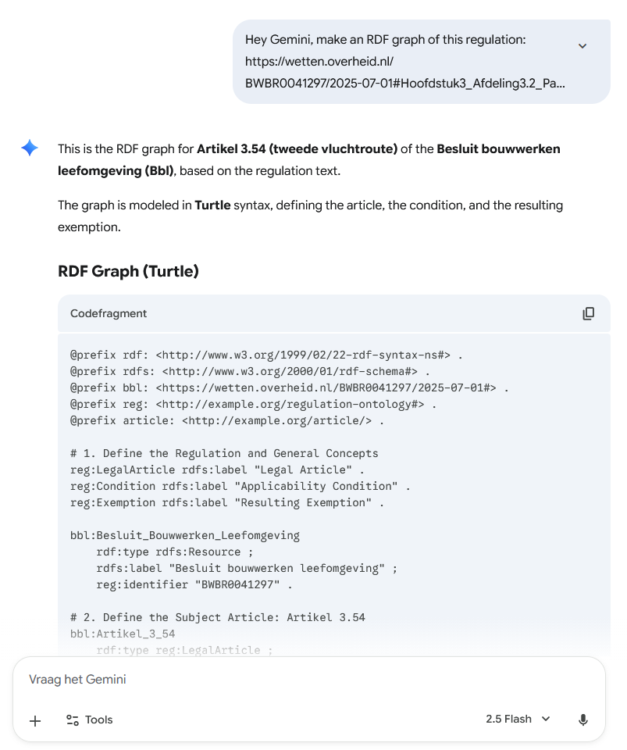
This is the wrong article
This is Gemini’s own interpretation of the article

Slide 20
Module 3 Graphs meet LLMs
Combining the strengths of symbolic AI and neural AI,
in this case, graphs and LLMs,
is what we call neuro-symbolic AI

Slide 21
Module 3 Graphs meet LLMs
More specifically is the development of GraphRAG, or Graph Retrieval Augmented Generation
Generation > LLM produces text from internal knowledge
RAG > LLM uses retrieved documents as context to improve answer
GraphRAG > LLM uses knowledge graph to retrieve connected concepts, not just raw text, leverages the graph structure and produces answers that reflect how concepts are connected
Slightly different from Supervised Fine-Tuning (‘training’) as the LLM itself doesn’t change, it now just reasons over the extra information.

Slide 22




Module 3 Graphs meet LLMs
Basic Generation pipeline
Question
Prompt
Generate answer

Slide 23

Module 3 Graphs meet LLMs
Basic RAG pipeline
Question
Prompt
Generate answer
Information retrieval e.g. vector database

Slide 24

Module 3 Graphs meet LLMs
Basic GraphRAG pipeline
Question
Prompt
Generate answer
Graph querying

Slide 25
Module 3 Graphs meet LLMs
fbr-nl:Clause_3.46
rdf:type fro:Clause ;
fro:hasText "De volgens NEN 6075 bepaalde weerstand tegen rookdoorgang van een subbrandcompartiment naar een besloten ruimte in het brandcompartiment is ten minste 20 minuten."@nl .
fro:isAbout fbo:FireCompartment
Pipelines that we’ll test today:
Question
“Extend the regulation
graph with topics”
Prompt
Generate answer
Extended regulation graph
Graph querying
Regulation Graph & Ontologies

Slide 26

Module 3 Graphs meet LLMs
fbr-nl:Clause_3.46
rdf:type fro:Clause ;
fro:hasText "De volgens NEN 6075 bepaalde weerstand tegen rookdoorgang van een subbrandcompartiment naar een besloten ruimte in het brandcompartiment is ten minste 20 minuten."@nl .
fro:isAbout fbo:FireCompartment
Pipelines that we’ll test today:
Question
“Convert my question
to a SPARQL query”
Prompt
Generate answer
SPARQL query
Graph querying
Example Q&A database & Ontologies
Extended regulation graph

Slide 27
Module 3 Graphs meet LLMs
Pipelines that we’ll test today:
Question
“Summarize the result
of the previous query”
Prompt
Generate answer
Natural language answer
Graph querying
Extended regulation graph & Ontologies

Slide 28
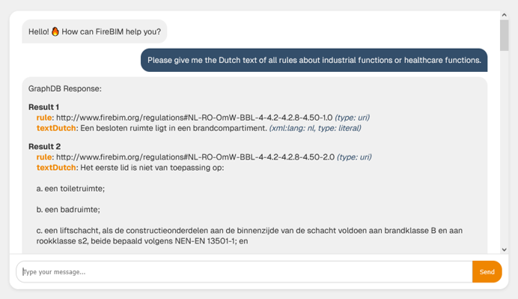
Chatbot example

Slide 29
Let’s start coding! 🚀
Make a Gemini API key: https://aistudio.google.com/app/api-keys
Open the Notebook: https://colab.research.google.com/drive/1_Z2fGH9IzpnvosbnmclMQuU0T9b3oy0q?usp=sharing
Star/Fork the GitHub repository: https://github.com/AlexDonkers/ISBECodingCafe/
Ideas or comments? Please add an Issue or send an email

Slide 30
Thanks for joining!
Other open software and data:
https://github.com/AlexDonkers
Research:
https://research.tue.nl/nl/persons/alex-ja-donkers/
Big thanks to Özgün / TU/e Built Environment Coding Café, Eureka ITEA4 FireBIM and RVO

