Slide 1
ONTOLOGY NAME
Author
Change colors using right-mouse click > Format Background

Slide 2
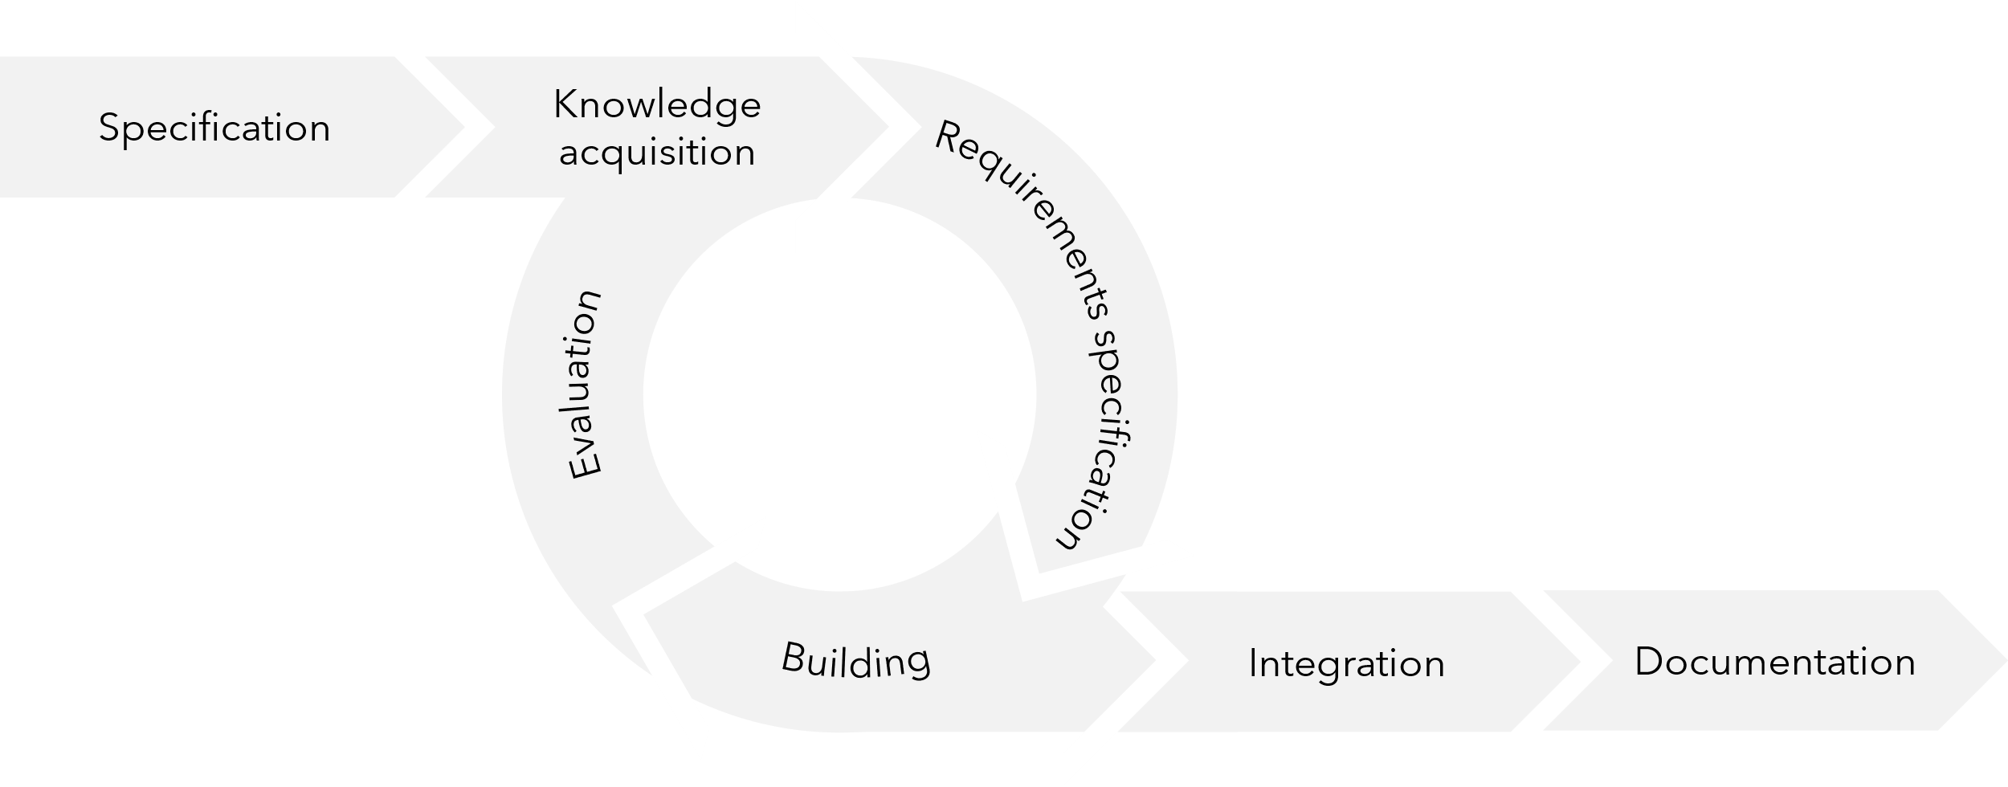
Ontology engineering cycle
Tools
Ontology editor
https://protege.stanford.edu/
Ontology validator
https://oops.linkeddata.es/
Turtle validator
http://ttl.summerofcode.be/
Register your prefix
https://www.prefix.cc
Register your w3id
https://github.com/perma-id/w3id.org
Create html documentation
https://dgarijo.github.io/Widoco/
SPARQL visualizer
https://madsholten.github.io/sparql-visualizer/

Slide 3
IDEAS

Slide 4
2022-01-01 Brainstorm meeting
How to deal with problem x?
ont:objectProperty2
ont:objectProperty3
ont:Class1
ont:Class2
ont:Class3
ont:objectProperty1
ont:objectProperty4
ont:Class4

Slide 5
ONTOLOGY NAME V0.1
Author
Date

Slide 6
Ontology name
rdfs:subClassOf
owl:ObjectProperty
owl:DatatypeProperty
rdfs:Class
rdfs:Literal
Class
Literal

Slide 7
Queries
SPARQL
PREFIX ont: <https://w3id.org/ont#>
PREFIX ont2: <https://w3id.org/ont2#>
SELECT ?s ?p ?o
WHERE {
?s ?p ?o . }

Slide 8
ONTOLOGY NAME V0.2
Author
Date

Slide 9
Ontology name
rdfs:subClassOf
owl:ObjectProperty
owl:DatatypeProperty
rdfs:Class
rdfs:Literal
Class
Literal

Slide 10
ONTOLOGY NAME V0.3
Author
Date

Slide 11
Ontology name
rdfs:subClassOf
owl:ObjectProperty
owl:DatatypeProperty
rdfs:Class
rdfs:Literal
Class
Literal

Slide 12
ONTOLOGY NAME V1.0
Author
Date

Slide 13
Ontology name
rdfs:subClassOf
owl:ObjectProperty
owl:DatatypeProperty
rdfs:Class
rdfs:Literal
Class
Literal

Slide 14
ELEMENTS

Slide 15
Design elements
T-box elements
Box for grouping
Example
A-box elements
Box for an instance with one rdf:type
Box for an instance with two rdf:types
Box for a literal
Design rules
An ontology has a primary color and a secondary color. Primary color is used for shape fill and secondary color for shape outline. The primary color is always a little brighter than the secondary color.
Boxes for literals have a colorless shape fill and a primary color shape outline.
Use multiple color sets for multiple ontologies.
To change the color of a shape > right-mouse click > Format Shape. The color of the A-box elements is created using gradients. Edit the gradient stops to change the color.
T-box text is always white. A-box text is always black.
rdfs:Class boxes have rounded edges. rdfs:Literal boxes don’t.
rdfs:subClassOf
owl:ObjectProperty
owl:DatatypeProperty
rdfs:Class
rdfs:Literal
Alternative line options
:JohnDoe
ont:Person
Class
:JohnDoe
ont:Person, ont2:Architect
Literal
“JohnDoe”
Header
Part of group X
ont:Subject
ont:Predicate
ont:Object

Slide 16
Design elements
Queries
SPARQL
PREFIX ont: <https://w3id.org/ont#>
PREFIX ont2: <https://w3id.org/ont2#>
SELECT ?s ?p ?o
WHERE {
?s ?p ?o . }
Alignment
Property chain axioms
Same as relationship
ont:Person ≡ ont2:Person
ont:Person
ont2:Person
SPARQL
PREFIX ont: <https://w3id.org/ont#>
PREFIX ont2: <https://w3id.org/ont2#>
SELECT ?s ?p ?o
WHERE {
?s ?p ?o . }
LIMIT 1
GROUP BY ?s
ORDER BY DESC ?o
Subclass relationship
ont:Architect ⊑ ont2:Employee
ont:Architect
ont2:Employee
ont:objectProperty3
ont:Class1
ont:objectProperty1
ont:Class2
ont:objectProperty2
ont:Class3
SPARQL
PREFIX ont: <https://w3id.org/ont#>
PREFIX ont2: <https://w3id.org/ont2#>
SELECT ?s ?o
WHERE {
?s ont:hasRelationship ?o . }
LIMIT 1
GROUP BY ?s
ORDER BY DESC ?o
Use bold text for SPARQL clauses. Optional: use primary color to highlight ontology elements.

Slide 17
Examples
Ontology Formal representation
Ontology Use-case representation Ontology Instantiation
Building information
City information
ont:partOf
ont:isLocatedIn
rdfs:subClassOf
owl:ObjectProperty
owl:DatatypeProperty
rdfs:Class
rdfs:Literal
ont:Roof
ont:House
ont:Street
Class
ont:hosts
ont:suppliesEnergyTo
ont:hasName
Literal
ont:SolarPanel
“InnovationAvenue”
ont:hosts
:roof_d576136d-a0bf-4ebc-8644-d1110b3a9274 ont:Roof
ont:hosts
:SolarPowerV9000
ont:SolarPanel
ont:Roof
ont:SolarPanel
ont:partOf
ont:suppliesEnergyTo
ont:partOf
ont:suppliesEnergyTo
ont:isLocatedIn
ont:House
ont:isLocatedIn
:JohnDoesHouse
ont:House
ont:Street
:NL_Eindhoven_InnovationAve
ont:Street
ont:hasName
ont:hasName
“InnovationAvenue”
“InnovationAvenue”

Slide 18
Examples Animated
Ontology Formal representation Ontology Instantiation
Start the Slide Show to see the animated versions.
To find the animation scheme, go to Animations > Animation Pane.
For text and the blocks, the Fade animation is used (Duration: 0,50s). For the arrows, Wipe is used (Duration: 0,50s, Effect Options: Direction should follow the main direction of the arrow).
Building information
City information
:roof_d576136d-a0bf-4ebc-8644-d1110b3a9274 ont:Roof
ont:hosts
:SolarPowerV9000
ont:SolarPanel
ont:partOf
ont:isLocatedIn
ont:Roof
ont:House
ont:Street
ont:partOf
ont:suppliesEnergyTo
ont:hosts
ont:suppliesEnergyTo
ont:hasName
ont:isLocatedIn
:JohnDoesHouse
ont:House
ont:SolarPanel
“InnovationAvenue”
:NL_Eindhoven_InnovationAve
ont:Street
ont:hasName
“InnovationAvenue”

Slide 19



ONTOLOGY DESIGN TEMPLATE
This template was created by Alex Donkers, Eindhoven University of Technology.
a.j.a.donkers@tue.nl
https://www.tue.nl/en/research/researchers/alex-donkers/

