Slide 2
Simulations
Create vectors representing a role, r, and a filler, f
Create 4 additional role vectors, r1-r4, such that:
Similarity (r1, r) = 1
Similarity (r2, r) = 0.5
Similarity (r3, r) = 0
Similarity (r4, r) = -1
Create 4 additional fillers, f1-f4, with the same costraints
Create binding (r, f) with tensors, synchrony, asynchrony
Compare similarities of binding (r, f) to other role filler bindings (r’, f’) as a function of similarity (r, r’) and similarity (f, f’)

Slide 3
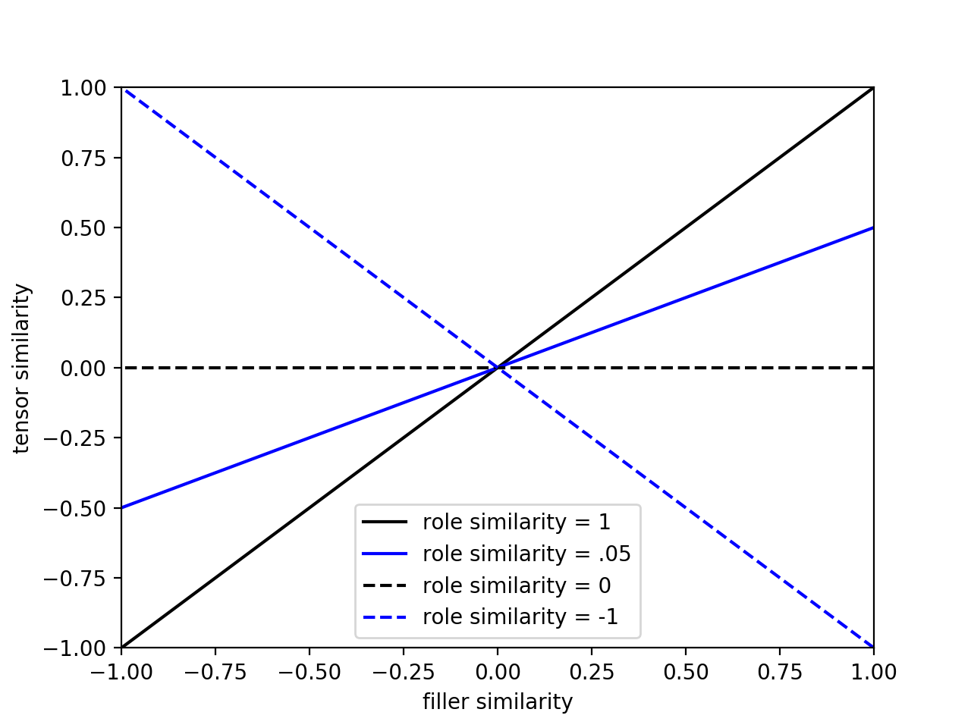
Note: if the similarity of roles and filler interact, then you’ve violated independence
Clearly similarity of tensors is an interactive function of similarity of roles, and similarity of fillers

Slide 4
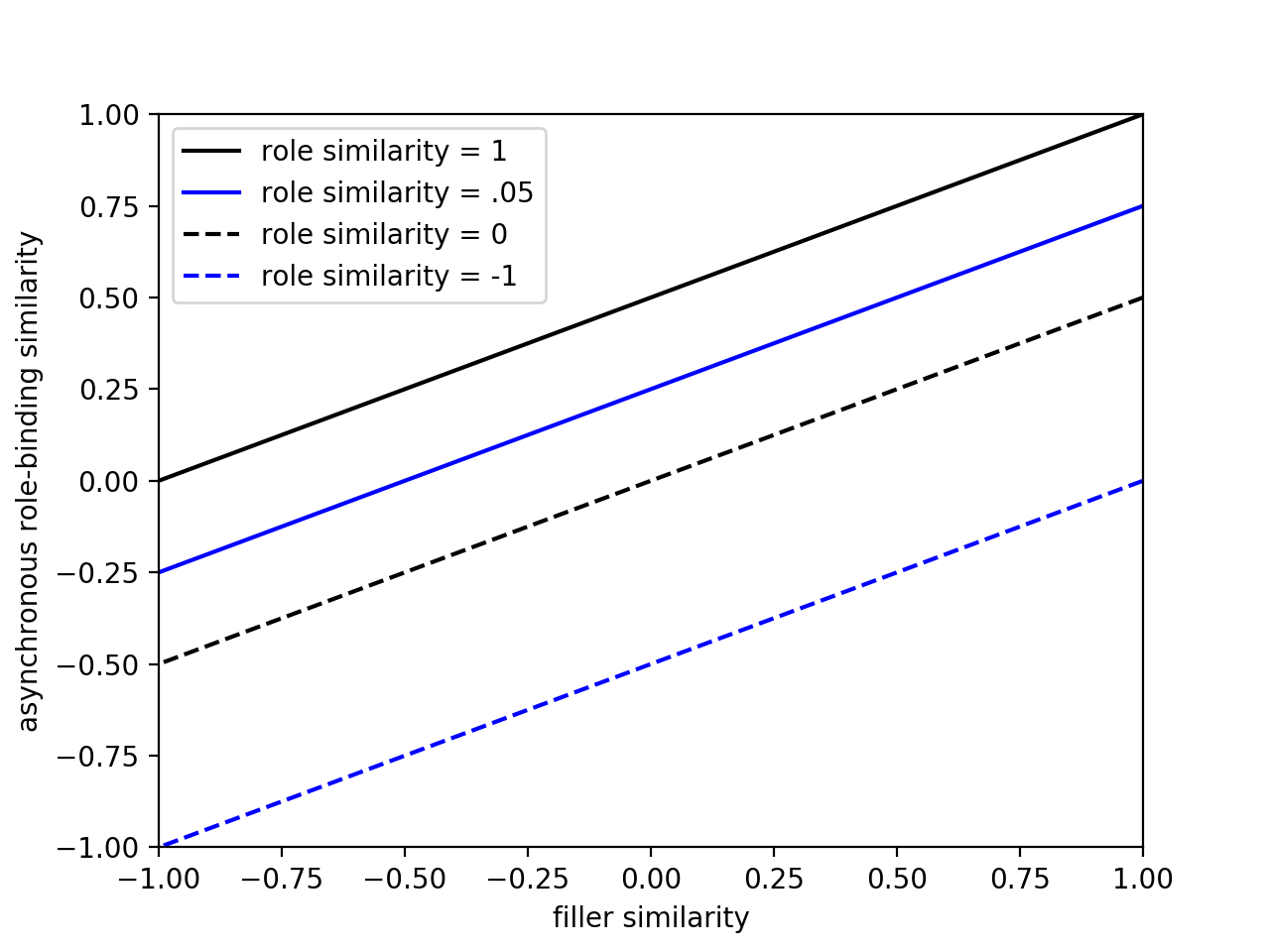
Note: if the similarity of roles and filler interact, then you’ve violated independence
Similarity of asynchrony based bindings is not an interactive function of similarity of roles, and similarity of fillers

Slide 5
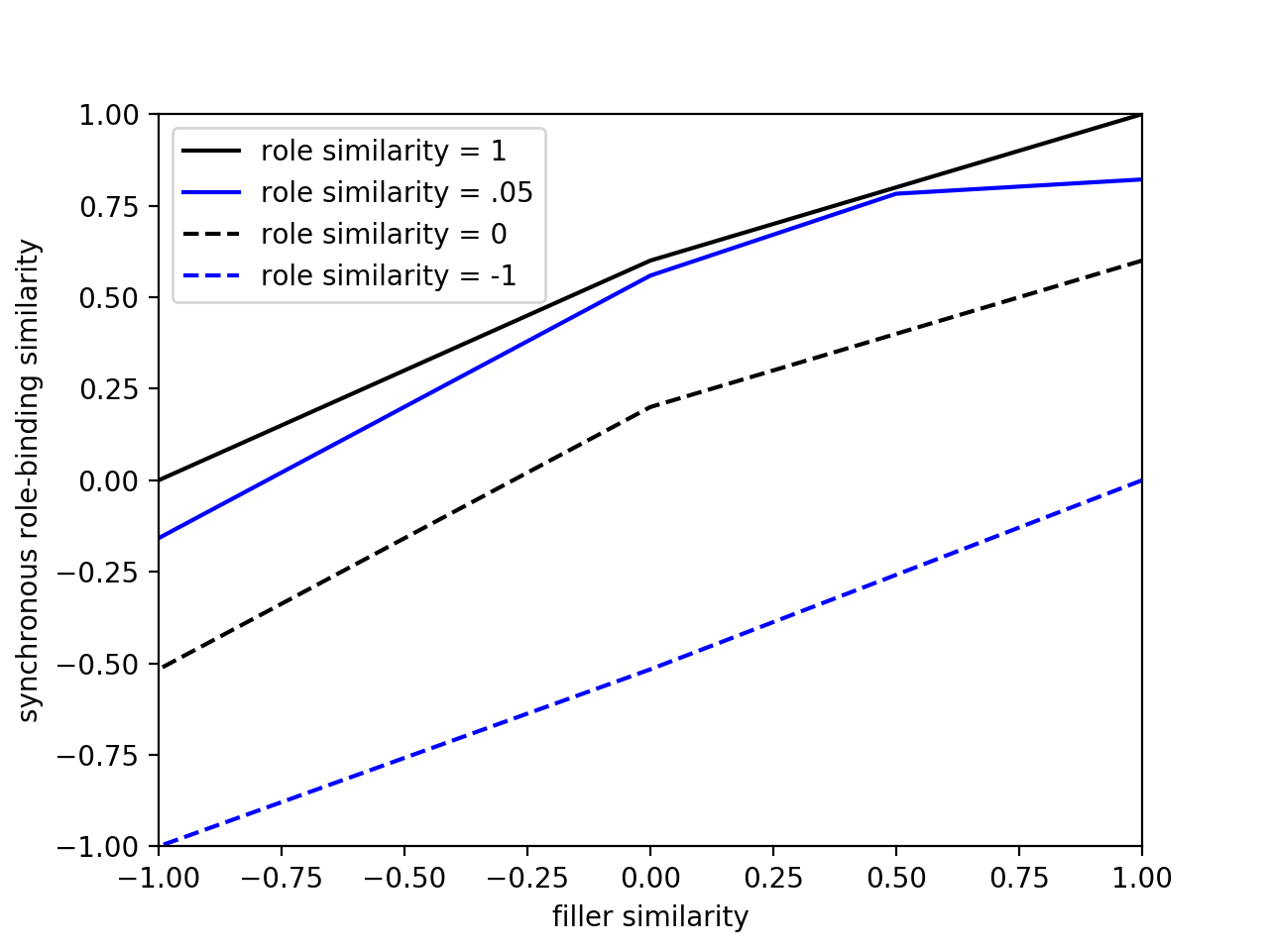
Note: if the similarity of roles and filler interact, then you’ve violated independence
Similarity of synchronously bound items is an slight interactive function of similarity of roles, and similarity of fillers
Why? It matters how much roles and fillers are allowed to share features!
If completely independent vector spaces for roles and fillers, then no interaction!

