Slide 1
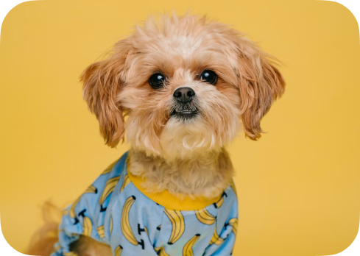
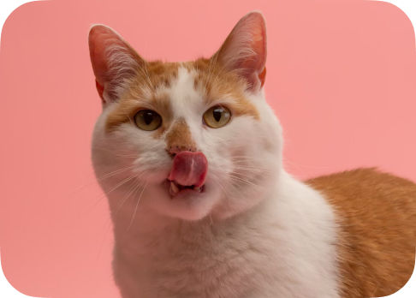
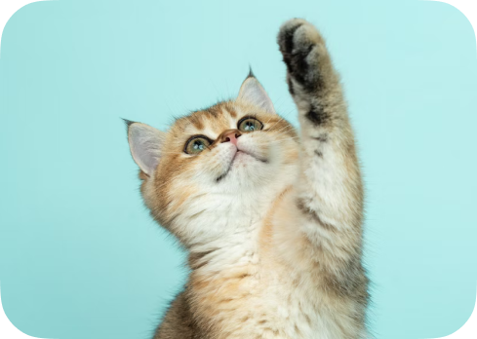
Pet Adoption App
Mobile marketplace for pet adoption, owner communication, favorites, and real-time adoption requests.
React Native · Expo · TypeScript · Firebase
Portfolio-ready mobile project analysis and roadmap
Pet Adoption App · React Native + Firebase
2026

Slide 2
Application Overview
A high-level view of the product idea and value for users.
Mobile pet adoption marketplace enabling users to list animals, browse nearby pets, favorite listings, and chat with owners instantly.
🐾 For adopters
👤 For owners
Browse cats and dogs, save favorites, request adoption, and chat with owners.
Publish pet listings, manage own animals, receive requests, and communicate quickly.
🏠 For shelters
🚀 Business value
Can be extended into a lightweight listing and communication channel.
Combines discovery, media posts, messaging, and adoption status in one app.
Pet Adoption App · React Native + Firebase
2026

Slide 3
Core Features
Main functionality currently implemented in the application.
🔐 Auth
🗂 Listings
📸 Add Post
Register, login, session state, and sign out through Firebase Auth.
Browse animals, filter categories, open detailed profiles, and use paginated loading.
Create pet listings with images, breed, age, weight, vaccine status, and description.
⭐ Favorites
💬 Chat
🔔 Notifications
Save animals to a personal favorites list and remove them when needed.
Real-time messaging with Firestore subscriptions and GiftedChat UI.
Adoption request, confirmation, rejection, and read/unread flows.
Pet Adoption App · React Native + Firebase
2026

Slide 4
Tech Stack
Frameworks, libraries, cloud services, and tooling detected in the source code.
📱 Mobile
☁️ Cloud Backend
🏗️ App Architecture
React Native 0.71 Expo 48 React 18 TypeScript OpenSans custom fonts
Firebase Auth Cloud Firestore Firebase Storage Serverless architecture Environment variables
React Navigation Redux Toolkit Service layer Reusable UI components Typed interfaces and hooks
Pet Adoption App · React Native + Firebase
2026

Slide 5
Architecture & Data Flow
The app is organized around screens, services, typed hooks, Redux, and Firebase.
Screens
UI Components
Hooks + Redux
Services
Firebase
Home, Profile, Chat, Add Post
Cards, forms, sliders, modals
Auth/session, validation, location
Auth, User, Chat, Animal, Image
Auth, Firestore, Storage
📁 Folder structure
🧩 Code pattern
⚡ State split
`app/components`, `hooks`, `services`, `navigation`, `store`, `interfaces`, `helper`, and `data`.
Screens use hooks and services instead of directly mixing all Firebase logic into the UI.
Session state lives in Redux, while remote data is handled through Firestore.
Pet Adoption App · React Native + Firebase
2026

Slide 6
Firebase Data Model
Main cloud collections and responsibilities inferred from the services.
1
users
2
animals
Profile data, avatar, location, chat IDs, favorites, notifications, own animals
Animal listings, owner data, photos, metadata, adoption status
3
chats
4
messages
Participants and chat metadata
Subcollection-style real-time chat messages
5
storage
Animal images and user avatar files
⚠️ Important note
For production, Firestore rules, indexes, and normalized data structures should be added before release.
Pet Adoption App · React Native + Firebase
2026

Slide 7
What Has Been Done
Completed development work visible from the current codebase.
Expo + TypeScript setup with path aliases and Metro SVG support
Authentication flow with Firebase Auth and Redux Toolkit state
Bottom tab navigation with nested stacks for key user flows
Animal gallery, category filtering, profiles, favorites, and own-pet gallery
Add-post workflow with validation, image compression, Storage upload, and Firestore writes
Real-time chat with GiftedChat and Firestore message subscriptions
Adoption request and notification flows with read/accept/reject logic
Reusable UI components: cards, modals, forms, sliders, skeletons, spinners, buttons
Pet Adoption App · React Native + Firebase
2026

Slide 8
What Needs To Be Improved
Recommended next steps before a production release or portfolio showcase.
Branding
Profile editing
Replace default Expo name, icon, and splash assets with final product branding.
Finish the empty edit-profile handler and add validation for profile fields.
Security
Data model
Add Firestore/Storage rules, indexes, and data validation.
Normalize arrays for notifications, favorites, chats, and own animals.
Code quality
Deployment
Reduce `any`, remove console logs, centralize errors, and add tests.
Add EAS Build config, release channels, and CI/CD documentation.
Pet Adoption App · React Native + Firebase
2026

Slide 9
Suggested Roadmap
A practical sequence for turning the MVP into a stronger production-ready app.
1
Stabilize
Fix branding, edit profile, error states, and form validation.
2
Secure
Add Firebase rules, indexes, and stricter data ownership checks.
3
Refactor
Normalize Firestore structures and strengthen TypeScript types.
Adopt faster
4
Test
Better profiles, safer data, clearer UX, and production deployment.
Add unit tests for hooks/services and manual QA checklists for flows.
5
Deploy
Configure EAS Build, app signing, environment profiles, and release process.
Pet Adoption App · React Native + Firebase
2026

Slide 10
Learning & Development Goals
Likely goals the author practiced while building this project.
Master Expo-managed React Native with TypeScript and clean imports
Build typed multi-level navigation with tabs and stacks
Practice serverless Firebase Auth, Firestore, and Storage integration
Separate Firebase logic into a reusable service layer
Implement media CRUD with image picking, compression, upload, and metadata
Create real-time chat with Firestore subscriptions and GiftedChat
Use Redux Toolkit and typed hooks for auth/session state
Improve UX through skeleton loaders, validation, modals, and empty states
Integrate device capabilities such as gallery access and location permissions
Prepare a scalable feature-based structure for future production work
Pet Adoption App · React Native + Firebase
2026

Slide 11
Project Summary
A strong mobile MVP for pet adoption with authentication, listings, image uploads, favorites, real-time chat, notifications, and location support.
✅ Strong foundation
🎯 Clear next steps
🚀 Business direction
Good feature coverage for a portfolio-level React Native project.
Security, testing, refactoring, branding, and deployment are the main priorities.
Can evolve into a local adoption platform or shelter management product.
Pet Adoption App · README and Presentation generated from source-code analysis

