Slide 1

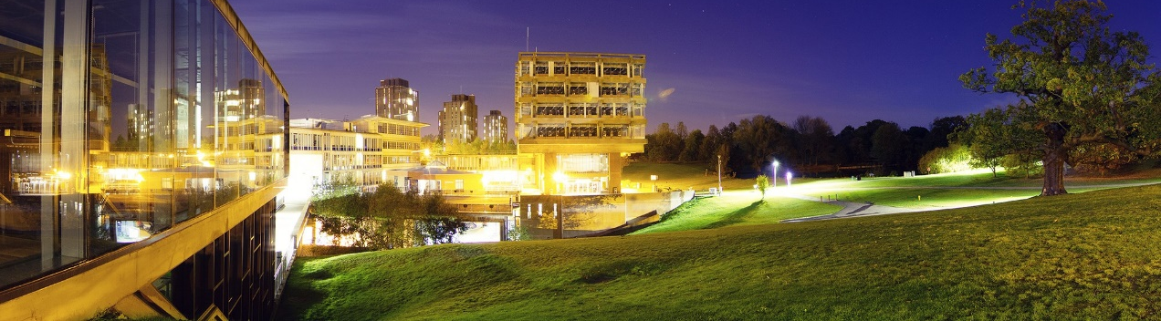

CSEE Home
Professor Richard Bartle FRSA Senior Lecturer & Honorary Professor Computer Science and Electronic Engineering rabartle@essex.ac.uk 01206 874246
Undergraduate Study
Postgraduate Study
How to Apply
Research
Staff
Overview
Publications
Research
About Us
Biography Dr Richard A. Bartle is Senior Lecturer and Honorary Professor of Computer Game Design at the University of Essex, UK. He is best known for having co-written in 1978 the first virtual world, MUD, and for his 1996 Player Types model which has seen widespread adoption by the MMO industry. His 2003 book, "Designing Virtual Worlds", is the standard text on the subject, and he is an influential writer on all aspects of MMO design and development. In 2010, he was the first recipient of the prestigious GDC "Online Game Legend" award.
Qualifications BSc Hons (1st class) Computer Science, Essex University, 1981. PhD Artificial Intelligence, Essex University, 1988
Additionally here is a blog I update daily: http://www.youhaventlived.com/qblog/index.html
Contact Us

Slide 2
MARGIN
PICTURE BANNER
MARGIN
VERTI
NAV MENU
PIC
IMPORTANT INFORMATION
HORIZONTAL NAVIGATION MENU
CONTENT PANEL
Basic information: Picture banner consists of the university logo overlaying a picture of the university. Content is centred hence the margins. Vertical navigation menu has links relating to the computer science department. Pic is a 107x133 image of the lecturer. Important information is name, job, department and contact details.
Colours: Page background will be white (#FFFFFF). Menus will be purple (#542163), then red (#D2302F) when selected or hovering. These are the colours used in the university logo
Pictures will be green when pictures can’t load, else will contain said picture. Information and content background colour will be a pale grey (#DCDCDC), to separate it from the background and other elements. Font:
Menu font will be white (#FFFFFF), the rest will be black (#000000). This provides contrast against background. Font style will be Arial as it’s a commonly used browser font.
Whitespace:
Whitespace created by padding around vertical navigation menu, pic with important information, and horizontal menu with content.

