Slide 1
Microsoft 365 Developer Certification Identity and Security
Notes:
This module introduces students to the Power BI Service API and provides an overview of its scope and functionality. The module explains the fundamentals of authenticating with Azure Active Directory and teaches students common programming techniques for authenticating using the Azure Active Directory Authentication Library (ADAL) and working with access tokens and refresh tokens. Students will learn how to call into the Power BI Service API using direct REST calls and also by programming with the .NET client library (Microsoft.PowerBI.Api.dll). Along the way, student will learn how to perform common tasks with the Power BI Service API including uploading PBIX files, patching datasource credentials, redirecting database connection strings and triggering data refresh.

Slide 2
Agenda
OAuth and OpenID Connect Primer
Register an Application
Implement Authentication
Configure Permissions to Consume an API
Implement Authorization to Consume an API
Implement Authorization in an API
Create a Service to Access Microsoft Graph

Slide 3
Authenticating with Azure AD
Custom applications must authenticate with Azure AD
Your code implements and authentication flow to obtain access token
Access token must be passed when calling Power BI Service API
Microsoft supports two endpoints for programming authentication
Azure AD V1 endpoint (released to GA over 8 years ago)
Azure AD V2 endpoint (released to GA in May 2019)
Azure Active Directory
Custom App
Access Token
Access Token
Power BI Service

Slide 4

Azure AD Endpoints and Libraries
Authenticating with the Azure AD V1 Endpoint
Heavily used over the last 5-6 years
Accessed through Azure AD Authentication Library (ADAL)
Authenticating with the Azure AD V2 Endpoint
Moved from preview to GA in May 2019
Accessed through Microsoft Authentication Library (MSAL)
Why move to the Azure AD V2 Endpoint?
Dynamic Incremental consent
New authentication flows (e.g. device code flow)

Slide 5
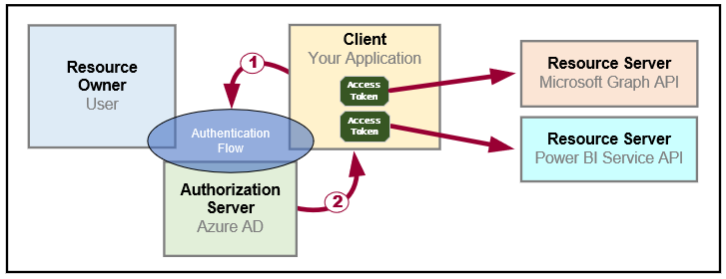
OAuth 2.0 Fundamentals
Client application calls to resource server on behalf of a user
Client implements authentication flow to acquire access token
Access token contains permission grants for client to call resource server
Client passes access token when calling to resource server
Resource server inspects access token to ensure client has permissions

Slide 6
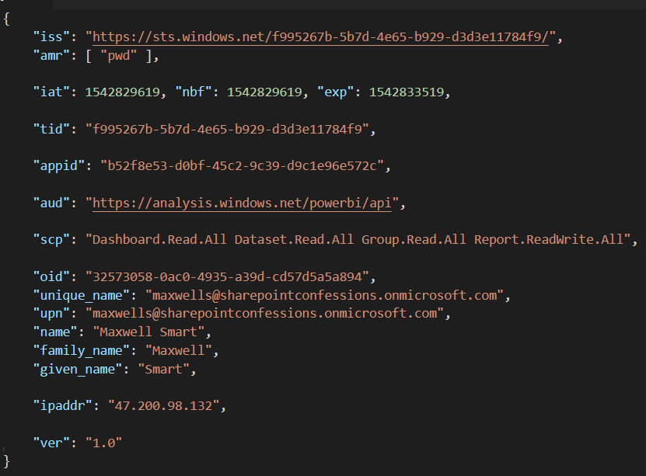
Access Token is a Bearer Token
It can be used by any who bears (e.g. steals) it
Always encrypt with HTTPS when transmitting access tokens

Slide 7
OAuth 2.0 Client Registration
Client must be registered with authorization server
Authorization server tracks each client with unique Client ID
Client should be registered with one or more Reply URLs
Reply URL should be fixed endpoint on Internet
Reply URL used to transmit security tokens to clients
Client registration tracks permissions and other attributes

Slide 8
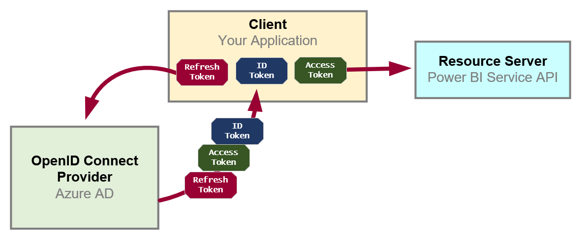
OpenID Connect Extends OAuth 2.0
OAuth 2.0 has shortcomings with authentication & identity
It does not provide client with means to validate access tokens
Lack of validation makes client vulnerable to token forgery attacks
Open ID Connect is standard which extends OAuth 2.0
OpenID Connect provider passes ID token in addition to OAuth 2.0 tokens
OpenID Connect provider provides client with keys for token validation

Slide 9
Azure AD Application Types
Where are my users
Inside a single tenant
Inside any Microsoft 365 tenant
Inside a Microsoft 365 tenant or
Where does the application run
Pubic client versus Confidential client
Should the app work on behalf of a user or work as itself
Should access tokens be created as user tokens or app-only tokens
What resource permissions are required by the app
When should permissions be requested and granted
when should the app ask the user for permissions to a resource

Slide 10
Authentication Flows
User Password Credential Flow (public client)
Used in Native clients to obtain access code
Requires passing user name and password across network
Device Code Flow (public client)
New style of authentication introduced with Azure AD v2 Endpoint
Client Credentials Flow (confidential client)
Authentication based on password or certificate held by application
Used to obtain app-only access tokens
Authorization Code Flow (confidential client)
Client first obtains authorization code sent back to browser
Client then obtains access token in server-to-server call
Implicit Flow (public client)
Used in SPAs built with JavaScript and AngularJS
Application obtains access token w/o acquiring authorization code

Slide 11
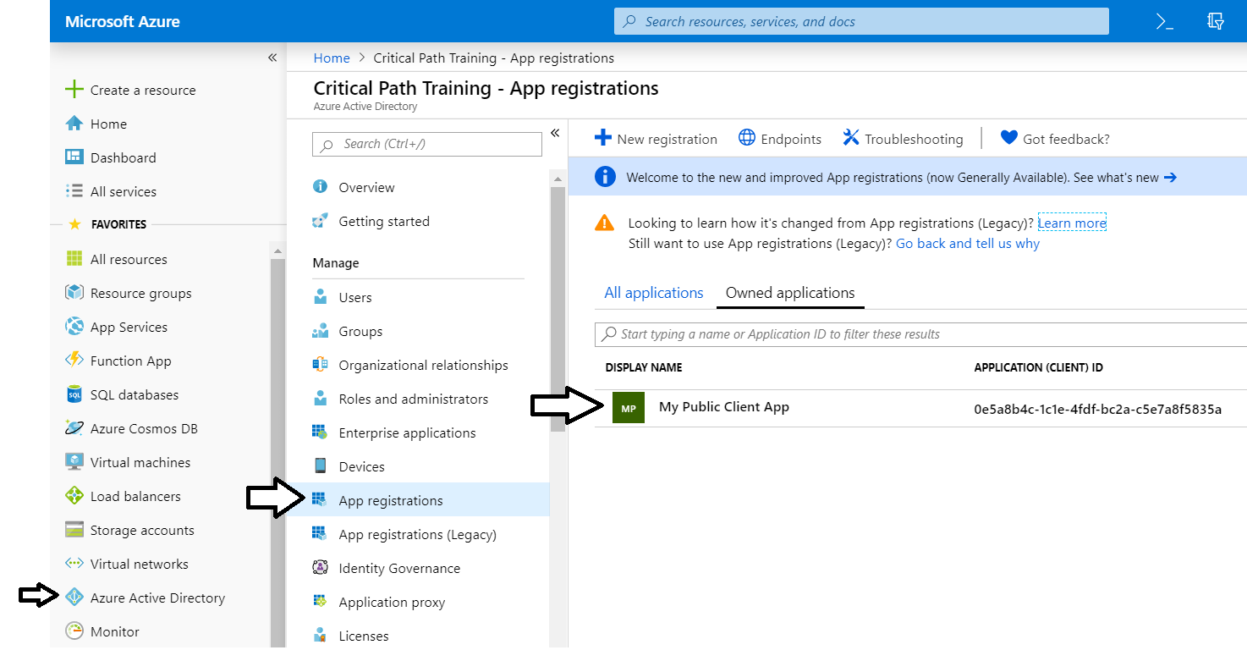
The Azure Portal
Azure portal allows you to register Azure AD applications
Azure Portal accessible at https://portal.azure.com
No Azure subscription required to register applications

Slide 12
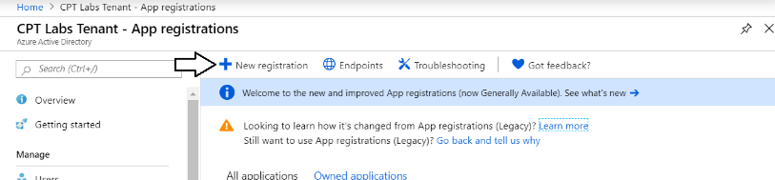
Azure AD Applications
Creating applications required for AAU authentication
Applications are as Native application or Web Applications
Application identified using GUID known as application ID
Application ID often referred to as client ID or app ID

Slide 13
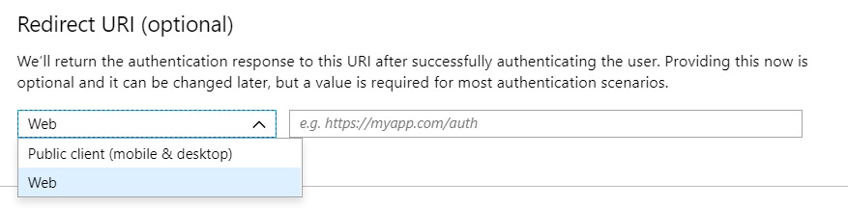
Application Types
Azure AD Application Types
Public client (mobile and desktop)
Web

Slide 14
Applications and Service Principals
Azure AD creates service principal(s) for each application
Service principle created once per tenant
Service principle acts as first-class AAD security principal
Host Tenant
Tenant 2
Tenant 3
Application
Application ID
Service Principal
Object ID
Service Principal
Object ID
Service Principal
Object ID
Permission Grants
User1
User2
Permission Grants
User1
User2
Permission Grants
User1
User2

Slide 15
Applications versus Service Principle
Application defined once across all tenants
Identified using global Application ID
Application object lives in tenant where it’s registered
Defines auth type, secrets and required permissions
Service principal created once per tenant
Identified using tenant-specific Object ID
Used to track permission grants for user consent

Slide 16
Identity Topology Options
Consumer
Microsoft personal accounts (Outlook, OneDrive, MSN, or Xbox LIVE)
Enterprises
Organizational accounts defined inside Azure AD tenant
Business to Business (B2B)
Organization accounts added as guest user in other tenants
Business to Customer (B2C)
Provides customer identity access management (CIAM) solution

Slide 17
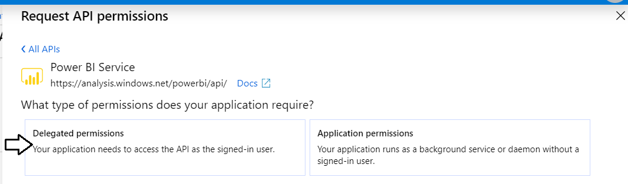
Delegated Permissions vs Application Permissions
Permissions categorized into two basic types
Delegated permissions are (app + user) permissions
Application permissions are app-only permissions (far more powerful)
Not all application types and APIs support application permissions
Power BI Service API does not support application permission

Slide 18
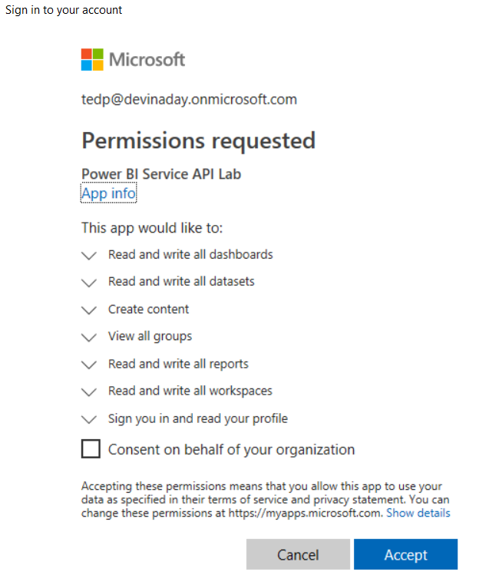
Interactive Consent for Delegated Permissions
Users must consent to delegated permissions
User prompted during first log in
User must click Accept
Only occurs once for each user

Slide 19
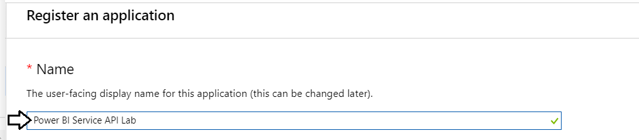
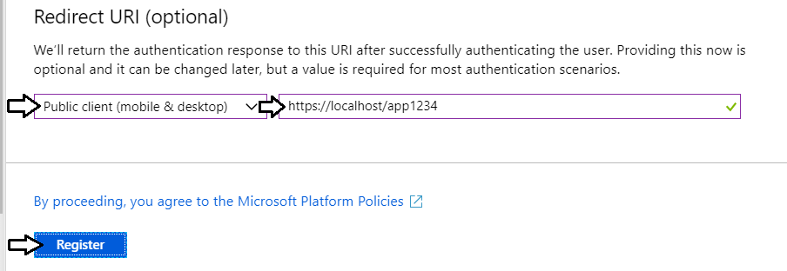
Creating a Public Client Application
Power BI supports Public Client Applications
Used for native applications and desktop applications
Requires Redirect URI for interactive logins

Slide 20
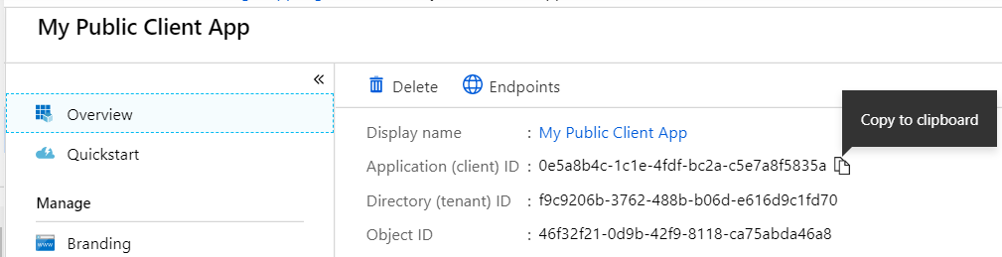
Copying the Application ID
Each new application created with Application ID
You cannot supply your own GUID for application ID
Azure AD will always create this GUID
You can copy the application ID from the Azure portal
Don’t forget this confusing fact…
Application ID == Client ID

Slide 21
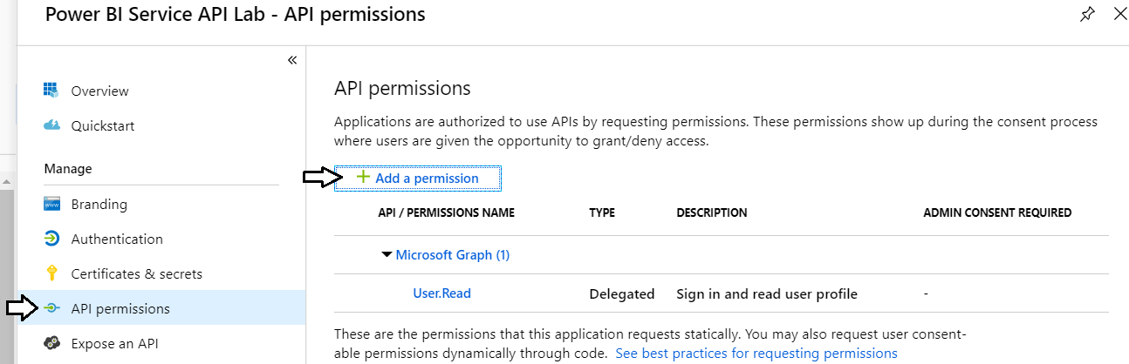
Configuring Required Permissions
Application configured with permissions
Default permissions allows user authentication – but that's it
To use APIs, you can assign permissions to the application

Slide 22
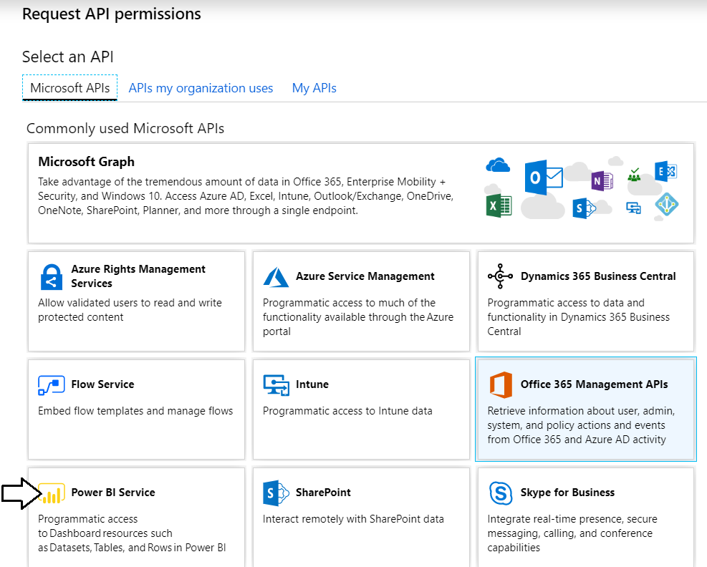
Choosing an API
There are lots of APIs to choose from
Microsoft Graph, Power BI Service, etc.

Slide 23
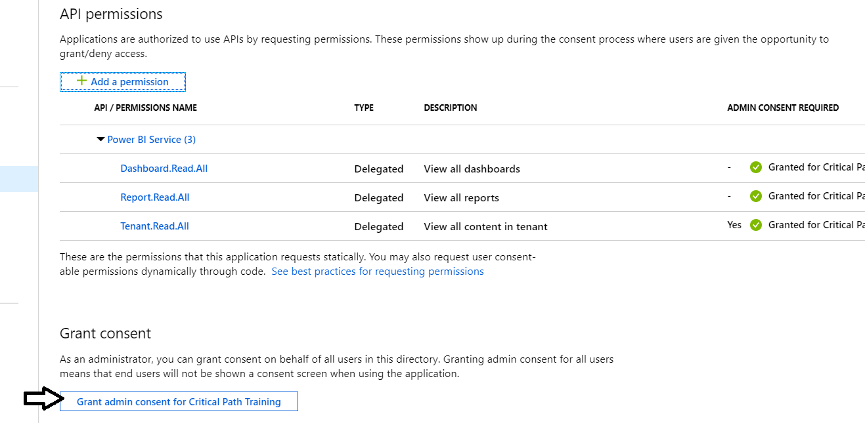
Granting Delegated Permissions
It can be helpful to Grant Permissions in Azure portal
Prevents the need for interactive granting of application by user
Might be required when authenticating in non-interactive fashion

Slide 24
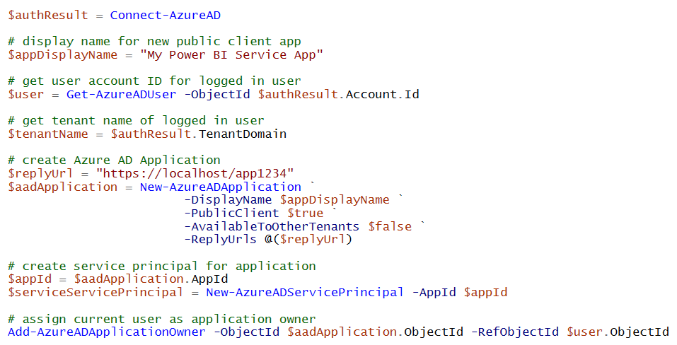
Registering AAD Apps with PowerShell

Slide 25
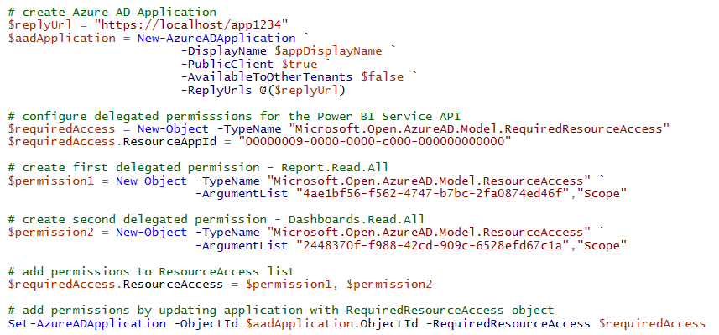
Configuring Delegated Permissions

Slide 26
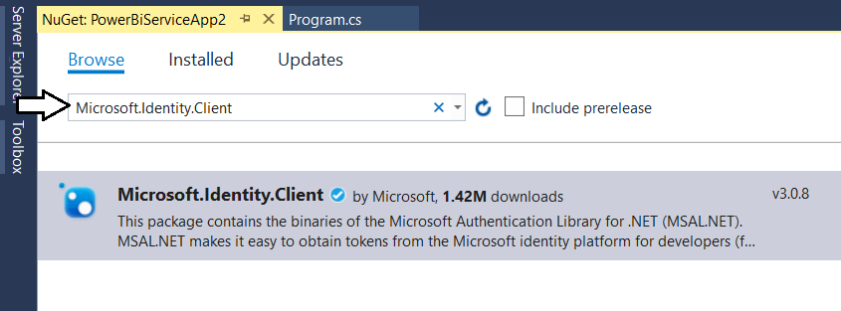
Microsoft Authentication Library (.NET)
Developing with the Microsoft Authentication Library
Provides access to Azure AD V2 Endpoint
Added to project as Microsoft.Identity.Client NuGet package
Provides different classes for public clients vs confidential clients

Slide 27
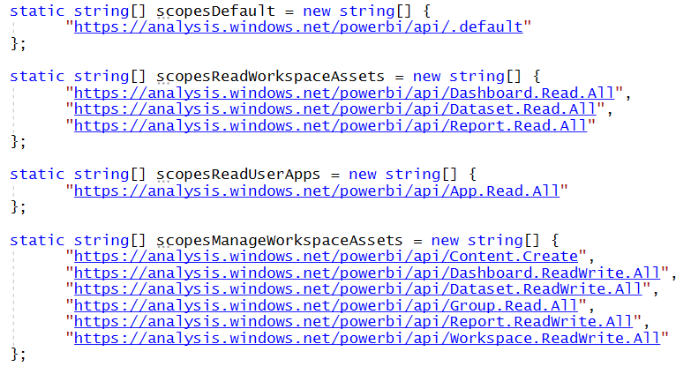
Power BI Service API Scopes
Azure AD V2 endpoint requires passing scopes
Scopes define permissions required in access token
Scopes defined as resource + permission https://analysis.windows.net/powerbi/api/ + Report.ReadWrite.All

Slide 28
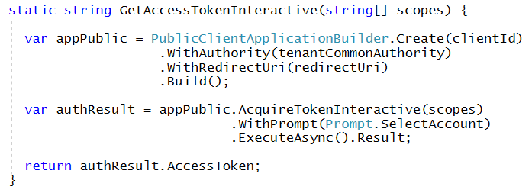
Interactive Access Token Acquisition Using MSAL with public client application
Flow implemented using PublicClientApplication object
Created using PublicClientApplicationBuilder object
Requires passing redirect URI
You can control prompting behavior

Slide 29
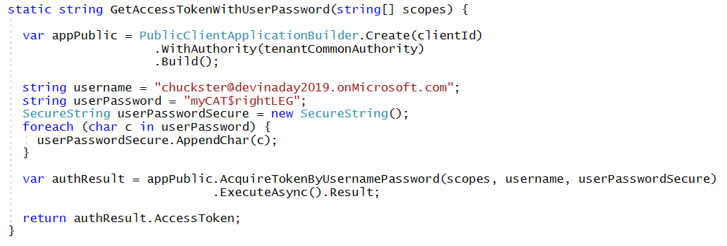
User Credential Password Flow Using MSAL with public client application
MSAL supports user credential password flow
Supported in .NET runtime but not in .NET CORE
Microsoft recommends against using this flow

Slide 30
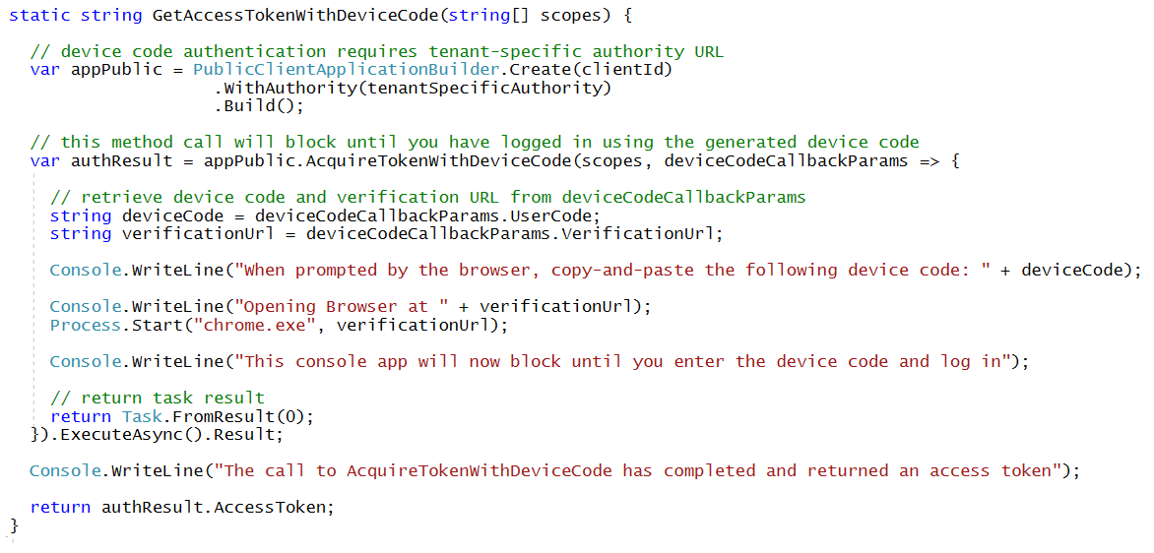
Device Code Flow Using MSAL with public client application
MSAL introduced this new flow with MSAL
Much more secure than user password credential flow
Not available in ADAL

Slide 31
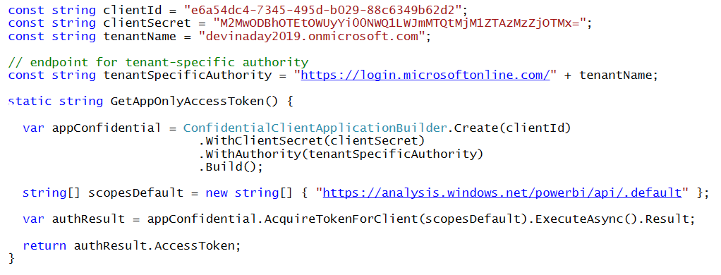
Client Credentials Flow Using MSAL with confidential client application
Client credentials flow used to obtain app-only token
Requires passing app secret (e.g. app password or certificate)
Requires passing tenant-specific endpoint

