Slide 1

Blackjack Analytics API
COMP3011 – Web Services and Web Data Coursework 1
By Alexander Fairley @ University of Leeds

Slide 2
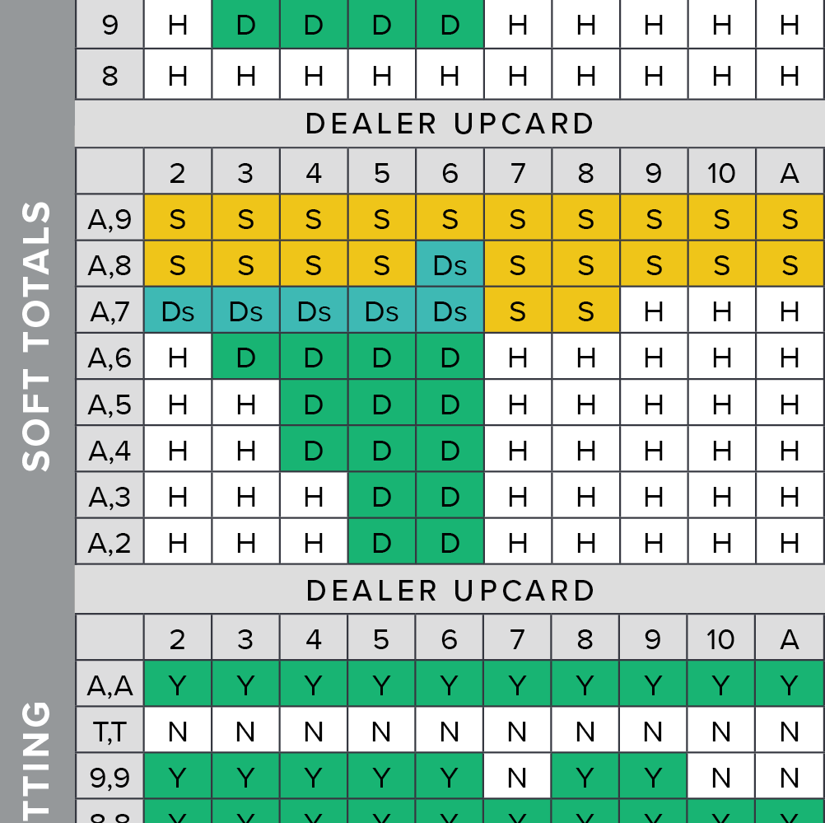
Project Overview
Track user’s blackjack sessions and hands
Analyse performance (win rate, profit, optimality)
Strategy evaluation and advice
Secure user system

Slide 3
System Architecture
Client
Fast API Routes
Data Access
Authentication
REST API
Programmed in Python
Fast API backend
PostgreSQL database
SQLAlchemy data interaction
JWT Authentication

Slide 4
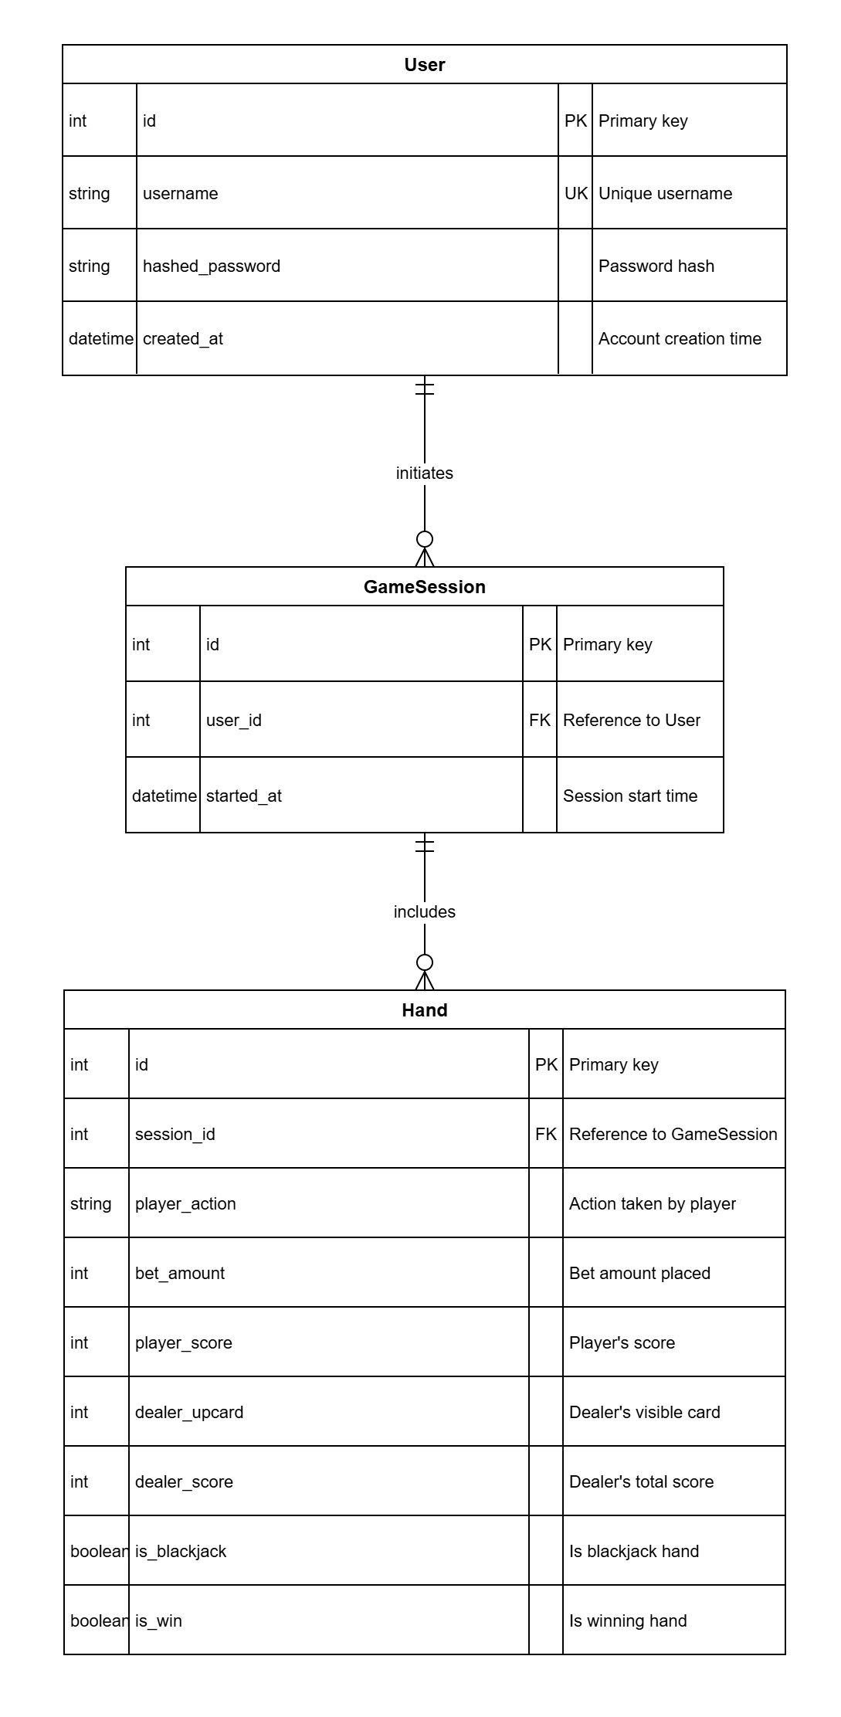
Database Design

Slide 5
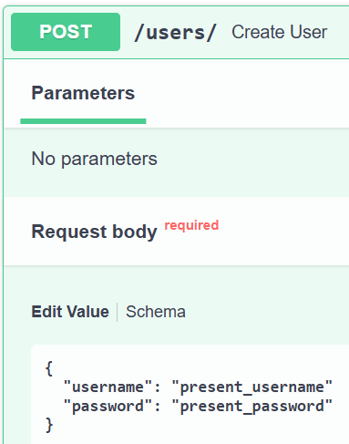
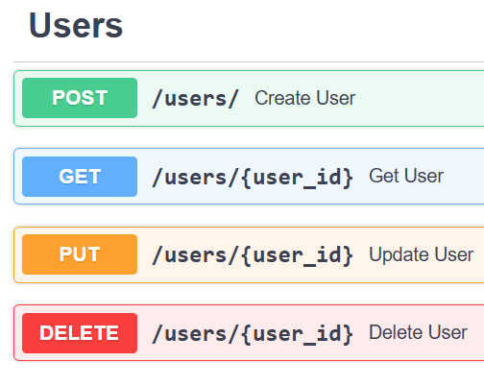
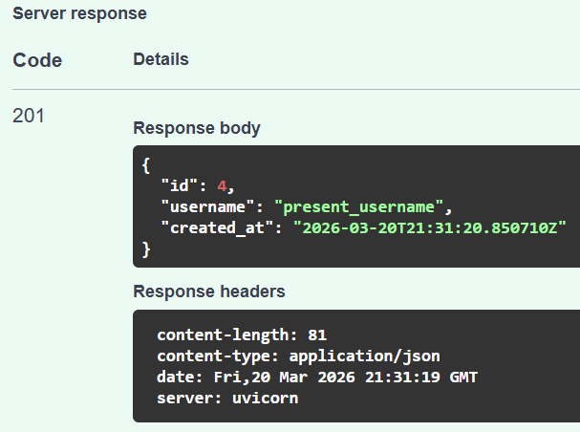
API Overview
REST endpoints
CRUD operations
JSON responses

Slide 6

Live Demonstration

Slide 7

Strategy Analysis
Personal analysis of performance
Evaluation of play versus perfect strategy
Advice on optimal play for each hand type

Slide 8
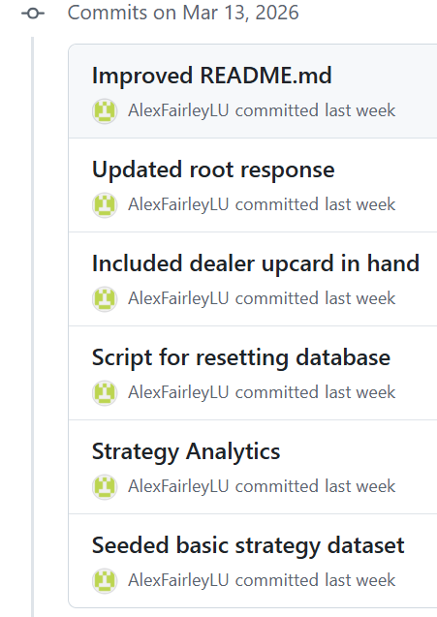
Version Control
GitHub used throughout development
Regular commits
Informative commit messages
GitHub Actions for CI/CD testing

Slide 9
Technical Report Highlights
System Architecture
Extensive technology stack
Limitations and Future Improvements

Slide 10

Deliverables
GitHub code repository
API documentation using SwaggerUI
Technical report

Slide 11

Thank you for listening!
Are there any questions?

