Slide 1

Knowledge Graph for Financial Analysis
Notes:
Good afternoon, professors!
As the representative of our group, I am going to talk about Knowledge Graph for Financial Analysis.
各位老师，下午好！作为我们小组的代表，我将会汇报我们的项目。我们小组的题目是用于金融分析的知识图谱。

Slide 2

01
Introduction
目录
02
Data
CONTENT
03
Knowledge Graph
04
Outcome
Notes:
I am breaking it down into four parts，including Introduction, Data, Knowledge Graph and Outcome.
我将会分四个部分进行汇报，包括介绍、数据、知识图谱和结果。

Slide 3

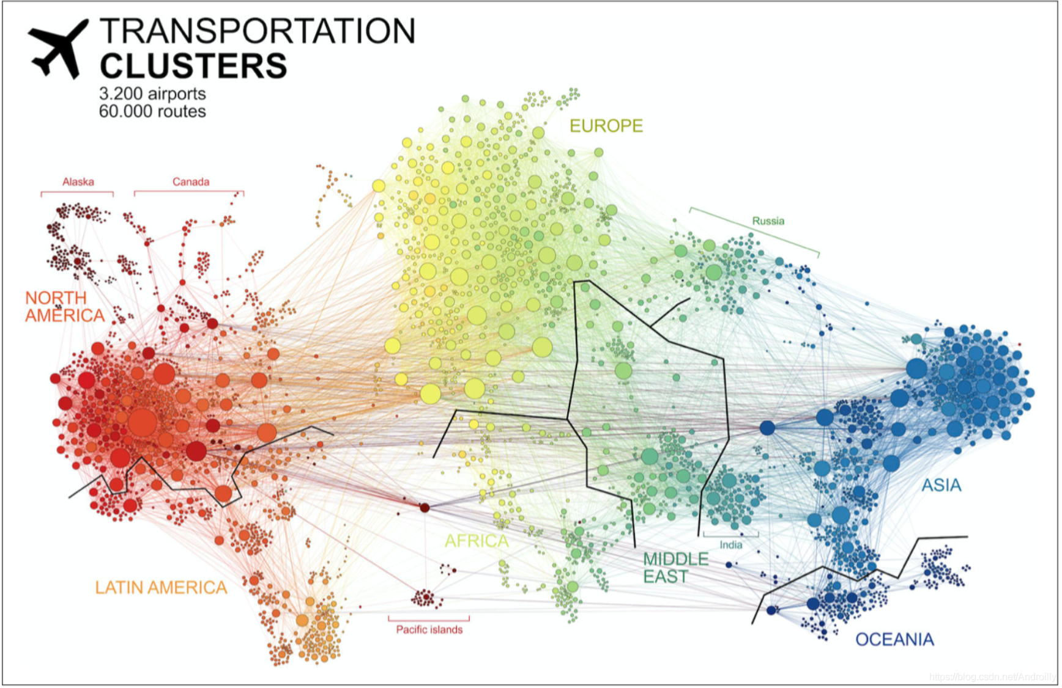
Introduction
Intro
Data
KG
Outcome
The project collects basic information data of New Third Board listed companies, major securities firms, as well as A shares and Hong Kong shares.
We used the Neo4j graph database for knowledge storage and carried out tasks such as knowledge completion and fusion on the knowledge graph, resulting in the creation of a high-quality financial knowledge graph.
Notes:
To start off,I will introduce our project briefly. The project collected basic information data of New Third Board listed companies, major securities firms, as well as A shares and Hong Kong shares.
我将简短介绍一下我们的项目。我们的项目采集了新三板上市公司、各大券商以及A股、港股的基本信息数据。
We used the Neo4j graph database for knowledge storage and carried out tasks such as knowledge completion and fusion on the knowledge graph, resulting in the creation of a high-quality financial knowledge graph
我们使用基于Neo4j图数据库进行知识存储，并对知识图谱进行知识补全、知识融合等工作，构建了高质量的金融知识图谱。

Slide 4
Scenarios
Intro
Data
KG
Outcome
Scenario 1
In financial markets, there exist relationships of control and being controlled between companies, supervisory relationship, shareholding and being held shares relationships.
Scenario 2
In the financial markets, a person can own shares in multiple companies.
Notes:
Let’s now turn to scenarios applied in the financial field. Our project can be applied in various fields. Here, we’re discussing the scenario in the financial field.
在金融领域中，有许多应用场景。我们的项目可以解决以下场景，当然，其他相关场景也可以应用。
For example, In Scenario 1：In financial markets, there exist relationships of control and being controlled between companies, supervisory relationship, shareholding and being held shares relationships.
例如，场景1，在金融市场中，有许多诸如公司间控制或者被控制关系、监管关系、控股或者被控股关系。
In Scenario 2，In the financial markets, a person can own shares in multiple companies.
场景2, 在金融市场中，一个人可以拥有多家公司的股权。

Slide 5
CQs
Intro
Data
KG
Outcome
CQ 1
What is the relationship between the company A and company B?
CQ 2
List a company’s all the shareholders.
CQ 3
List a person’s all the controlling companies.
Notes:
According to the proposed application scenarios, for example, the following CQs can be extracted from the scenarios.
根据所提出的应用场景，例如以下CQs 可以从场景中提取出来。
CQ1: What is the relationship between the company A and company B?
CQ1: A公司和B公司之间的关系是什么？
CQ2: List a company’s all the shareholders.
CQ2: 列出一家公司的所有股东。
CQ3: List a person’s all the controlling companies.
CQ3: 列出一个人所有控股的公司。

Slide 6
Data Resource
Intro
Data
KG
Outcome
A-Share
The A-share market specifically refers to Mainland China’s primary stock trading market, used for the trading of stocks of companies registered within Mainland China
Hong Kong stock
It is globally recognized as an international financial hub, permitting international investors to buy and sell shares of companies registered in Hong Kong.
New Third Board
It provides financing and equity trading opportunities, primarily for small and medium-sized enterprises. These markets offer diversified investment opportunities for both Mainland China and international investors
Notes:
Let’s move on to part two,data.
Our purpose is to collect the data of the following three stock markets, because they are the most important stock markets in China at present.
我们目的是收集以下三个股市的数据，因为它们是目前中国最主要的股市。
First is the A-share market it refers to Mainland China’s primary stock trading market, used for the trading of stocks of companies registered within Mainland China
A股市场具体指中国大陆的主要股票交易市场，用于交易在中国大陆注册的公司的股票。
Second is Hong Kong Stock,it recognized as an international financial hub, permitting international investors to buy and sell shares of companies registered in Hong Kong.
港股是全球公认的国际金融中心，允许国际投资者买卖在香港注册的公司的股份。
The third one is new Third Board,it provides financing and equity trading opportunities, primarily for small and medium-sized enterprises. These markets offer diversified investment opportunities for both Mainland China and international investors
它主要为中小型企业提供融资和股权交易机会。这些市场为中国大陆和国际投资者提供了多样化的投资机会。

Slide 7
Data Resource
Intro
Data
KG
Outcome
A Share & Hong Kong Share
We collect data from URLs：
A share：https://s.askci.com/stock/a/?reportTime=2018-09-30
Hong Kong share：https://s.askci.com/stock/h/?reportTime=2018-09-30
sub_URL: https://s.askci.com/stock/summary/{}.format(stockcode)
Steps：
1. Use module pandas.read_html(url) to crawl the table data.
2. Get the company’s information including the stock code.
3. Crawl the sub_URL based on stock code, to get more detailed information about each company.
4. All the data were saved as json format.
Notes:
For A-share and Hong Kong share data, we use URL to crawl.
对于A股和港股的数据，我们使用URL进行爬取。
The crawling steps are as follows:
爬取步骤如下：
1. Use module pandas.read_html(url) to crawl the table data. Because the data we would like to crawl is in table form, pandas.read_ html() module can directly crawl the table data of the web page. Through crawling, we got the basic information of the company, including the stock code.
使用pandas.read_html(url) 爬取数据。因为我们要爬取的数据是表格形式，pandas.read_html()模块可以直接爬取网页表格数据。通过第一步的爬取，我们得到了公司的基本信息，包括股票代码。
2. Based on the stock code of each company, obtain more detailed information about the company.
根据每个公司的股票代码，以获得公司更加详细的信息。
3. All the data were saved as json format.
所有数据都保存为json格式。

Slide 8
Data Resource
Intro
Data
KG
Outcome
Brokers & Listed Companies
We collect data from API：
Brokers: http://xinsanban.eastmoney.com/api/Organization/Broker/qslb?
Listed Companies: http://xinsanban.eastmoney.com/api/DataCenter/JGCG/GetSSGSCG?
Steps：
1. Use module requests to get html webpage content.
2. Use module pyquery parse library to get the target content.
3. All the data were saved as json format.
Notes:
For Brokers and Listed Companies data, we use Eastmoney API to crawl.
对于券商和港股的数据，我们使用Eastmoney API进行爬取。
The crawling steps are as follows:
爬取步骤如下：
1. Use module requests to get html webpage content.
使用模块requests请求获得html网页内容.
2. Use module pyquery parse library to get the target content.
使用模块pyquery解析库，对requests的请求内容进行所需的目标内容解析。
3. All the data were saved as json format.
所有数据都保存为json格式。

Slide 9
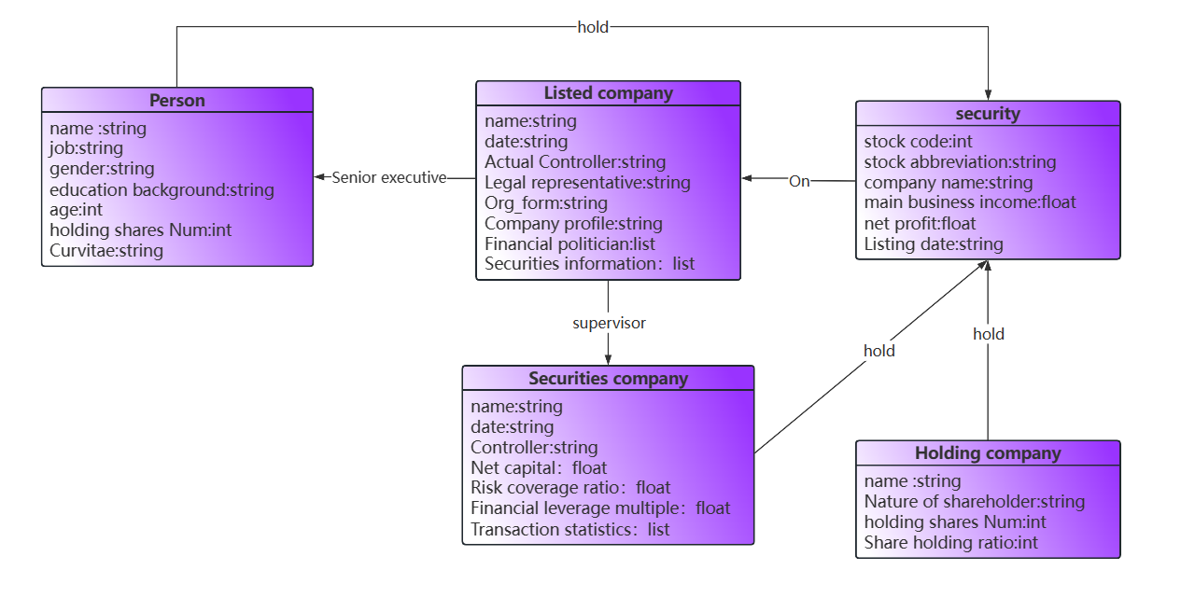
ER
Intro
Data
KG
Outcome
Notes:
Based on the obtained data, we defined three basic relationships: senior executives, supervisor, and holding.
根据获取的数据，我们定义了三种基本关系：高管、督导券商、股东，
And we also defined entity categories such as person, listed company, securities company.
并且定了：个人，上市公司，证券公司等实体类别
Entities of each category are interrelated through the three basic relationships mentioned above.
各类别的实体通过上述三种基本关系相互关联。

Slide 10
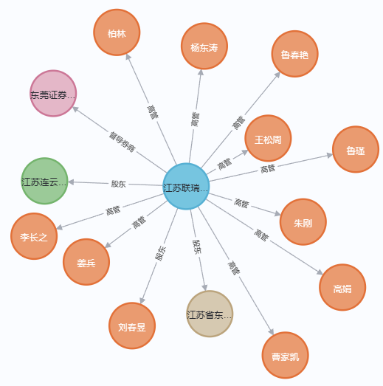
KG
Intro
Data
KG
Outcome
KG initialization
We initiate the KG by using the listed companies dataset.
Broker
Supervising Broker
Share Holder
New Third
Board
Shareholder
Executive
Executive
Notes:
Moving on to part three,knowledge graph,in this section,i am going to introduce Language Definition、Knowledge Definition、Data Definition.
我们使用上市公司数据集初始化知识图谱
As you can see on the right graph, it can be divided into five steps.
step 1. Create nodes labeled as “New Third Board”, with the name of the company’s name.
创建标签为新三板的结点，节点名称为公司名称
step 2. Create nodes labeled as “Broker” and connect them to “New Third Board” nodes using the relationship of “Supervising Broker”.
创建标签为券商的结点，并使用督导券商的关系与新三板结点连接。
step 3. Create nodes labeled as shareholder’s nature and and connect them to “New Third Board” nodes using the relationship of “Shareholder”.
创建标签为股东的结点，并使用股东关系与新三板结点连接。
step 4. Create nodes labeled as “executive” and connect them to “New Third Board” nodes using the relationship of “Executive”.
创建标签为高管的结点，并使用高管关系与新三板结点连接。
step 5. When creating nodes, we store many other useful information as node and relationship attributes at the same time.
当创建结点时，我们同时存储许多其他有用的信息作为结点和关系的属性。

Slide 11
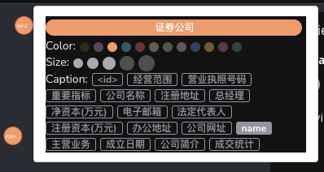
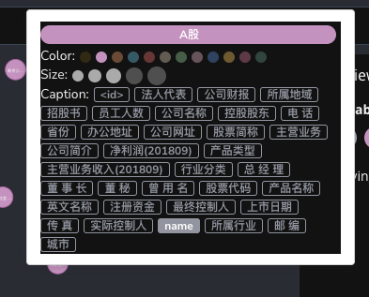
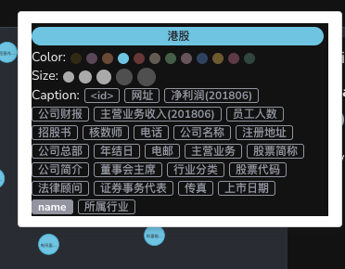
KG
Intro
Data
KG
Outcome
KG initialization
Using the same method, we create nodes：
A-share,
Hong Kong share,
securities company
Notes:
Similarly, we create nodes by the other three datasets： A-share,Hong Kong share, securities company.
使用相同的方法，我们通过其他三个数据集创建节点：A股、香港股票、证券公司。

Slide 12
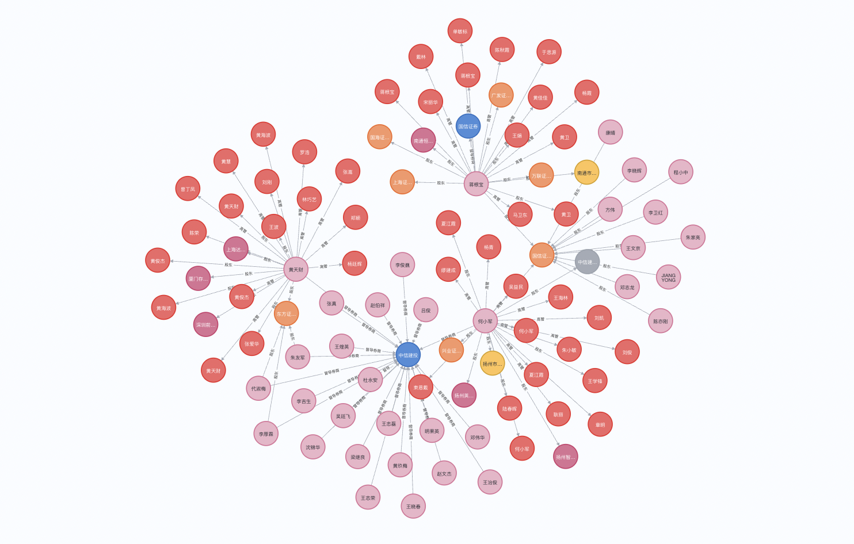
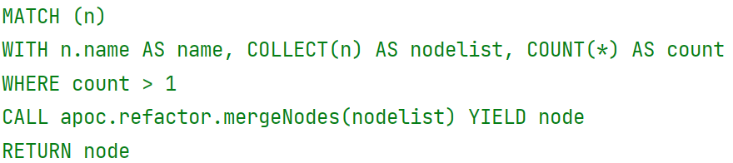
KG
Intro
Data
KG
Outcome
KG Integration
Each node has a unique name, we use the node name to determine whether two nodes are the same node
If it is determined to be the same node, nodes with the same name will be merged and the attributes of the nodes will also be merged.
Notes:
Each node has a unique name, we use the node name to determine whether two nodes are the same node
每个结点都有独特的名字，我们使用结点名字来判断两个结点是否为同一个结点
If it is determined to be the same node, nodes with the same name will be merged and the attributes of the nodes will also be merged.
如果判断为同一结点，将相同名字的结点融合成一个结点，同时结点的属性也被融合到一个结点中。
And we use the Cypher query language to query all nodes with the same name, and use module apoc to fuse these nodes.
我们使用Cypher查询语言来查询所有名字相同的结点，并使用模块apoc融合这些结点。

Slide 13
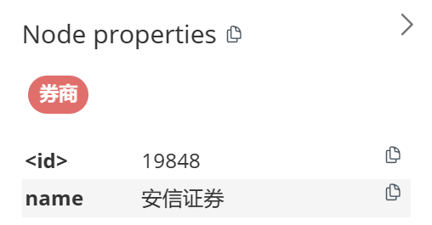
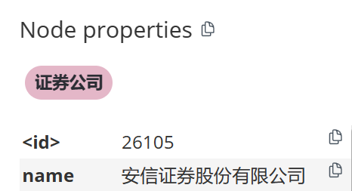
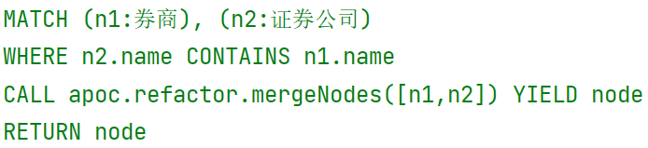
KG
Intro
Data
KG
Outcome
KG Integration
The same nodes’names in securities firms and brokers are inclusive relationships, not identical relationships.
These two sets of nodes need to be fused again.
Notes:
Besides, nodes in securities firms and brokers are not identical relationships but inclusive relationships.
同时，我们发现券商和证券公司中相同的结点，名称是包含关系，而不是相同关系。
These two sets of nodes need to be merged again.
需要对这两组结点，再进行一次融合。
Before the module apoc merges nodes, it is necessary to use the Cypher language to determine whether there is an inclusion relationship.
在模块apoc融合结点之前，需要用Cypher语言对是否有包含关系进行判断。

Slide 14
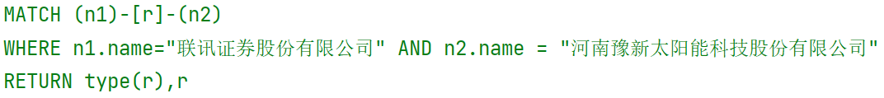
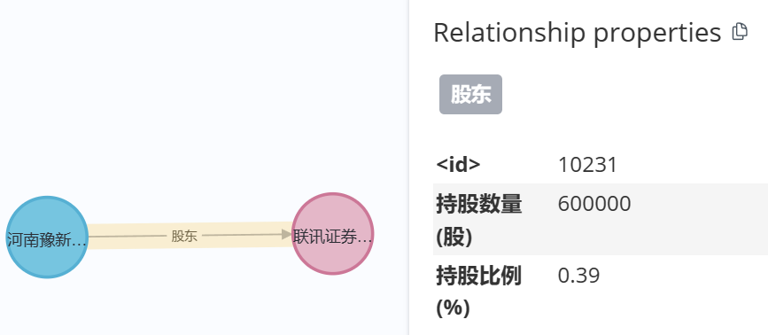
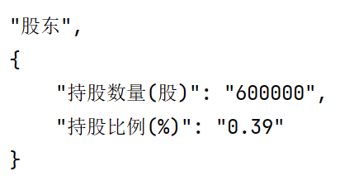
Query
Intro
Data
KG
Outcome
CQ 1
What is the relationship between the company A and company B?
eg: A：联讯证券股份有限公司 B：河南豫新太阳能科技股份有限公司
内容主题概括
内主题概括
内容主题概括
Notes:
Finally, we will be looking at the outcome part.
At this point, the establishment and integration of the knowledge graph have been completed.
至此，完成了知识图谱的建立和融合。
Now answer the previously raised CQs.
现在对之前提出的CQ，进行解答
CQ1: What is the relationship between the company A and company B?
CQ1: A公司和B公司是什么关系？
If Company A and Company B are as follows:
假如A公司和B公司如下所示：
We can know that the relationship is a shareholder and obtain the relationship attributes: the number of shares held and the proportion of shares held.
我们可以知道关系为股东，并可以得到关系属性：持股数量和持股比例。

Slide 15
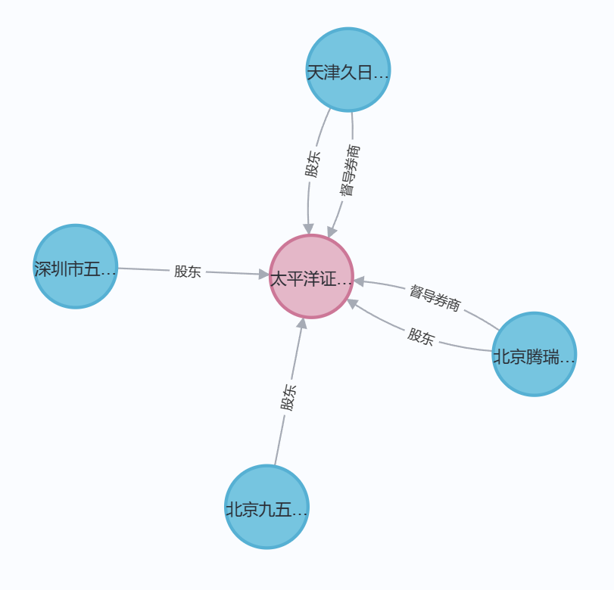
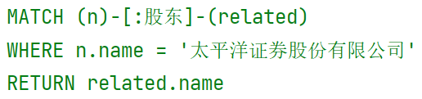
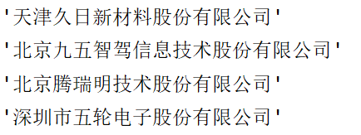
Query
Intro
Data
KG
Outcome
CQ 2
List a company’s all the shareholders.
eg：太平洋证券股份有限公司
内容主题概括
内主题概括
内容主题概括
Notes:
CQ2: List a company’s all the shareholders.
CQ2: 列出一家公司的所有股东。
If the company name is as follows:
假如公司名称如下所示：
We can obtain the names of the four shareholders of the company, and of course, we can also obtain more information about the shareholders through the names.
我们可以得到该公司的四家股东名称，当然也可以通过名称获得股东的更多信息。

Slide 16
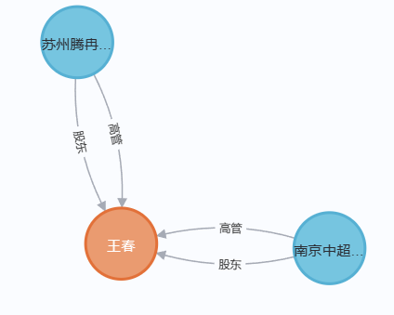
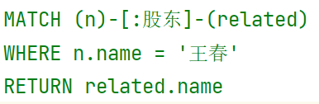

Query
Intro
Data
KG
Outcome
CQ 3
List a person’s all the controlling companies.
eg：王春
内容主题概括
内主题概括
内容主题概括
Notes:
CQ3: List a person’s all the controlling companies.
CQ3:列出一个人所有控股的公司.
If the company name is as follows:
假如公司名称如下所示：
Like CQ2, we have obtained the names of all shareholders and can obtain more information through their names.
和CQ2一样，我们得到了所有的股东名字，并可以通过名字获得更多信息

Slide 17
Conclusion
Intro
Data
KG
Outcome
Conclusion
We complete a knowledge graph of financial analysis by collecting datasets from different sources.
Not only can it meet the previously proposed scenarios, but it can also meet the requirements of other scenarios through personalized query statements.
Because our project mainly considers domestic companies, we can improve the performance of the knowledge graph by adding data like foreign stock markets.
Notes:
Finally, it can be concluded that:
最后可以得出结论：
We complete a knowledge graph of financial analysis by collecting datasets from different sources.
我们通过收集不同来源的数据集，完成了一个金融分析的知识图谱。
Not only can it meet the previously proposed scenarios, but it can also meet the requirements of other scenarios through personalized query statements.
不仅可满足之前提出的场景，还可以通过个性化查询语句，完成其他场景的要求。
Since our project mainly considers domestic companies, the performance of knowledge graph can be improved by adding data like foreign stock markets
因为我们项目主要考虑国内公司，可以通过添加如国外股市的数据来提高知识图谱的性能。

Slide 18
THANKS FOR WATCHING
Notes:
This all my presentation of our project. Thanks for your time.
这就是我们项目的全部汇报，感谢观看。

