Slide 1


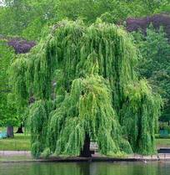
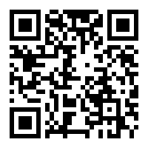
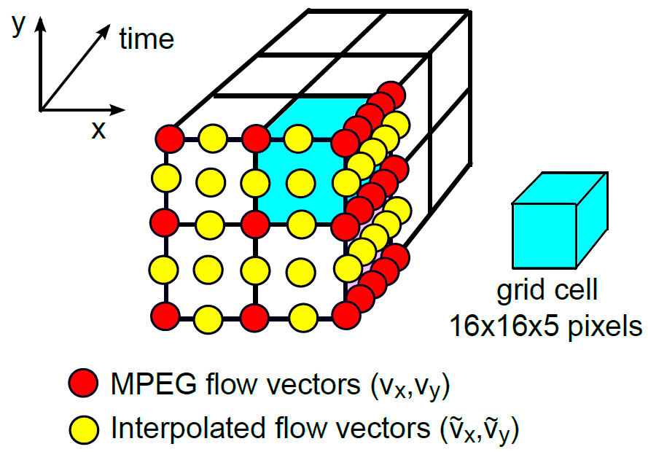
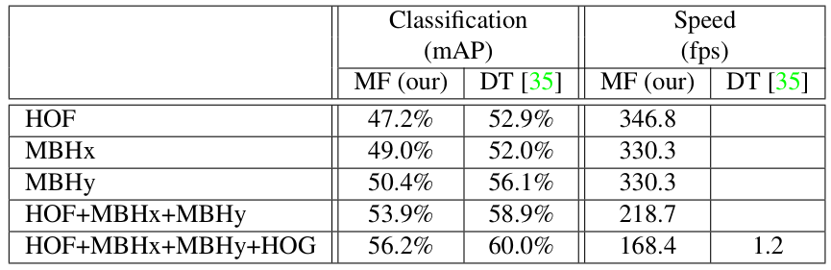




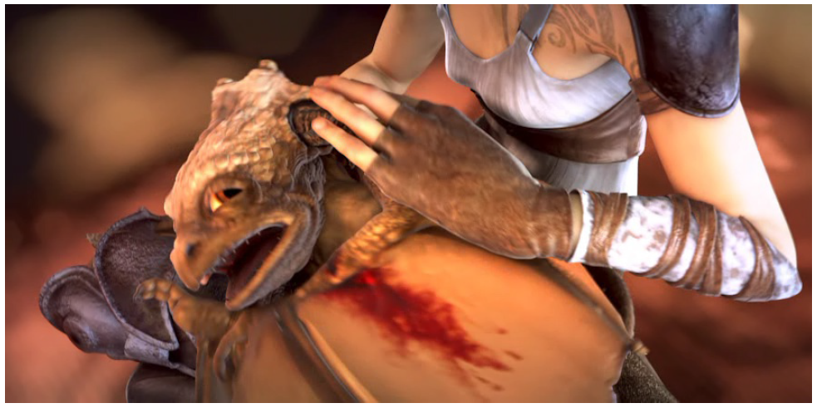
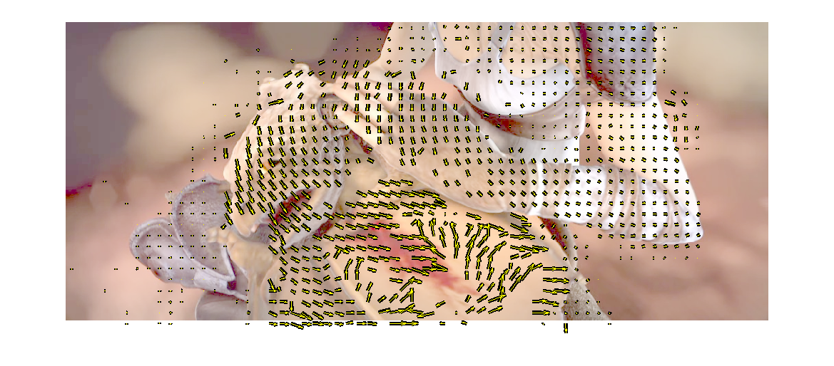
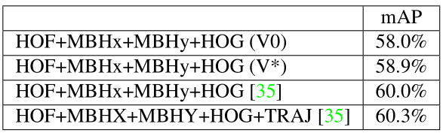
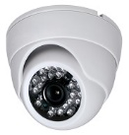
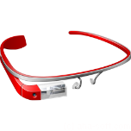
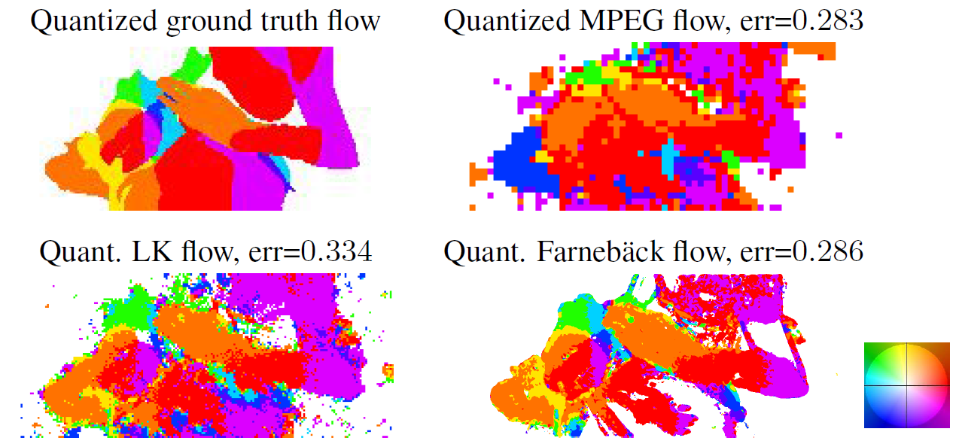
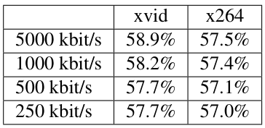
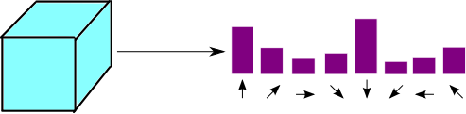
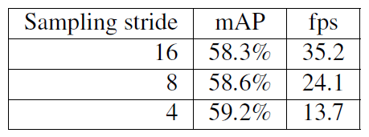
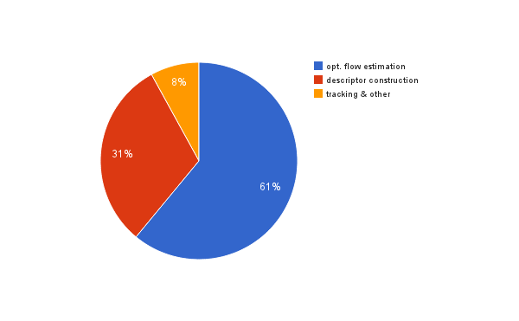
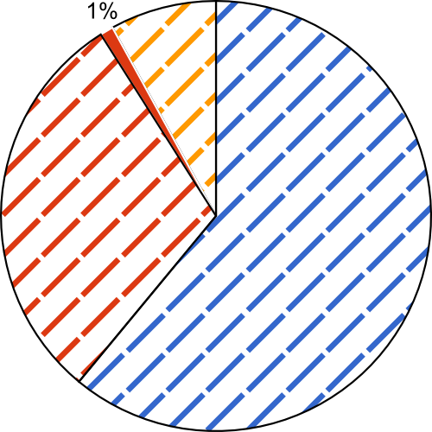

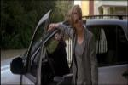
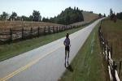


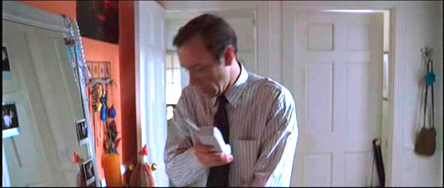

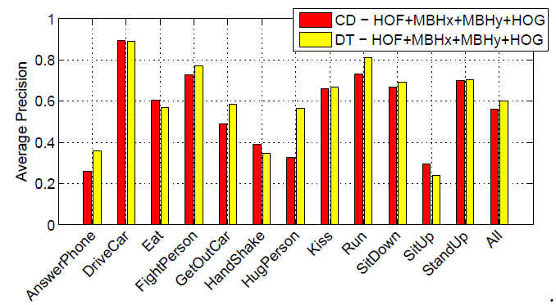
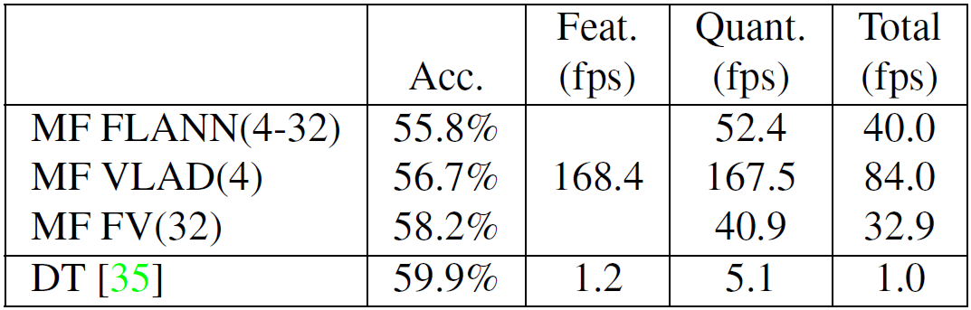



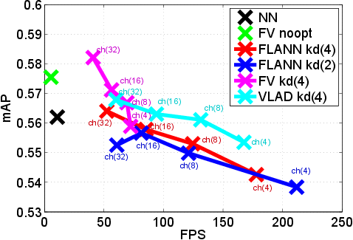
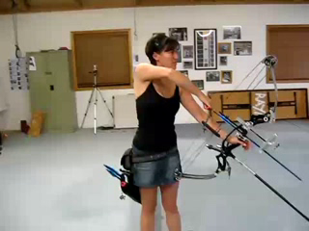
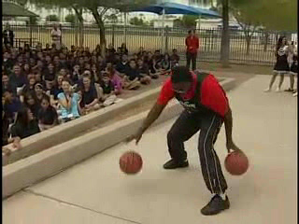
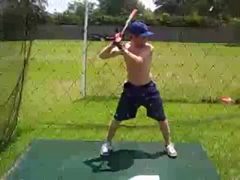
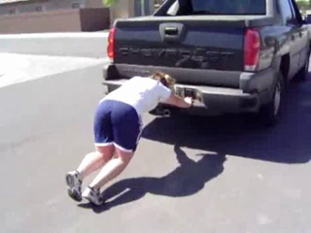
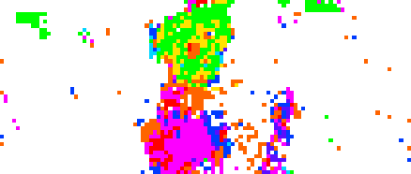

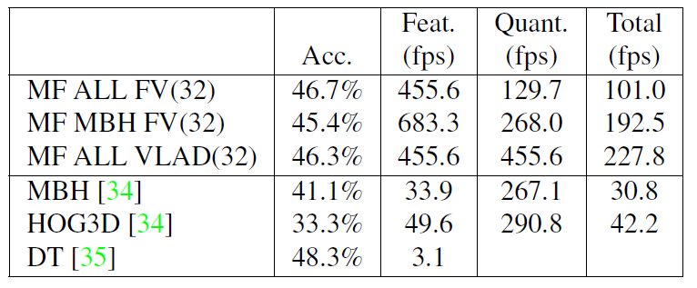
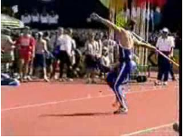
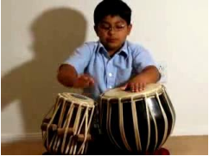
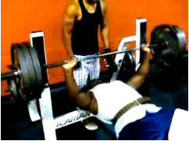
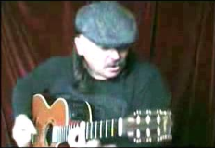
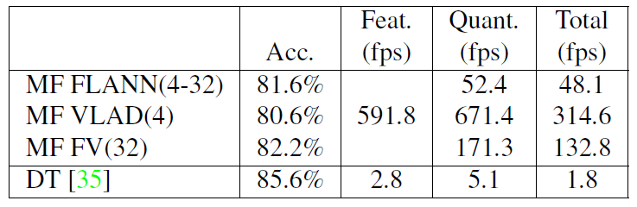
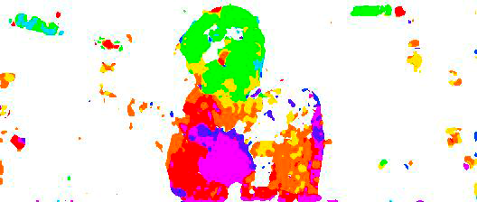
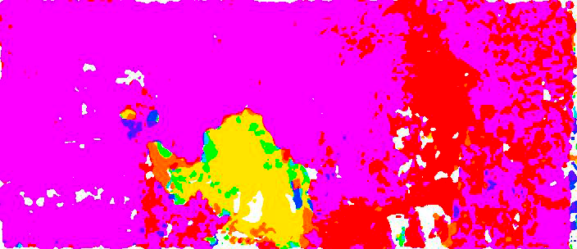
Efficient feature extraction, encoding and classification for action recognition
Vadim Kantorov, Ivan Laptev
INRIA – WILLOW / École Normale Supérieure, Paris, France
École Normale Supérieure
Goal
Approach
Results
•
Fast action recognition.
MPEG flow
Local motion descriptor
Descriptor evaluation
•
State-of-the-art performance.
Motivation
•
Estimated motion vectors are part of the most compressed video representations: MPEG, H-264, VP9.
Hollywood2 Histogram encoding
•
Huge amounts of video:
•
MPEG motion vectors are sparse, typically defined on a 16x16 pixel grid.
Decades of TV channels
•
The quality of MPEG flow is comparable to motion estimation by standard Optical Flow algorithms.
6000 years of new video each year
5M years of video transfer per month in 2018
•
Large-scale applications:
Motion in the synthetic MPI Sintel Flow dataset:
V*
V0
Video indexing
-1%
Surveillance
-1%
[1]
V*
Augmented reality
•
Use sparse MPEG flow vectors to compute HOF: Histograms of flow MBH: Motion boundary histograms
•
Current state-of-the-art methods for action recognition typically process ≈1 frame per second
Trajectory information has limited influence on results
•
Grid cells of two scales: 16x16 pixels, 5 frames 24x24 pixels, 5 frames
Parameter sensitivity
Contributions
•
>100x speed-up of video feature extraction.
•
Dense descriptor sampling with 16 pixels spatial stride 5 frames temporal stride
Optical flow estimation
OF stride marginally affects accuracy
Stable recognition across codecs and bit-rates
Descriptor aggregation
<1%
Time for video feature extraction
8%
Tracking
Descriptor aggregation
Comparison to the state of the art
31%
61%
Motion in movie frames:
•
Feature encoding and classification schemes: Histogram encoding + kernel SVM VLAD + linear SVM Fisher Vector [3] + linear SVM
Hollywood 2
•
Dense trajectories [1]
Our method
•
4x real-time action recognition (CPU).
•
Descriptor assignment using approximate Nearest Neighbor search (FLANN) [4].
•
Minor decrease in recognition accuracy.
Publicly available implementation http://www.di.ens.fr/willow/research/fastvideofeat
Quantized MPEG flow
•
Approximate FV aggregation with updates of five nearest centroids only.
Related work
HMDB 51
UCF 50
[1] H. Wang, A. Klaser, C. Schmid, and C.-L. Liu. Dense trajectories and motion boundary descriptors for action recognition. IJCV, 2013.
[2] F. Shi, E. Petriu, and R. Laganiere. Sampling strategies for real-time action recognition. In CVPR, pages 2595–2602, 2013.
[3] F. Perronnin and J. Sanchez. High-dimensional signature compression for large-scale image classification. In CVPR, 2012.
[4] M. Muja and D. Lowe. Fast approximate nearest neighbors with automatic algorithm configuration. In VISSAPP, pp. 331–340, 2009.
Quantized Lukas-Kanade flow
Quantized Farnebäck flow
Code available http://www.di.ens.fr/willow/research/fastvideofeat

