Slide 1

Rockbuster Stealth
Business Analysis
Alexander Koba
August 2023

Slide 2

Introduction
Rockbuster Stealth LLC is a movie rental company that had stores around the world. Facing stiff competition from streaming services such as Netflix and Amazon Prime, the management team plans to use its existing movie licenses to launch an online video rental service to stay competitive.
The Rockbuster management needs data-driven analysis and conclusions that they can use for their future company strategy.
Some of the main questions they’d like to answer: Which countries are Rockbuster customers based in? Do sales figures vary between geographic regions? Which movies contributed the most/least to revenue gain?

Slide 3
DATA OVERVIEW
Rockbuster’s business data saved in the PostgreSQL Database. The main data characteristics are:
Number of sale countries – 109
Number of customers – 599
Number of titles – 1000
Number of film categories - 20
Number of languages – 6
Revenue - $61,312.04
Period of data collection 05/2005 - 02/2006
Rental statistics
Indicator | MIN | MAX | MEAN
Rental rate ($) | 0.99 | 4.99 | 2.98
Rental duration (days) | 3 | 7 | 5
Length (minutes) | 46 | 185 | 115
Replacement cost ($) | 9.99 | 29.99 | 19.98

Slide 4
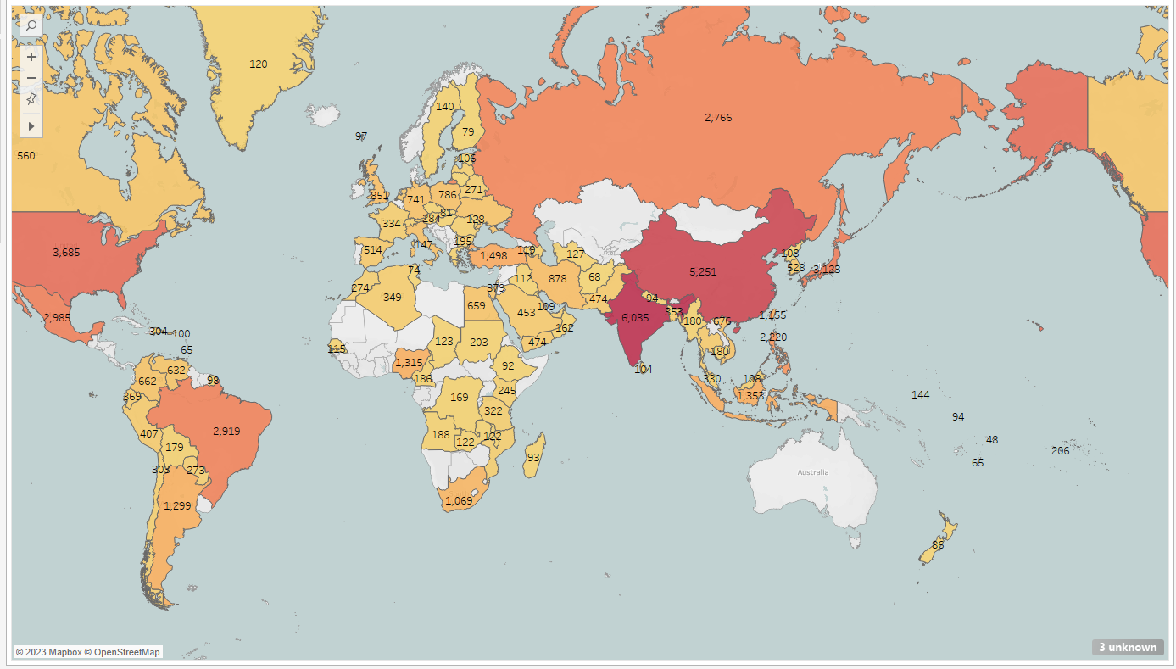


The choropleth map of the sum of payments by countries
Countries which give the most revenue ($)
India 6,035
China 5,251
USA 3,685
Japan 3,128
Brazil 2,919

Slide 5
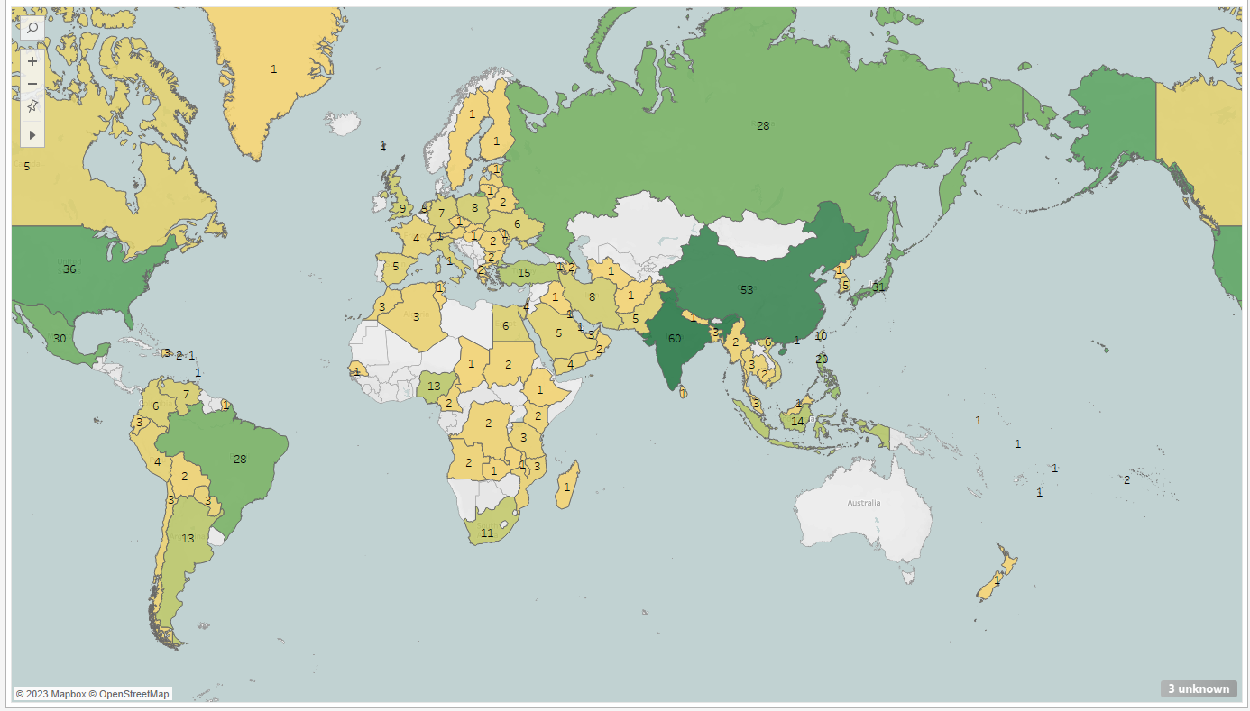

The choropleth map of the customers number by countries
Countries which have the most customers
India 60
China 53
USA 36
Japan 31
Brazil 28
Languages of films
English
French
German
Mandarin
Japanese
Italian

Slide 6


SOME characteristics of the movie database
Number of film titles by genres
Genre | Number
Sports | 74
Foreign | 73
Thriller | 69
Documentary | 68
Animation | 66
Action | 64
New | 63
Drama | 62
Sci-Fi | 61
Games | 61
Main Actors
First Name | Last Name | Number
Gina | Degeneres | 42
Walter | Torn | 41
Mary | Keitel | 40
Matthew | Carrey | 39
Sandra | Kilmer | 37
Scarlett | Damon | 36
Angela | Witherspoon | 35
Vivien | Basinger | 35
Val | Bolger | 35
Henry | Berry | 35

Slide 7
Conclusions
The revenue and customers of the company, that are spread around the world, fit into an online service
Sports, foreign, thriller, documentary, and animation genres are the most popular
India, China, and Japan give the most revenue in Asia
USA and Brazil give the most revenue in Americas
The number of customers is spread similarly
Recommendations
Forward more marketing resources to the top countries as India, China, Japan, USA, Brazil
Invest in more movies into the most popular categories like sport, foreign, thriller, documentary, and animation
Expand the inventory of films by including more national languages.

