Slide 1
Ames, Iowa Housing Price Prediction
Michelle Bui, Alex Galczak, Chad Loh, James Reno

Slide 2
Ames, Iowa
INTRODUCTION

Slide 3
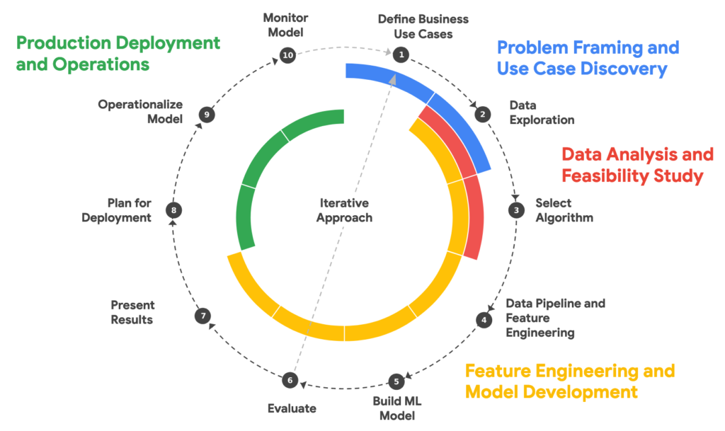
What does a Machine Learning project look like?
OUTLINE
DISCOVERY PHASE
Research Questions
DISCOVERY PHASE
Exploratory Data Analysis
ANALYSIS PHASE
Feature Analysis
ANALYSIS PHASE
Data Cleaning
ANALYSIS PHASE
ML Algorithms
DEVELOPMENT PHASE
Feature Analysis
Adaptation of Google Cloud ML Workflow
DEVELOPMENT PHASE
ML Model Development
DEVELOPMENT PHASE
ML Model Testing
DEPLOYMENT PHASE
Shiny App Development

Slide 4
Research Questions
DISCOVERY PHASE

Slide 5
Exploratory Data Analysis
DISCOVERY PHASE

Slide 6
Feature Analysis
ANALYSIS PHASE

Slide 7
Data Cleaning
ANALYSIS PHASE

Slide 8
Exploration of ML Algorithms
ANALYSIS PHASE

Slide 9
Feature Engineering
DEVELOPMENT PHASE

Slide 10
ML Model Development
DEVELOPMENT PHASE

Slide 11
ML Model Testing
DEVELOPMENT PHASE

Slide 12
Shiny App Development
DEPLOYMENT PHASE

Slide 13
Thank You.

