Slide 1
Ames, Iowa Housing Price Prediction
Michelle Bui, Alex Galczak, Chad Loh, James Reno

Slide 2
Ames, Iowa
INTRODUCTION
Copy from somewhere

Slide 3
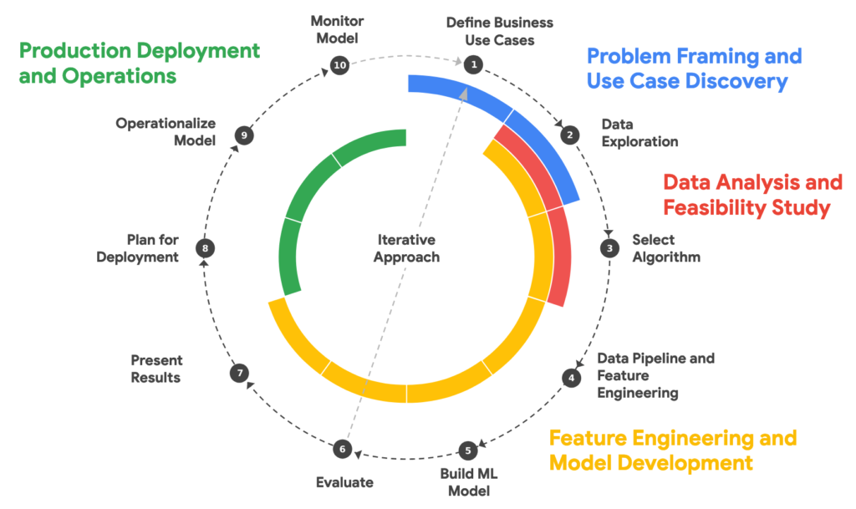
What does a Machine Learning project look like?
OUTLINE
DISCOVERY PHASE
Research Questions
DISCOVERY PHASE
Exploratory Data Analysis
ANALYSIS PHASE
Feature Analysis
ANALYSIS PHASE
Data Cleaning
ANALYSIS PHASE
ML Algorithms
DEVELOPMENT PHASE
Feature Engineering
Adaptation of Google Cloud ML Workflow
DEVELOPMENT PHASE
ML Model Development
DEVELOPMENT PHASE
ML Model Testing
DEPLOYMENT PHASE
Shiny App Development

Slide 4
Market research? Zillow?

Slide 5
Research Questions
DISCOVERY PHASE
Assess price point when you sell/buy

Slide 6
Exploratory Data Analysis
DISCOVERY PHASE
Michelle: What EDA we did, what visuals we want to include
James: What EDA, feature selection
Chad: How I deleted some features

Slide 7
Feature Analysis
ANALYSIS PHASE
Alex: Explanation of the features?

Slide 8
Data Cleaning
ANALYSIS PHASE
James, Chad: How we cleaned the data, How we deleted some outliers

Slide 9
Exploration of ML Algorithms
ANALYSIS PHASE
Michelle: Multiple regression, Tree?
Gridsearch? CV? Normalization? Traintest split?

Slide 10
Feature Engineering
DEVELOPMENT PHASE
James: New feature
Chad: Neighborhood

Slide 11
ML Model Development
DEVELOPMENT PHASE

Slide 12
ML Model Testing
DEVELOPMENT PHASE

Slide 13
Shiny App Development
DEPLOYMENT PHASE
Master of Shiny: Alex
Chad, Michelle, James

Slide 14
Thank You.

