Slide 1
IMPOSSIBLE TO WIN TIC TAC TOE
Alexis Garcia Gutierrez

Slide 2
Minimax strategy in game theory or decision making.
Is a tactic in which individuals attempt either to minimize their own maximum losses or to reduce the most an opponent will gain
Minimize the maximum expected loss with an opponent with perfect information.
https://dictionary.apa.org/minimax-strategy
https://es.wikipedia.org/wiki/Minimax

Slide 3
Example
Turn = IA
Objective = Minimize loss
Note gain and losses are based in a score
IA
IA: 15
Player
Player
Player
IA:3
IA:1
IA:-5
IA:6
IA:10

Slide 4
General example
Turn = Player
Objective = Maximize loss
Note gain and losses are based in a score
IA
IA: 15
Player:3
Player:-5
Player:6
IA:3
IA:1
IA:-5
IA:6
IA:10

Slide 5
General example
Turn = IA
Objective = Minimize loss
Note gain and losses are based in a score
IA:6
IA: 15
Player:3
Player:-5
Player:6
IA:3
IA:1
IA:-5
IA:6
IA:10

Slide 6
General example
Turn = IA
Objective = Minimize loss
Note gain and losses are based in a score
IA:6
IA: 15
Player:3
Player:-5
Player:6
IA:3
IA:1
IA:-5
IA:6
IA:10

Slide 7
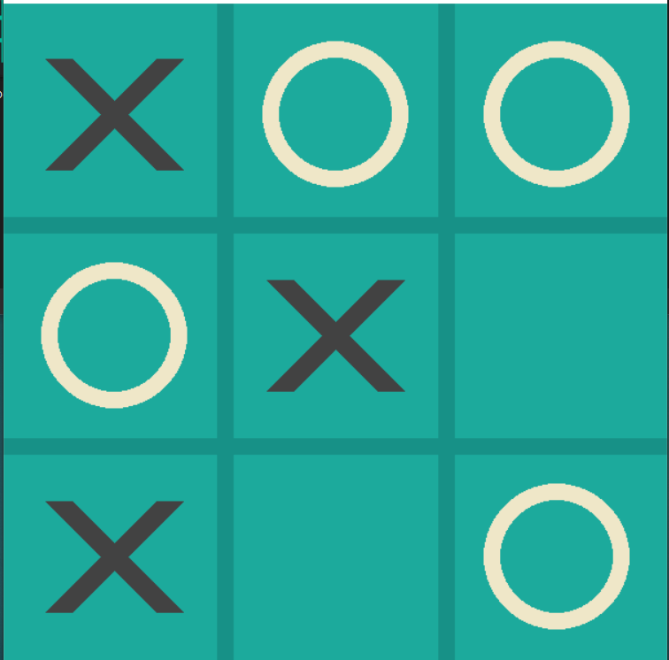
Tic Tac Toe example
Turn = X

Slide 8
Tic Tac Toe example
Turn = X
Turn = O

Slide 9
Tic Tac Toe example
Turn = X
Turn = o

Slide 10
Tic Tac Toe example
Turn = X
Turn = o
Calculate x score
0
-1

Slide 11
Tic Tac Toe example
Turn = X
Turn = o
0
-1
Calculate x score
0
-1

Slide 12
Tic Tac Toe example
Turn = X
0
Turn = o
0
-1
Calculate x score
0
-1

Slide 13
Tic Tac Toe example
Turn = X
0
Turn = o
0
-1
Calculate x score
0
-1

Slide 14
Pros and Cons
Pros
It can not loss: Its possibility goes from a tie to win the game. (If the game is fair)
Cons
Is too slow: In tic tac toe must calculate 9! = 362880 possible moves (in the first turn)

Slide 15

How to make a better algorithm

Slide 16
Source
How to create tic tac toe game
https://www.youtube.com/watch?v=pc7XhHxSgrM
How to implement minimax in tic tac toe
https://www.youtube.com/watch?v=trKjYdBASyQ&t=1371s
Explanation of minimax
https://www.youtube.com/watch?v=l-hh51ncgDI
How to improve minimax
http://blog.gamesolver.org/

