Slide 1
Diploma presentation
EPAM DevOps Internship
Stream 24
Variant 8
by Alexander Shcherbakov (Aleksandr_Shcherbakov1@epam.com)
https://github.com/AlexGenSh/DevOpsScool-diploma

Slide 2
Task
A light-weight Python/Flask application with MySQL database. It gets Star wars herous via API (), stores it in the database and displays on the web page. For a marketing campaign collect information about Star Wars universe using open API https://swapi.dev/ Store the following data in the local database: character: Name, Gender, homeworld, and other if it is necessary; planet: Name, Gravitation, Climate, and other if it is necessary. Create a report contenting information (see above) about the planet (or planets) with a list of its residents.
Data source
The app pulls data about Star Wars canon universe through HTTP web API in JSON format from https://swapi.dev/

Slide 3
Used technologies and tools
application - Python + Flask + SQLAlchemy + JavaScript + HTML + Bootstrap
compute - AWS/EC2 instances as Kubernetes worker nodes
containers – Docker
version control system is used GitHub
orchestration - AWS/EKS Kubernetes
database - AWS/RDS MySQL
IaC - Terraform
CI/CD - GitHub Actions
container registry / artifact storage - AWS/ECR
logging and monitoring - AWS/CloudWatch Container insight, S3 backet “diploma-s3-backet-log-dev / prod”
code quality gate - SonarCloud

Slide 4
Terraform
All infrastructure components are deployed via Terraform and stored in IaC folder GitHub https://github.com/AlexGenSh/DevOpsScool-diploma/IaC
The only components not covered by Terraform are:
GitHub and GitHub Actions
SonarCloud
Metrics server
Container insight
After infrastructure provisioning the initialal docker images is deployed in EKS using “Initial deploy” Github Action

Slide 5
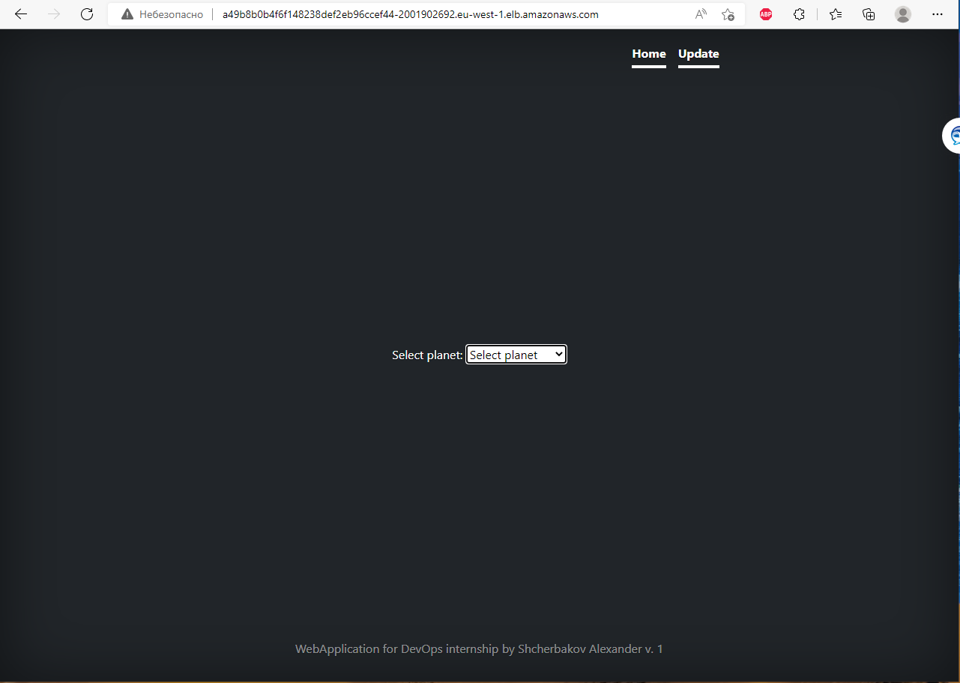
App features
Select planet from drop down list for display data for selected planet;
Performs data update per user’s request;

Slide 6
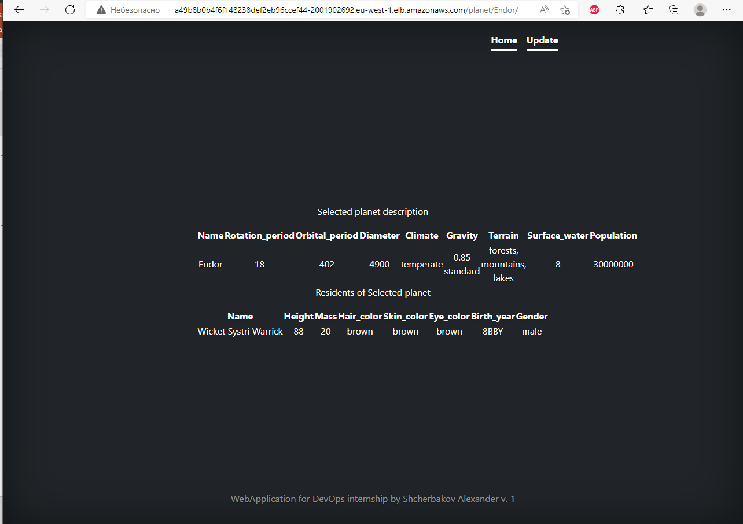
App features
Information about planet and residents;

Slide 7
Implementation highlights
Flask Python framework and internal flask server are used for web;
JavaScript for dynamic table creation and Bootstrap templates are used at front-end;
SQLAlchemy is used for interaction with MySQL database;
API sometimes returns inconsistent data thus exception handling is in place;
GitHub Flow was demonstrated but not much sense for it in such a small project created by single person. Trunk-based developments used most of time.

Slide 8
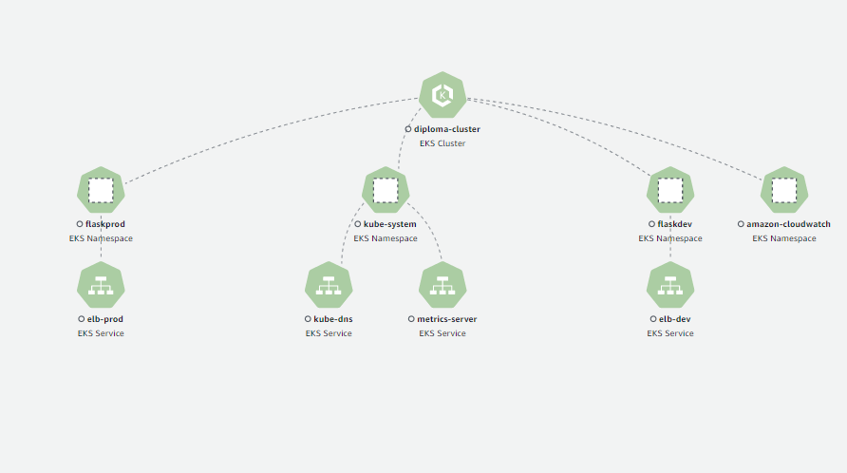
Container map

Slide 9
Monitoring EKS using Container insight and CloudWatch
kubectl apply -f https://raw.githubusercontent.com/aws-samples/amazon-cloudwatch-container-insights/latest/k8s-deployment-manifest-templates/deployment-mode/daemonset/container-insights-monitoring/cloudwatch-namespace.yaml
kubectl apply -f https://raw.githubusercontent.com/aws-samples/amazon-cloudwatch-container-insights/latest/k8s-deployment-manifest-templates/deployment-mode/daemonset/container-insights-monitoring/cwagent/cwagent-serviceaccount.yaml
curl -O https://raw.githubusercontent.com/aws-samples/amazon-cloudwatch-container-insights/latest/k8s-deployment-manifest-templates/deployment-mode/daemonset/container-insights-monitoring/cwagent/cwagent-configmap.yaml
kubectl apply -f cwagent-configmap.yaml
kubectl apply -f https://raw.githubusercontent.com/aws-samples/amazon-cloudwatch-container-insights/latest/k8s-deployment-manifest-templates/deployment-mode/daemonset/container-insights-monitoring/cwagent/cwagent-daemonset.yaml
kubectl get pods -n amazon-cloudwatch
Set up the CloudWatch agent to collect cluster metrics - Amazon CloudWatch (amazonaws.cn)

Slide 10
Create horizontal autoscale group
kubectl apply -f https://github.com/kubernetes-sigs/metrics-server/releases/latest/download/components.yaml
kubectl autoscale deployment flaskappprod -n flaskprod --cpu-percent=50 --min=1 --max=3
kubectl describe hpa -n flaskprod
Create load generator for test pods autoscale
kubectl run -i --tty load-generator -n flaskprod --rm --image=busybox:1.28 -- /bin/sh
while true; do wget -q -O - a95fbf1b483644f4bba26e31323b1a37-1870510020.eu-west-1.elb.amazonaws.com; done

Slide 11
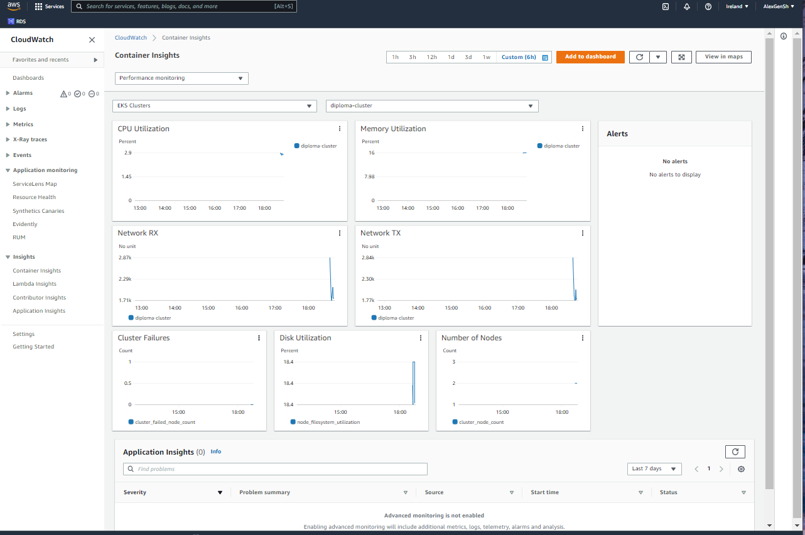
Monitoring EKS using Container insight

Slide 12
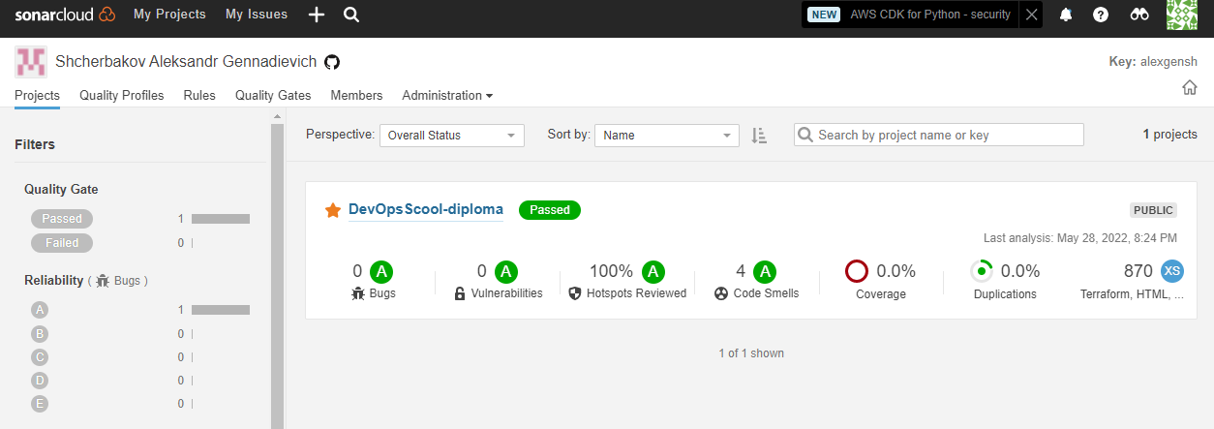
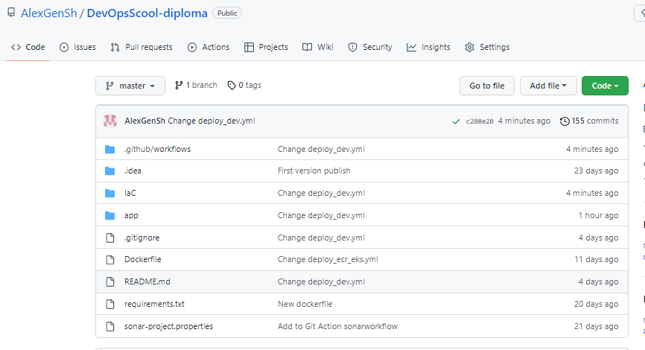
SonarCloud check

Slide 13
AWS
Personal account with free tier was used. This is a low-cost learning project and only few expenses were needed. These are:
EKS cluster control plane
t3a.small instances to run worker nodes (2 instances)
Although in production environment worker nodes should reside in Private subnets (with NAT Gateway), for learning purpose Public subnets with Security Groups and Internet Gateway were used.
Two worker nodes are deployed in different availability zones. Elastic Load Balancer (ELB) acts as an outside interface for app users.
RDS is accessible from the Internet but only for a limited range of source IPs.

Slide 14













AWS infrastructure scheme
Users
AWS Cloud
Region eu-west-1
diploma-vpc-main
Internet gateway EKS-IGW
Classic Load Balancer
Classic Load Balancer
Availability Zone eu-west-1a
Availability Zone eu-west-1b
Public subnet public-eu-west-1a
Public subnet public-eu-west-1b
Auto Scaling group Diploma_autoscale_policy
Registry test-repo
Amazon CloudWatch
Security group diploma-rds-dev-sg
Security group diploma-rds-prod-sg
MySQL
diploma-rds-dev
MySQL
diploma-rds-prod

Slide 15









Kubernetes infrastructure scheme
Users
Internet gateway EKS-IGW
Classic Load Balancer
Classic Load Balancer
EKS Cluster
DEV Namespace HPA
PROD Namespace HPA
Load balancing service
Load balancing service
DEV RDS
POD
POD
PROD RDS
Cluster auto scaler
Metric Server

Slide 16
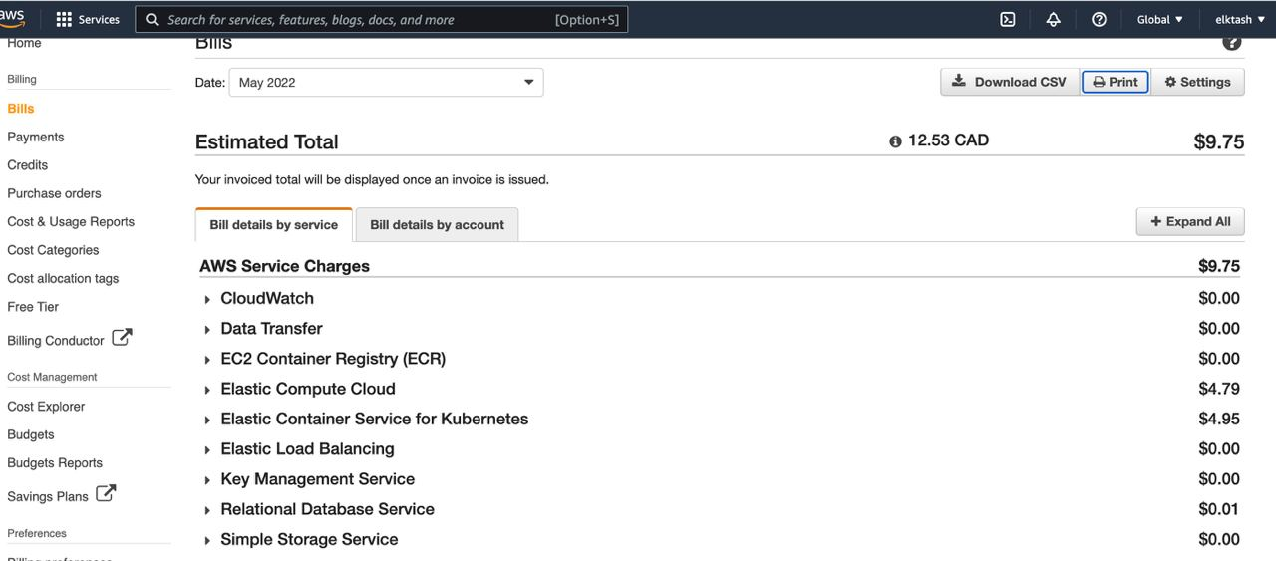
About expenses
According to AWS Budgets report expenses for 1 months of diploma preparation was 9.75 USD.

Slide 17
Thank you
for your attention

