Slide 1




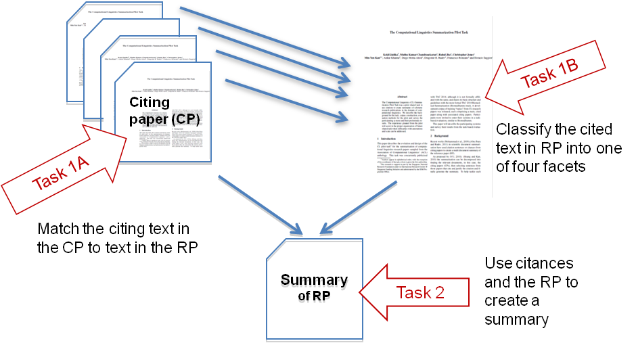
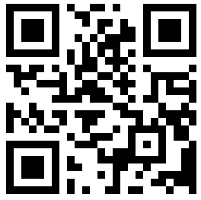
Scientific Document Summarization
Standardized Reference Corpus and Shared Task
Min-Yen Kan*, Kokil Jaidka⁺, Muthu Kumar Chandrasekaran* *National University of Singapore
⁺University of Pennsylvania
Chin-Yew Lin, Microsoft Research
Where we are after 3 years?
2014
10 target papers; 100 citing papers; annotated by three of the organisers at NUS
CL-SciSumm Pilot Shared Task @ TAC, MD, USA
Self-reported evaluation cross-validated on a single corpus
Corpus annotation and shared task funded by MSR
2016
30 target papers; 500 citing papers; annotated by a 5+ applied linguistics students from U. Hyderabad, India
Largest corpus in the world
CLSciSumm – 16 @ JCDL, New Jersey
Centralised evaluation on a test set of 10 papers
2017
Upcoming! Expanding to 50 target papers
Centralised, automated, transparent evaluation on codalab.org
CLSciSumm – 17 @ SIGIR, Tokyo
Sign up! http://wing.comp.nus.edu.sg/cl-scisumm2017
Tasks
Result Overview from CLSciSumm – 16
Task 1A: Identify the text span in the RP which corresponds to the citing sentences from the cited paper (CP).
Task 1B: Identify the discourse facet for every cited text span from a predefined set of facets.
Task 2: Output a summary of the reference paper (RP)!
Reference
paper (RP)
System performances on Task 1A of the CL-SciSumm ‘16 Shared Task
Annotated Corpus
Gold standard annotations for Task 1A and 1B, per topic or reference paper
Community and hand-written summaries for Task 2, per topic
Systems performance vs. human summaries (part of Task 2) of CL-SciSumm ‘16 Shared Task
Download the corpus form GitHub repo, accessible using this QR code.
https://github.com/WING-NUS/scisumm-corpus
Acknowledgements: Chin-Yew Lin (MSRA), Hoa Dang and NIST, Lucy Vanderwende (MSR), Anita de Ward (Elsevier Data Services), Kevin B Cohen and team (U. Colorado, Boulder), Rahul Jha (Google), CLAIR, (U.Michigan, Ann Arbor) and University of Hyderabad (India)

