Slide 1
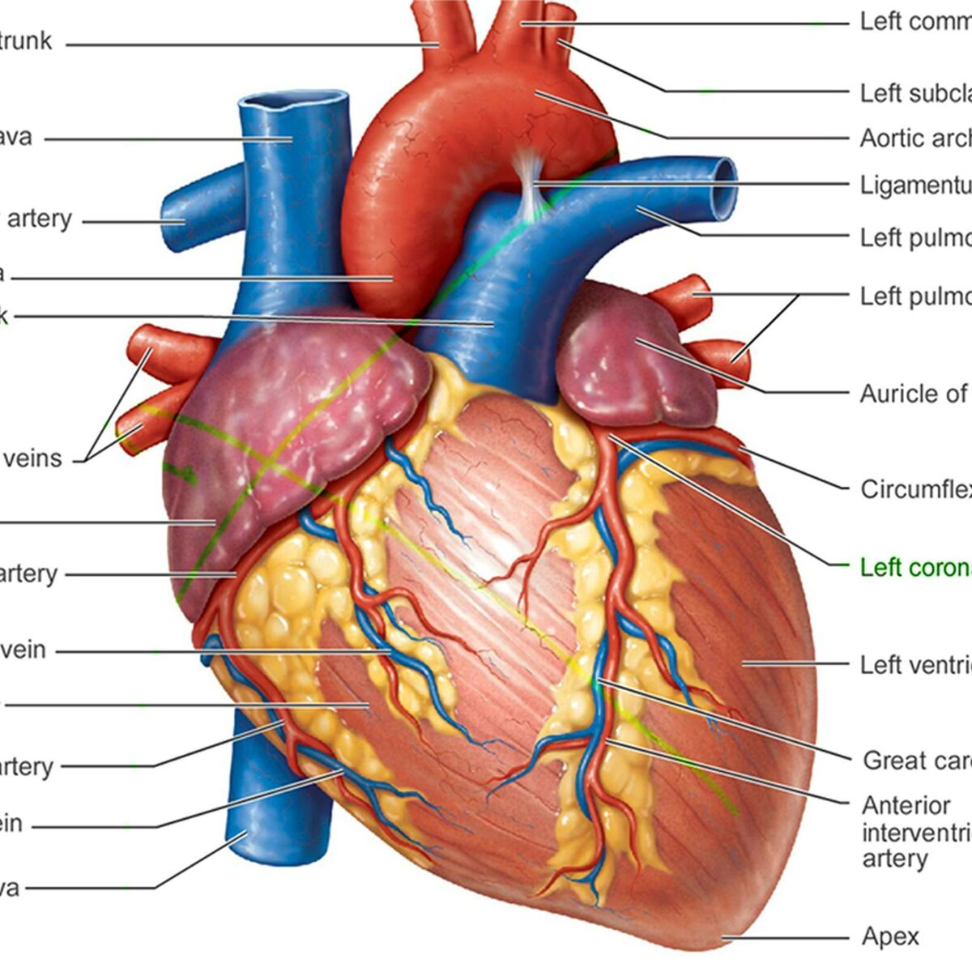
Different approaches for Heart Attack Analysis & Prediction
Intelligent Systems
Alexandre Gonçalves 100121, alexandre.n.goncalves@tecnico.ulisboa.pt
Francisco Pinto 089888, francisco.v.pinto@tecnico.ulisboa.pt

Slide 2
Introduction
In medical applications, predicting heart attacks is crucial, requiring models that are both accurate and interpretable;
”Heart Attack Analysis & Prediction Dataset” from Kaggle, which contains 303 records and 14 clinical features. The target variable is binary, indicating whether a patient is at risk of a heart attack;
This project aims to compare different types of machine learning models, focusing on both performance and interpretability.

Slide 3
Exploratory Data Analysis
Variable | Type | Description
Age | Numerical | Patient’s age
Sex | Categorical (0/1) | Patient’s sex
Cp | Categorical (0-3) | Degree of chest pain symptoms
Trestbps | Numerical | Resting blood pressure (mm Hg)
Chol | Numerical | Patient’s cholesterol (mg/dl)
Fbs | Categorical (0/1) | Fasting blood sugar >120 mg/dL
Restecg | Categorical (0-2) | Resting ECG results
Thalach | Numerical | Maximum heart rate achieved
Exang | Categorical (0/1) | Exercise induced angina
Oldpeak | Categorical (0/1) | ECG depression induced by exercise
Slope | Categorical (0-2) | Slope used during the exercise
Ca | Categorical (0-3) | Number of major vessels
Thal | Categorical (0-3) | Degree of thalassemia symptoms
Table: Variable descriptions

Slide 4
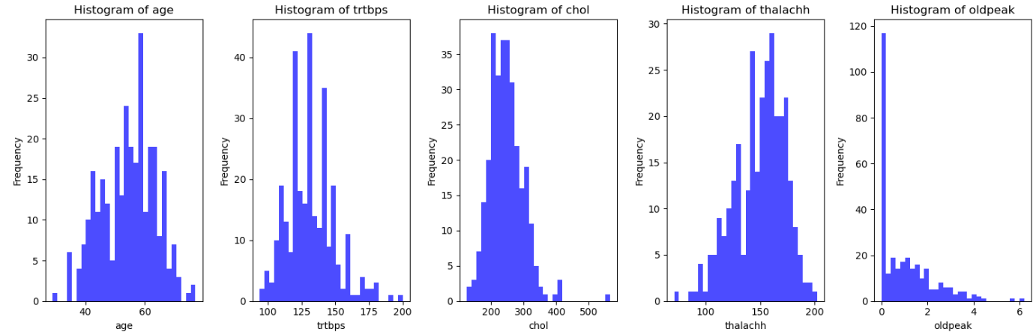
Exploratory Data Analysis
Dataset contains 303 observations, each with 14 features;
Figure: Histograms of numerical variables

Slide 5
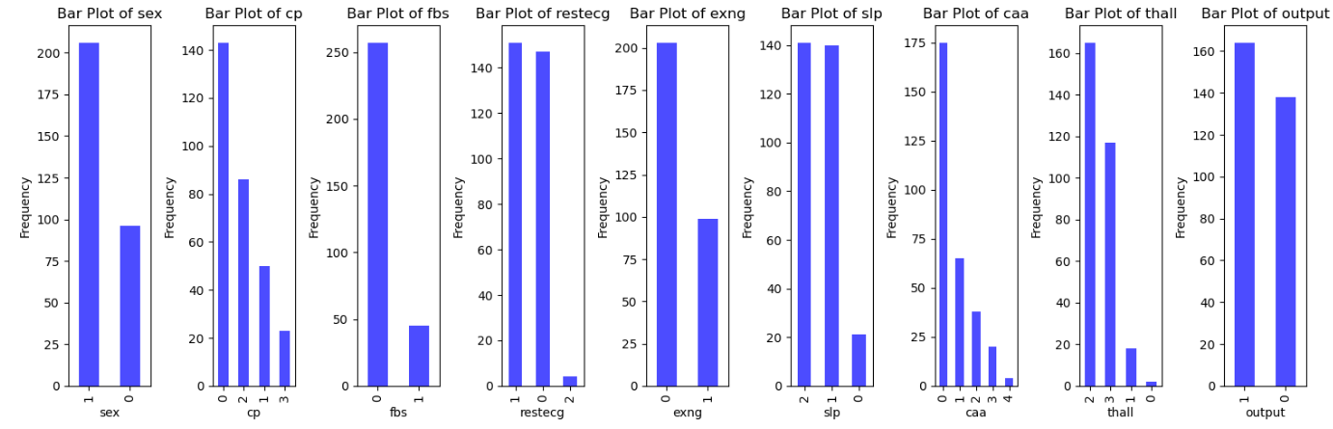
Exploratory Data Analysis
Dataset contains 303 observations, each with 14 features;
Figure: Histograms of categorical variables

Slide 6
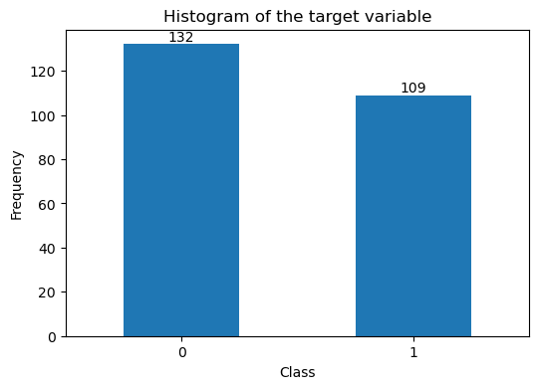
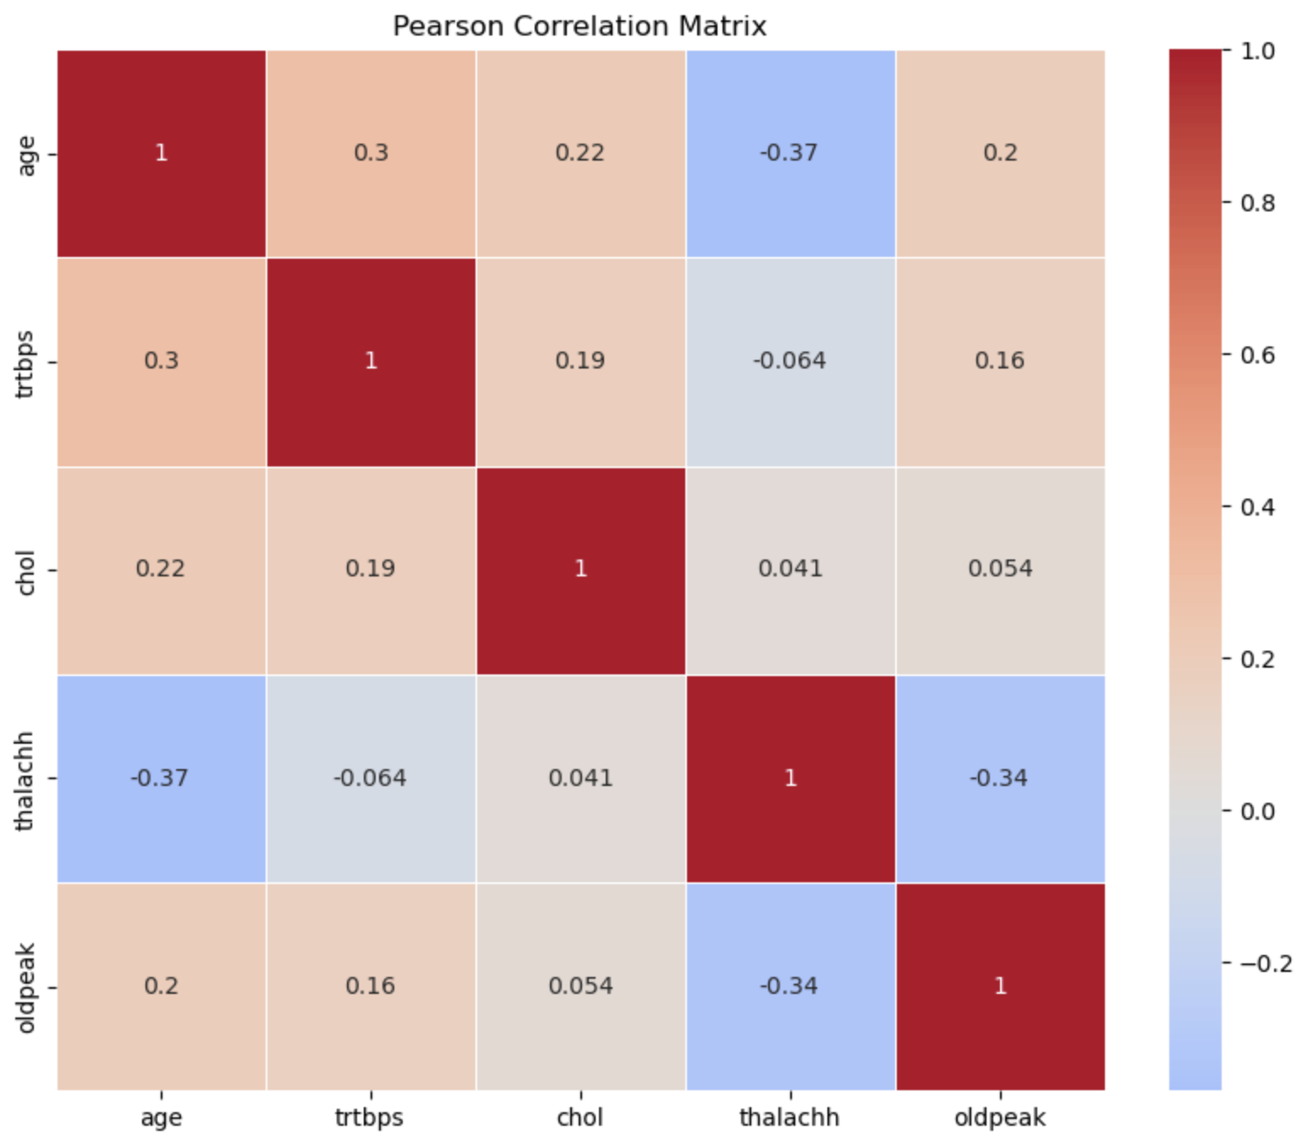
Feature Selection and Engineering
IQR used to identify and treat outliers;
Pearson correlation matrix used to identify correlated pairs of features;
The target variable wasn’t extremely unbalanced
RFE used to recursively identify relevant subsets of features;
Standard Scaler used to scale the data and adjust its distribution.

Slide 7
Important Considerations
Since we are trying to predict a health condition, our recall should be as high as possible;
The number of false positives may increase, but this is often considered an acceptable trade-off given the stakes and the context of the problem.
Since our team is not specialized in medicine in any way, it is important not to trust these kinds of models blindly. In a real-world scenario, the supervision/input of a medical team would be crucial.

Slide 8
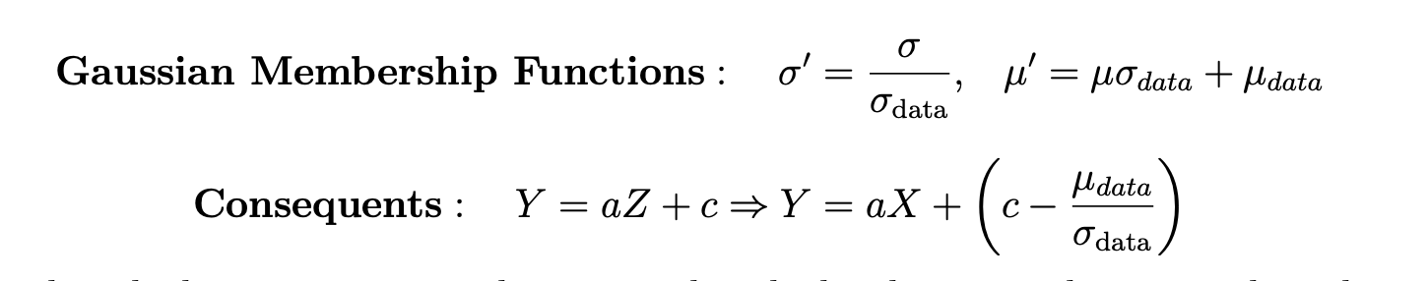
Fuzzy Inference System
Simpler and more explainable;
Building steps:
Fuzzy Clustering;
Approximate membership functions;
Estimate consequents.
Since the data used to build the model was scaled, we will adapt the final model so it can receive and work with real world values, making it more interpretable:

Slide 9
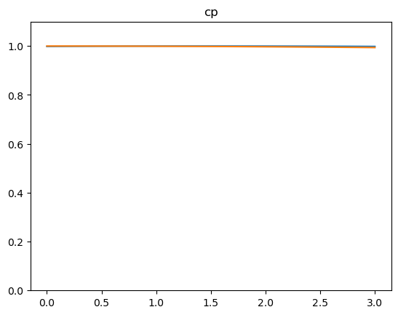
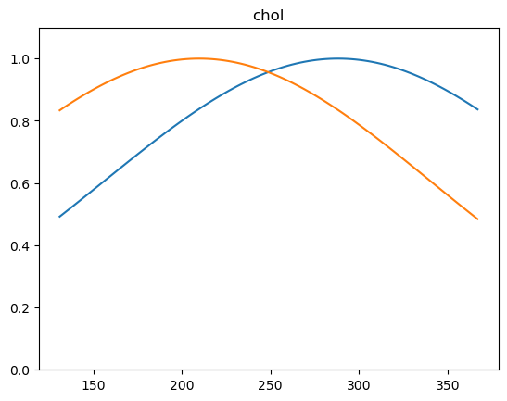
Fuzzy Clustering
Fuzzy c-means clustering delivered bad results, cluster centers were almost coinciding, and membership functions were almost one in all the universe of discourse (the clusters were “competing” with each other.
FST-PSO clustering was used, as offered by pyFUME. This method is better at handling high-dimensional or complex datasets.
This method fixed our problem in most of the membership functions.
The images shown are already on correctly valued universes of discourse.
Figure: Chest pain and cholesterol membership functions

Slide 10
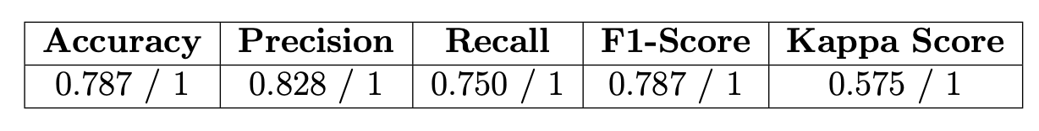
Fuzzy Clustering
The obtained results are on-par with other used methods;
This model is highly interpretable, we can easily deduct why it reached a specific result by looking at each variable’s membership functions and at the consequents it uses.
Table: Model’s performance metrics
Table: Consequents used by the model

