Slide 1
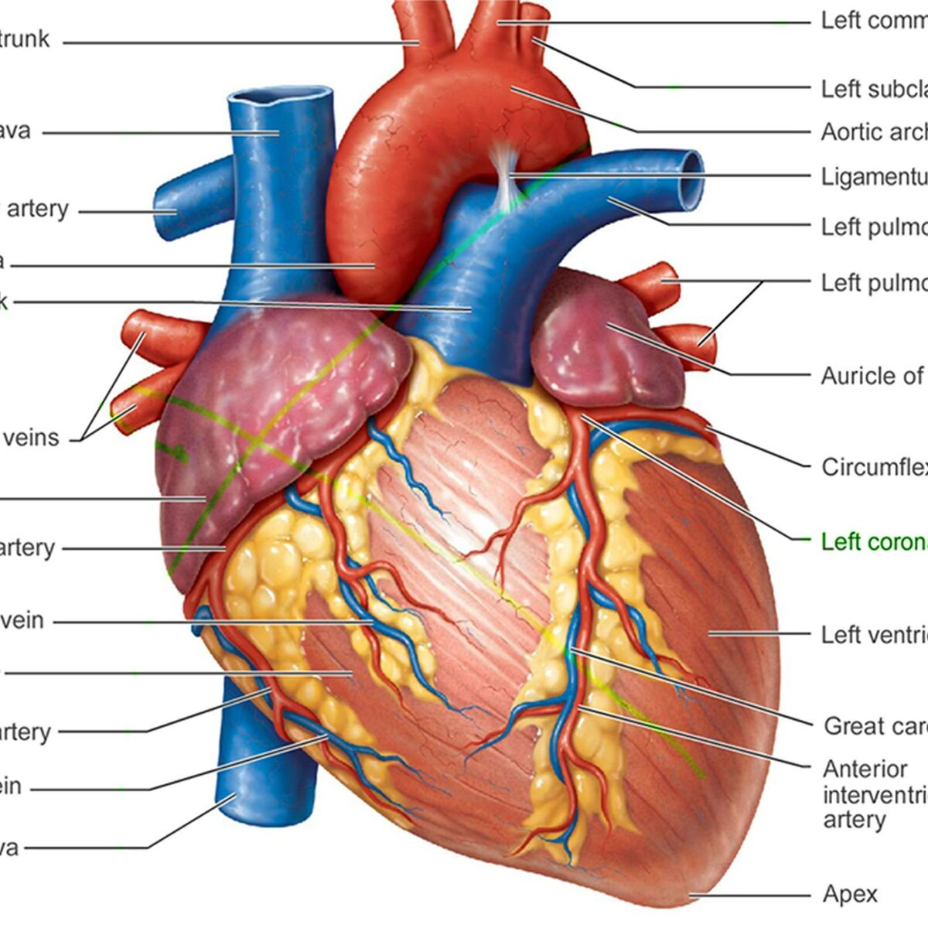
Different approaches for Heart Attack Analysis & Prediction
Intelligent Systems
Alexandre Gonçalves 100121, alexandre.n.goncalves@tecnico.ulisboa.pt
Francisco Pinto 089888, francisco.v.pinto@tecnico.ulisboa.pt

Slide 2
Introduction
In medical applications, predicting heart attacks is crucial, requiring models that are both accurate and interpretable;
”Heart Attack Analysis & Prediction Dataset” from Kaggle, which contains 303 records and 14 clinical features. The target variable is binary, indicating whether a patient is at risk of a heart attack;
This project aims to compare different types of machine learning models, focusing on both performance and interpretability.

Slide 3
Exploratory Data Analysis
Variable | Type | Description
Age | Numerical | Patient’s age
Sex | Categorical (0/1) | Patient’s sex
Cp | Categorical (0-3) | Degree of chest pain symptoms
Trestbps | Numerical | Resting blood pressure (mm Hg)
Chol | Numerical | Patient’s cholesterol (mg/dl)
Fbs | Categorical (0/1) | Fasting blood sugar >120 mg/dL
Restecg | Categorical (0-2) | Resting ECG results
Thalach | Numerical | Maximum heart rate achieved
Exang | Categorical (0/1) | Exercise induced angina
Oldpeak | Categorical (0/1) | ECG depression induced by exercise
Slope | Categorical (0-2) | Slope used during the exercise
Ca | Categorical (0-3) | Number of major vessels
Thal | Categorical (0-3) | Degree of thalassemia symptoms

Slide 4
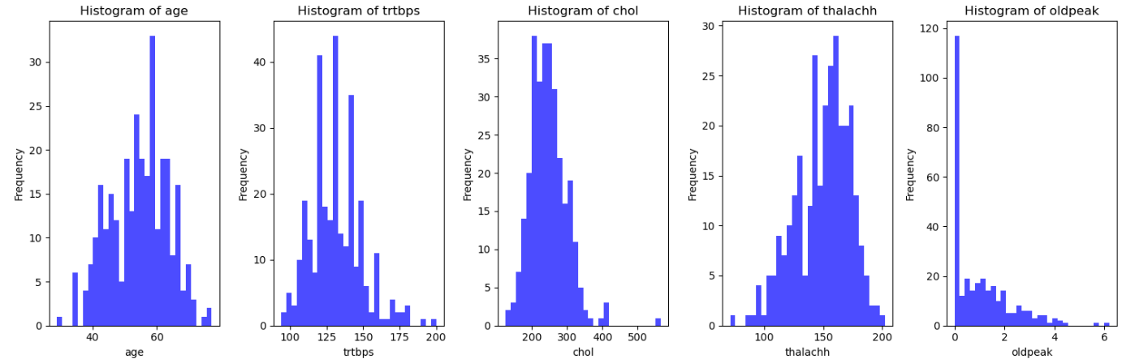
Exploratory Data Analysis
Dataset contains 303 observations, each with 14 features;

Slide 5
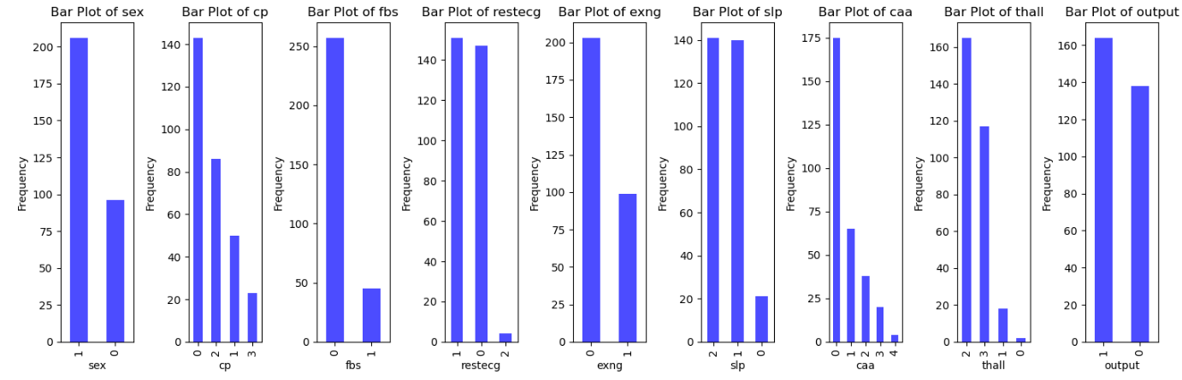
Exploratory Data Analysis
Dataset contains 303 observations, each with 14 features;

Slide 6
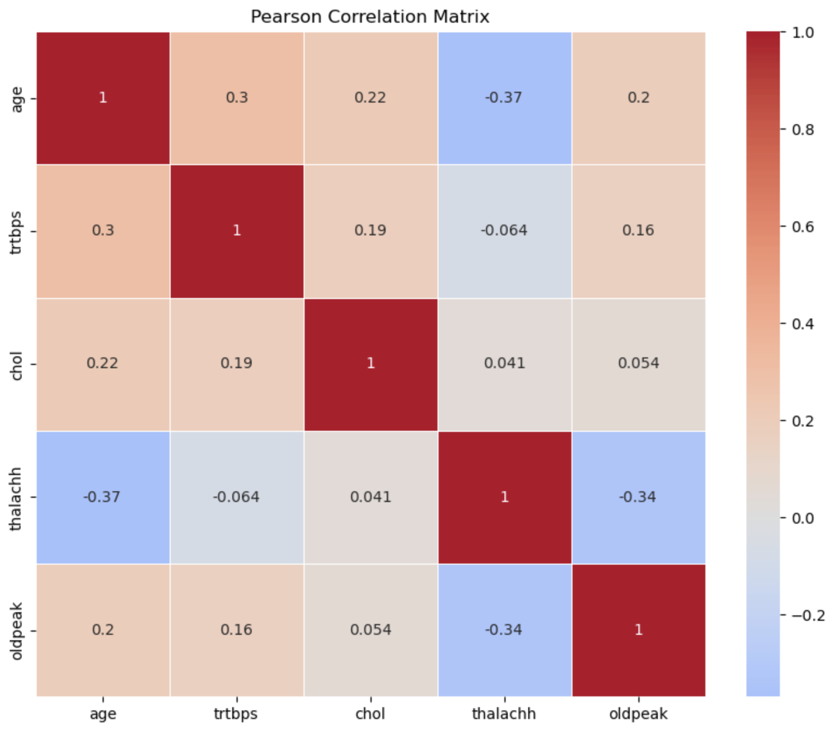
Feature Selection and Engineering
IQR used to identify and treat outliers;
Pearson correlation matrix used to identify correlated pairs of features;
RFE used to recursively identify relevant subsets of features;
Standard Scaler used to scale the data and adjust its distribution.

