Slide 1
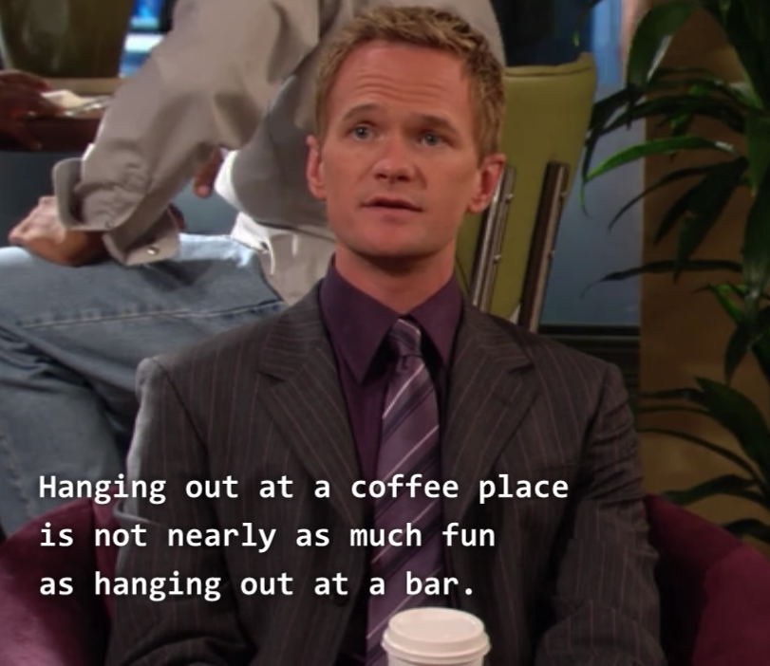

Traveling to a new place?

Slide 2

The Neurons may be with you

Slide 3
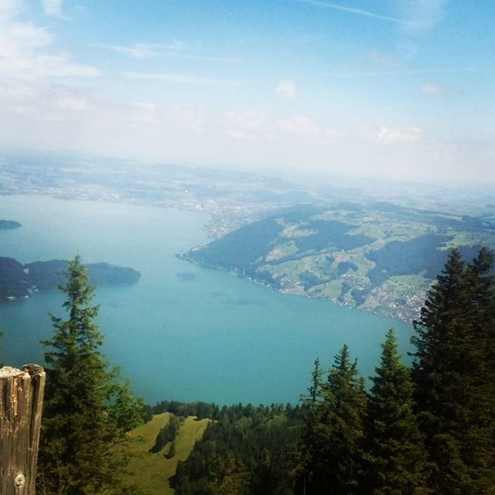
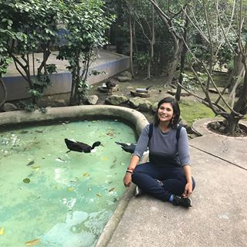
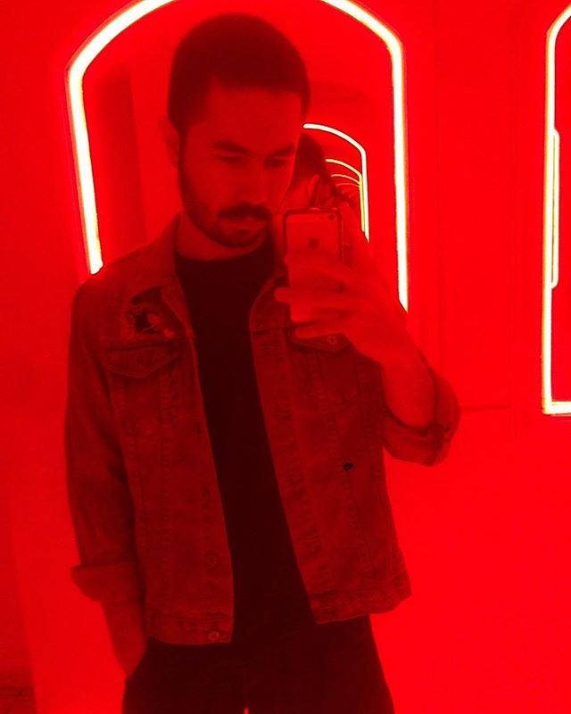
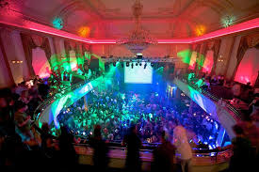
Destiny:
Profile’s pics Lucern Switzerland
Different people
Different
destinations
Mount Rigi
Grand Casino Luzern

Slide 4
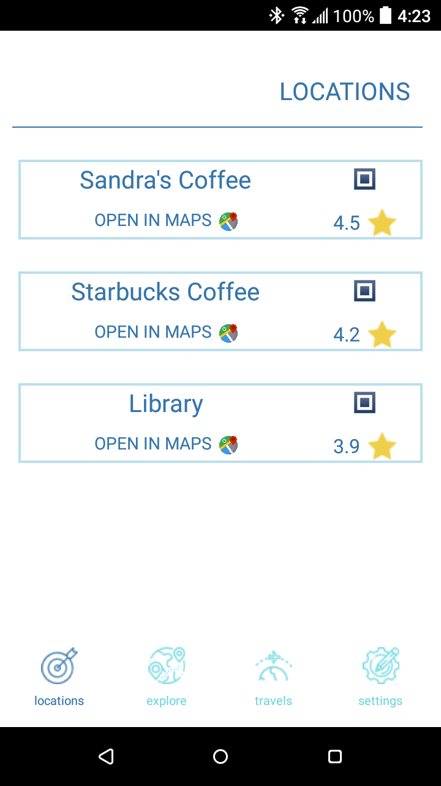

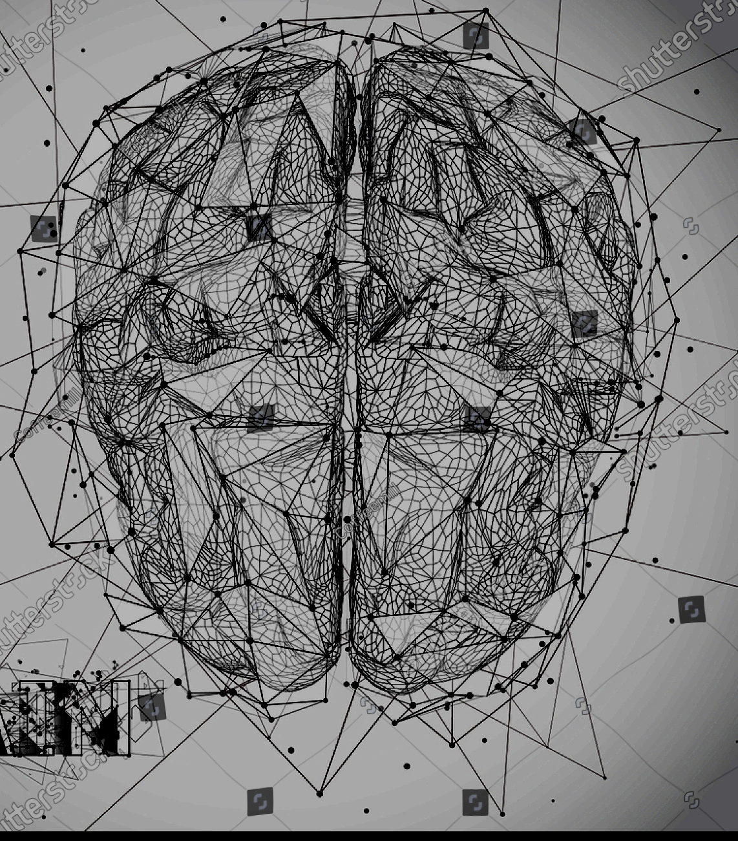

All profile´s info at the cloud
The Neural Network calculates your tastes
Get pics from your Social N
Look at your new favorite place!

Slide 5
WE MAKE ADS ELEGANT AND SUBTLE
Priority in search suggestions
User will never see direct advertising
The app generate gains and we wont starve ☺

Slide 6
Travel, with an intelligent guide.

