Slide 1
Data Structures and
Algorithms – Lab 7
mariaiuliana.dascalu@gmail.com

Slide 2
What is a graph?
A set of vertices and edges
  Directed/Undirected
  Weighted/Unweighted
  Cyclic/Acyclic
vertex
edge

Slide 3
Representation of Graphs
Adjacency Matrix
  A V x V array, with matrix[i][j] storing whether there is an edge between the i^{th} vertex and the j^{th} vertex
Linked List of Neighbours
  One linked list per vertex, each storing directly reachable vertices

Slide 4
Graph Searching
Why do we do graph searching? What do we search for?
What information can we find from graph searching?
How do we search the graph? Do we need to visit all vertices? In what order?

Slide 5
Depth-First Search (DFS)
Strategy: Go as far as you can (if you have not visit there), otherwise, go back and try another way

Slide 6
Implementation
DFS (vertex u) {
mark u as visited
for each vertex v directly reachable from u
if v is unvisited
DFS (v)
}
Initially all vertices are marked as unvisited

Slide 7
Application: Topological Sort
Topological order:
A numbering of the vertices of a directed acyclic graph such that every edge from a vertex numbered i to a vertex numbered j satisfies i<j
Topological Sort:
Finding the topological order of a directed acyclic graph

Slide 8
Example: Teacher’s Problem
Emily wants to distribute candies to N students one by one, with a rule that if student A is teased by B, A can receive candy before B.
Given lists of students teased by each students, find a possible sequence to give the candies

Slide 9
Breadth-First Search (BFS)
Instead of going as far as possible, BFS tries to search all paths.
BFS makes use of a queue to store visited (but not dead) vertices, expanding the path from the earliest visited vertices.

Slide 10
Simulation of BFS
Queue:
1
4
3
5
2
6
4
1
3
6
2
5

Slide 11
Implementation
while queue Q not empty
dequeue the first vertex u from Q
for each vertex v directly reachable from u
if v is unvisited
enqueue v to Q
mark v as visited
Initially all vertices except the start vertex are marked as unvisited and the queue contains the start vertex only

Slide 12
Application: Shortest Path
If all edges have the same cost, we find the minimum distance between two nodes A and B by performing a BFS from node A and stop when node B was found.
Example: The travelling salesman problem is the problem of finding the shortest path that goes through every vertex exactly once, and returns to the start

Slide 13
There is more…
Other Graph Searching Algorithms:
  Bidirectional search (BDS)
  Iterative deepening search (IDS)

Slide 14
Graph Modeling
Conversion of a problem into a graph problem
Essential in solving most graph problems

Slide 15
Basics of graph modeling
Identify the vertices and the edges
Identify the objective of the problem
State the objective in graph terms
Implementation:
  construct the graph from the input instance
  run the suitable graph algorithms on the graph
  convert the output to the required format

Slide 16
Well-known Applications
Social networks
The salesman problem
The timetable problem
......

Slide 17
Exercise 1
Let’s consider un undirected graph, representing a social network. Given an user, display all his friends (or information about them) having the degree <=N (N is given). A is friend with B if there is an edge between A and B; we say that the degree of friendship is 1. Friends of friends have the degree of friendship 2. Use the code headers from Moodle to represent graphs.

Slide 18
Exercise 2
Check if a graph is bipartite and if so, display the components of those two sets A and B. Use the code headers from Moodle to represent graphs. Check your code for the following graphs:
  G1=({ 1,2,3,4,5,6,7,8,9},{ 12, 13, 45, 56, 75, 24, 58, 79, 43, 89})
  G2=({ 1,2,3,4,5,6,7,8,9},{ 12, 13, 45, 56, 75, 24, 58, 79, 43, 89,47})

Slide 19
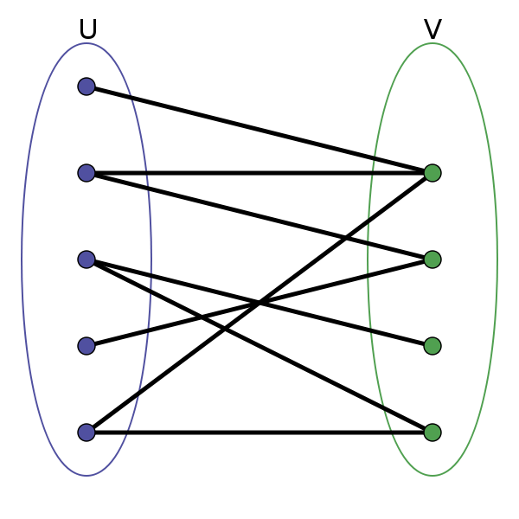
Tips
In the mathematical field of graph theory, a bipartite graph (or bigraph) is a graph whose vertices can be divided into two disjoint sets and such that every edge connects a vertex in to one in ; that is, and are each independent sets. Equivalently, a bipartite graph is a graph that does not contain any odd-length cycles.(Wikipedia)
Use BFS:
http://www.personal.kent.edu/~rmuhamma/Algorithms/MyAlgorithms/GraphAlgor/breadthSearch.htm

