Slide 1
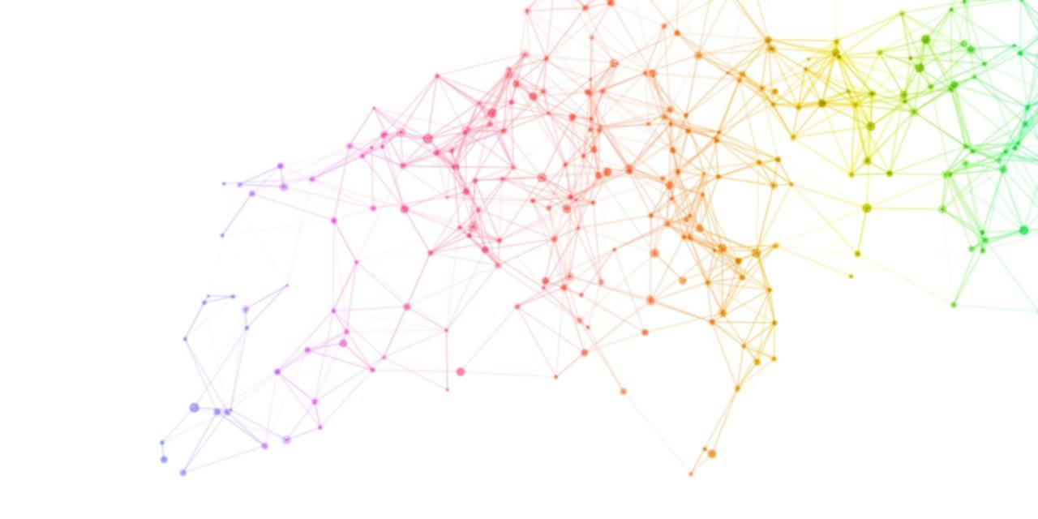


The Emergence of Modularity in Neural Networks
Alex Haskel
Mentor: Daoyuan Qian
PI: Ila Fiete

Slide 2
What is a modular task?

Slide 3
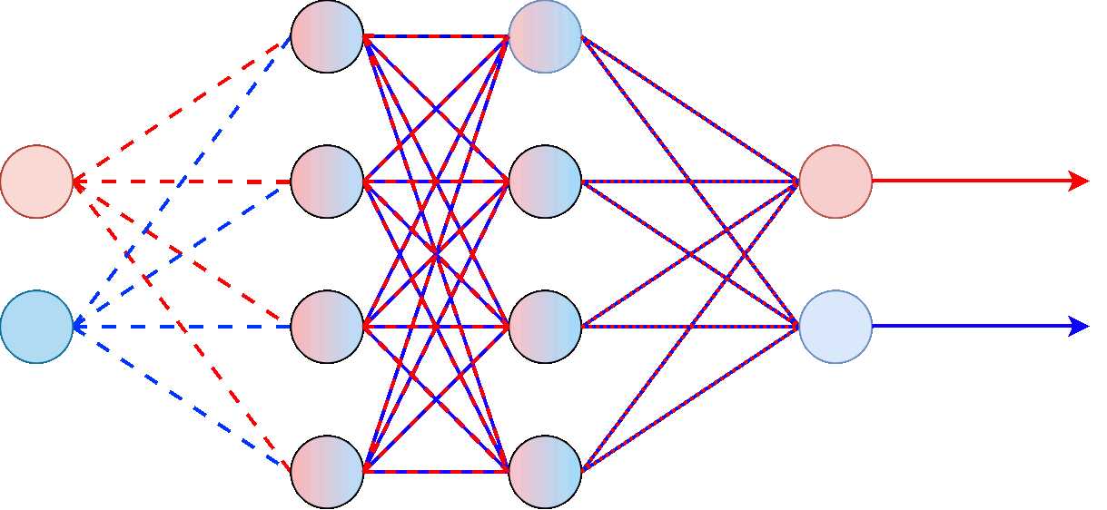

What is a modular neural network?
Shape
related
data
Shape label
Color related
data
Color label
INPUT
NON-MODULAR NETWORK

Slide 4
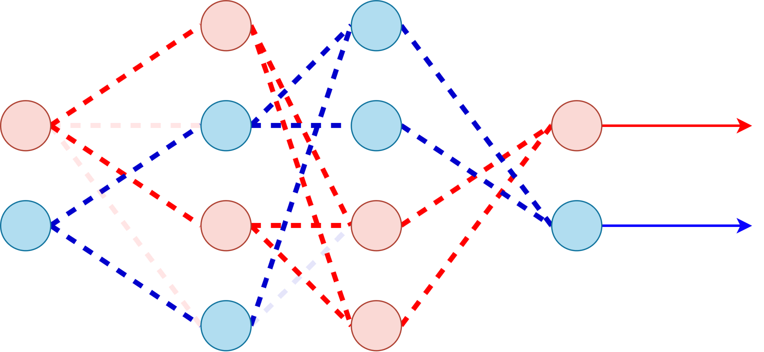
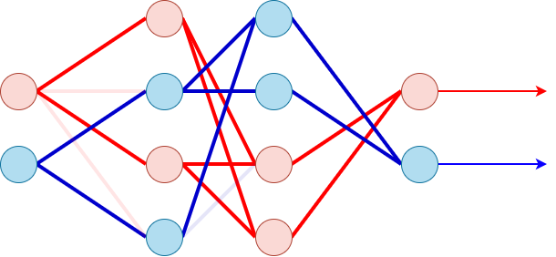
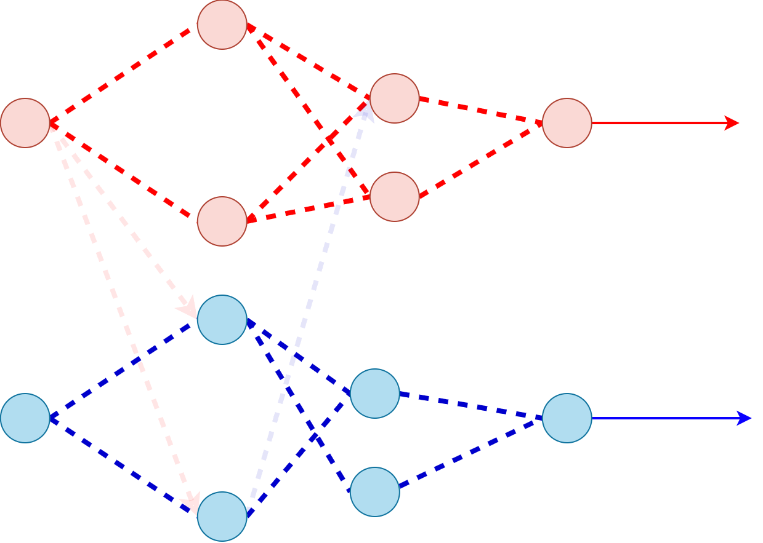
Shape
related data
SHAPE LABEL
COLOR LABEL
Color related data
MODULAR NETWORK
Shape
related
data
SHAPE LABEL
Color related data
COLOR LABEL
(same network)

Slide 5
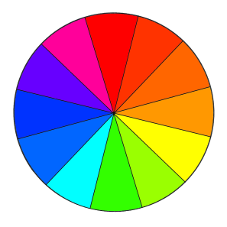

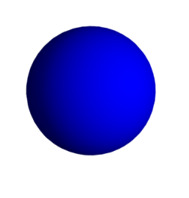
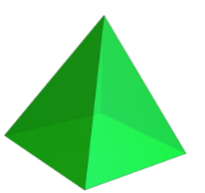

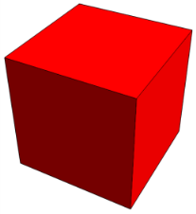
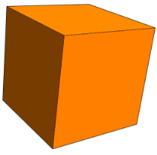
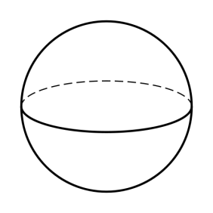
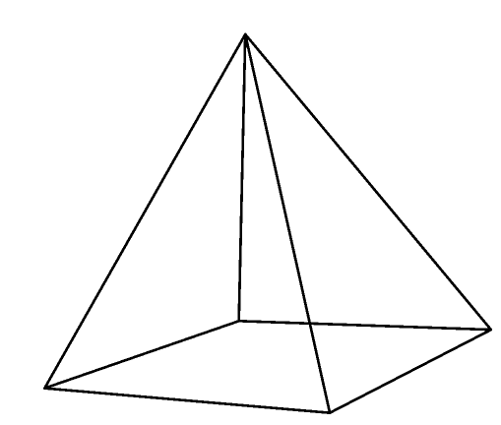
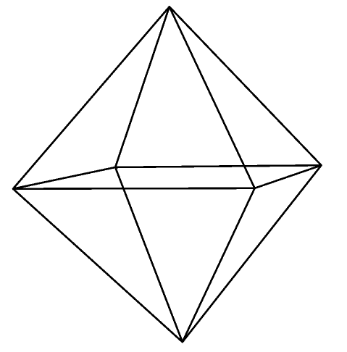
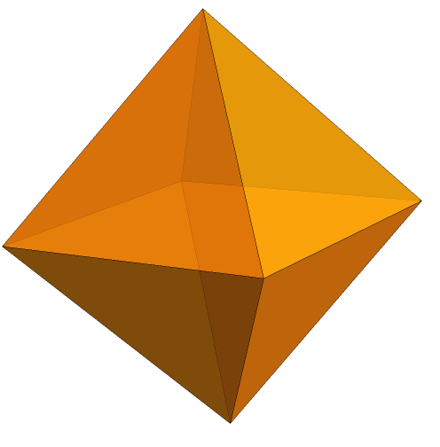
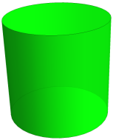
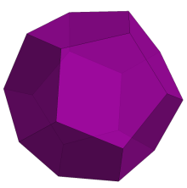
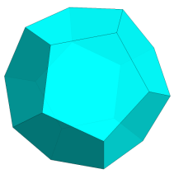

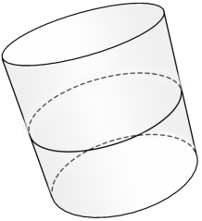
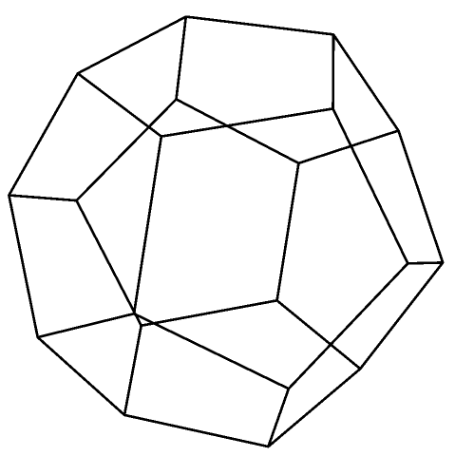
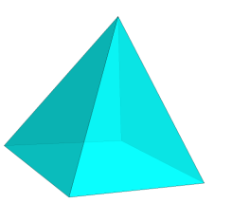
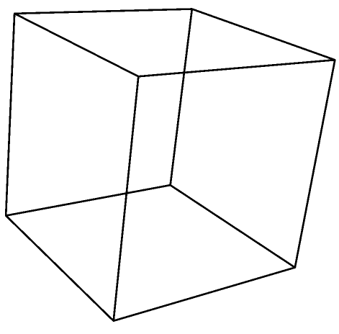
Why modularity is important
TASK = MODULAR
SYSTEM ≠ MODULAR
MANY UNIQUE COMBINATIONS TO LEARN
BUT, IF SYSTEM IS MODULAR…
ONE
COMPONENT
LEARNS:
ANOTHER COMPONENT LEARNS:

Slide 6
How we encouraged modularity in neural networks
Highly active unit
+
Numerous/strong
connections
=
Large penalty
Weakly active unit
+
Few/weak
connections
=
Small penalty

Slide 7
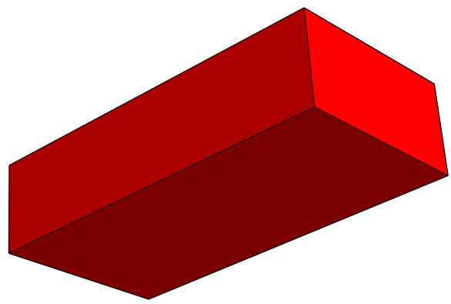
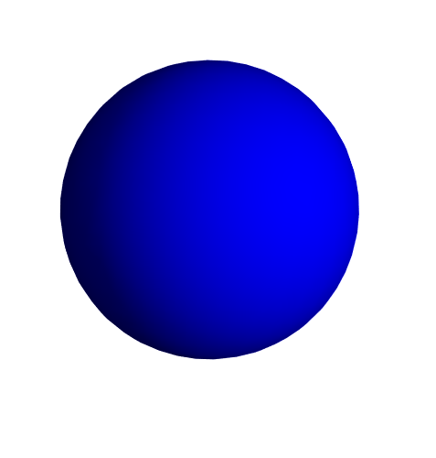
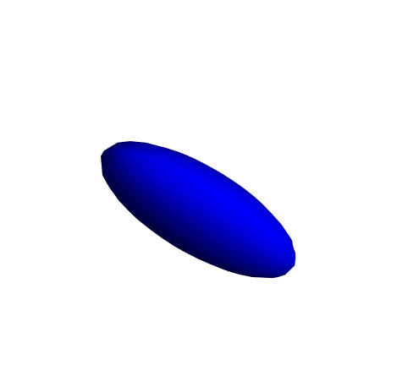
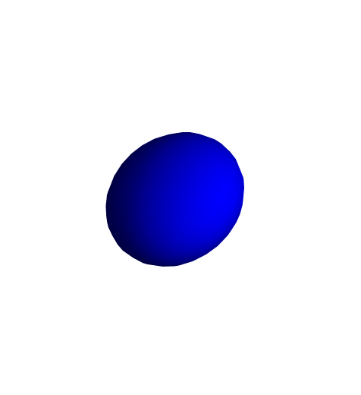
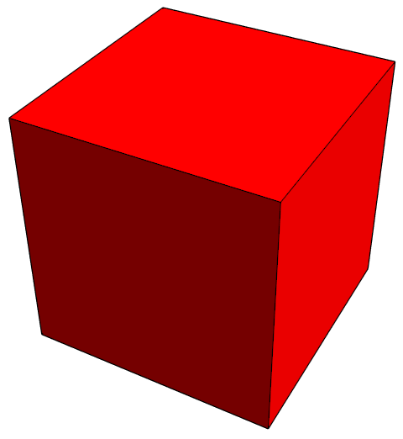
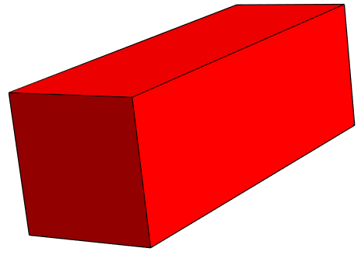
How does dataset design affect modularity in neural networks?
Highly correlated properties → Poor modularity
However, minimizing correlation between properties doesn’t guarantee modular solutions

Slide 8
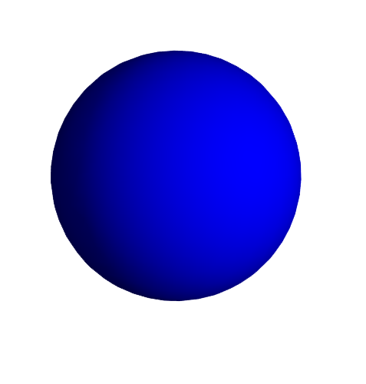

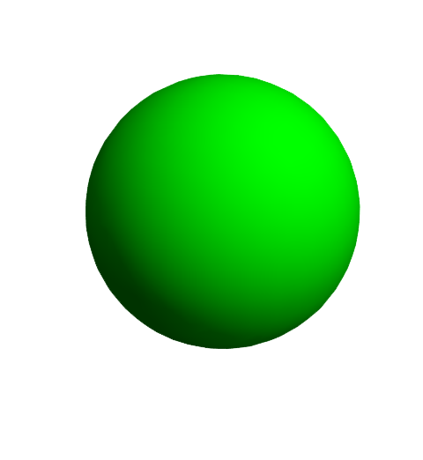
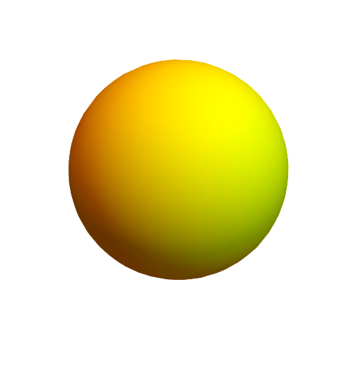
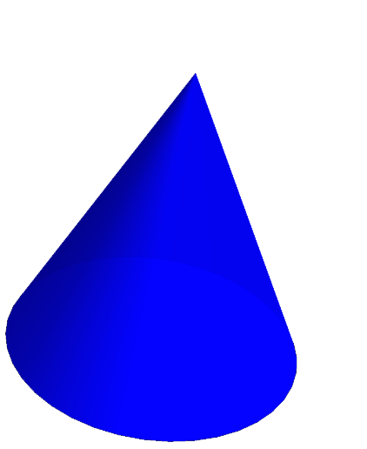
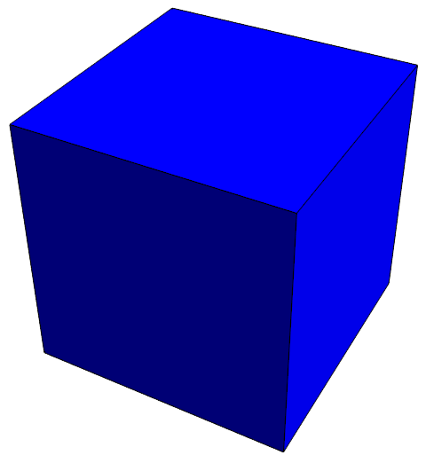
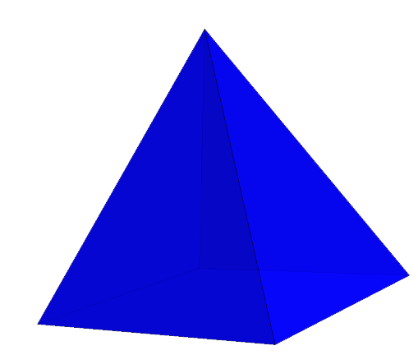
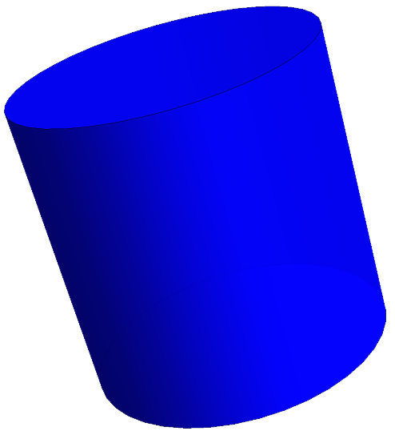
Highly contrasted combinations → Great modularity
Hard to quantify exactly; may require a custom metric
Best way to exploit this remains to be seen

Slide 9


Takeaways
Whether a network discovers a modular solution depends on the data it is trained on.
Strong statistical dependence inhibits modularity, but reducing it does not guarantee it.
Repeated contrasts are highly effective at inducing modularity.
Future work may examine how to measure and exploit this structural property for dataset construction.
Acknowledgements
MSRP-Bio Program, Mandana, Paloma, Fiete Lab and my mentor, Daoyuan Qian

Slide 10
Extra slides

Slide 11
What is a neural network?

Slide 12
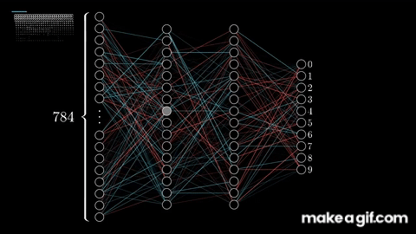
Source: 3Blue1Brown (Grant Sanderson)

Slide 13
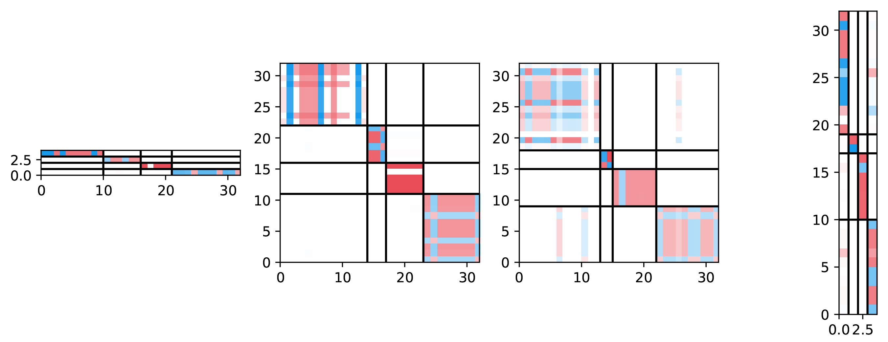
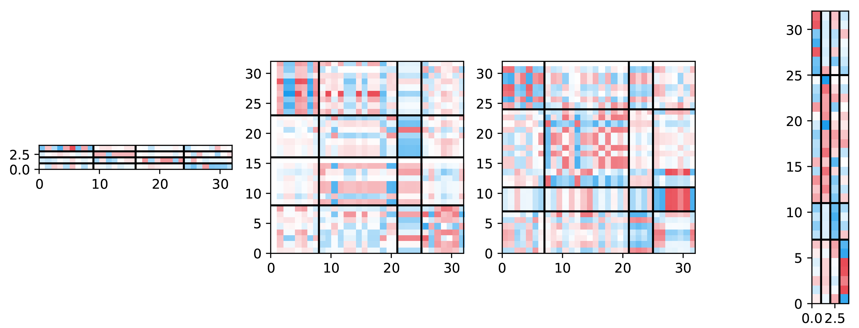
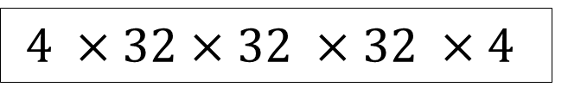
Connectivity Matrix Examples
Modular matrix
$$4 ×32×32 ×32 ×4$$
Non-modular matrix

