Slide 1



Slide 2
Solving Phishing for Passively
Most modern Phishing attempts are done either through email or SMS. Our product checks passively on the user’s activity and analyzes for incoming threats the second the get delivered to your phone.

Slide 3

VPN - Background URL Security
App runs in the background as a VPN checking all links for possible threats.

Slide 4
SMS & Email Checking
Push notifications activate Smart Message Analyzing which checks for 3 things in all email and sms:
Who sent it (Number or Email Address)
Body of the message
Any links attached

Slide 5



Three Factor Security

Slide 6
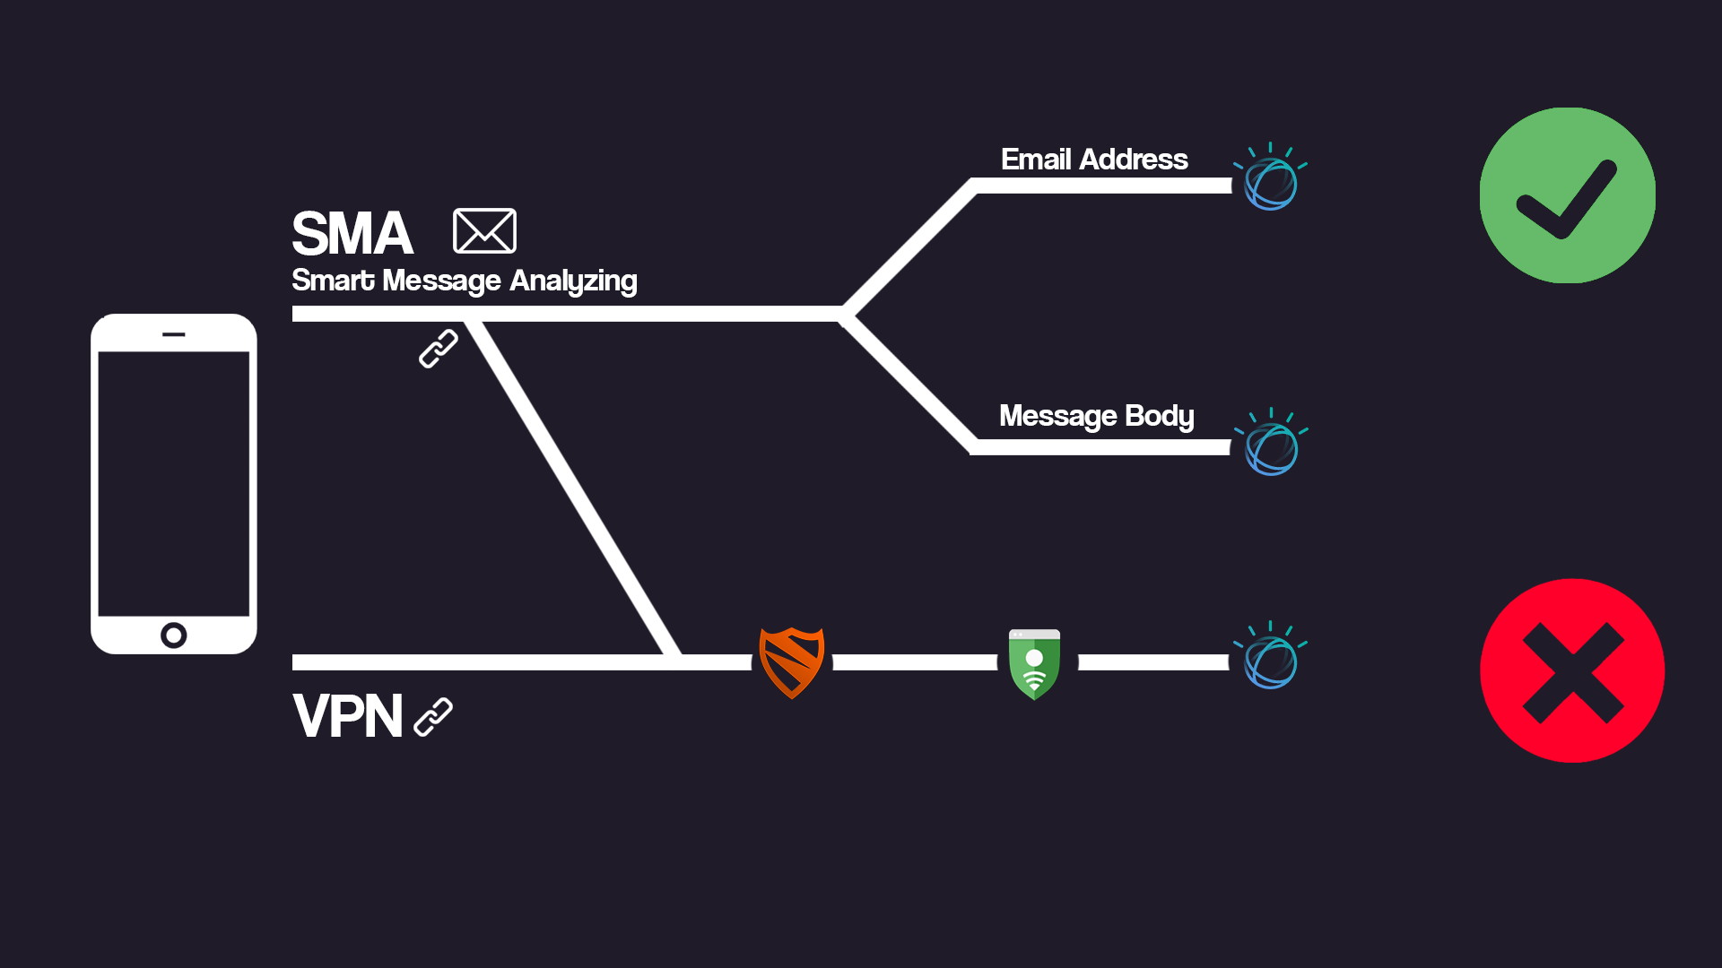
How it works

Slide 7


Technologies
Frontend:
React
XCode
Backend:
Java
Watson IBM Machine Learning
Google Safe Browsing API
Blockada VPN

Slide 8

Machine Learning/Deep Learning
Hosted on the Cloud
Binary Classification Algorithm
Conversation Clasificator
81% Accurrancy
500K entries dataset

Slide 9
Report to companies
The app will allow the user to send reports to the companies about the scam.
abuso@banorte.com

