Slide 1
Session Guarantees for Weakly Consistent Repliated Data
D. Terry, A. Demers, K. Petersen, M. Spreitzer, M. Theimer, M. Welch
<Presenters here>

Slide 2
Problem
Weakly consistent systems provide
High availability
Good scalability
Simple design
They allow R/W with little synchronization
Lack of guarantees are confusing to users
Breaking essential mobile computing paradigms

Slide 3
Motivation
What if we could get rid of the confusion?
Maintaining the advantages of weak consistency
By issuing session guarantees to users

Slide 4
Sessions
Abstraction for the sequence of R/W operations performed during the execution of the application
Present applications with a view that is consistent with their own actions

Slide 5
Storage System
Weakly consistent, replicated
Servers hold a full copy of the database
Servers run on different machines
Operations on servers: read, write
Writes have a unique write ID (WID)

Slide 6
Storage System
DB(S, t)
Ordered sequence of writes received by server S
Current contents of the database at time t
DB(S1, t) ≠ DB(S2, t) – weak consistency
Eventual consistency – servers converge
WriteOrder(W1, W2) – W1 should be before W2
RelavantWrites(S, t, R)
Smallest set of writes that is complete for read R and DB(S, t)

Slide 7
Guarantees
Can be applied independently to a session
Read Your Writes
Monotonic Reads
Writes Follow Reads
Monotonic Writes
These properties are either ensured, or the application is notified of a failure
Guarantees can be requested individually

Slide 8
1 – Read Your Writes
The effect of any write made within a session are visible to reads within that session
If Read R follows Write W in a session and R is performed at server S at time t, then W is included in DB(S, t)
Example – changing a password and not being able to log in

Slide 9
2 – Monotonic Reads
Users observe a database that is increasingly up-to-date over time
If Read R1 occurs before R2 in a session and R1 accesses server S1 at time t1 and R2 accesses server S2 at time t2, then RelevantWrites(S1, t1, R1) is a subset of DB(S2, t2)
Example: online appointment calendar with periodic refreshes – appointments disappear

Slide 10
3 – Writes Follow Reads
Write/Read dependencies are preserved in the ordering of Writes at all servers
If Read R1 precedes Write W2 in a session and R1 is performed at server S1 at time t1, then, for any server S2, if W2 is in DB(S2) then any W1 in RelevantWrites(S1, t1, R1) is also in DB(S2) and WriteOrder(W1, W2) stands.
Example: TODO

Slide 11
WFRO/WFRP?
Should we add these?

Slide 12
4 – Monotonic Writes
Writes must follow previous writes within the session
If Write W1 precedes Write W2 in a session, then, for any server S2, if W2 in DB(S2) then W1 is also in DB(S2) and WriteOrder(W1, W2) stands
Example: a text editor, when saving, can’t cause version Ni to overwrite version Ni+1

Slide 13
Providing the guarantees
Only minor cooperation is required
WID, RelevantWrites(S, t, R), DB(S, t)
Session manager
Provides the guarantees
Mediates communication with servers
Read-set (RS) and Write-set (WS) for each session
RS – Set of WIDs for the Writes that are relevant to session reads
WS – Set of WIDs for those Writes performed

Slide 14
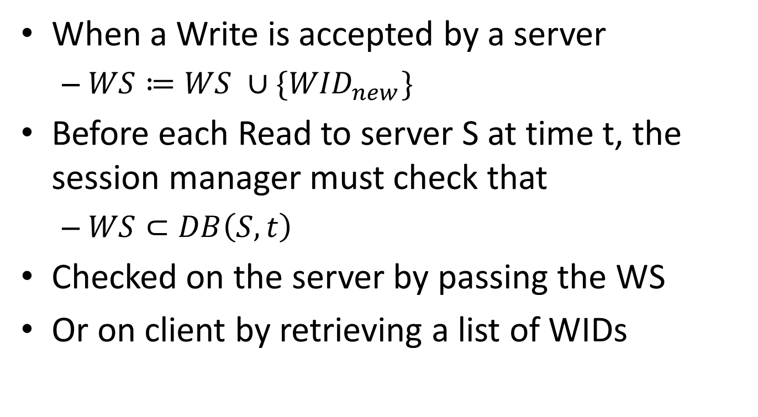
Providing „Read Your Writes”
When a Write is accepted by a server
$WS≔WS ∪\{{WID}_{new}\}$
Before each Read to server S at time t, the session manager must check that
$WS⊂DB\left(S, t\right)$
Checked on the server by passing the WS
Or on client by retrieving a list of WIDs

Slide 15
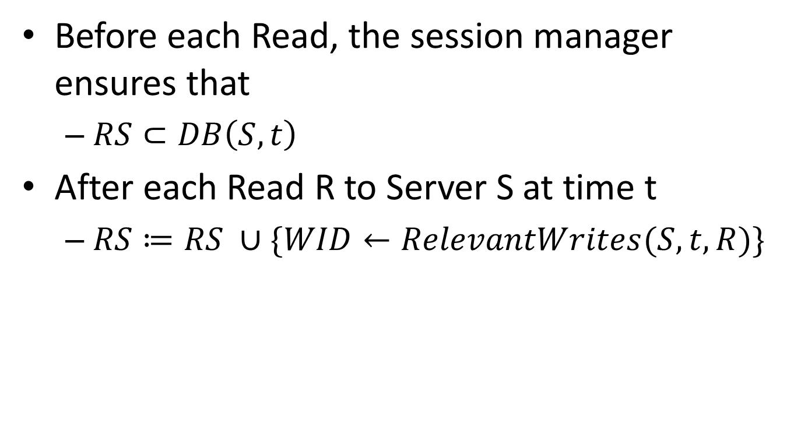
Providing „Monotonic Reads”
Before each Read, the session manager ensures that
$RS⊂DB\left(S, t\right)$
After each Read R to Server S at time t
$RS≔RS ∪\{WID←RelevantWrites(S, t, R)\}$

Slide 16
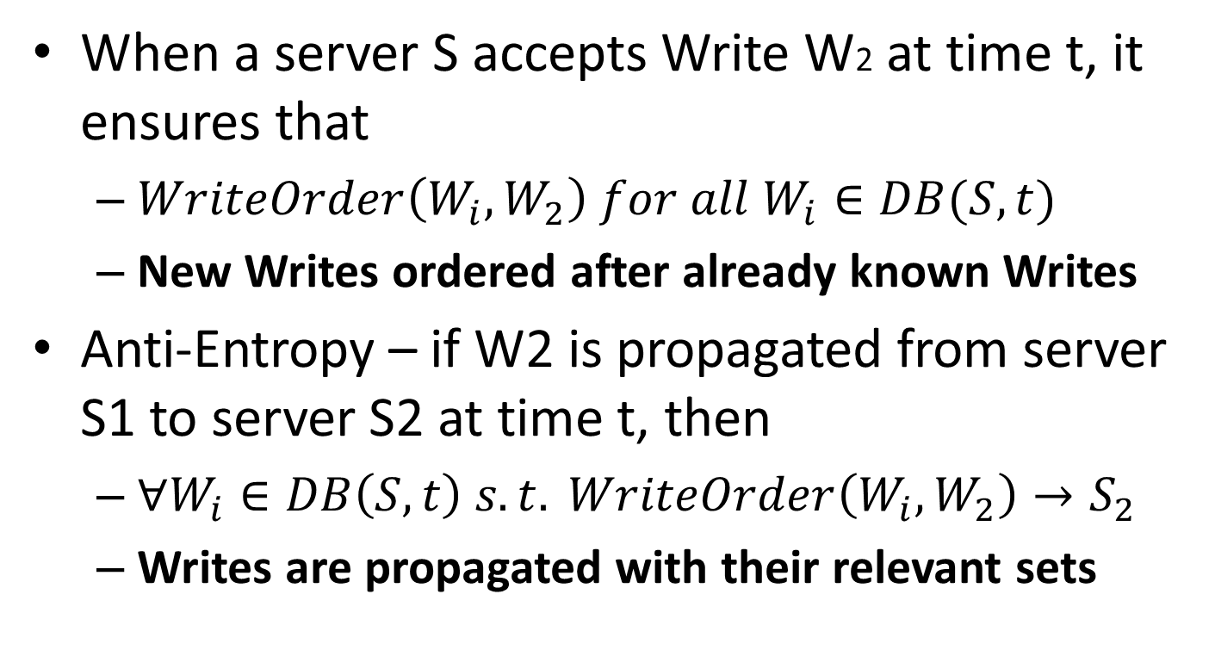
Additional Constraints
When a server S accepts Write W2 at time t, it ensures that
$WriteOrder\left(W_{i},W_{2}\right) for all W_{i}∈DB(S, t)$
New Writes ordered after already known Writes
Anti-Entropy – if W2 is propagated from server S1 to server S2 at time t, then
$∀W_{i}∈DB\left(S, t\right) s.t. WriteOrder\left(W_{i}, W_{2}\right)→S_{2}$
Writes are propagated with their relevant sets

Slide 17
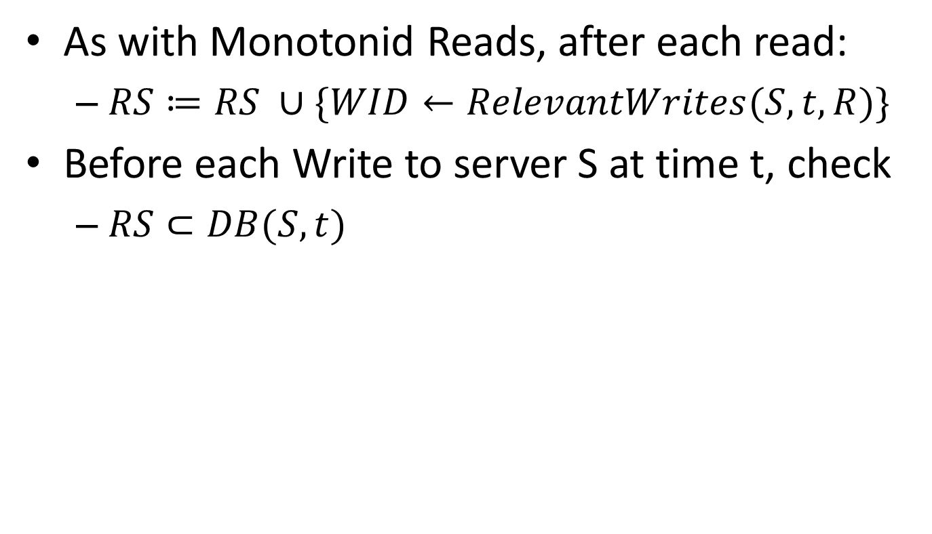
Providing „Writes Follow Reads”
As with Monotonid Reads, after each read:
$RS≔RS ∪\{WID←RelevantWrites(S, t, R)\}$
Before each Write to server S at time t, check
$RS⊂DB(S, t)$

Slide 18

Providing „Monotonic Writes”
To accept a Write at time t, ensure that
$WS⊂DB\left(S, t\right)$
When a Write is accepted by a server
$WS≔WS∪\left\{{WID}_{new}\right\}$

Slide 19
Implementation Details
Practical problems
Set of WIDs maintained could get large
Checking that a server contains all necessary writes is very expensive
Keeping track of Read-sets could be excessive

Slide 20
Version Vectors
Tracking changes to data in distributed systems
Participants can determine order of updates
Sequence of <server, clock> pair
Server – unique identifier
Clock – logical clock value

