Slide 1
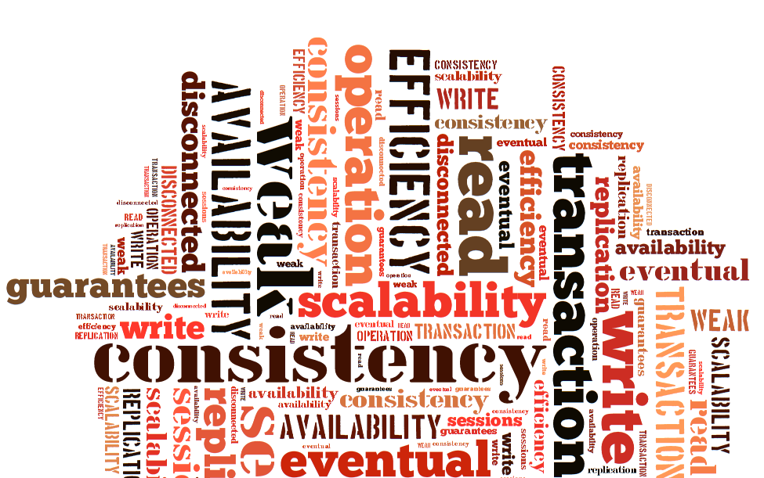
Session Guarantees for Weakly Consistent Repliated Data
D. Terry, A. Demers, K. Petersen, M. Spreitzer, M. Theimer, M. Welch
Dániel Bali
Gayana Chandrasekara
Seçkin Savaşçı
Notes:
Before the presentation
Authors, Xerox, Bayou project “Democratic weak consistent distributed systems with requires user interaction”
“Replicated data consistency explained through baseball”
2. Explain what we are going to go over
What is weak consistency?
Mobile comp. Aspects
Proble, motivation, actual content of the paper

Slide 2
Weakly Consistent Systems
What is consistency?
What is weak consistency?
Why do we need it?
Consistency-Availability-Partition Tolerance
Read-any/write-any replication
Transactions are inefficient
Notes:
Logic: theory is one that does not contain a contradiction
DB Systems : consistent transaction is one that starts with a database in a consistent state and ends with the database in a consistent state.
In the second, more general, sense weak consistency may be applied to any consistency model weaker than sequential consistency.
Why don’t we just use transactions? They could solve all of our problems.
But: they aren’t as scalable.
Disconnected users can read and update data

Slide 3
Problem
Weakly consistent systems provide
High availability
Good scalability
Simple design
They allow R/W with little synchronization
BUT Lack of guarantees are confusing to users
Breaking essential mobile computing paradigms
Notes:
TODO: rearrange this slide

Slide 4
Problem: Mobile Computing Aspects
Why do we need Read-any/write-any systems?
Why separating server duties is no good?
How can we handle disconnected operations?
Closed, synchronized copies are unavailable
Can I disconnect in time?

Slide 5
Motivation
Imagine your daily mobile device usage
You don’t live in an eventually consistent world
You don’t want to live in it either.
Eventual consistency is not always enough for the user
So now, will we present a solution which requires to redevelop everything?
Notes:
What if we could get rid of the confusion?
Maintaining the advantages of weak consistency
By issuing session guarantees to users

Slide 6
Solution: Session Guarantees
Can be applied independently to sessions
Read Your Writes
Monotonic Reads
Writes Follow Reads
Monotonic Writes
These properties are either ensured, or the application is notified of a failure
Guarantees can be requested individually

Slide 7
Sessions
Abstraction for the sequence of R/W operations performed during the execution of the application
Present applications with a view that is consistent with their own actions
What’s the difference between transactions and sessions?
Notes:
Transactions tend to be small, they want to act atomically, it’s „rigid”.
Sessions on the other hand are a logical timespan for user operations.

Slide 8
Assumptions
Weakly consistent, replicated
Servers hold a full copy of the database
Servers run on different machines
Operations on servers: read, write
Writes have a unique write ID (WID)
Eventual consistency – servers converge

Slide 9
Terminology
DB(S, t)
Ordered sequence of writes received by server S
Current contents of the database at time t
DB(S1, t) ≠ DB(S2, t) – weak consistency
WriteOrder(W1, W2) – W1 should be before W2
RelavantWrites(S, t, R)
Smallest set of writes that is complete for read R and DB(S, t)

Slide 10
1 – Read Your Writes
t1
t2
Time(t)
User A: Write Data.
(W1)
User A: Read Data.
(R)
If Read contains: {W1}
This implies the Read Your Write Guarantee

Slide 11
1 – Read Your Writes
The effects of any write made within a session are visible to reads within that session
If Read R follows Write W in a session and R is performed at server S at time t, then W is included in DB(S, t)
Example - User change a password in a weakly consistent system. - Read Your Writes ensure application read the latest password, next time. - User will not get a login failure.

Slide 12
2 – Monotonic Reads
Time(t)
t1
Write by A : W1
t2
Write by B : W2
t3
Read by A : R1 ={W1,W2}
t4
Write by C : W3
t5
Read by A must be :
R2 ={W1,W2,[W3]}

Slide 13
2 – Monotonic Reads
Users observe a database that is increasingly up-to-date over time
If Read R1 occurs before R2 in a session and R1 accesses server S1 at time t1 and R2 accesses server S2 at time t2, then RelevantWrites(S1, t1, R1) is a subset of DB(S2, t2)
Example: - Calendar app is updated by user and a auto scheduler. - If no Monotonic Read guarantee appointments may appear and disappear time to time.

Slide 14

3 – Writes Follow Reads
Time, (S1)
Time, (S2)
Write by A : W1
Read by A : R1={W1}
Write by A : W2
If DB(S2) contain W2,
W1 also include in DB(S2) and ordered as {W1,W2}

Slide 15
3 – Writes Follow Reads
Writes made during the session are ordered after any Writes whose effects were seen by previous Reads in the session
If Read R1 precedes Write W2 in a session and R1 is performed at server S1 at time t1, then, for any server S2, if W2 is in DB(S2) then any W1 in RelevantWrites(S1, t1, R1) is also in DB(S2) and WriteOrder(W1, W2) stands.
Example: A user creates a place in Foursquare, then checks in. If a server sees the check-in, they also saw the place creation event before.
Notes:
TODO: maybe mention that this can be relaxed, and separated to 2 sub-guarantees:
WFRO – order is concerned
WFRP – prepagation is concerned

Slide 16
4 – Monotonic Writes
Time, (S1)
Time, (S2)
Write by A : W1
Write by A : W2
If DB(S2) contain W2,
W1 also include in DB(S2) and ordered as {W1,W2}

Slide 17
4 – Monotonic Writes
Writes must follow previous writes within the session
If Write W1 precedes Write W2 in a session, then, for any server S2, if W2 in DB(S2) then W1 is also in DB(S2) and WriteOrder(W1, W2) stands
Example: Automatic address book backup service – shouldn’t overwrite/remove previous versions
Notes:
It’s like a chain of changesets

Slide 18
Providing the guarantees
Only minor cooperation is required
WID, RelevantWrites(S, t, R), DB(S, t)
Session manager
Provides the guarantees
Mediates communication with servers
Read-set (RS) and Write-set (WS) for each session
RS – Set of WIDs for the Writes that are relevant to session reads
WS – Set of WIDs for those Writes performed

Slide 19
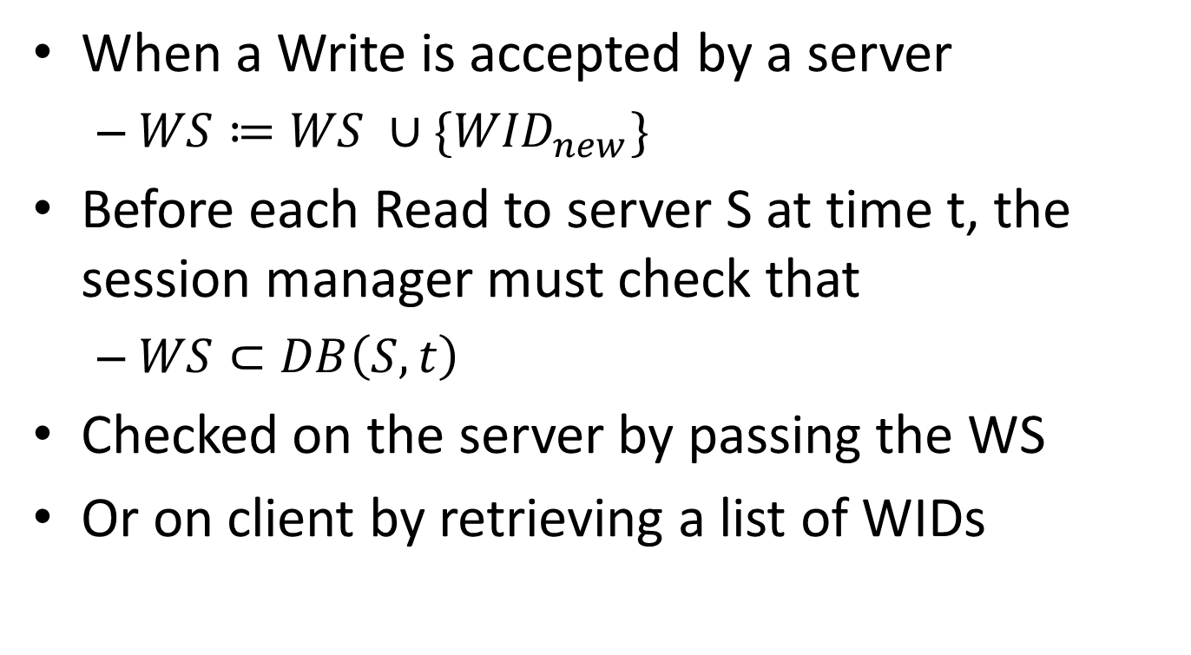
Providing „Read Your Writes”
When a Write is accepted by a server
$WS≔WS ∪\{{WID}_{new}\}$
Before each Read to server S at time t, the session manager must check that
$WS⊂DB\left(S, t\right)$
Checked on the server by passing the WS
Or on client by retrieving a list of WIDs

Slide 20
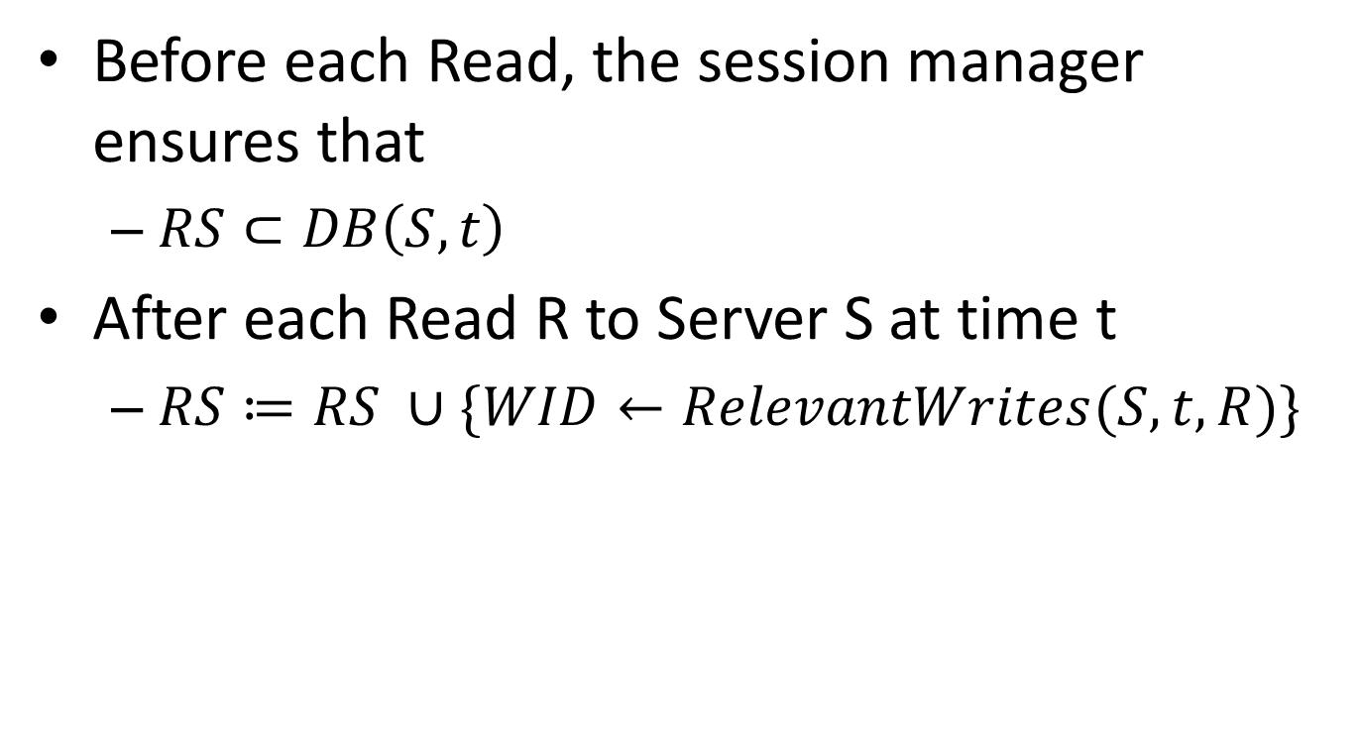
Providing „Monotonic Reads”
Before each Read, the session manager ensures that
$RS⊂DB\left(S, t\right)$
After each Read R to Server S at time t
$RS≔RS ∪\{WID←RelevantWrites(S, t, R)\}$

Slide 21
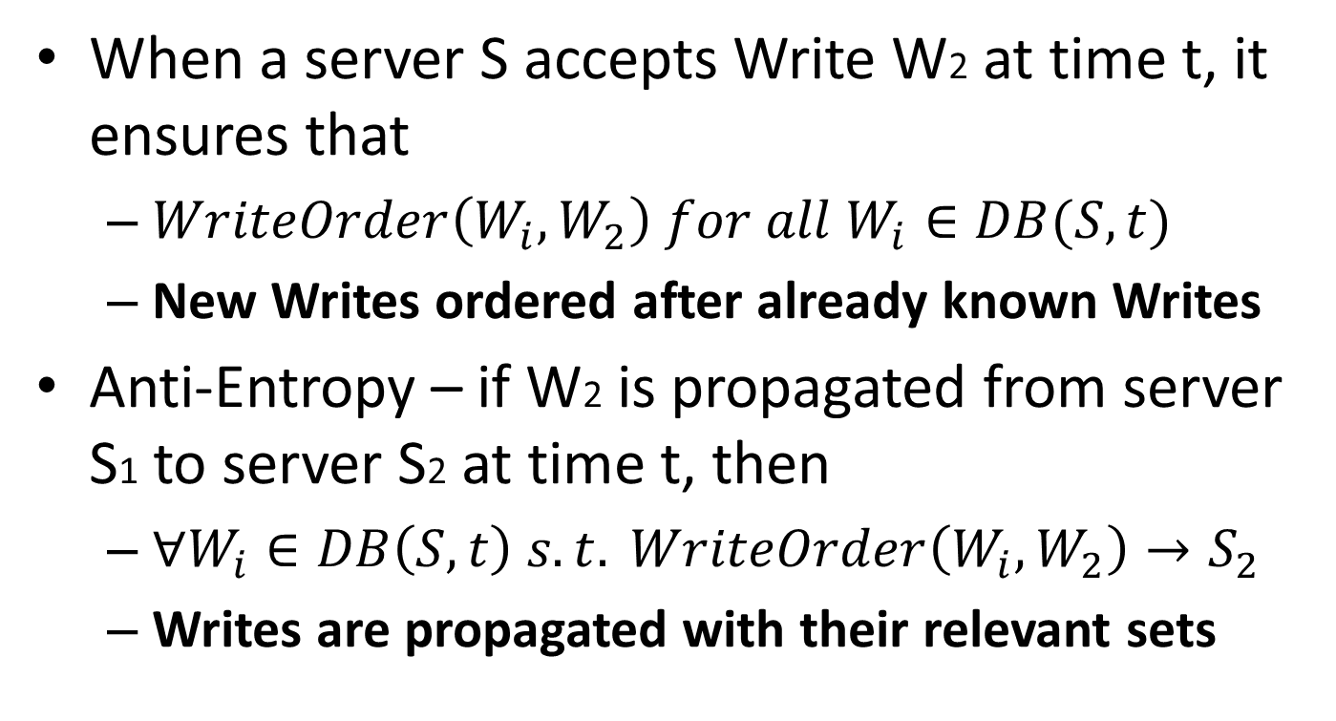
Additional Constraints
When a server S accepts Write W2 at time t, it ensures that
$WriteOrder\left(W_{i},W_{2}\right) for all W_{i}∈DB(S, t)$
New Writes ordered after already known Writes
Anti-Entropy – if W2 is propagated from server S1 to server S2 at time t, then
$∀W_{i}∈DB\left(S, t\right) s.t. WriteOrder\left(W_{i}, W_{2}\right)→S_{2}$
Writes are propagated with their relevant sets

Slide 22
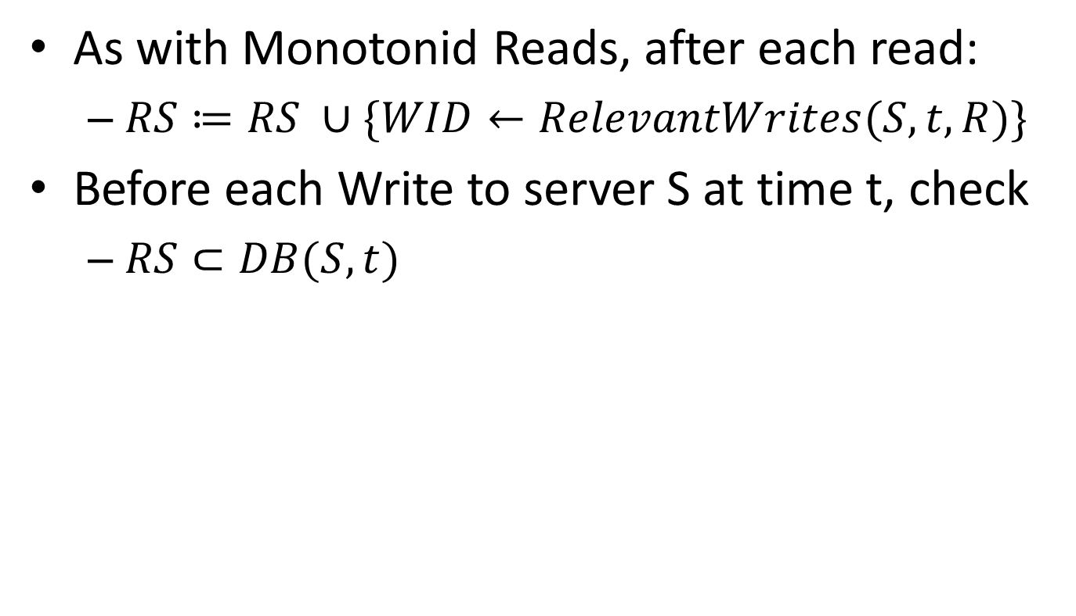
Providing „Writes Follow Reads”
As with Monotonid Reads, after each read:
$RS≔RS ∪\{WID←RelevantWrites(S, t, R)\}$
Before each Write to server S at time t, check
$RS⊂DB(S, t)$

Slide 23

Providing „Monotonic Writes”
To accept a Write at time t, ensure that
$WS⊂DB\left(S, t\right)$
When a Write is accepted by a server
$WS≔WS∪\left\{{WID}_{new}\right\}$

Slide 24
Implementation Details
Practical problems
Set of WIDs maintained could get large
Checking that a server contains all necessary writes is very expensive
Keeping track of Read-sets could be excessive

Slide 25
Version Vectors
Tracking changes to data in distributed systems
Participants can determine order of updates
Sequence of <server, clock> pair
Server – unique identifier
Clock – logical clock value
The clock value describes the last seen WID
Updated as a part of the anti-entropy process

Slide 26
Version Vectors in Action
Representation of a WID set Ws
V[S] = time of latest WID assigned in Ws (or 0)
Union of WID sets Ws1 and Ws2
V[S] = MAX(V1[S], V2[S]) for all S
Check if Ws1 is a subset of Ws2
V2[S] > V1[S] for all S
We can use a VV for Writes and Reads
To find acceptable servers, we need dominating Version Vectors

Slide 27
Additional Improvements
Finding a suitable server can be simplified by using the previously contacted server
Checks only need to happen when switching servers
Session Manager can cache Version Vectors of various servers
Data can also be cached at clients to improve overall performance

Slide 28
Adding guarantees to existing systems
Trivial for any system that has version vectors (Coda, Ficus, refdbms)
Incremental and/or Selective Deployment
Sorry!: The article doesn’t mention about evaluation any more

Slide 29
Related Work
“Causal Operations” by Ladin, Liskov, Shrira, and Ghemawat - Clients ensure causal ordering of their Read and Write operations by means of version vectors, but it does not have the notion of sessions in order to define fine-grained consistency requirements.
Lotus Notes - Clients desiring consistency among multiple read and/or write operations must, in general, use the same server for their interactions.
File system of Tait and Duchamp supports both strict and loose read operations
Much work has been done on providing various “degrees of consistency” in database systems
Notes:
Strict=that the most recent version of a file existing in the system is returned.
Loose=weakly consistent semantics where any available copy is returned.

Slide 30
Conclusion
The paper does not present any evaluation
Supposedly, it is straightforward to add guarantees to existing systems
„Modular” in a sense, guarantees are independently grantable
We can get the benefits of weakly consistent systems, with added guarantees, at a reasonable cost

Slide 31
Questions?

