Slide 1
gRPC

Slide 2
1.Getting Started

Slide 3
Client Server Communication
SOAP, REST, GraphQL
SSE, WebSockets
Raw TCP

Slide 4
The Problem with Client Libraries
Any commucations protocols needs client library for the language of choice
- SOAP Library
- HTTP Client Library
Hard to maintain and patch client libraries
- HTTP/1.1 HTTP/2, new features, security etc

Slide 5
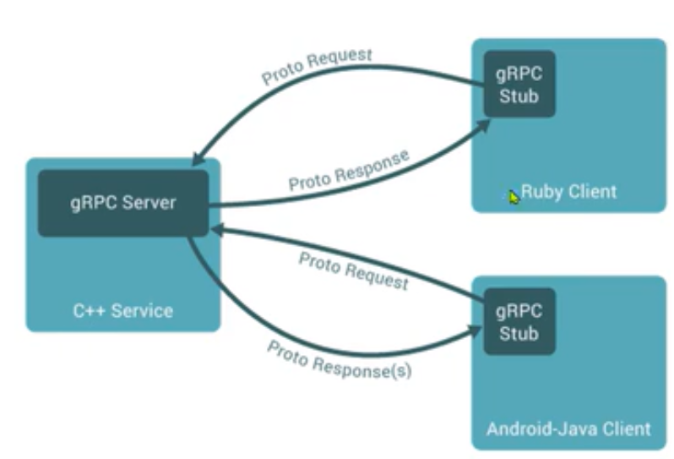
What is gRPC？
Popular open source RPC framework
- Largest RPC mindshare
- Cloud Native Computing Foundation project
- gRPC stands for gRPC Remote Procedure Calls
Built with modern technologies
- HTTP/2
- Protocol Buffers
Designed for modern apps
- High performance
- Platform independent

Slide 6
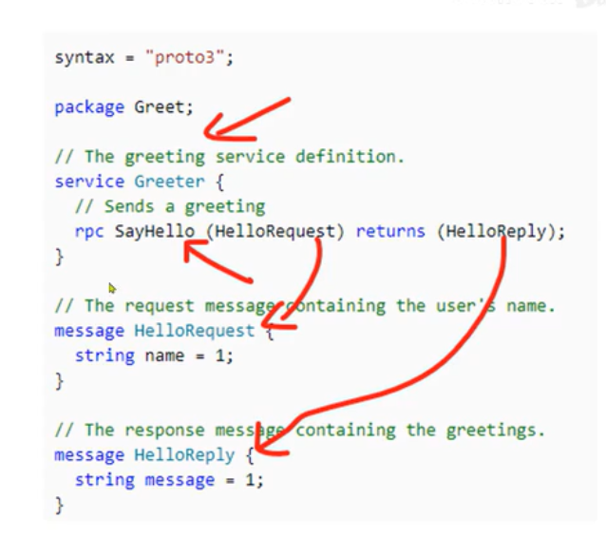
What is Protobuf
IDL(interface definition language)
- Describe and generate Interfaces for any language
Service model
- Service method and structure of the request and
the response
Wire format
- Binary format for network transmission

Slide 7
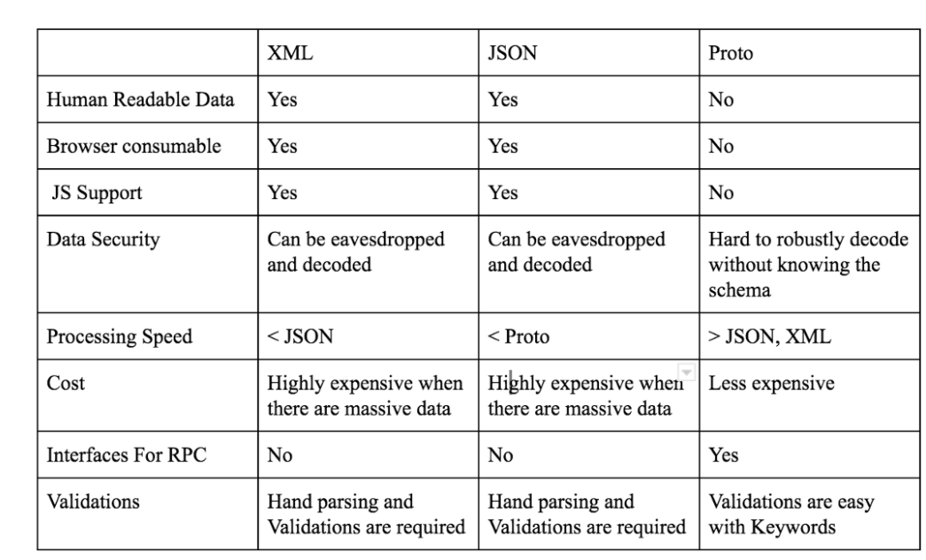
Comparison of different serialization schemes

Slide 8
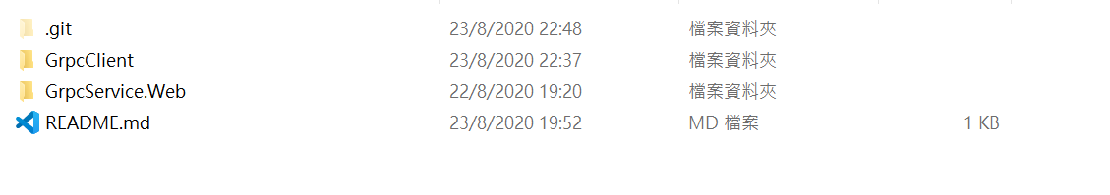
Demo (Server side)
Two Services one for client and other for server

Slide 9
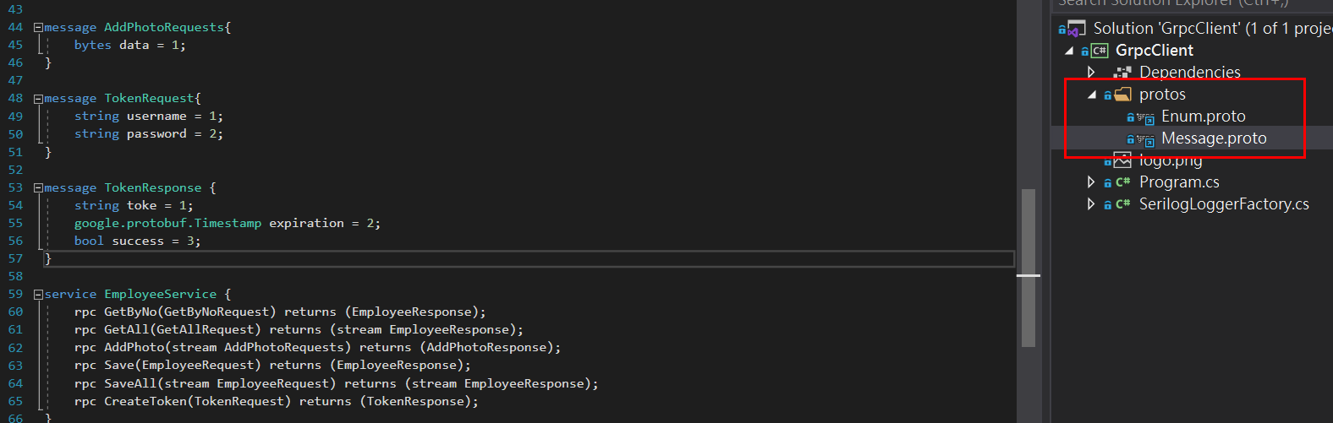
Demo (Server Side)
Need to declare the Protobuf in server side
Also declare the rpc services

Slide 10
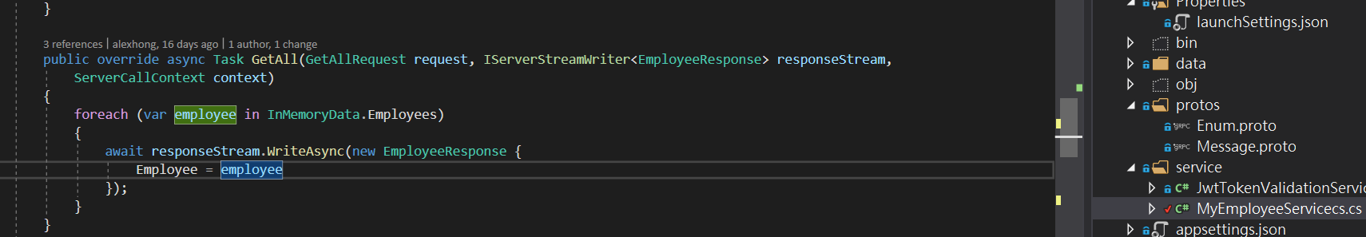
Demo (Server Side)
Then implement the service on the server side

Slide 11
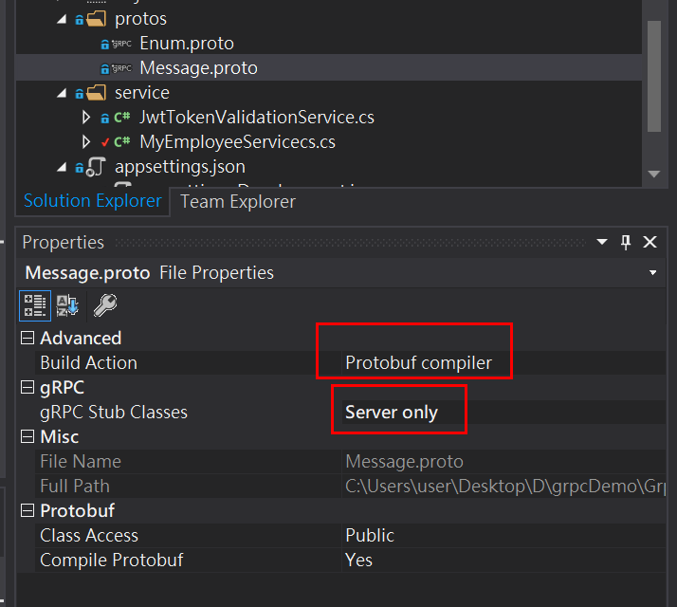
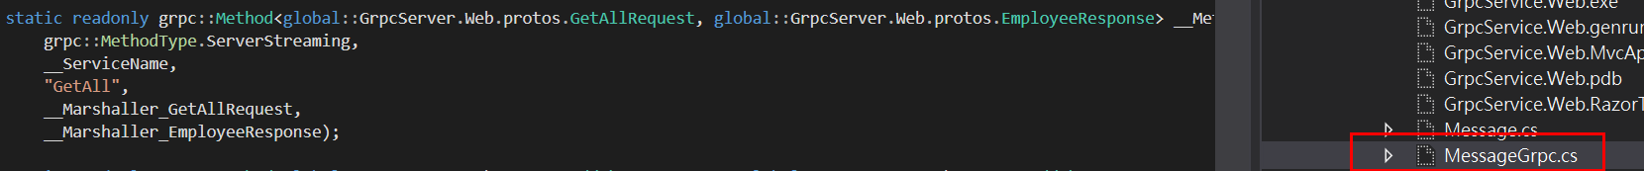
Demo (Server Side)
After implement all the service on the server and build up the Protobuf, the gRPC code will be auto generated.

Slide 12
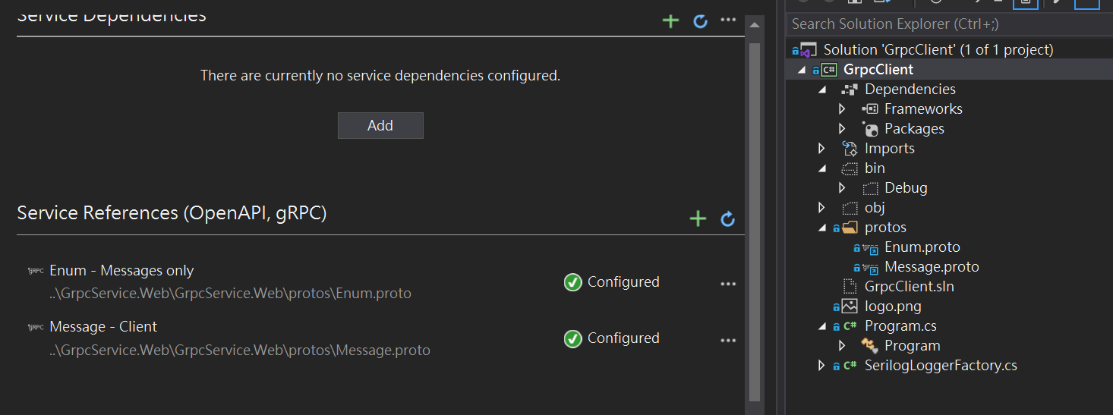
Demo (Client Side)
Go to the client side and add service reference to the server side

Slide 13
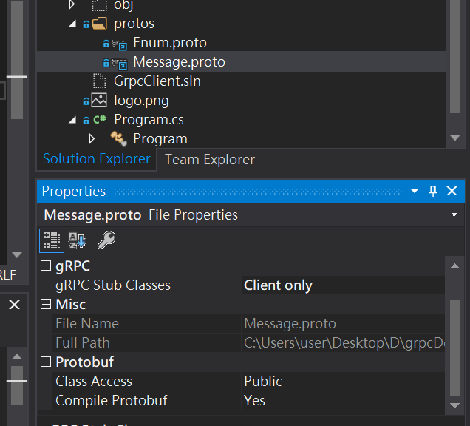
Demo (Client Side)
Then build up the the Protobuf for client side

Slide 14
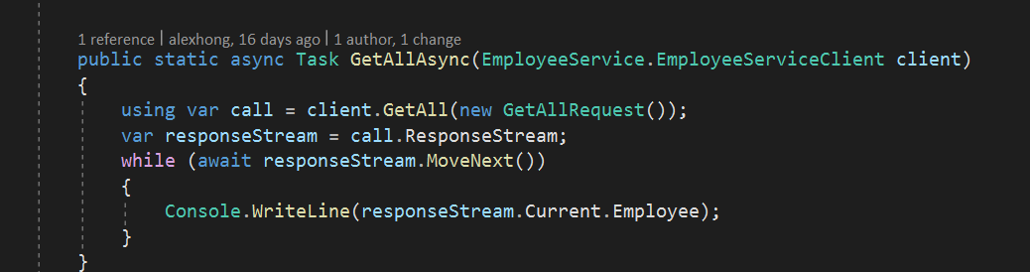
Demo (Client Side)
The can use the interface from server side to call method, and the server side will give response directly.

Slide 15
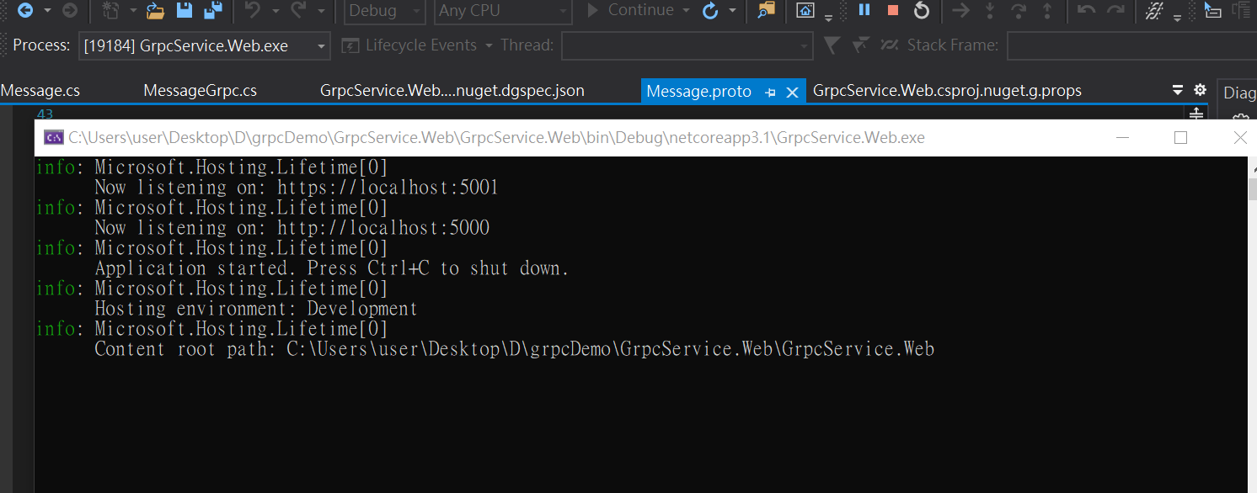
Demo (Client Side)
Run the Server Side and waiting for calling service from client side.

Slide 16
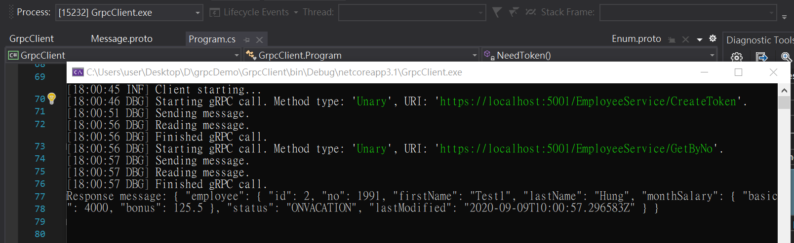
Demo (Client Side)
Client Side get the response from server side

Slide 17
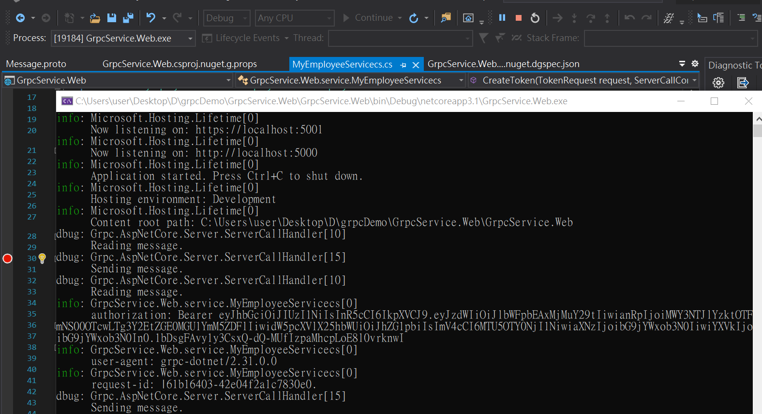
Demo (Client Side)
.Server Side will log the message

Slide 18
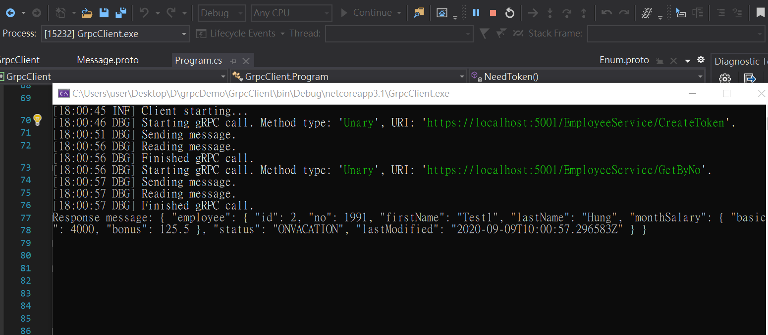
Demo (Client Side)
.

Slide 19
Advantages of gRPC
Auto generated client code
Duplex streaming
High performance along with Safety
Internal services requires duplex streaming with high load of data
The microservices is only internal and when one server needs to talk to the other
Don’t need to write client libraries

Slide 20
Pain Points of gRPC
No support for browsers hence cannot be used for external services.
No url end points hence can't be tested with postman or curl to check the response.
No predefined status codes and creating custom status code may end up in conflicts.

