Slide 1
Banking Modern Data Stack
End-to-End Data Engineering Training PostgreSQL → MinIO → Snowflake → dbt → Airflow
Training Workshop

Slide 2
Training Agenda
Step 1-2: Set up PostgreSQL & create database tables
Step 3: Generate fake banking data with Python Faker
Step 4: Set up Apache Airflow for orchestration
Step 5: Set up MinIO (S3-compatible object storage)
Step 6-7: Set up Snowflake & create raw tables
Step 8-9: Build & run the MinIO → Snowflake Airflow DAG
Step 10-11: Initialize dbt & run transformations
Step 12: Run the SCD2 Snapshots DAG
Step 13: Verify data in Snowflake

Slide 3
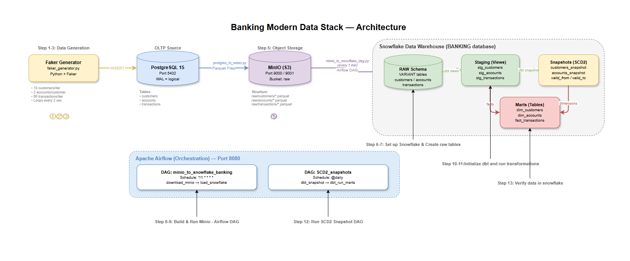
Architecture Overview
All infrastructure runs in Docker containers via docker-compose.yml

Slide 4
Tech Stack
PostgreSQL 15 — Source OLTP relational database (customers, accounts, transactions)
Python + Faker — Synthetic data generation to simulate real banking activity
MinIO — S3-compatible object storage (local data lake for Parquet files)
Snowflake — Cloud data warehouse (RAW → Staging → Marts)
dbt (data build tool) — SQL transformations, SCD2 snapshots, testing
Apache Airflow — Workflow orchestration and scheduling (DAGs)
Docker + docker-compose — Containerized infrastructure for all services

Slide 5
Step 1-2
Set Up PostgreSQL & Create Tables
PostgreSQL runs as a Docker container (image: postgres:15)
Credentials managed via .env file (POSTGRES_USER, POSTGRES_PASSWORD, POSTGRES_DB)
Three tables defined in postgres/schema.sql:
• customers — id, first_name, last_name, email (UNIQUE), created_at
• accounts — id, customer_id (FK), account_type, balance (CHECK ≥ 0), currency
• transactions — id, account_id (FK), txn_type, amount (CHECK > 0), related_account_id, status
Performance index on transactions(account_id, created_at)
Command: docker-compose up -d postgres | Then run schema.sql against the database

Slide 6
Step 3
Generate Fake Banking Data (Faker)
Script: data-generator/faker_generator.py
Uses the Python Faker library to create realistic synthetic data
Each iteration generates:
• 10 customers with random names & unique emails
• 2 accounts per customer (SAVINGS or CHECKING), random balance $10-$1000
• 50 transactions (DEPOSIT / WITHDRAWAL / TRANSFER), amounts up to $1000
Runs in a continuous loop (2-second intervals) or single iteration (--once flag)
Connects to PostgreSQL using psycopg2 with credentials from .env
Command: python data-generator/faker_generator.py

Slide 7
Step 4
Set Up Apache Airflow
Custom Docker image built from dockerfile-airflow.dockerfile:
• Base: apache/airflow:2.9.3
• Installs: dbt-core, dbt-snowflake
Two containers: airflow-webserver (UI on port 8080) + airflow-scheduler
Key volume mounts:
• ./docker/dags → /opt/airflow/dags (DAG files)
• ./banking_dbt → /opt/airflow/banking_dbt (dbt project)
• ./banking_dbt/.dbt → /home/airflow/.dbt (dbt profiles.yml)
Separate airflow-postgres database on port 5433 for Airflow metadata
Access UI: http://localhost:8080

Slide 8
Step 5
Set Up MinIO (S3-Compatible Storage)
MinIO runs as a Docker container (image: minio/minio:latest)
API on port 9000, Console UI on port 9001
Acts as a local data lake — stores Parquet files between PostgreSQL and Snowflake
Bucket structure:
raw/customers/customers_2026-05-15_143022.parquet
raw/accounts/accounts_2026-05-15_143022.parquet
raw/transactions/transactions_2026-05-15_143022.parquet
Script: consumer/postgres_to_minio.py
→ Reads all rows from PostgreSQL, converts to Parquet, uploads to MinIO
Console: http://localhost:9001 | Command: python consumer/postgres_to_minio.py

Slide 9
Step 6-7
Set Up Snowflake & Create Raw Tables
Sign up for Snowflake 30-day free trial at signup.snowflake.com
Run these queries in Snowflake (from snowflake/queries.txt):
CREATE DATABASE banking;
CREATE SCHEMA banking.raw;
CREATE TABLE customers (v VARIANT);
CREATE TABLE accounts (v VARIANT);
CREATE TABLE transactions (v VARIANT);
Why VARIANT? — Stores semi-structured data (Parquet/JSON) without rigid schema
→ Fields extracted later in dbt staging models: v:id::string, v:email::string
VARIANT = flexible schema for data lake ingestion pattern

Slide 10
Step 8-9
MinIO → Snowflake Airflow DAG
DAG: minio_to_snowflake_banking (Schedule: every 1 minute)
File: docker/dags/minio_to_snowflake_dag.py
Task 1 — download_minio:
→ Connects to MinIO via boto3 (S3 client)
→ Lists & downloads all Parquet files to /tmp/minio_downloads
Task 2 — load_snowflake:
→ PUT files to Snowflake internal stage (@%tablename)
→ COPY INTO table with FILE_FORMAT=(TYPE=PARQUET)
Task flow: download_minio → load_snowflake
Enable the DAG in Airflow UI → it auto-runs every minute

Slide 11
Step 10-11
Initialize dbt & Run Transformations
dbt project: banking_dbt/
Profile in banking_dbt/.dbt/profiles.yml → connects to Snowflake
Layers:
Sources (sources.yml) → Points to BANKING.RAW tables
Staging (views) → stg_customers, stg_accounts, stg_transactions
• Extracts fields from VARIANT: v:id::string, v:email::string
• Deduplicates using ROW_NUMBER() OVER (PARTITION BY id ORDER BY created_at DESC)
Marts (tables) → dim_customers, dim_accounts, fact_transactions
• Dimensions built from SCD2 snapshots (effective_from, effective_to, is_current)
• Fact table uses incremental materialization with unique_key
Commands: dbt debug → dbt run

Slide 12
Step 12
Run SCD2 Snapshots DAG
DAG: SCD2_snapshots (Schedule: @daily)
File: docker/dags/scd_snapshots.py
Task 1 — dbt_snapshot:
→ Runs: dbt snapshot --profiles-dir /home/airflow/.dbt
→ Compares current staging data vs. previous snapshot
→ Detects changes and creates historical records
Task 2 — dbt_run_marts:
→ Runs: dbt run --select marts
→ Rebuilds dimension and fact tables with latest snapshot data
SCD Type-2 strategy: 'check' — monitors specific columns for changes:
• customers_snapshot checks: first_name, last_name, email
• accounts_snapshot checks: customer_id, account_type, balance
Changed rows get dbt_valid_to timestamp; new row inserted with dbt_valid_from = now()

Slide 13
How SCD Type-2 Works
Slowly Changing Dimension Type 2 = Full History Tracking
Example: Customer 1 changes their email address
customer_id │ email │ effective_from │ effective_to │ is_current
────────────┼────────────────────┼────────────────┼──────────────┼───────────
1 │ old@email.com │ 2026-01-01 │ 2026-05-15 │ FALSE
1 │ new@email.com │ 2026-05-15 │ NULL │ TRUE
• Old row: dbt_valid_to gets set to the change timestamp
• New row: inserted with dbt_valid_from = now, dbt_valid_to = NULL
• is_current = TRUE only for the latest version
This preserves complete audit history — you can query any point in time

Slide 14
Step 13
Verify Data in Snowflake
Check raw data landed:
SELECT COUNT(*) FROM banking.raw.customers;
SELECT COUNT(*) FROM banking.raw.accounts;
SELECT COUNT(*) FROM banking.raw.transactions;
Check staging views:
SELECT * FROM banking.analytics.stg_customers LIMIT 10;
Check SCD2 snapshot history:
SELECT * FROM banking.analytics.customers_snapshot
WHERE customer_id = '1' ORDER BY dbt_valid_from;
Check marts (dimension & fact tables):
SELECT * FROM banking.analytics.dim_customers WHERE is_current = TRUE LIMIT 10;
SELECT * FROM banking.analytics.fact_transactions LIMIT 10;

Slide 15
Key Files Reference
postgres/schema.sql — Database table definitions
data-generator/faker_generator.py — Synthetic data generator
consumer/postgres_to_minio.py — Direct PostgreSQL → MinIO transfer
docker/dags/minio_to_snowflake_dag.py — Airflow DAG: MinIO → Snowflake
docker/dags/scd_snapshots.py — Airflow DAG: dbt snapshots + marts
snowflake/queries.txt — Initial Snowflake setup queries
banking_dbt/models/staging/stg_*.sql — dbt staging models
banking_dbt/models/marts/ — dbt dimension & fact tables
banking_dbt/snapshots/ — dbt SCD2 snapshot definitions
banking_dbt/.dbt/profiles.yml — dbt Snowflake connection profile
docker-compose.yml — All Docker service definitions
dockerfile-airflow.dockerfile — Custom Airflow image with dbt

Slide 16
Thank You!
Questions?

