Slide 1
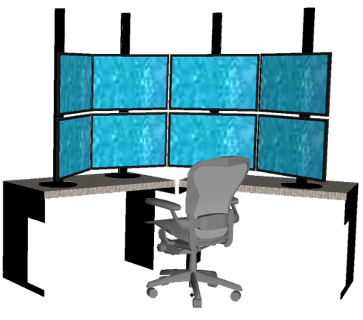
Visualizing Cyber Security: Usable Workspaces
Glenn A. Fink, Christopher L. North, Alex Endert, Stuart Rose

Slide 2
What did we do?
How can we design visual workspaces that aid Cyber Security?
Tons of data?
Lots of windows and tools?
Why don’t we give the user more space?
Notes:
Let me give you a little background…
Sounds like the user needs more space!!

Slide 3
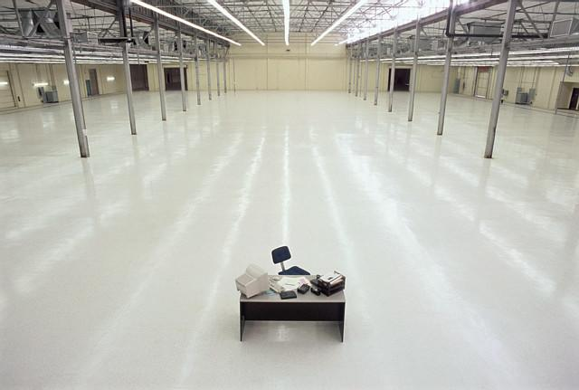
Let’s give the user more space!
Notes:
Great metaphor for the idea if giving the user more space to perform their work, without keeping in mind designing usable workspace that utilize the additional display space … the theme of this work.

Slide 4
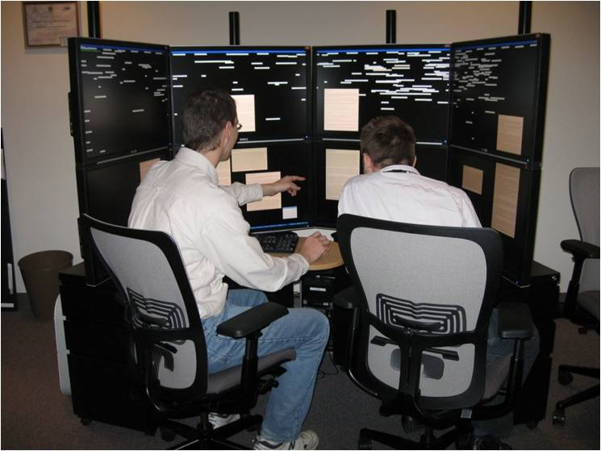
Large, High-Resolution Displays
(8) 30-inch high-res LCD Panels
33 Megapixel total resolution (10,240 x 3,200)
“Single PC” Architecture
Curved for optimal individual use
Notes:
Coolness Factor!!

Slide 5
Methods
1. Interviews (8 professional cyber analysts)
Typical tasks and data?
Work style?
E.g., Collaboration? Multi-tasking? Time constraints?
Office setup
What does your finished analysis product contain?
2. User study (4 cyber analysts, VAST09 dataset)
2 sources of data: Building/room access records (Prox) and simulated computer network flows
HINT: making connections between the sources is key! ☺
Tools provided: Excel, Spotfire, Windows XP
3. Feedback from the analysts on our prototypes.
Notes:
I’d like to point out how important the VAST dataset is.
How did the analysts make use of this additional space?
Public dataset to use when testing tools is great!!

Slide 6
Key Ethnographic Discoveries
Data sources reside in separate tools
Analysts spend much time doing low-level tasks
They distrust visualizations
They are on a “Quest for a Query”
Cyber data comes in huge volumes and velocities
Cyber data comes from many diverse sources
Analysts seek direct access to the data
Analysts routinely conduct a large number of tasks in parallel (multi-tasking)
Notes:
I will talk about the one’s in bold.

Slide 7
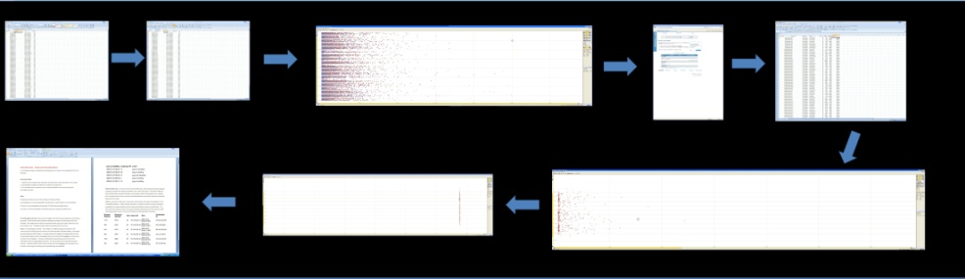
1. Data Resides in Different Tools
Used space for visual path
Rote mechanical process
Analyst: “Tedious!”

Slide 8
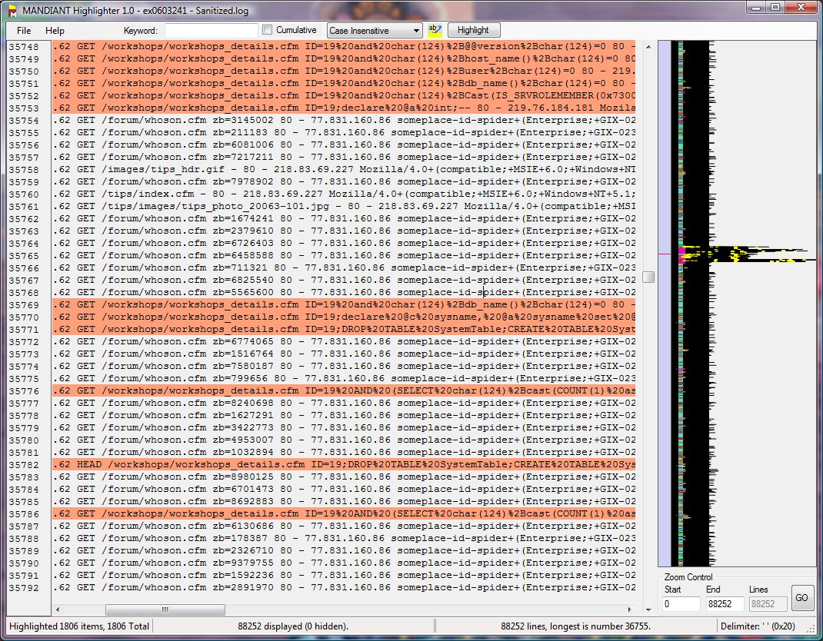
2. Low-level Tasks
Analysts filter out the “normal”
line-by-line
Seek patterns of familiar abnormalities
Previous experience creates personal “hit list”
Analysts observe data individually, not in connection with whole dataset
Mandiant Highlighter

Slide 9
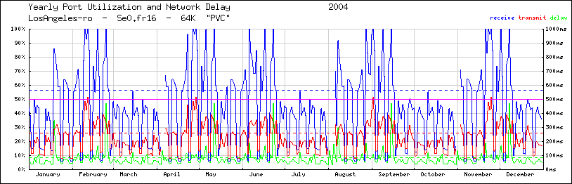
3. Distrust of Visualizations
Analyst: “Visualizations are in the way of the data”
Visualizations:
May be too slow
May hide important, small details
Analysts can only see, not manipulate the data
Notes:
Also highlights Analysts want direct access to data

Slide 10
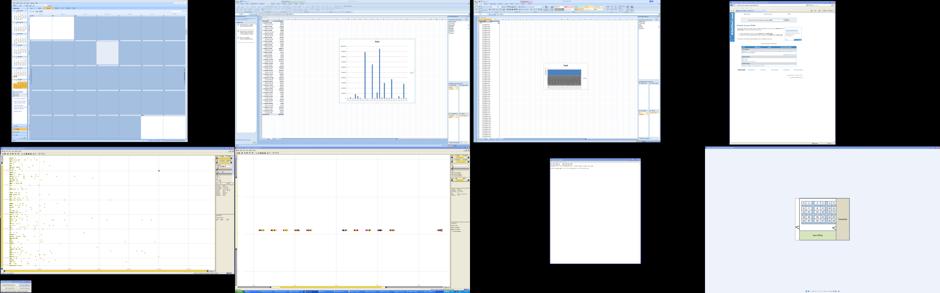
4. Quest for a “Query”
“Query” != SQL query
“Query” is the question that finds the answer you have
Cumulative result of interaction with variety of tools
The process of forming this query is key!
Notes:
Result of all the interaction coupled with their previous knowledge makes up this query.

Slide 11
Guidelines for Usable Workspaces
Multi-scale Visualizations
De-Aggregate Vital Information
Support multiple, simultaneous investigation cases
Provide history and traceability for investigations
Notes:
Built prototypes based on…

Slide 12
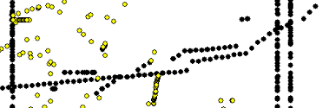
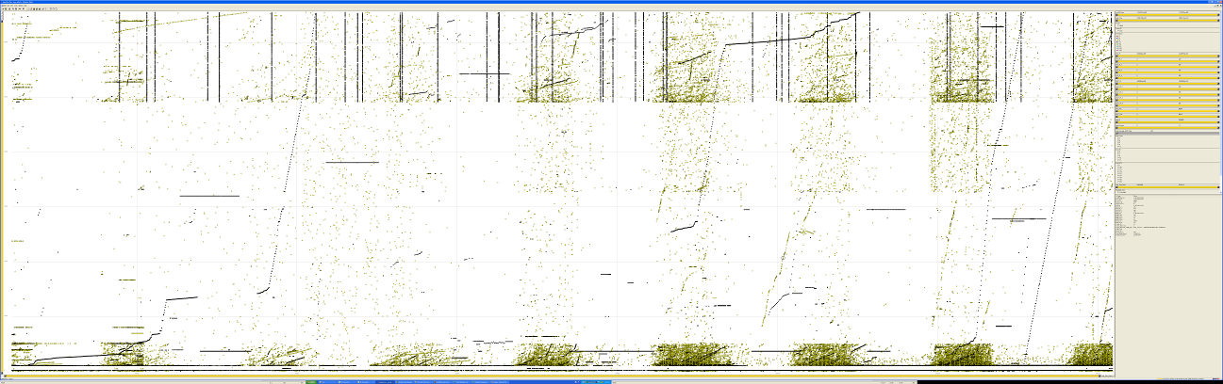
Large, High-Resolution Visualization
Visibility of patterns at multiple scales
Provides overview and detail

Slide 13
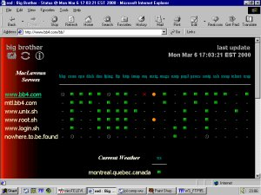
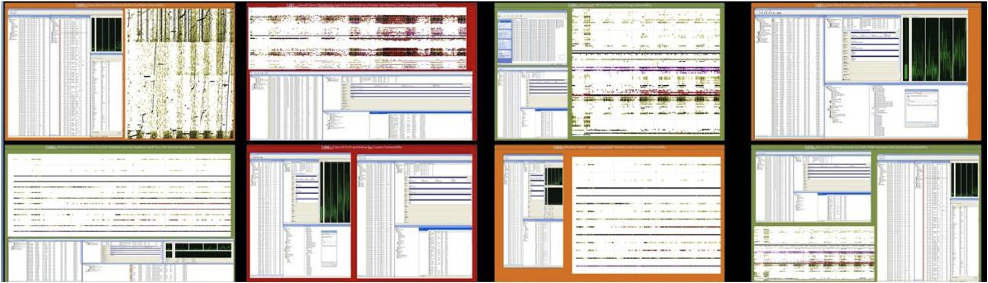
De-Aggregate Vital Information
Provides analyst with situational awareness
De-aggregation of information
More upfront information, while maintaining overview

Slide 14
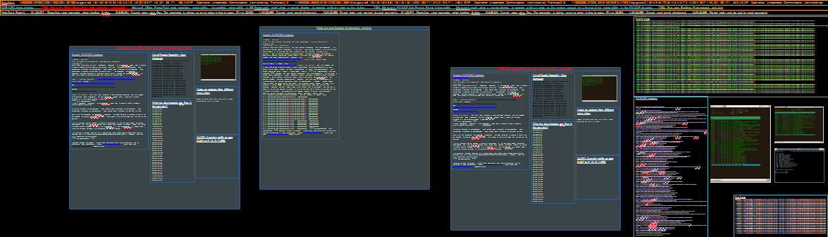
Multiple Simultaneous Cases
Shows live data
Real time updating
Analyst can set alerts for monitoring
Enables collaboration by sharing cases

Slide 15
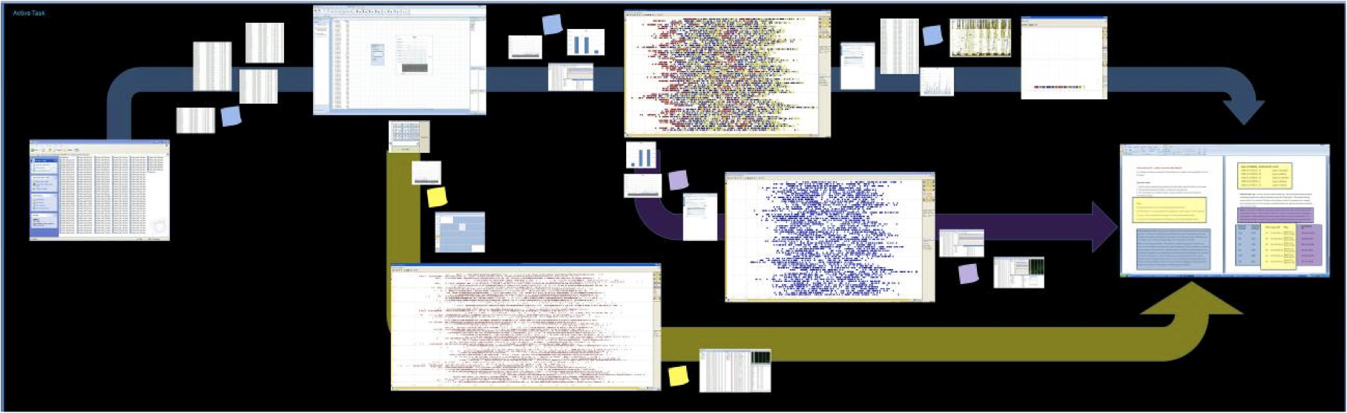
History and Traceability
“History Trees”: concept providing traceability and history of analyst’s workflow
A visualization should be the means for a user to interact and think.

Slide 16
Intelligence vs. Cyber Analytics
Stegosaurus Scenario (Intelligence Analytics) | Cyber Security Scenario (Cyber Analytics)
Creating a story about the threat. Product = story | Building a query to identify the threat. Product = query
Work done in a visual space. (Sensemaking Process) | Work done in textual space. (Tools to Process the Data)
Rely on Visualizations. | Rely on Linux Command Line.
Un-, semi-, and structured data. | Mainly structured data. (packet, etc.)
Lots of data. | Even more data!
Interactions reside outside the windows. | Interactions reside within the windows

Slide 17
Let’s give the user more space!

Slide 18
Let’s make the space more useful!
History and Traceability
Multiple, Simultaneous Investigation cases
Large, High-Resolution Visualizations
De-Aggregate Vital Information
Notes:
Enjoyed working with the large displays.
Made them more easily organize their information and thoughts.

