Slide 1
A6: Med-Fi Prototype
tutti

Slide 2

Value Proposition
Tutti is a peer tutoring platform that empowers students to support each other within a trusted school network, providing accessible, fair tutoring with AI-generated, reports for both tutors and tutees, enhancing their learning experience.

Slide 3
Problem
Inflexible office hour schedules
Students don’t have a platform on which to find tutors within the network of their school outside of the formal TA process
Lack of personalized support for large classes
Student/Teacher scheduling conflicts
Understaffed classes with too few TAs

Slide 4
Solution
Tutor without being a TA
A free marketplace where student tutors can create their own listings and find tutees independently of school involvement, leveraging AI reports for both the tutor and tutee to help the learning process
Personalized support and feedback
Eliminate scheduling conflicts
Location and time flexibility

Slide 5

Encoded Values
Accessibility: tutti aims to lower the barrier to high quality tutoring
Empowerment through Peer Learning: The app fosters a supportive environment where students help one another
Actionable Feedback: By providing detailed reports, tutti values personalized learning
Community and Collaboration: tutti encourages a collaborative academic culture where students work together to solve problems

Slide 6

Design Features
AI-Generated Reports: Each session ends with insights that highlight key strengths and areas for improvement, enhancing personalized learning for tutor and tutee.
In-School Peer Tutoring: Student-to-student tutoring promotes empowerment, accessibility, and community within the school network.
Default Pricing: Tutti starts with a $20/hr rate, creating an accessible baseline for tutoring while allowing tutors to adjust as needed.
Flexible Scheduling: Tutti offers convenient session scheduling to overcome conflicts and limited office hour access, ensuring flexibility for all users.

Slide 7

Value Tensions
Privacy vs. Feedback: Balancing personalized feedback with the need to protect privacy.
Empowerment vs. Equity: Financial challenges in setting fair tutoring prices can impact accessibility and create disparities.
AI vs. Human Insight: AI-generated reports must complement, not replace, the tutor’s real-time insights.

Slide 8
Refined Low-Fi Tasks

Slide 9
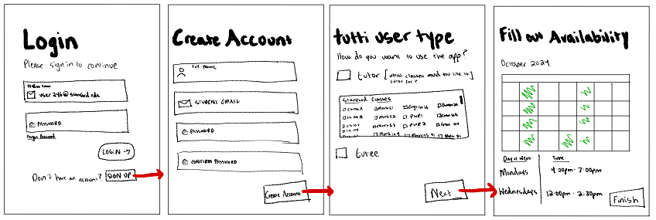

Simple Task: Create an Account
@stanford.edu
Recommended: a9qp!%wqahp98
(H3) New Back Buttons
Recommended Password
Colored box Tutor or Tutee

Slide 10

Simple Task Changes
New back buttons added to every step of the set up account process (H3 User Control and Freedom)
Recommended complex password for additional safety
School email autofill for clarity and ensured usage of school account
New colored box to indicate tutor/tutee option chosen

Slide 11
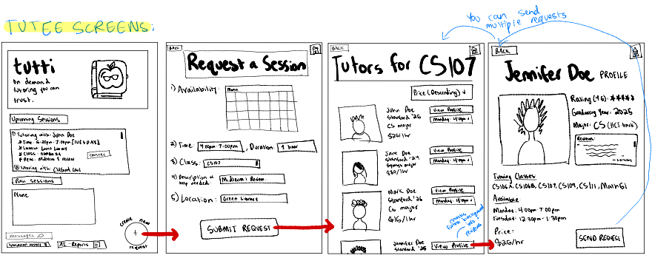
Moderate Task (tutee): Schedule and Handle a Session
(H3) New Back Buttons
Updated Home Page
Scrollable List of Tutors

Slide 12

Moderate Task Changes - Tutee
Added AI-reports tab on the home screen for easy access to post-session insights.
Improved tutor search navigation by adding back, cancel, and home buttons to enhance user control and freedom (H3 User Control and Freedom).
Updated profile layout with improved image display and scrolling tutor reviews for clearer ratings and feedback.

Slide 13
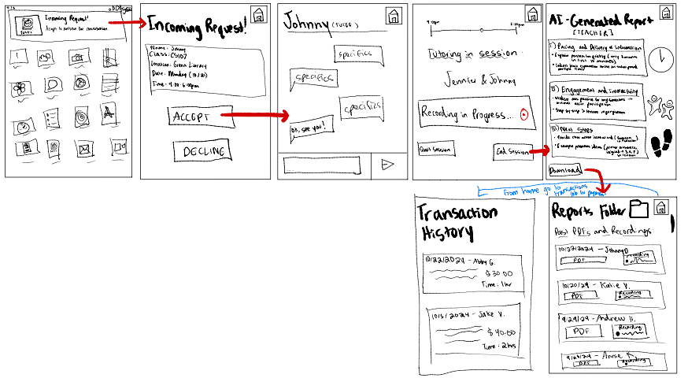
Moderate Task (tutor): Schedule and Handle a Session
Home Screen Button
Home screen notification popup
View all past reports from home screen
New Transaction History Screen

Slide 14

Moderate Task Changes - Tutor
Added notification popup for incoming requests to improve immediate feedback (H4 Consistency and Standards across different applications).
Added a transaction history section for better payment tracking (H10 Help and Documentation - ensuring flexibility and efficiency of use).
Introduced a consolidated reports folder for teaching method insights, allowing tutors to improve their skills.
New home screen button on Every Page (H3)

Slide 15
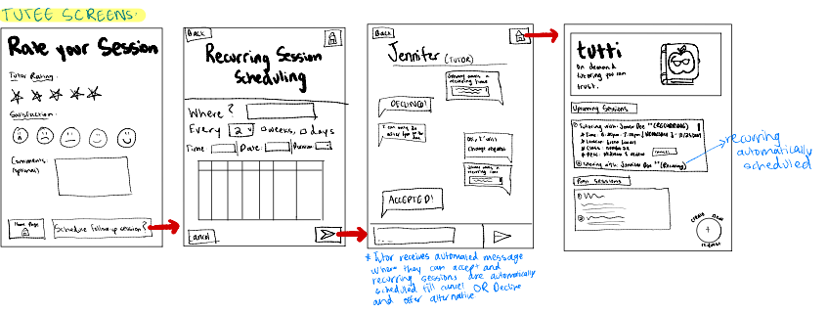
Complex Task: Schedule a Recurring Session
Updated Scheduling Screen
Option to Select Recurring when initially scheduling
Automated messages when tutors accept

Slide 16

Complex Task Changes
Updated Calendar – modeled scheduling options after Google Calendar (H11 Accessible Design) for clearer session choices (recurring, single, canceled sessions).
Added an option for single session or recurring session when creating the meeting
Conducted re-testing to validate new recurring session features features based on Nielsen Heuristics – especially user control, flexibility, and efficiency.

Slide 17
Our Med-Fi Prototype So Far

Slide 18
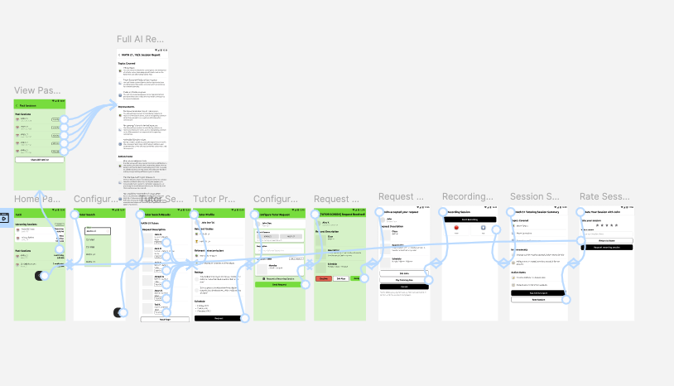
https://www.figma.com/proto/GyUpmnb6Z08Y2LOmmlnaUZ/Med-Fi-Prototype?node-id=0-1&t=mp9dtFlymoTCKQgr-1

