Slide 1
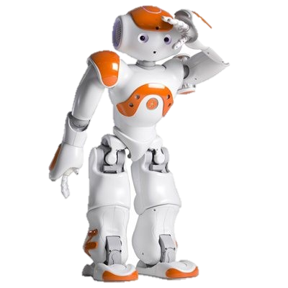
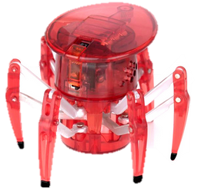
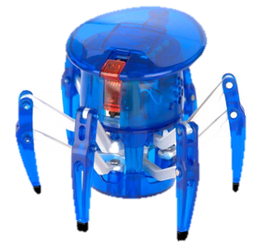
Intelligent Toy Interfaces

Slide 2
Project Objectives
Create intelligent interfaces
For smart toy-robot interaction

Slide 3
What do we mean?
Low Cost
Learning
Fun
Interaction
Mental Disorders
Physical Disabilities

Slide 4
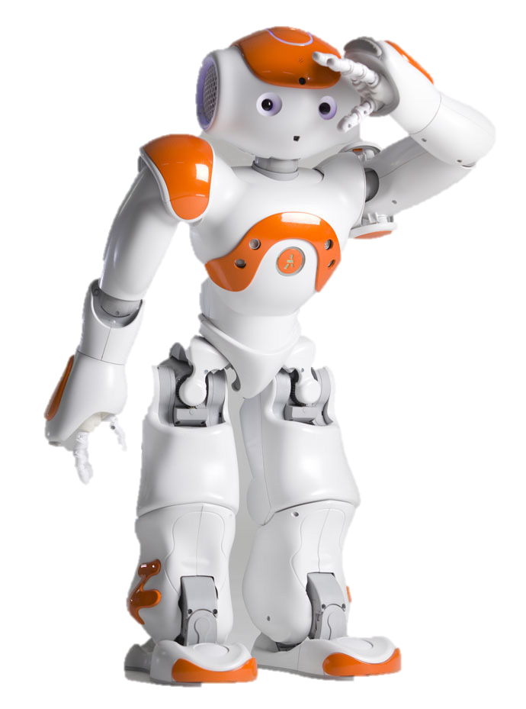
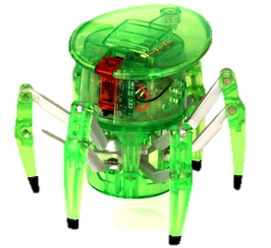
How we will do it?
Hex-Bugs
NAO Robot

Slide 5
How we will do it?
MCU
Sensors
Infrared
RF Motes
Contact
Atmosphere
Motion
Send/Receive

Slide 6
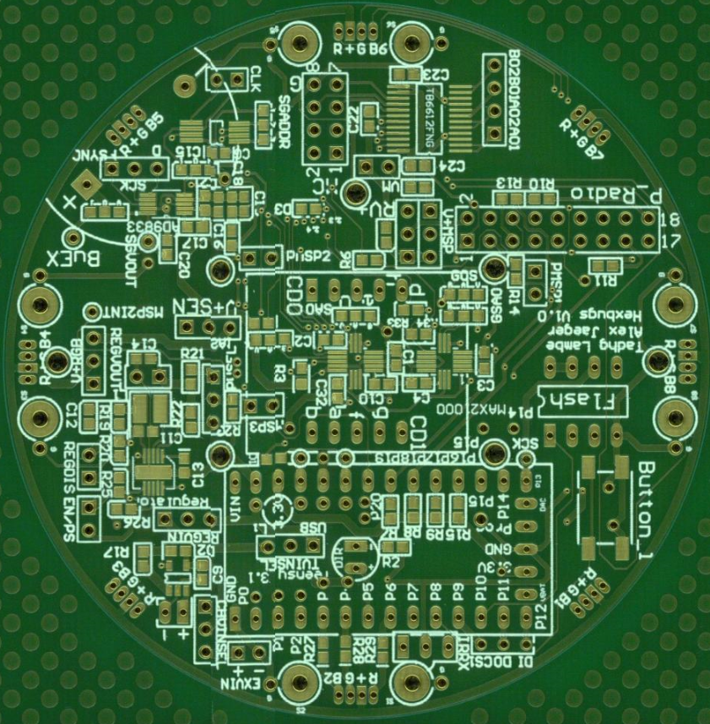
Work Completed
Power and MCU schematics designed.
PCB layed out + fabricated.
Hardware drivers written for sensors (I²C).
8cm

Slide 7
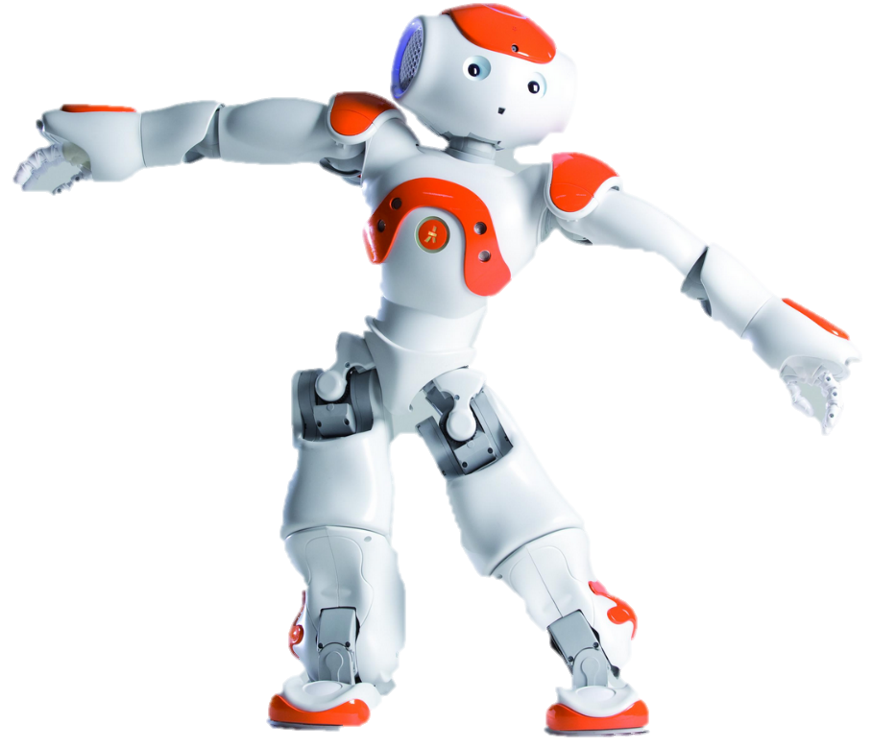

Work Completed
Learned about NAO,
Used Python to access the NAO API
Interfaced NAO with PC gaming joystick
Demonstrated Elec-Eng open day

Slide 8
Requirements

