Slide 1
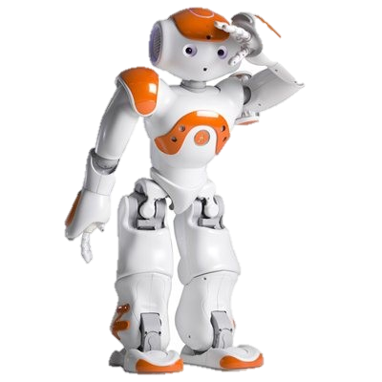
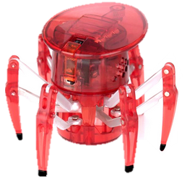
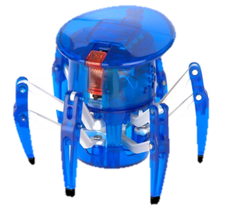
Intelligent Toy Interfaces

Slide 2
Agenda
Project Overview
Work summary
System Design
Ethical considerations

Slide 3
Project Objectives
Create intelligent interfaces
For smart toy-robot interaction

Slide 4
What do we mean?
Low Cost
Learning
Fun
Interaction
Mental Disorders
Physical Disabilities

Slide 5
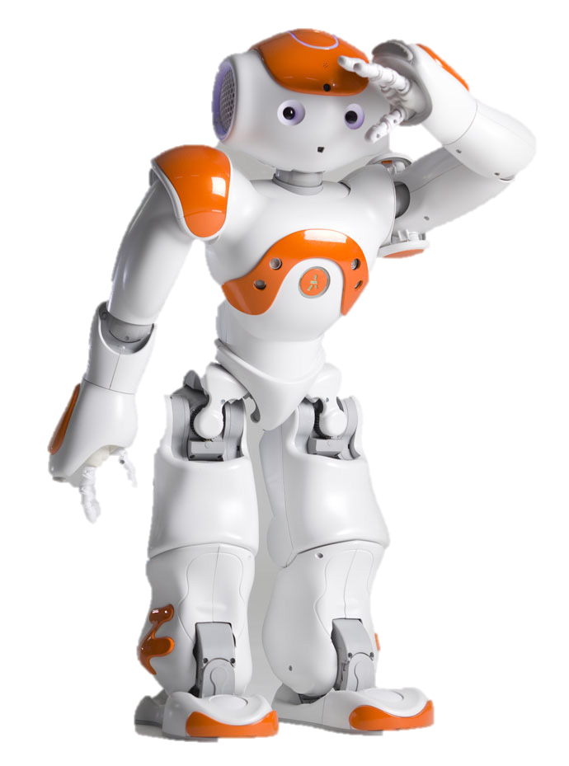
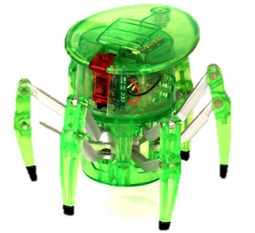
How we will do it?
Hex-Bugs
NAO Robot

Slide 6
How we will do it?
MCU
Sensors
Infrared
RF Motes
Contact
Atmosphere
Motion
Send/Receive

Slide 7
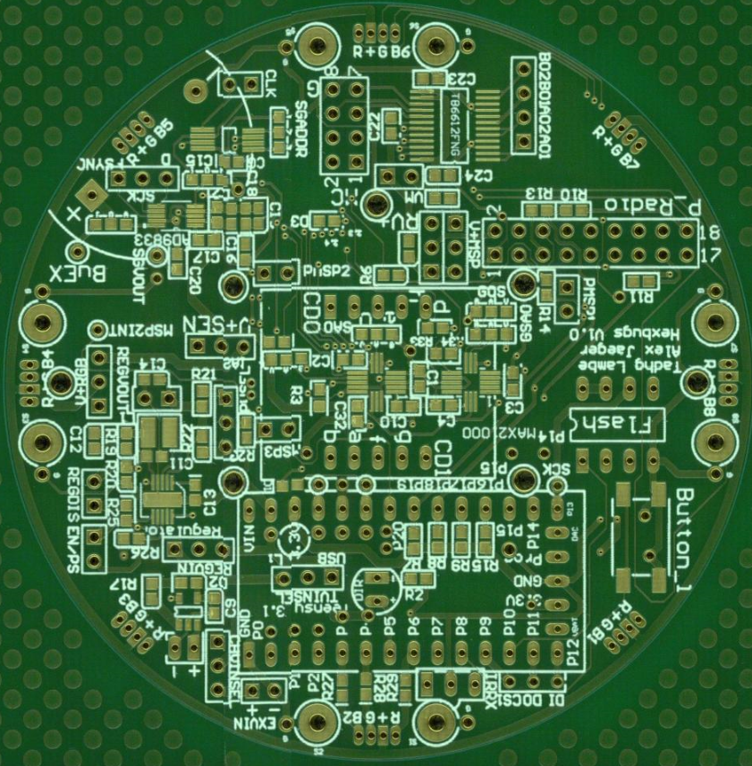
Work Completed
Power and MCU schematics designed.
PCB layed out + fabricated.
Hardware drivers written for sensors (I²C).
8cm

Slide 8
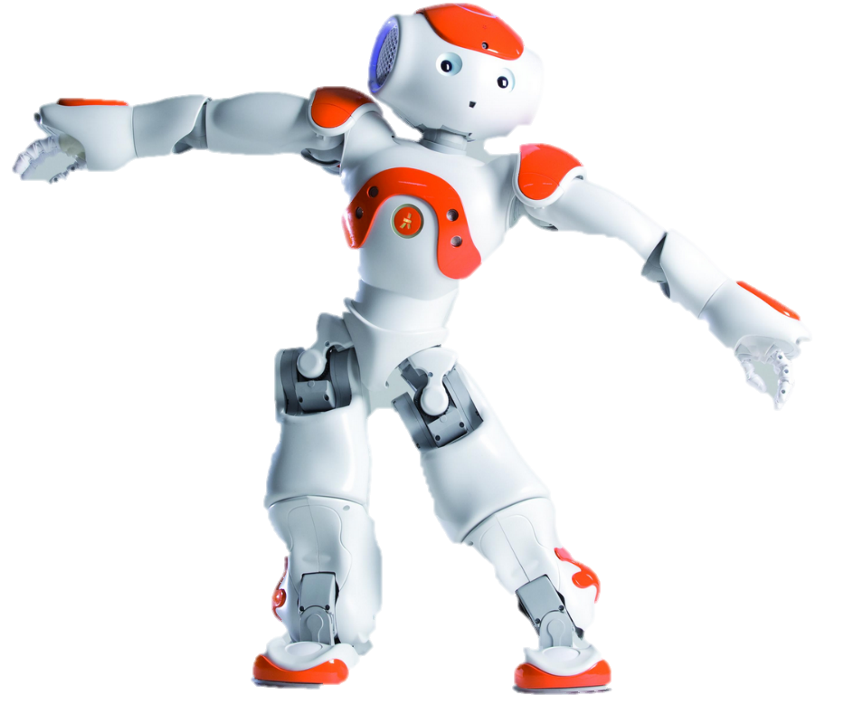

Work Completed
Learned about NAO,
Used Python to access the NAO API
NAO with joystick
Infrared communications

Slide 9
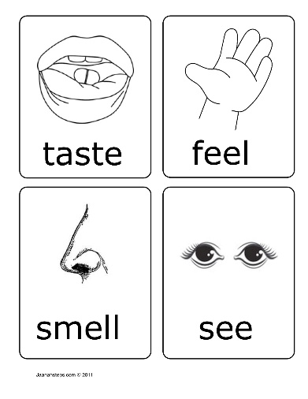

System Design
Give affordable toys senses
Reaction to senses
Enable collaboration
Interact with NAO

Slide 10
Bug Design
MCU
TI MSP430 MCU
7-Seg
RGB LEDs
Contact Sensors
Temp.. Pressure…
TI RF2500… Infrared
Gyro… Magn… Accel..
I2C Bus
Bugs…
PC…
NAO… Tech…

