Slide 1
Gibsov algoritam

Slide 2
Šta je Gibsovo uzorkovanje?
Generička metoda koja se koristi za uzorkovanje multivarijacionih uslovnih raspodela.
Drugim reĉima, Gibbs sampler podrazumeva biranje uzorka iz uslovne raspodele za svaki parametar posebno, uzimajući u obzir tekuće vrednosti svih ostalih parametara.
Neke od bitnih multivarijacionih uslovnih raspodela su:
- Multivarijaciona normalna raspodela
- Wishart-ova raspodela
- Multivarijaciona studentova raspodela

Slide 3
Preciznije
Opšti Gibbs sampler
Gibbs sampler je najĉešće korišćen MCMC metod u Bajesovoj statistici i
predstavlja sledeći iterativni proces (j je indeks koji ukazuje na broj
iteracije):
MCMC („Markov chain Monte Carlo’) metod biranja uzorka obezbeĊuje biranje uzorka iz
višedimenzionih gustina raspodela, razlažući ih na raspodele manjih dimenzija sa kojima je
lakše raditi. Deo imena „Monte Carlo‟, navedenog metoda, ukazuje na proces sluĉajne
simulacije, dok deo imena „Markov chain‟ ukazuje da se element uzorka iz aposteriorne
raspodele bira na osnovu prethodno izabranog elementa

Slide 4
Pseudokod
Ulaz: neophodni parametri za računanje uslovnih verovatnoća
Izlaz: niz tačaka koje aproksimiraju aposteriorne raspodele parametara
Algoritam:
Inicijalizacija
Za svako i<n:

Slide 5
BIG CONCEPT
Bring the attention of your audience over a key concept using icons or illustrations

Slide 6
You can also split your content
White
Is the color of milk and fresh snow, the color produced by the combination of all the colors of the visible spectrum.
Black
Is the color of coal, ebony, and of outer space. It is the darkest color, the result of the absence of or complete absorption of light.

Slide 7
In two or three columns
Yellow
Is the color of gold, butter and ripe lemons. In the spectrum of visible light, yellow is found between green and orange.
Blue
Is the colour of the clear sky and the deep sea. It is located between violet and green on the optical spectrum.
Red
Is the color of blood, and because of this it has historically been associated with sacrifice, danger and courage.

Slide 8
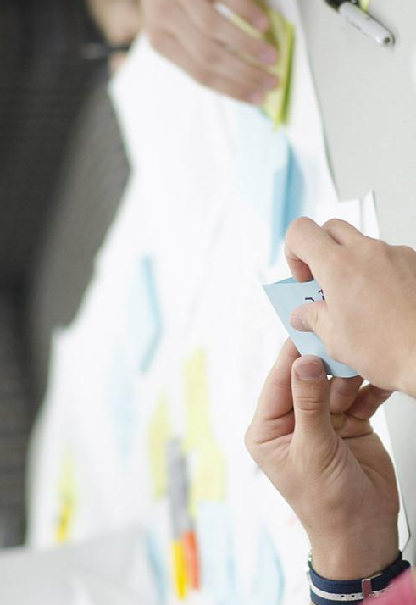
A picture is worth a thousand words
A complex idea can be conveyed with just a single still image, namely making it possible to absorb large amounts of data quickly.

Slide 9

Want big impact? USE BIG IMAGE

Slide 10
Use charts to explain your ideas
White
Gray
Black

Slide 11
And tables to compare data
 | A | B | C
Yellow | 10 | 20 | 7
Blue | 30 | 15 | 10
Orange | 5 | 24 | 16

Slide 12
Maps
our office

Slide 13
89,526,124
Whoa! That’s a big number, aren’t you proud?

Slide 14
89,526,124$
That’s a lot of money
185,244 users
And a lot of users
100%
Total success!

Slide 15
Our process is easy
FIRST
SECOND
LAST

Slide 16
Let’s review some concepts
Yellow
Is the color of gold, butter and ripe lemons. In the spectrum of visible light, yellow is found between green and orange.
Blue
Is the colour of the clear sky and the deep sea. It is located between violet and green on the optical spectrum.
Red
Is the color of blood, and because of this it has historically been associated with sacrifice, danger and courage.
Yellow
Is the color of gold, butter and ripe lemons. In the spectrum of visible light, yellow is found between green and orange.
Blue
Is the colour of the clear sky and the deep sea. It is located between violet and green on the optical spectrum.
Red
Is the color of blood, and because of this it has historically been associated with sacrifice, danger and courage.

Slide 17
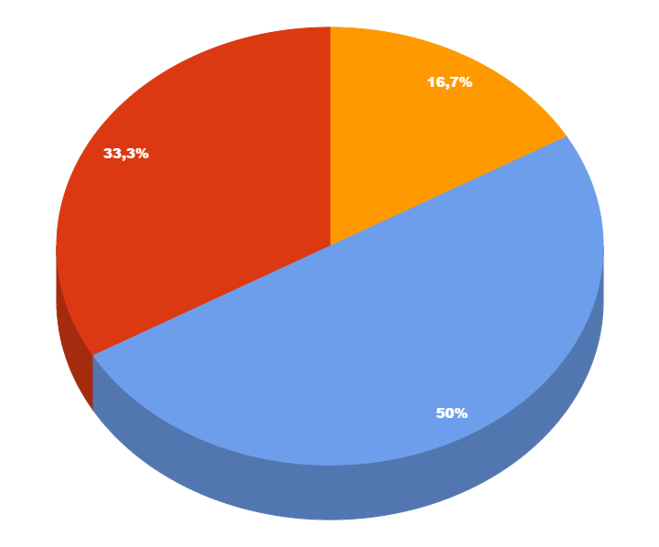
You can copy&paste graphs from Google Sheets

Slide 18
ANDROID PROJECT
Show and explain your web, app or software projects using these gadget templates.
Place your screenshot here

Slide 19
iPHONE PROJECT
Show and explain your web, app or software projects using these gadget templates.
Place your screenshot here

Slide 20
TABLET PROJECT
Show and explain your web, app or software projects using these gadget templates.
Place your screenshot here

Slide 21
DESKTOP PROJECT
Show and explain your web, app or software projects using these gadget templates.
Place your screenshot here

Slide 22
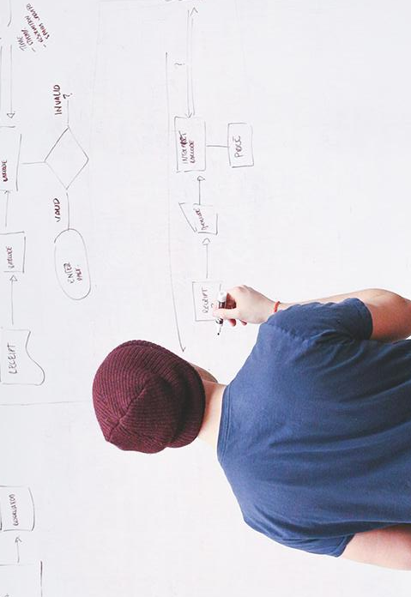
THANKS!
Any questions?
You can find me at:
@username · user@mail.me

Slide 23
Credits
Special thanks to all the people who made and released these awesome resources for free:
Presentation template by SlidesCarnival
Photographs by Startupstockphotos

Slide 24

Presentation design
This presentation uses the following typographies:
Titles: Hind
Body copy: Hind
You can download the fonts on this page:
https://www.google.com/fonts#UsePlace:use/Collection:Hind:400,700
Click on the “arrow button” that appears on the top right
You don’t need to keep this slide in your presentation. It’s only here to serve you as a design guide if you need to create new slides or download the fonts to edit the presentation in PowerPoint®

Slide 25
SlidesCarnival icons are editable shapes.
This means that you can:
Resize them without losing quality.
Change fill color and opacity.
Change line color, width and style.
Isn’t that nice? :)
Examples:

Slide 26
😉
Now you can use any emoji as an icon!
And of course it resizes without losing quality and you can change the color.
How? Follow Google instructions https://twitter.com/googledocs/status/730087240156643328
✋👆👉👍👤👦👧👨👩👪💃🏃💑❤😂😉😋😒😭👶😸🐟🍒🍔💣📌📖🔨🎃🎈🎨🏈🏰🌏🔌🔑 and many more...

