Slide 1



Oxygen AI Positron: Transforming Technical Content Creation through AI-Powered Writing
Alex Jitianu
alex_jitianu@oxygenxml.com
@AlexJitianu
© 2023 Syncro Soft SRL. All rights reserved.
Notes:
We explore how to empower tech content creation through AI

Slide 2
Outline
Positron actions
Chat view
Customization (context, new actions), sharing, favorites
Recording examples
AI powered validation
Web Author integration

Slide 3
How to get it
Oxygen XML Author
    Help → Install new add-ons...
Oxygen Web Author
    https://www.oxygenxml.com/oxygen-xml-web-author/
Auth
Notes:
Present params for shortdesc, invoke it
Make grammar problem, correct it, show preview
Improve readability on next pragraph

Slide 4
Talking to an AI
Prompt
  instructions and context given to an AI to perform a task
Prompt engineering
  development and refining of prompts to best perform a task
Challenges, time consuming
Notes:
Present params for shortdesc, invoke it
Make grammar problem, correct it, show preview
Improve readability on next pragraph

Slide 5
Positron Actions
Short descriptions
  “The short description (or shortdesc) is arguably the most important component of a DITA topic, and is also one of the most difficult elements to write. ” The DITA Style GuideBest Practices for Authors
  Parameters
  Preview
Index terms
Correct grammar
Notes:
Present params for shortdesc, invoke it
Make grammar problem, correct it, show preview
Improve readability on next pragraph

Slide 6
Positron Actions
Search engines, AI-powered
  “Does this <topic> answers this <question>?”
    How can I add media resources to my DITA documents?
    How can I make a mojito?
  “What questions does this <topic> answer?”
    How can I enhance my DITA, DocBook, or XHTML topics with media resources?
    What types of media resources are supported in DITA, DocBook, or XHTML topics?
    How can I add a video, audio clip, or embedded HTML frame to my DITA, DocBook, or XHTML topic?
    What is the procedure to insert a media resource in a document?
    What should I do if I receive an error when trying to play videos in Author mode on Ubuntu 17.10?
Notes:
What media format can I insert in DITA?
In what frameworks I can insert media?
what types of resources I can add?
How can I repair a car engine?

Slide 7
Positron Actions
Search engines, AI-powered
  “Does this <topic> answers this <question>?”
  “What questions does this <topic> answer?”
Help with
  Release notes
  Marketing Post
Notes:
What media format can I insert in DITA?
In what frameworks I can insert media?
what types of resources I can add?

Slide 8
Workflows
Chat view (Improve readability)
  Refining
    “Write for a beginner audience. Use simple terms.”
  Editing
    “Write for a beginner audience. Use simple terms and make a joke to break the ice.”
  Favorite
    audience.novice
  History
Context
Custom actions – create definition lists from lists
Notes:
“has the chain of thought” – gandirea umana colecteaza informatie, knowledge. I-ai spus ceva, ramane acolo, influenteaza cum informatia ulterioara va fi procesata. Un AI are un context-window (acei N tokeni). Ce a iesit din ea e ca si uitat

Slide 9
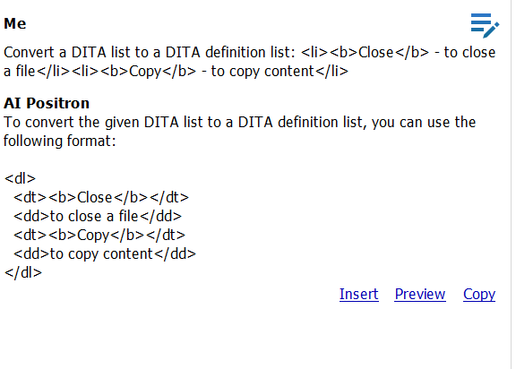
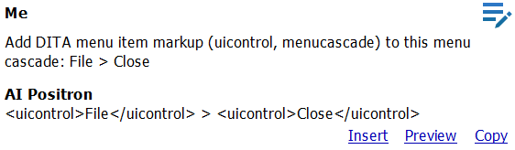
Recording examples
“Why?”
Zero-Shot, Few-Shot
Notes:
“has the chain of thought” – gandirea umana colecteaza informatie, knowledge. I-ai spus ceva, ramane acolo, influenteaza cum informatia ulterioara va fi procesata. Un AI are un context-window (acei N tokeni). Ce a iesit din ea e ca si uitat

Slide 10
AI Fix
“Why?”
“You already have the business rules and human readable messages!”
TODO – more samples
Notes:
“has the chain of thought” – gandirea umana colecteaza informatie, knowledge. I-ai spus ceva, ramane acolo, influenteaza cum informatia ulterioara va fi procesata. Un AI are un context-window (acei N tokeni). Ce a iesit din ea e ca si uitat

Slide 11
AI functions
Schematron
  ai:verify-content(instructions, text)
  ai:transform-content(instructions, text)
Author actions (XSLTOperation based)
XML Refactoring
Notes:
“has the chain of thought” – gandirea umana colecteaza informatie, knowledge. I-ai spus ceva, ramane acolo, influenteaza cum informatia ulterioara va fi procesata. Un AI are un context-window (acei N tokeni). Ce a iesit din ea e ca si uitat

Slide 12
AI Positron for Web Author
Notes:
“has the chain of thought” – gandirea umana colecteaza informatie, knowledge. I-ai spus ceva, ramane acolo, influenteaza cum informatia ulterioara va fi procesata. Un AI are un context-window (acei N tokeni). Ce a iesit din ea e ca si uitat

Slide 13
THANK YOU!
Alex Jitianu
alex_jitianu@oxygenxml.com
@AlexJitianu
© 2023 Syncro Soft SRL. All rights reserved.

