Slide 1
Apartment Electricity & Weather Analysis: Clustering & Pattern Discovery
Alex Jurcich
Data Mining – Final Project
December 2025

Slide 2
Project Overview
Dataset: 85k daily observations across 114 apartments (2014-2016)
Goal: Identify energy-use patterns & weather relationships
Methods: K-Means, DBSCAN, GMM, PCA, FP-Growth / Apriori
Key Questions:
  How do weather & seasons influence electricity usage?
  Do daily patterns from meaningful behavioral clusters?
  What combinations do conditions commonly co-occur?
Outputs: Cluster Insights + Rule Networks + Actionable patterns

Slide 3
Dataset & Preprocessing Pipeline
Raw Data
85k observations
114 apartments
Cleaning
IQR Outliers
Remove Nulls
Feature Engineering
Season Encoding
Weekend Encoding
Power metrics
Scaling + PCA
StandardScalar
PCA (7 components)

Slide 4
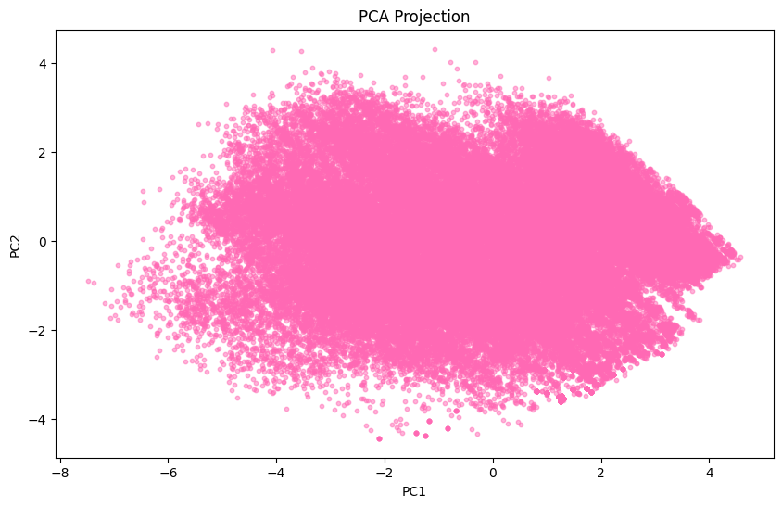
PCA Visualization of Daily Energy
Reduced original feature set to 7 PCA components
These 7 components explain ~92.6% of total variance

Slide 5
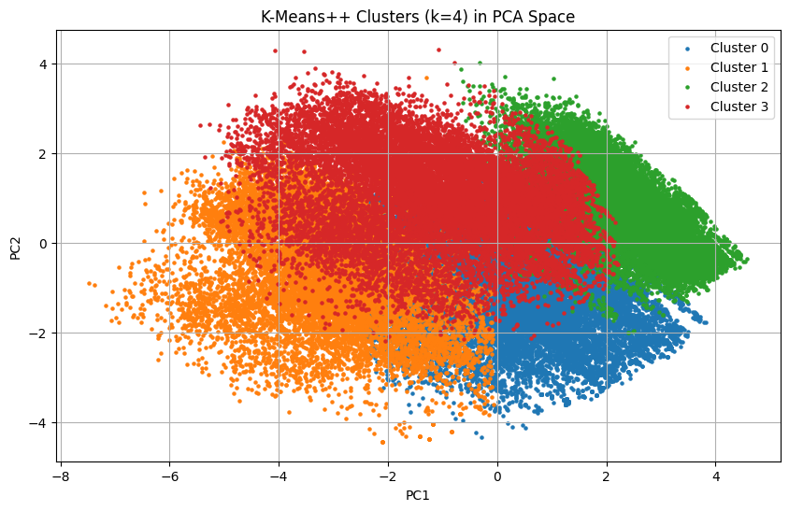
K-Means ++
Chose k = 4 using the elbow method
Performed reasonably well given the density of the projection
Captured broad usage patterns tied to temperature + total consumption
Noticeable overlap

Slide 6


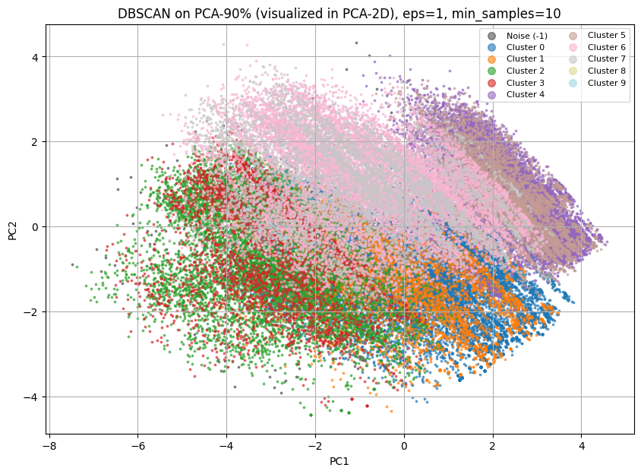
DBSCAn
Used grid search of eps and min_samples
Identified several small-to-midsize clusters, along with a moderate noise region
The density of the PCA projection makes DBSCAN struggle
No Clear Patterns
DBSCAN is not a good method for this dataset

Slide 7
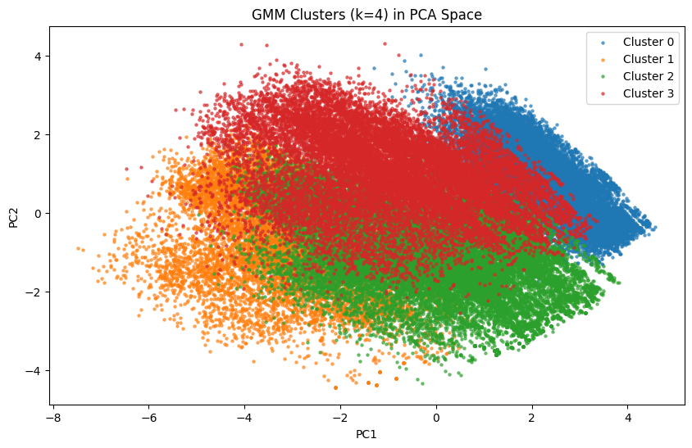
GMM
Chose k = 4 using AIC/BIC comparison
Performed comparably to K-Means
Still Significant overlap

Slide 8
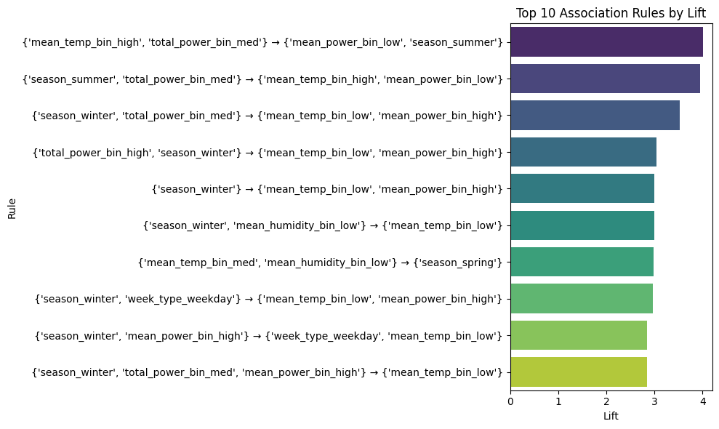
Association Rule Mining (Apriori + FP-Growth)
Both Apriori and FP-Growth produced identical rule sets
Strongest Rule Consistency Link:
  Cold days → higher power usage (winter heating)
  Warm/summer days → higher total and mean power (cooling loads)
Seasonality is the most predictable diver of pattern

Slide 9
Conclusion & Next Steps
Key Conclusions:
  Daily energy usage clusters into a few broad behavioral patterns, primality shaped by temperature and season
  Clustering performance was weak. Extremely dense with heavy overlap, making it difficult to form clean separatable groups
Next Steps:
  Try time-series segmentation or dynamic clustering
  Evaluate alternate dimensionality reduction
  Train a prediction model

Slide 10
Thank You!
[1] Smart*: An Open Data Set and Tools for Enabling Research in Sustainable Homes. Sean Barker, Aditya Mishra, David Irwin, Emmanuel Cecchet, Prashant Shenoy, and Jeannie Albrecht. Proceedings of the 2012 Workshop on Data Mining Applications in Sustainability (SustKDD 2012), Beijing, China, August 2012. Pdf Smart* | UMass Trace Repository
[2] Tan, P., Steinbach, M., Karpatne, A., & Kumar, V. Introduction to Data Mining (2nd ed.). Available via the U. Minnesota web site. College of Science and Engineering
[3 ] “MMDS” (Massive Data Mining Series) – http://www.mmds.org/
[4 ] Course slides from CSCI-B 565 (Data Mining)

Slide 11
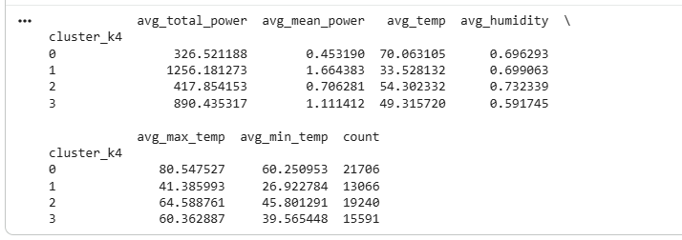
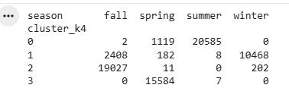
K-means Model Summary

Slide 12
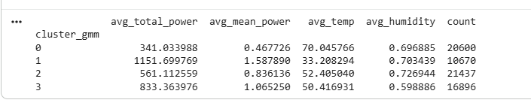
GMM Model Summary

Slide 13
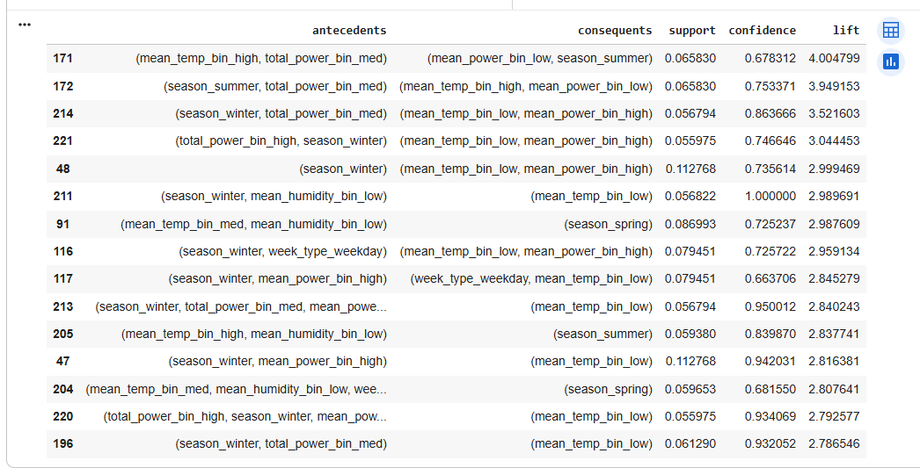
Apriori

Slide 14
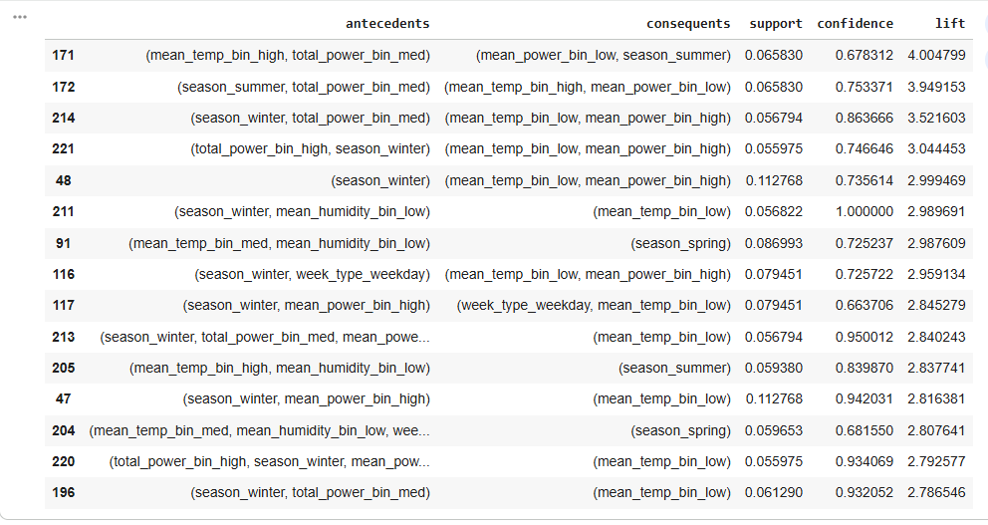
FP-Growth

